Slide 1
Layer Activations
Intermediate model 2
Intermediate model 3
Intermediate model ‘n-1’
Mixer Layer 1
Mixer Layer 2
Mixer Layer 3
Mixer Layer N-1
Mixer Layer N
…
Preprocessing + Patches
Global Average Pooling + Class

Slide 2
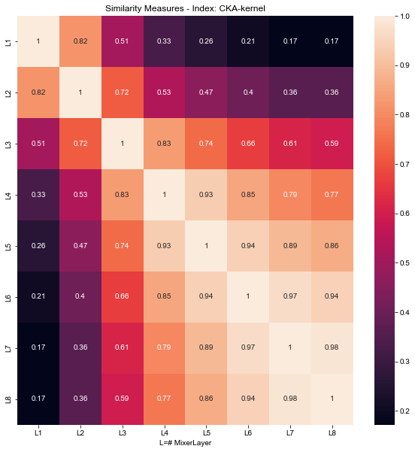
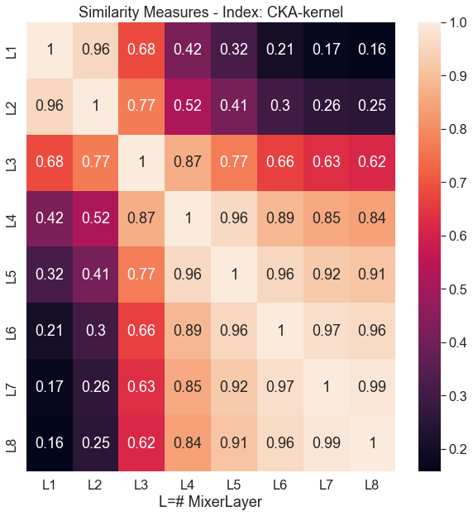
First Results
1
2
Fig | Batch | Layers | Name | Dataset
1 | 512 | 8 | Random Sample
2 | 512 | 8 | Average of Layer Activations

Slide 3
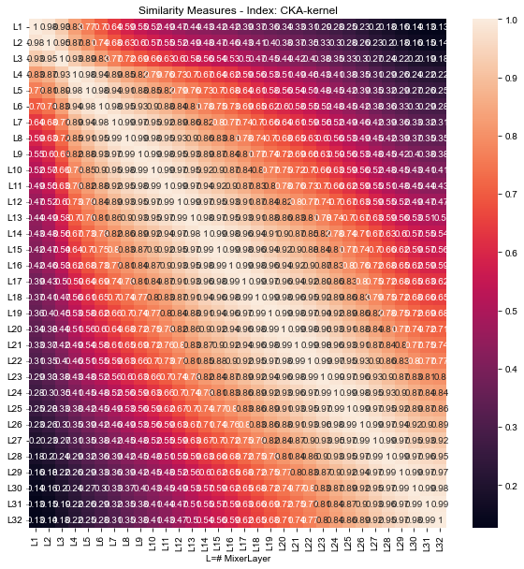
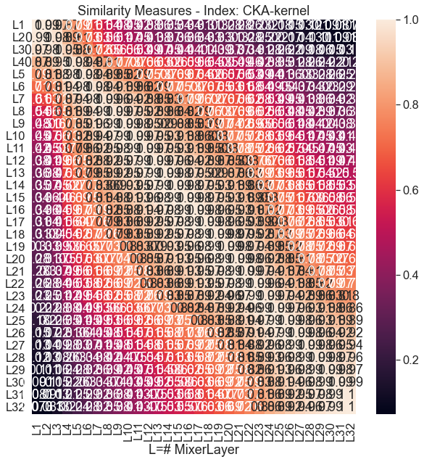
1
2
1
Fig | Batch | Layers | Name | Dataset
1 | 256 | 32 | Random Sample
2 | 256 | 32 | Average of Layer Activations

Slide 4
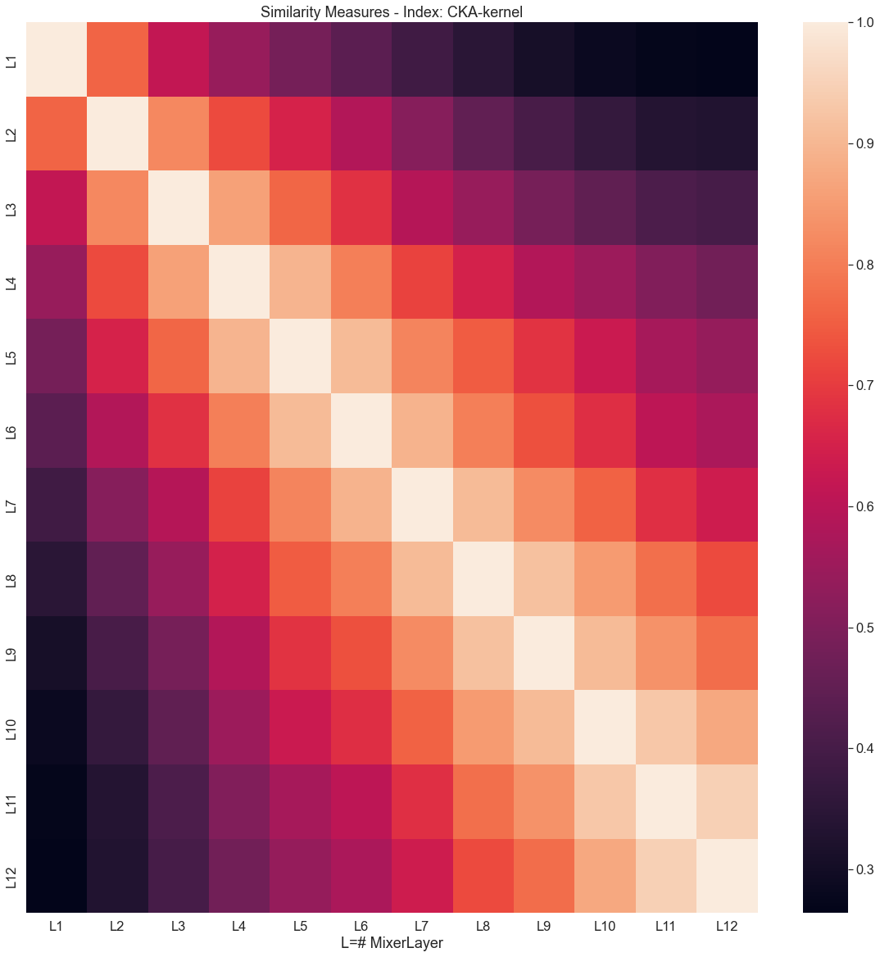
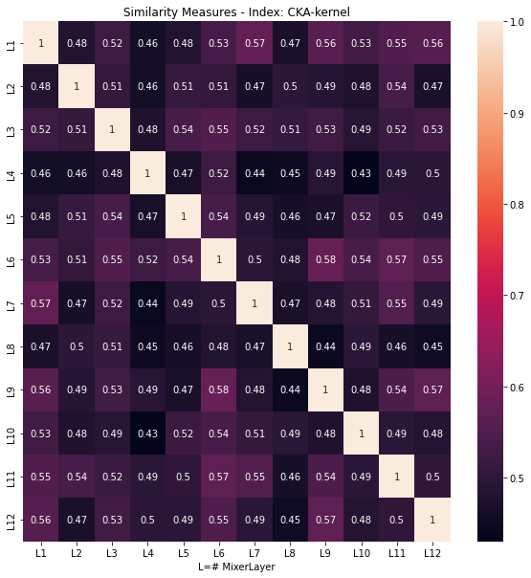
1
2
1
Fig | Batch | Layers | Name | Dataset
1 |  | 12 | Random weights/ Current
2 |  | 12 | Random weights/Previous

