Slide 1
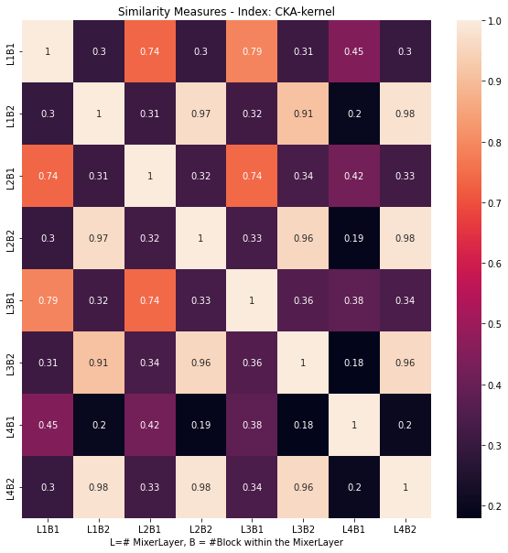
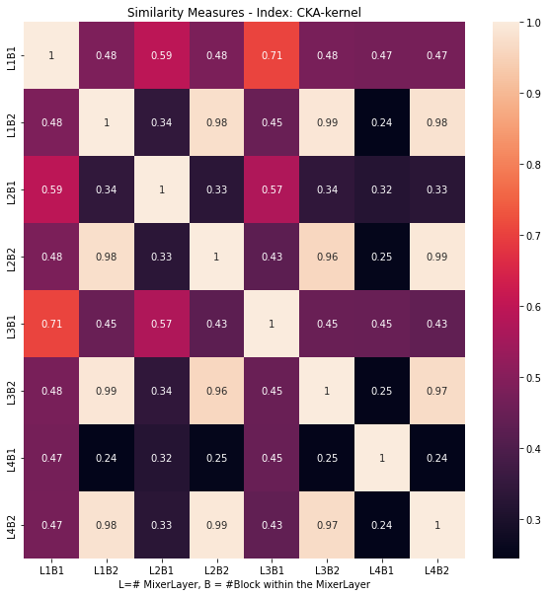
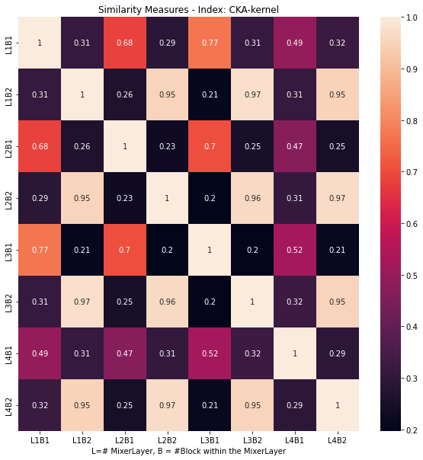
Average of all layers activations in a batch
1
2
3
Batch = 128 sample random
4 Mixer-MLP layers : 8 blocks/layer in total
Average time - 1:41 minutes each

Slide 2
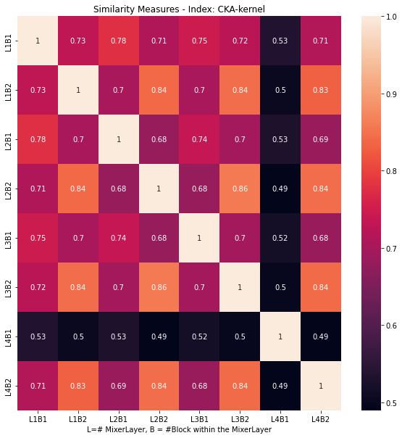
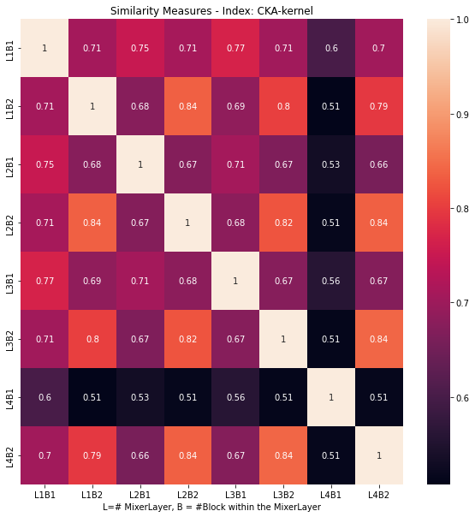
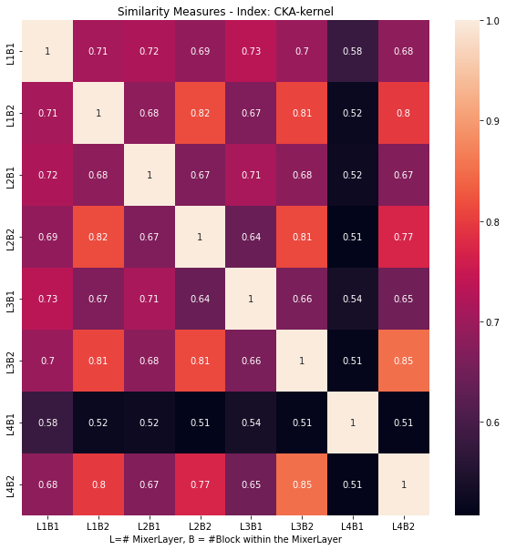
Average of each heatmap in a batch
1
2
3
Batch = 128 sample random
4 Mixer-MLP layers : 8 blocks in total
Average time - 3:57 min each

Slide 3
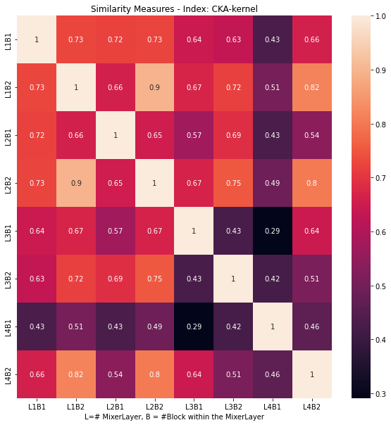
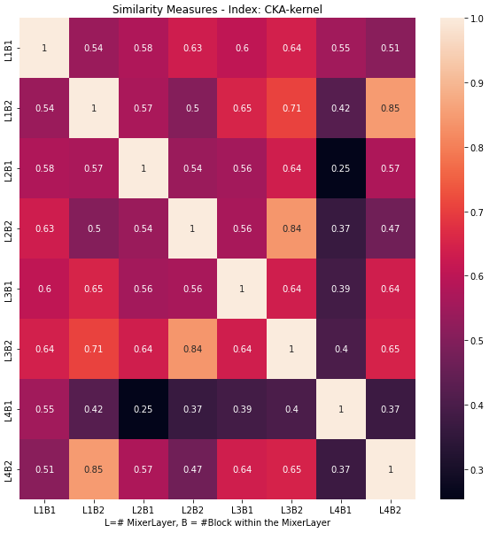
Single test with a random sample
Sample - x_train[10]
4 Mixer-MLP layers : 8 blocks in total

