Slide 1
Project Position
Reproduce official Diffusion Policy Push-T
Implement inference-time DDIM sampler replacement
Evaluate on official checkpoint rollouts
Keep claim bounded and matched-seed

Slide 2
Official Reproduction
Official source and checkpoint loaded
50-seed DDPM reproduction score: 0.9187
Compatibility environment gap documented
Baseline runner preserved

Slide 3
Improvement Idea
Replace DDPM ancestral sampler with DDIM deterministic sampler
No retraining and no model weight changes
Same Push-T env, same seeds, same (k,h)
Implemented in run_official_kh_grid.py --sampler ddim

Slide 4
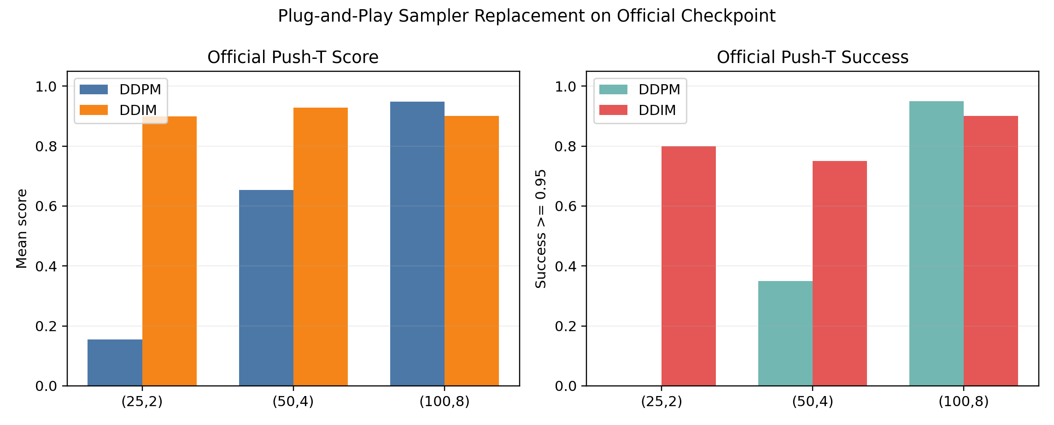
Main Results
(25,2): 0.155 -> 0.900, success 0.000 -> 0.800
(50,4): 0.653 -> 0.929, success 0.350 -> 0.750
(100,8): 0.949 -> 0.900, DDPM remains strongest
DDIM improves low/mid-denoising frontier

Slide 5
Statistical Check
20 matched official Push-T seeds
Paired bootstrap CI positive for (25,2) and (50,4)
(100,8) CI includes zero and mean favors DDPM
No universal dominance claim

Slide 6
Claim Boundary
This is not a new sampler algorithm
DDIM is known prior work
Contribution: application and validation on official checkpoint
Surrogate scheduler is not headline evidence

Slide 7
Limitations
Only three official (k,h) settings for DDIM
Wall-clock latency not separately benchmarked
Original environment differs from compatibility container
Best high-denoising DDPM baseline remains strong

Slide 8
Final Claim
DDIM sampler replacement is a real implemented improvement
It directly improves official low/mid-denoising rollout performance
The project now satisfies reproduction + improvement requirements

