Slide 1

AI Ethics
Organized by Habib Matar
in collaboration with Intel.

Slide 2
Fears of AI
AI will produce biased outcomes
We have no idea why AI does what it does
AI will make bad decisions
AI will lead to a loss of anonymity
AI will put me out of a job

Slide 3
Main Debates of Ethical AI
Privacy and Surveillance
How do we control who collects data and who has access to that data?
How to protect ourselves from surveillance economy that focuses on feeding us “goodies” that promote exploitation of human weakness, furthering procrastination, generating addiction, and manipulation?

Slide 4
Main Debates of Ethical AI
Manipulation of Behavior
Gambling and sale of addictive substances are highly regulated, but online manipulation and addiction are not.
Faking of once reliable evidence. Easy to create “deep fake” text, photos, video material.

Slide 5
Main Debates of Ethical AI
Opacity of AI
Many AI systems rely on extracting patterns from given data set, without “correct” solutions provided. Programmer doesn’t know which patterns the system has chosen.
How can we make fair decisions based on a system that is supposedly superior to humans but cannot explain its decisions?

Slide 6
Main Debates of Ethical AI
Bias in Decision Systems
How do we know if historical data has bias compared to new reformed data?
Data sets can be made to focus on a single matter with no bias, but how do we account for the bias if it is used for another matter?

Slide 7
Main Debates of Ethical AI
Human Robot Interaction
Even if robot can be assigned tasks in health care, do we want the human component to be taken away? (robotic arm vs comfort/company bots)
Sex Robots – do we want humans to grow intimate deep attachments to an object that cannot mean what it says or have feelings?

Slide 8
Main Debates of Ethical AI
Automation and Employment
Replacement of expensive human thought to cheap digital automation. Will the creation of new jobs and wealth keep up with the destruction of jobs?
Can further create the gap between high skill / high paid jobs and low skilled / low paid service jobs?

Slide 9
Main Debates of Ethical AI
Autonomous Systems
Is the autonomy responsible for its decision making?
Is it best to leave our lives to a system that will choose the common defined good over pursuing personal interest?
Is it best for an autonomous weapon to fight against other autonomous weapons to save human interaction in conflict?

Slide 10
Main Debates of Ethical AI
Machine Ethics – ethics of machines as subjects not objects in use
First Law: Robot may not injure a human being
Second Law: Robot must obey orders given it by human except by conflict of first law
Third Law: Robot must protect its own existence as long as protection does not conflict with first and second law.

Slide 11
Main Debates of Ethical AI
Responsibility for Robots
If the robots act, will they themselves be responsible, liable or accountable for their actions? Or is it the owner of the robot? Or is it the manufacturer of the robot?
Do the robot themselves get rights?

Slide 12
Main Debates of Ethical AI
Singularity and Superintelligence
Does AI have the potential to surpass human intelligence and create its own systems that also surpass humanity?
At what point do we define an AI to be superintelligent and what is our plan if such technological advancement occurs?

Slide 13
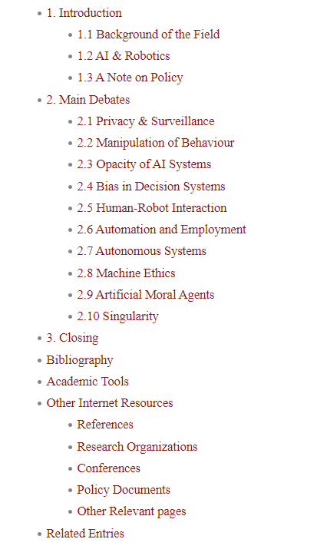
Stanford Encyclopedia of Ethics on AI
https://plato.stanford.edu/entries/ethics-ai/

Slide 14
Study on Ethical Guidelines
1. Manual search through link hub webpages
27 eligible from human search
2. Auto search through Google, remove duplicates
44 eligible from automated search
3. Records identifiable from citation chaining
13 eligible from citation chaining
https://www.nature.com/articles/s42256-019-0088-2#Sec15

Slide 15
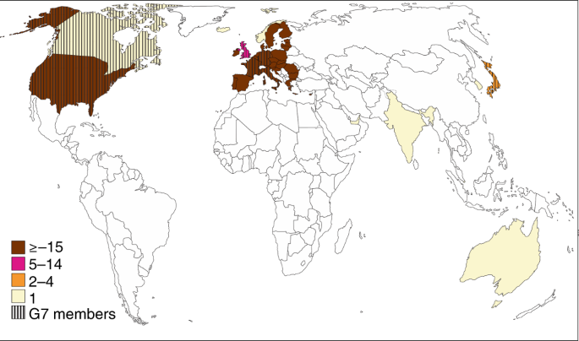
Geographic Distribution
Pro: The US is aware and active in the discussion
Con: Possible location bias

Slide 16
Australia Ethics Framework for AI (2019)
Generates net-benefits. > for people.
Do not harm or deceive.
Regulatory and legal compliance
Privacy protection
Fairness. No discrimination. No bias in training data.
Transparency/Explainability. Explain impact and decision making
Contestability. Challenge use or output.
Accountability. Keep creators responsible for outcome.

Slide 17
Activity
Split into your groups
Choose a country listed and create a list of AI Ethics that are reflected in their policy. Dig deep!
https://futureoflife.org/national-international-ai-strategies/
https://www.cs.ox.ac.uk/efai/resources/alphabetical-list-of-resources/
https://alanwinfield.blogspot.com/2019/04/an-updated-round-up-of-ethical.html
https://futureoflife.org/ai-policy-resources/
Notes:
Add backup questions here if no response.

Slide 18
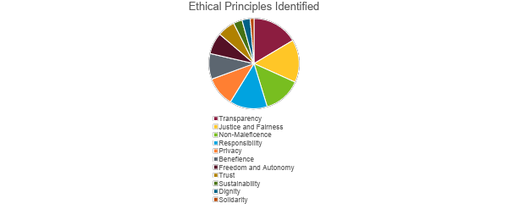
Ethical Principles Identified

Slide 19
Activity
Split into your groups
https://www.nature.com/articles/s42256-019-0088-2#ref-CR30
Research the following topics – split topics
Transparency Justice/Fairness
Non-Maleficence Responsibility
Privacy Freedom/Autonomy
Trust Sustainability
Dignity Solidarity
CTRL-F topic to find the piece of the article.
Notes:
Add backup questions here if no response.

Slide 20
Food for Thought: No Ethical AI
Taken from article: https://onezero.medium.com/theres-no-such-thing-as-ethical-a-i-38891899261d
Ethical code is much different than computer code
Ethics can be aspirations that beg more questions than answers
There is no single set of ethical principles among humanity
Who are using this the most?
Google , Amazon, Facebook, Microsoft
Challenge may be primarily political and social, not AI

