Slide 1
Chapter 7
Arrays
Adapted from notes by Pat Baker based on Java Foundations by Lewis, Chase, & DePasquale

Slide 2
Chapter Topics
Array declaration and use
Bounds checking
Arrays as objects
Arrays of objects
Command-line arguments
Variable-length parameter lists
Multidimensional arrays

Slide 3
Arrays
An array is an object that holds a list of values
The array has a name that represents the entire array
Each value in the array is stored at a specific location (cell)
Each cell has a numeric index
Note that array indices start at 0
So an array with 5 cells has indices 0, 1, 2, 3, & 4

Slide 4
Arrays
An array is an object that holds a list of values.
Array of ints:
3
98
45
68
129
21
9
42
57
35
77
0
1
2
3
4
5
6
7
8
9
10

Slide 5
Arrays
An array is an object that holds a list of values.
Array of Strings:
“CSC110”
“CSC120”
“CSC205”
“CSC230”
“CSC240”
0
1
2
3
4

Slide 6
Arrays
An array is an object that holds a list of values.
Array of Strings (this time displayed with a horizontal orientation):
“CSC110”
0
“CSC120”
1
“CSC205”
2
“CSC230”
3
“CSC240”
4

Slide 7
Arrays
An array is an object and an array can hold objects as elements
The array name is an object reference variable
Say that our String array was called “csClasses”
Then this is another way to visually depict an array:
“CSC110”
0
csClasses
“CSC120”
1
“CSC205”
2
“CSC230”
3
“CSC240”
4

Slide 8
Arrays
3
98
45
68
129
21
9
42
57
35
77
0
1
2
3
4
5
6
7
8
9
10
We reference a particular value stored in an array using the array’s name followed by the index of the value in brackets.
If the array above was named “nums”, then
nums[0] = 3
nums[1] = 98
nums[3] = 3
nums[7] = 3
nums[10] = 3

Slide 9
Arrays
We can also use expressions as the index of the array so
nums[x+4]
would return the index 4 cells beyond cell x
We can use an array expression in place of any variable (as long as the array stores the correct type
int result = nums[7] + 3
would return the value 45 (42 + 3)

Slide 10
Arrays
An array element can be assigned a value, printed, or used in a calculation
scores[2] = 89;
scores[first] = scores[first] + 2;
mean = (scores[0] + scores[1])/2;
System.out.println("Top = " + scores[5]);

Slide 11
Arrays
The values held in an array are called array elements
An array stores multiple values of the same type – the element type
The element type can be a primitive type or an object reference
Therefore, we can create an array of ints, an array of chars, an array of String objects, an array of Account objects, etc.
In Java, the array itself is an object that must be instantiated

Slide 12
Declaring Arrays
The nums array could be declared as follows
int[] nums = new int[11];
The type of the variable nums is int[] (an array of integers)
Note that the array type does not specify its size, but each object of that type has a specific size
The reference variable nums is set to a new array object that can hold 11 integers

Slide 13
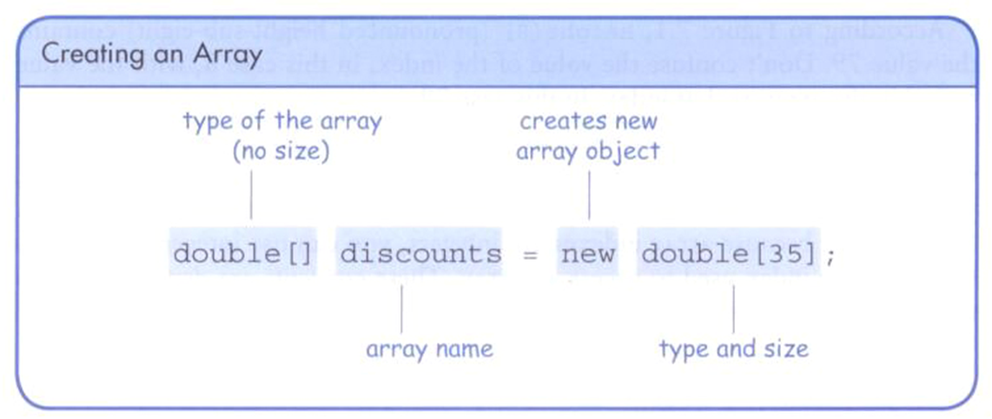
Declaring Arrays

Slide 14
Declaring Arrays
Some other examples of array declarations
float[] prices = new float[500];
boolean[] flags;
flags = new boolean[20];
char[] codes = new char[1750];

Slide 15
Using Arrays
The for-each loop can be used when processing array elements:
for (int score : scores)
System.out.println(score);
Note that using a for-each loop is only appropriate when you want to process every one of the array elements from the lowest index to the highest index

Slide 16
Bounds Checking
Once an array is created, it has a fixed size
An index used in an array reference must specify a valid element
That is, the index value must be in range 0 to N-1
The Java interpreter throws an ArrayIndexOutOfBoundsException if an array index is out of bounds
This is called automatic bounds checking

Slide 17
Bounds Checking
For example, if the array codes can hold 100 values, it can be indexed using only the numbers 0 to 99
If the value of count is 100, then the following reference will cause an exception to be thrown
System.out.println(codes[count]);
It’s common to introduce off-by-one errors when using arrays
for (int index=0; index <= 100; index++)
codes[index] = index*50 + epsilon;

Slide 18
Bounds Checking
Each array object has a public constant called length that stores the size of the array
It is referenced using the array name
nums.length
Note that length holds the number of elements, not the largest index

Slide 19
Alternate Array Syntax
The brackets of the array type can be associated with the element type or with the name of the array
Therefore the following two declarations are equivalent
float[] prices;
float prices[];
The first format generally is more readable and should be used

Slide 20
Array Initialization
An initializer list can be used to instantiate and fill an array in one step
The values are delimited by braces and separated by commas
Examples:
int[] units = {147, 323, 89, 933, 540,
269, 97, 114, 298, 476};
char[] letterGrades = {'A', 'B', 'C', 'D', ’F'};

Slide 21
Array Initialization
Note that when an initializer list is used
the new operator is not used
no size value is specified
The size of the array is determined by the number of items in the initializer list
An initializer list can be used only in the array declaration

Slide 22
Arrays as Parameters
An entire array can be passed as a parameter to a method
Like any other object, the reference to the array is passed, making the formal and actual parameters aliases of each other
Therefore, changing an array element within the method changes the original
An individual array element can be passed to a method as well, in which case the type of the formal parameter is the same as the element type

Slide 23
Arrays of Objects
An array of objects really holds object references
The following declaration reserves space to store 5 references to String objects
String[] words = new String[5];
It does not create the String objects themselves
Initially an array of objects holds null references
Each object stored in an array must be instantiated separately

Slide 24
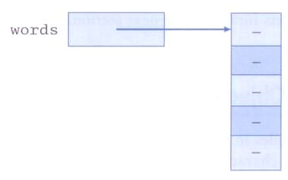
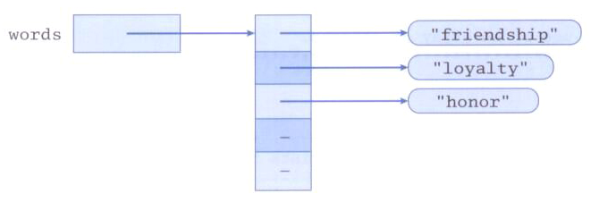
Arrays of Objects
After initial creation, an array holds null references:
Each element is a reference to an object:

Slide 25
Arrays of Objects
Keep in mind that String objects can be created using literals
The following declaration creates an array object called verbs and fills it with four String objects created using string literals
String[] verbs = {"play", "work", "eat", "sleep"};

Slide 26
Arrays of Objects
The following example creates an array of Grade objects, each with a string representation and a numeric lower bound
Grade[] grades =
{
new Grade("A", 95), new Grade("A-", 90),
new Grade("B+", 87), new Grade("B", 85), new Grade("B-", 80),
new Grade("C+", 77), new Grade("C", 75), new Grade("C-", 70),
new Grade("D+", 67), new Grade("D", 65), new Grade("D-", 60),
new Grade("F", 0)
};

Slide 27
The for-each Loop and Arrays
We can use a variant of the for loop called the for-each loop to s
For example, if GradeList is an array that manages int values, the following loop will print each number in the array:
for (int num : GradeList) {
System.out.print(num);
Notice we don’t have to use array indexes when using a for-each loop - that is all handled under the hood by Java
You also can only iterate forward using a for-each loop

Slide 28
Two-Dimensional Arrays
The arrays we have seen before store lists of elements
You can also have a 2 dimensional array, which you can think of as a table with row and columns
1D Array
2D Array

Slide 29
Two-Dimensional Arrays
To be precise, in Java a two-dimensional array is an array of arrays
A two-dimensional array is declared by specifying the size of each dimension separately
int[][] scores = new int[12][50];

Slide 30
Two-Dimensional Arrays
We can also initialize a 2D array when we declare it:
int[][] scores = { {89, 73, 83, 94, 95},
{98, 100, 94, 92, 100},
{88, 94, 88, 79, 81},
{100, 89, 91, 98, 94} };
Result:
89
73
83
94
95
98
100
94
92
100
88
94
88
79
81
100
89
91
98
94

Slide 31
Two-Dimensional Arrays
We reference individual elements using two index values
value = scores[2][4];
Some examples of using indices to access elements:
Scores
scores[0][0] = 89
scores[1][3] = 92
scores[2][1] = 94
scores[2][2] = 88
scores[2][4] = 81
scores[3][4] = 94
89
73
83
94
95
98
100
94
92
100
88
94
88
79
81
100
89
91
98
94

Slide 32
Two-Dimensional Arrays
We can reference individual rows using a single index:
value = scores[2];
Some examples of using indices to access individual rows:
Scores[0]
89
73
83
94
95
Scores[1]
98
100
94
92
100
Scores[2]
88
94
88
79
81
Scores[3]
100
89
91
98
94

Slide 33
Two-Dimensional Arrays
Suppose we have a 2D array declared as follows:
int[][] table = new int[5][10];
Expression | Type | Description
table | int[][] | 2D array of integer, or array of integer arrays
table[5] | int[] | Array of integers
table[5][2] | int | Integer

Slide 34
Multi-dimensional Arrays
Any array with more than one dimension is a multidimensional array
Each dimension subdivides the previous one into the specified number of elements
Each dimension has its own length constant
Because each dimension is an array of array references, the arrays within one dimension can be of different lengths
these are sometimes called ragged arrays

Slide 35
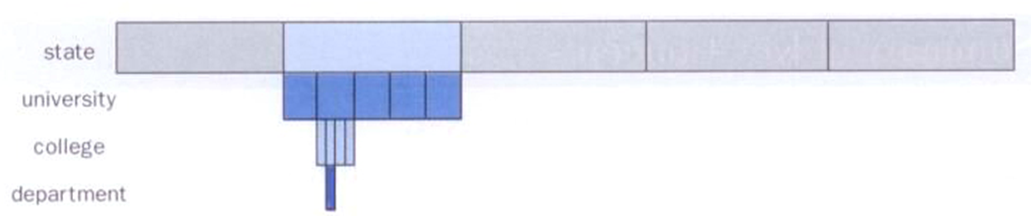
Arrays
One way to visualize a four-dimensional array:
Two-dimensional arrays are common, but beyond that usually an array has other objects involved

Slide 36
Command-Line Arguments
The signature of the main method indicates that it takes an array of String objects as a parameter
These values come from command-line arguments that are provided when the interpreter is invoked
For example, the following invocation of the interpreter passes three String objects into main
> java StateEval pennsylvania texas arizona
These strings are stored at indexes 0-2 of the array parameter of the main method

Slide 37
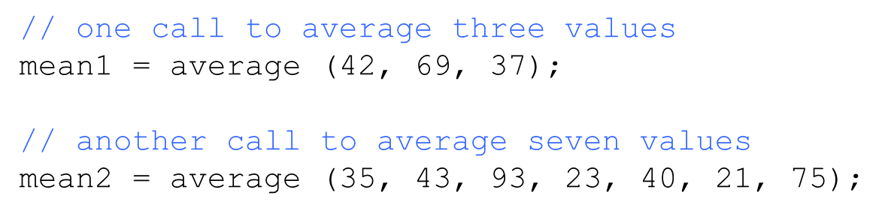
Variable Length Parameter Lists
Suppose we wanted to create a method that processed a different amount of data from one invocation to the next
For example, let's define a method called average that returns the average of a set of integer parameters

Slide 38
Variable Length Parameter Lists
We could define overloaded versions of the average method
Downside: we'd need a separate version of the method for each parameter count
We could define the method to accept an array of integers
Downside: we'd have to create the array and store the integers prior to calling the method each time
Instead, Java provides a convenient way to create variable length parameter lists

Slide 39
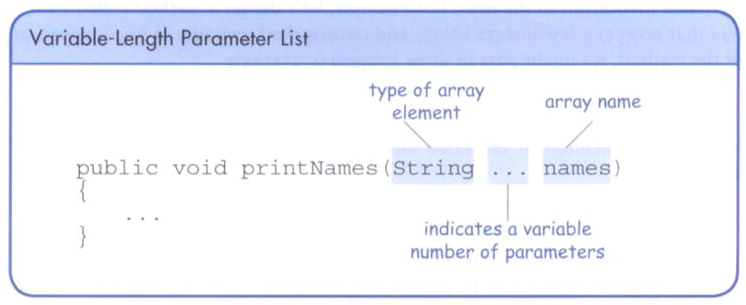
Variable Length Parameter Lists
Using special syntax in the formal parameter list, we can define a method to accept any number of parameters of the same type
For each call, the parameters are automatically put into an array for easy processing in the method

Slide 40
Variable Length Parameter Lists
public double average(int ... list)
{
double result = 0.0;
if (list.length != 0)
{
int sum = 0;
for (int num : list)
sum += num;
result = (double)num / list.length;
}
return result;
}

Slide 41
Variable Length Parameter Lists
The type of the parameter can be any primitive or object type
public void printGrades(Grade ... grades)
{
for (Grade letterGrade : grades)
System.out.println (letterGrade);
}

Slide 42
Variable Length Parameter Lists
A method that accepts a variable number of parameters can also accept other parameters
The following method accepts an int, a String object, and a variable number of double values into an array called nums
public void test(int count, String name,
double ... nums)
{
// whatever
}

Slide 43
Variable Length Parameter Lists
The varying number of parameters must come last in the formal arguments
A single method cannot accept two sets of varying parameters
Constructors can also be set up to accept a variable number of parameters

Slide 44
Now go write some code!

