Slide 1
Chapter 1
Introduction to Computers & Java Programming

Slide 2
What is a computer?
A computer is machine that manipulates data and performs arithmetic and logical operations
A computer consists of:
Hardware - the parts of a computer that you touch
Software - the programs and data used by the computer
We tell a computer what to do using a program (application) - a set of instructions that the computer executes to perform a task

Slide 3
Programming Languages
Programs are written using programming language
A programming language is a set of words and symbols (tokens) that we use to write programs
Each programming language has a syntax that describes how the tokens of the language can be put together to form valid statements
The semantics of a program defines what the statements mean
A syntactically correct program may not be semantically correct!
A program will always do exactly what you tell it to do, not what we meant to tell it to do

Slide 4
Programming Languages
There are many programming languages in use today such as Python, C++, JavaScript, C#, and hundreds of others
In this course, we will be using Java as our programming language of choice
Many concepts you will learn will carry over to other languages
For example, most languages have for-loops, and the Java syntax is identical to C & C++

Slide 5
Programming Languages
Programming languages are constantly evolving
Machine language is the language of the CPU (binary code)
But, they are CPU-specific!
Assembly language is a mnemonic device that maps human-readable identifiers to machine language
High level languages are more human-readable and get converted to machine language by a compiler
Fourth-generation languages are more natural-language like

Slide 6
The Java Programming Language
Java was introduced in 1995
It was created by a team at Sun Microsystems let by James Gosling
Java is an object-oriented programming language (more on that later!)
A Java program is made up of one or more classes that contain methods that contain statements
Every Java application must contain a method called main which is where the program starts
The main method often uses other classes and calls other methods

Slide 7
The Java Programming Language
Java was introduced in 1995
It was created by a team at Sun Microsystems let by James Gosling
Java is an object-oriented programming language (more on that later!)
A Java program is made up of one or more classes that contain methods that contain statements
Every Java application must contain a method called main which is where the program starts
The main method often uses other classes and calls other methods

Slide 8
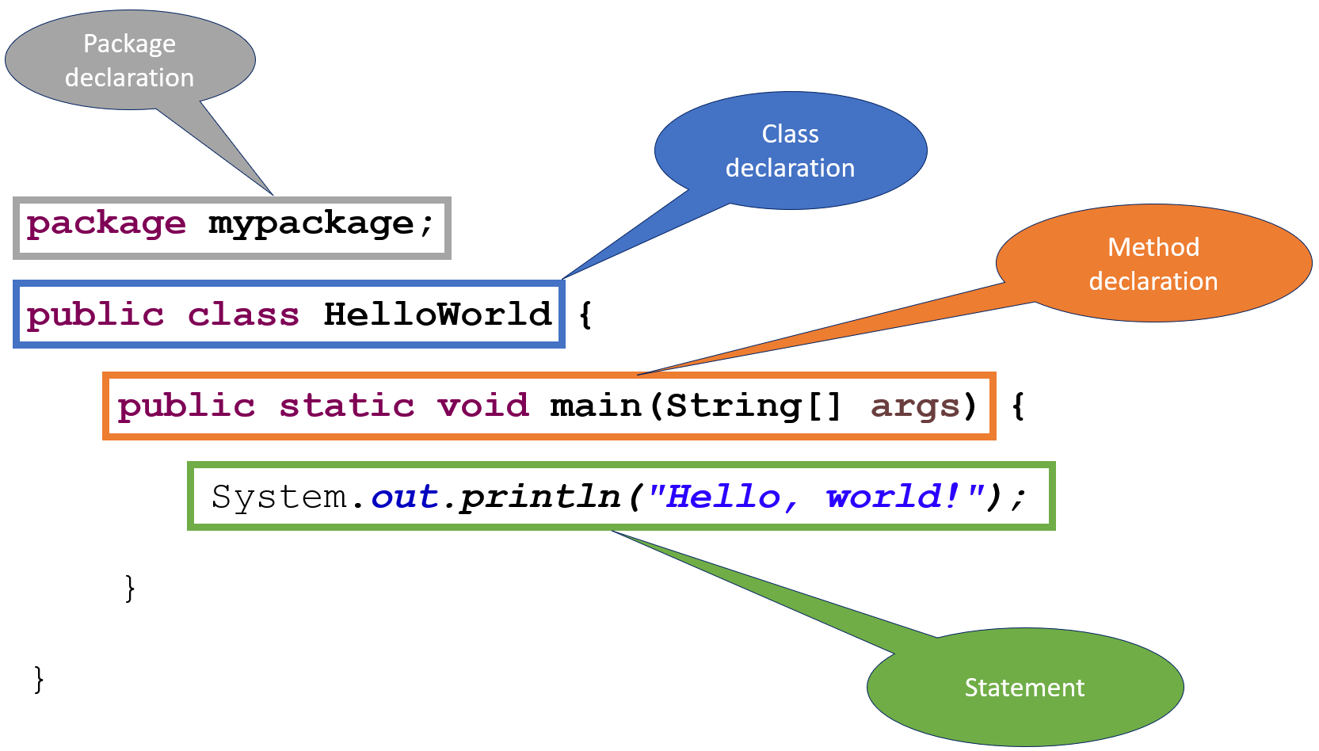
A Java Program

Slide 9
Comments
Comments are code that the compiler ignores - they allow the programmer to document their code
Java has 3 comment formats:
C style: /* this is a comment */ (can extend multiple lines
C++ style: // this is a one line comment
Javadoc: /** this is a javadoc comment **/
Comments do not affect how the program runs - the serve to give hints to other programmers about what the program is doing

Slide 10
Comments
Use comments to clarify the thought behind your code, not what it does. For example, here are 3 lines of code that do the same thing:
Bad: a = t / c; // A is equal to t divided by c
Better: a = t / c; // Compute the average
Best: averageStudents = totalStudents / numberOfClasses;
Notice that the best use of comments is using descriptive names instead of comments!

Slide 11
Identifiers
Identifiers are names chosen for things in their program
Reserved words have a predefined meaning to the language, so you cannot use them as identifiers
See https://docs.oracle.com/javase/tutorial/java/nutsandbolts/_keywords.html for a list
Java identifiers are made up of letters (A-Z), digits (0-9), and the underscore (_) and dollar sign ($) characters
Java identifiers cannot begin with a digit
Java identifiers are case-sensitive
So value, Value, VALUE, VaLuE, and vAlUe are 5 distinct identifiers
Value, _Value, Value$, and Value1 are also 4 distinct identifiers
Note that it is best to use descriptive names, not different case to differentiate identifiers

Slide 12
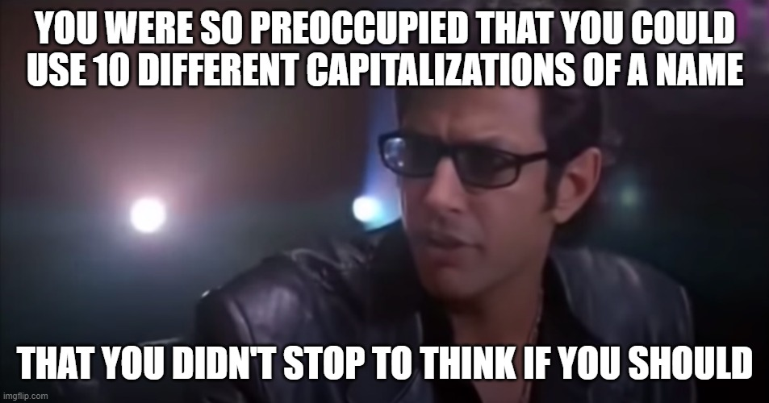

Slide 13
Identifiers
Conventions:
Capitalize class names - Circle, GameBoard
Use ALLCAPS for constants - PI, DEFAULT_LENGTH
lowercase names for packages - project01, mystuff
camelCase for method & variable names - avgGrade, myValue, bestCaseScenario, thisOneIsALittleBitLong

Slide 14
White Space
The spaces, blank lines, and tabs in your program are called white space
White space is used to separate the tokens (symbols & words) in your program
Extra white space in your program is ignored by the compiler
Use white space to make your code more clear (readabile)
But, as with comments, you can have too much of a good thing

Slide 15
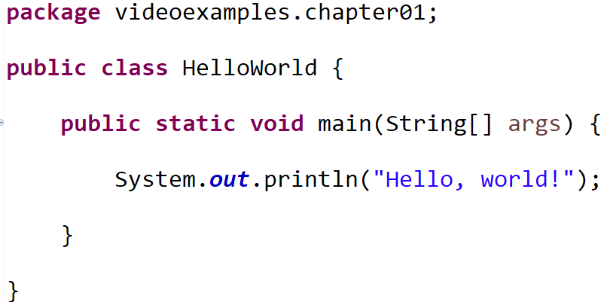
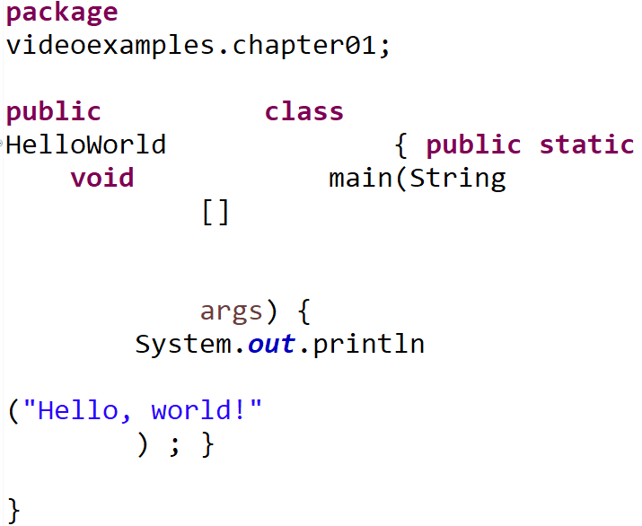
White Space
These programs are identical in what they do, but one is a bit clearer
Use whitespace for clarity!

Slide 16
Documenting your code
Strive to write code that does not need to be documented
Descriptive variable/method names
Classes/methods should encapsulate/do one thing
Comments should be used to provide the big picture
Use white space to make your code more readable
Provide tests to demonstrate how your code works
Bad programmers write complex code, good programmers write simple code
Always code as if the guy who ends up maintaining your code will be a violent psychopath who knows where you live. Code for readability.
- John F. Woods, comp.lang.c++

Slide 17
What is the purpose of programming?
The purpose of writing any program is to solve a problem
Actually writing the code is not particularly valuable
Companies do not pay software engineers to write code - they pay them to solve problems
Code is just the tool they use to solve the problems
Your value as a programmer is in your problem solving ability
The reason you should learn to code is so that you can implement your solutions!

Slide 18
Problem Solving with Programming
Understand the problem
Establish requirements
Design a solution - break the problem into manageable pieces
Implement your solution
Refine the solution & consider alternatives
Test your solution

Slide 19
The Program Development Process
Requirements – an informal description of the program’s needed functionality from the user’s point of view
Specification – a formal description of the programs requirements from the programmer’s point of view.
Preconditions & postconditions (what the inputs & outputs are)
Design – translating the specification into procedure
Implementation – instantiating the design (programming)
Testing – verifying that the implementation works correctly
Verification & Validation - verifying that the implementation meets the requirements & specification

Slide 20
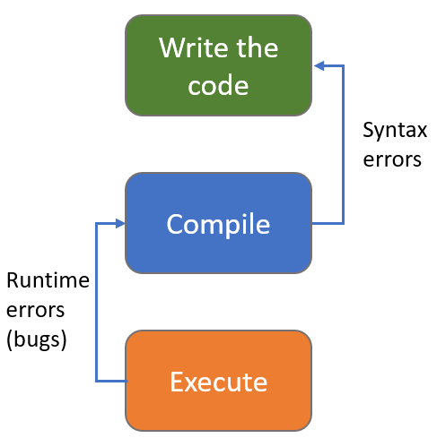
How Code Runs
Write your code using an editor
Save your code as ASCII text
Converts (compiles) your source code to a form that the computer understands (machine language)
The compiler my find places where you wrote the code incorrectly (syntax errors)
If there are syntax errors, you will need to fix them before you move on
Run (execute) your code
Errors at this point are called runtime errors and usually indicate a problem with the logic of your solution

Slide 21
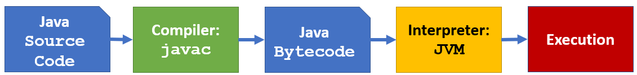
How Java Code Runs
Java has a 2 step compilation process - your code is first converted into Java Bytecode and then the Java Virtual Machine executes the Java Bytecode
Note that this means Java is more CPU-independent than other languages as it can run on any CPU that has a JVM!

Slide 22
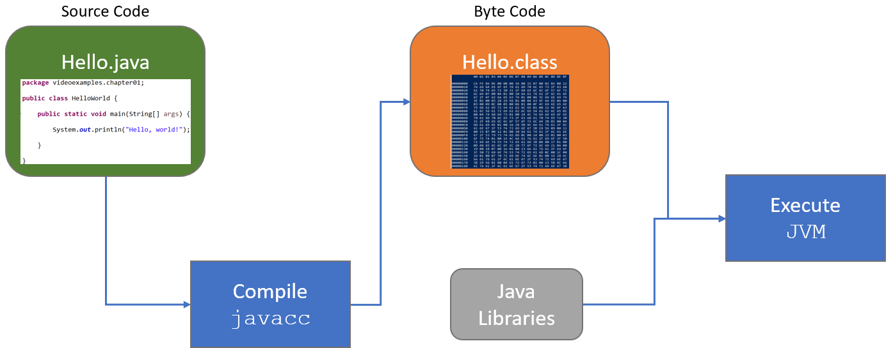
How Java Code Runs

Slide 23
Program Errors
Compile-time Errors are syntax errors and other problems with your code that the compiler will find
Run-time Errors occur during program execution and cause the program to terminate abnormally (crash)
Example: divide by 0, using a null reference
Logic Errors occur when the program terminates successfully, but produces incorrect results
Example: use of an incorrect formula, incorrectly updating a variable

Slide 24
Development Environment
To write and execute your own programs, you will need a development environment that consists of the tools you need (toolchain):
Editor: create & modify your source
Compiler: convert your code to executable format
Test environment (Unit testing)
Debugger: help you find errors in your program
You can use individual programs for each step of the software development process
There are also programs called integrated development environments (IDEs) that combine all the tools into one software application

Slide 25
Java IDEs
There are several popular Java IDEs
Eclipse
IntelliJ
NetBeans
Repl.it
They all work a little bit differently, but the edit/compilation/execution process is essentially the same for all of them
You can also go hardcore and use the command line tools such as javacc to compile your source code and java (to run the JVM)

Slide 26
A quick overview of Object-Oriented Programming
We will not discuss objects for several weeks, but you will come across the term “OOP” quite a bit, so this section is intended to be a general overview of the topic. You are not expected to fully grasp this material until nearer the end of the semester.

Slide 27
Object-Oriented Programming
Java is an Object-Oriented Programming Language
The object is the fundamental entity in a Java program
A Java program is made up of objects
An object has some information & some operations
Represents some real-world entity
A particular employee in a company
A window in a GUI
A character in a game
Each object handles its own processing and data management

Slide 28
Object-Oriented Programming
Each object has state and behaviors
State - data members / fields / instance variables
What an object knows about itself
Behaviors - members / methods / functions
What an object does
The behavior of an object may change its state

Slide 29
Object-Oriented Programming
Methods define the possible behaviors of the object
Think of calling a method as “sending a message” that asks the object to do something
We say the sender of the method is the client
The message contains the operations name and arguments
The client doesn’t care how the message is handled, only that it produces an expected result

Slide 30
Object-Oriented Programming
There are often multiple ways to represent a problem
Usually there is no “one right answer”
In fact, OOP itself is not always the answer - other paradigms such as functional programming are better at solving some problems

Slide 31
Objects vs Classes
A class represents a abstract concept
An object is the realization of a class
We instantiate one or more objects of a specific class
The Java new operator creates a new object
There can be multiple objects of a given class (called instances), but each object is an instantiation of a single class

Slide 32
Objects vs Classes
Class | Example Objects
Room | Kitchen, Bedroom, Study, Bathroom
Movie | Star Wars, Clueless, Knives Out, Casablanca
Team | Diamondbacks, Sun Devils, Cardinals, JoesGarage
CSClass | CSC110AA, CSC205, CSC230, CSC240
States | Arizona, Louisiana, New York, Alaska

Slide 33
Now go write some code!

