Slide 1
Week 2: Statements and Control Flow
Conditional Statements: if, elif, else
Loops: for and while
Loop Control: break, continue, and else
Error Handling: try-except

Slide 2
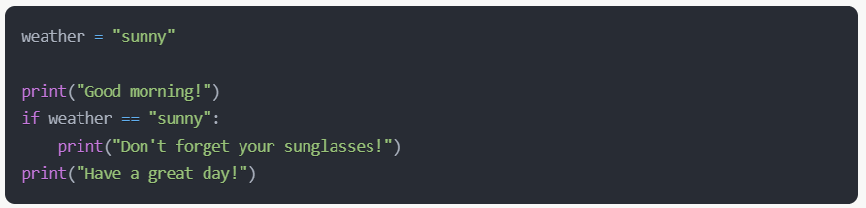
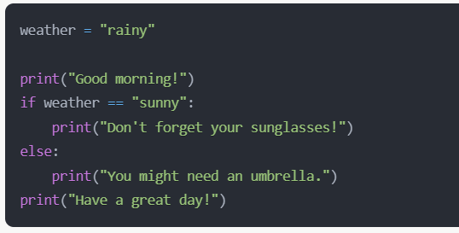
If-Else Statements - The Basic Decision
Use double equals (==) or not equals (!=) ← Good because these expressions will resolve to bool (True/False), which is what an if-statement’s condition requires
Do not use single equals: weather = “sunny” ← Bad

Slide 3
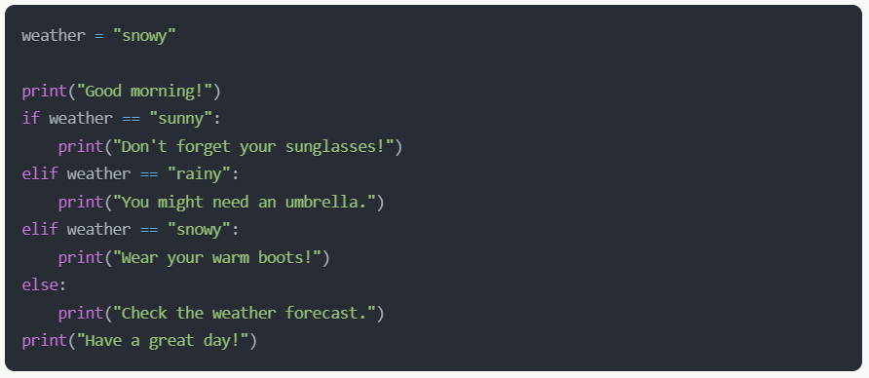
If-Elif-Else Statements – Multiple Choice
“Good morning!” and “Have a great day!” will always print

Slide 4
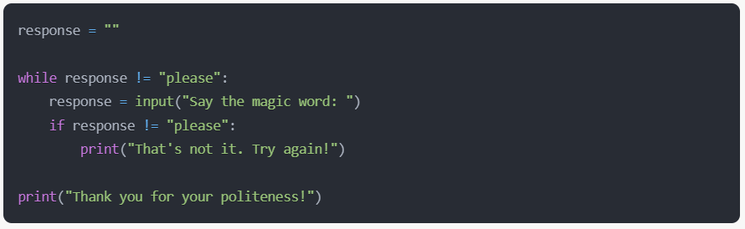
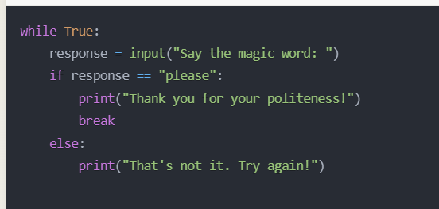
While Loops - The Persistent Asker
These are actually the same program, just written differently
`while True` is known as an infinite loop. Quite useful.
`while False` would deactivate the code (like commenting it out). So, not so useful.

Slide 5
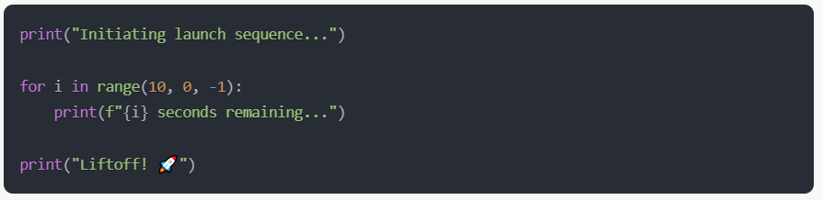
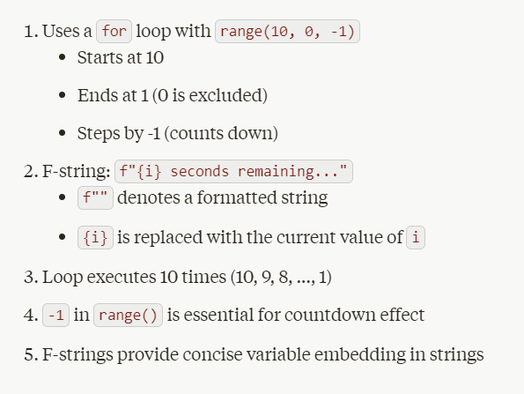
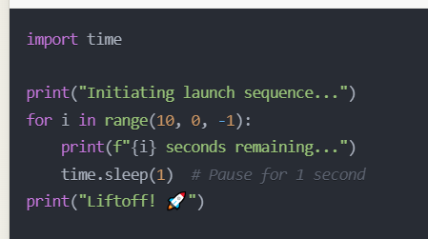
For Loops - The Efficient Counter
Try this to add `sleep` between prints:

Slide 6
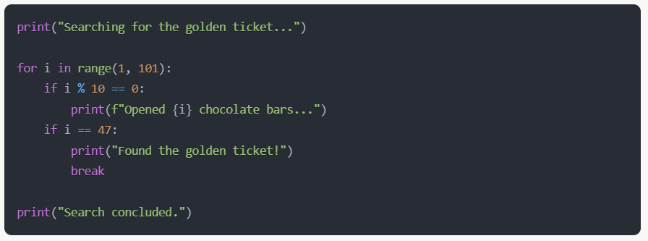
Break - The Emergency Exit
The break statement is like finding what you're looking for and immediately stopping your search (and getting out of the loop).

Slide 7
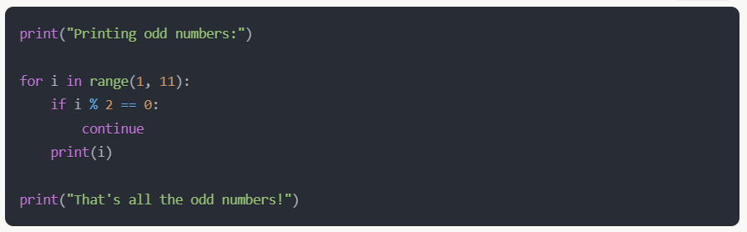
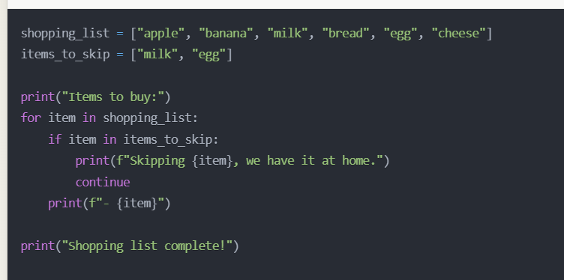
Continue - The Skippy Skipper
Basically, `continue` skips the rest of the current loop iteration and jumps to the next one. I don’t use it so often, but sometimes it’s handy.

Slide 8
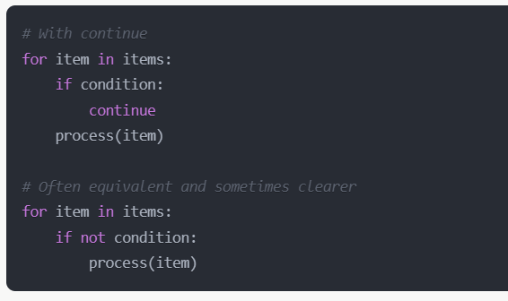
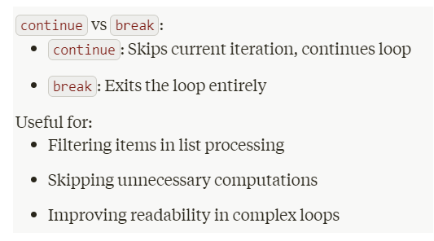
Deep Dive: The Continue Statement
A bit suspect
preferred
Remember: the `not` operator interchanges True and False True becomes False False becomes True

Slide 9
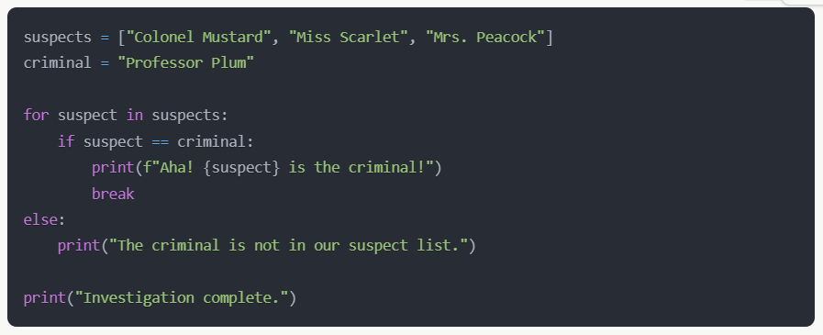
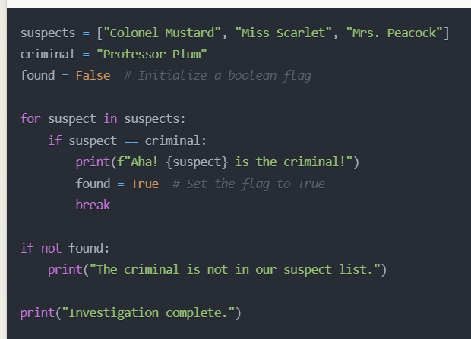
Else in Loops - The Completion Checker
These are both the same program (just written differently)
Basically, the `else` block activates when the loop is finished and `break` never occurred.

Slide 10
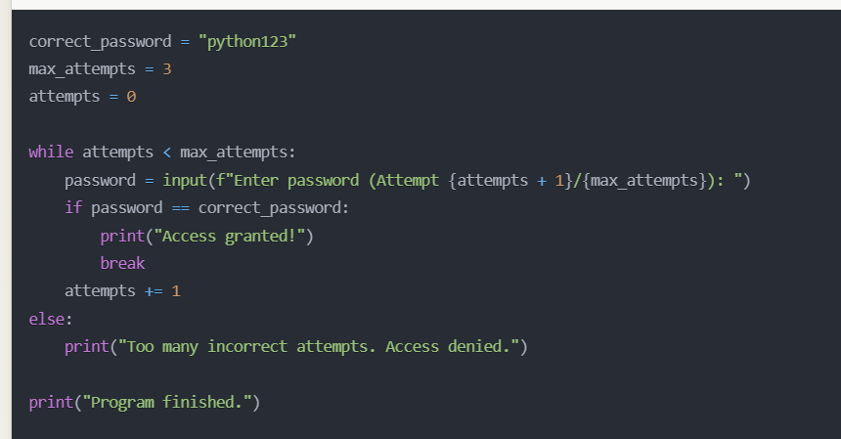
Else in Loops - The Completion Checker
The `else` block also works with the while loop. It activates if `break` never occurs.

Slide 11
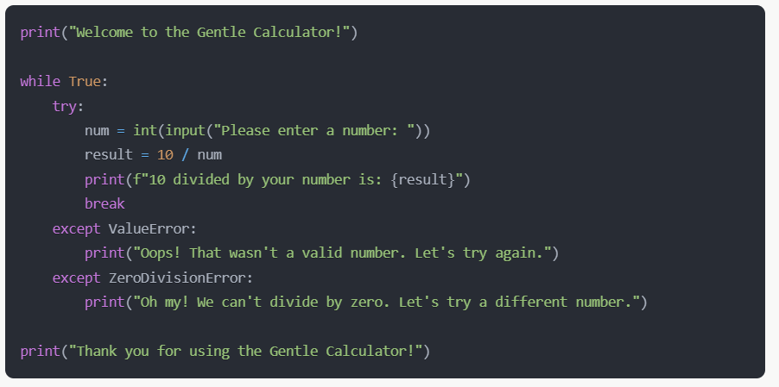
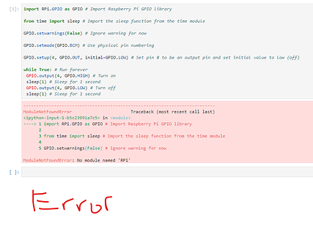
Try-Except - The Safety Net
Try-except is like a safety net, catching errors gently and allowing our program to recover gracefully.

Slide 12
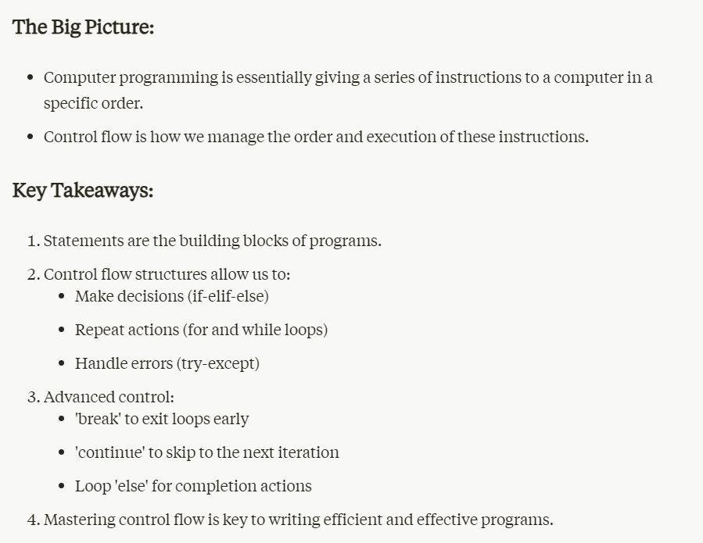

Slide 13


