Slide 1
Week 1: Python Basics
Variables
Data Types
Simple Operations
Basic Python Syntax
Coming Soon…
Week 2
Git and GitHub | Control structures (if, else, elif)
PyCharm setup | Loops (for and while)

Slide 2
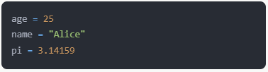
Variables
Variables are containers that hold your data
At any given time, your data is stored in the computer’s memory (RAM or Random Access Memory)
The CPU accesses this data when needed
Examples:

Slide 3
Variables, continued
Key Points:
Variables have names (e.g., age, name, pi, first_name, last_name)
They can hold different types of data
The value of a variable can change during program execution
Use underscores_between_words_like_this when naming variables

Slide 4
Python Data Types
Basic Data Types:
Integers (int): Whole numbers Example: 27, -99, 1000
Floating-point numbers (float): Decimal numbers Example: 3.14, -0.001, 2.0
String (str): Text wrapped in double “hi” or single quotes ‘hi’ Example: “Hello, World!”, ‘Python’, “40”
Booleans (bool): True or False Example: True, False

Slide 5
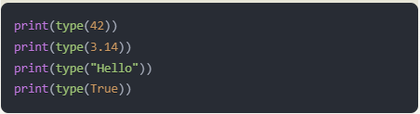
Data Types, continued
Key Points:
Python automatically determines the type (int, float, str, or bool)
You can check the type with the type() function
Different types support different operations
Examples:

Slide 6
Simple Operations with Data Types
Numeric Operations:
Addition: 5 + 3 = 8
Subtraction: 10 - 4 = 6
Multiplication: 4 * 2 = 8
Division: 15 / 3 = 5.0 (division always outputs float, e.g., 5.0)
Division: 15.0 / 3 = 5.0
Integer Division: 15 // 3 = 5
Integer Division: 15 // 4 = 3 (rounds down to int 3)
Modulus (remainder): 15 % 4 = 3
Exponentiation: 2 ** 3 = 8

Slide 7
Simple Operations, continued
String Operations:
Concatenation: “Hello” + “ ” + “World” = “Hello World”
Repetition: “Architecture” * 3 = “ArchitectureArchitectureArchitecture”

Slide 8
Simple Operations, continued
Boolean Operations:
and: True and False = False
or: True or False = True
not: not True = False
not False = True

Slide 9
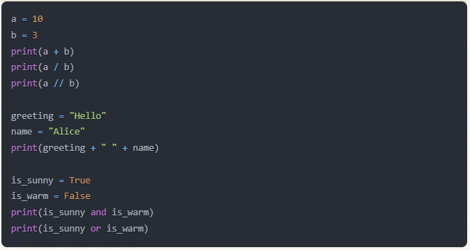
Simple Ops, continued
Examples of each:

Slide 10

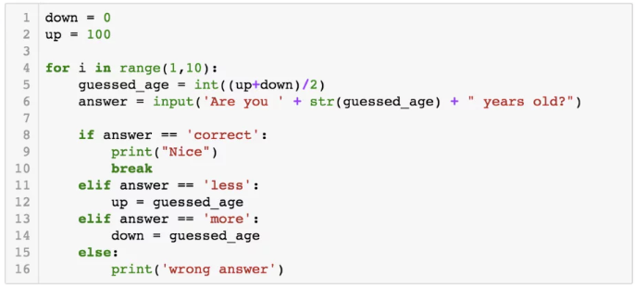
Basic Python Syntax
Python uses indentation to define code blocks
Typically 4 spaces or 1 tab

Slide 11
Syntax, continued
Comments:
Single line (# hashtag): # This is a comment
Multi-line (""" wrap with three double quotes """): """ This is a multi-line comment """

Slide 12
Syntax, continued
Parentheses and Order of Operations:
Group operations: (2 + 3) * 4 = 20
Without parentheses: 2 + 3 * 4 = 14
Override default precedence: 2 + 3 * 4 = 14 With parentheses: (2 + 3) * 4 = 20

Slide 13
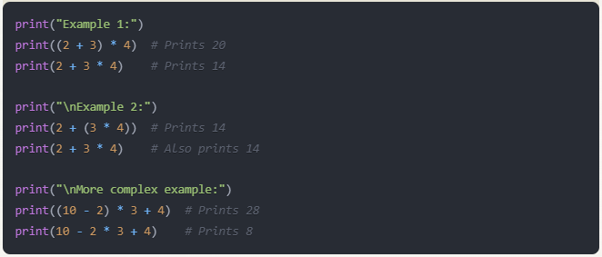
Syntax, continued
Print Statements:

Slide 14
Exercises
## 1. Variables
# Exercise 1.1: Create a variable named 'course_name' and assign it the value 'Python'.
# Then create another variable 'week_number' and assign it the value 1.
# Exercise 1.2: Print both variables on separate lines.
## 2. Data Types
# Exercise 2.1: Create variables of each basic data type (int, float, str, bool).
# Use descriptive names for your variables.
# Exercise 2.2: Use the type() function to print the type of each variable you created.
## 3. Simple Operations
# Exercise 3.1: Perform the following numeric operations and print the results:
# - Add 5 and 3
# - Subtract 10 from 25
# - Multiply 4 by 7
# - Divide 20 by 4
# - Calculate 17 modulo 5
# - Raise 2 to the power of 4
# Exercise 3.2: Create two string variables and concatenate them.
# Then print the result.
# Exercise 3.3: Create two boolean variables. Use them in an 'and' operation
# and an 'or' operation. Print the results of both operations.
## 4. Basic Python Syntax
# Exercise 4.1: Write a multi-line comment explaining what you've learned so far in this course.
# Exercise 4.2: Create a numeric variable. Then, using a single print statement and an f-string,
# print a sentence that includes the variable's value.
# Exercise 4.3: Write an expression that uses parentheses to change the normal order of operations.
# Print both the original expression and the modified expression with their results.
## 5. Challenge Exercise
# Exercise 5.1: Create a variable 'radius' with a value of 5.
# Calculate the area of a circle with this radius (area = pi * r^2).
# Use 3.14159 for pi. Print the result formatted to 2 decimal places.

