Slide 1

Search & Rescue
Coordinated Intelligence
Systems
The autonomous teamwork of ground and air assets in a mission-oriented environment
Yavanni
Ensley
Younghoon
Cho
Jaylin “Pop”
Ollivierre

Slide 2

OVERVIEW
Progress Matrix
Accomplished Tasks
Interface Demo
Milestone 4 Plan
Demos
Younghoon
Cho
Yavanni
Ensley
Jaylin “Pop”
Ollivierre

Slide 3
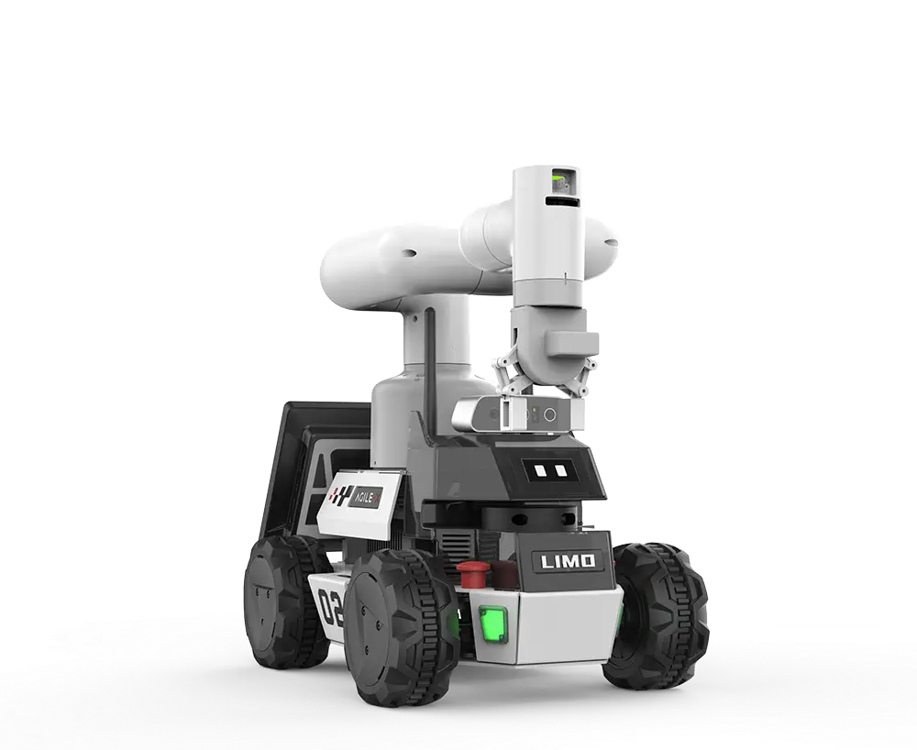
M3
Progress Matrix

Slide 4
M3 Progress Matrix
Completed Tasks
Task | Completion | Yav | Young | Pop
Heartbeat Safety | 100% | 30% | 0% | 70%
Static Target Detection | 100% | 25% | 50% | 25%
Multi-agent View | 100% | 50% | 25% | 25%
Location Info (SLAM) | 100% | 40% | 60% | 0%
Moving Target Detection | 100% | 60% | 40% | 0%
Complete repair of LIMOs | 100% | 33% | 33% | 33%
Drone integration (Parrot) | 10% | 0% | 10% | 0%
Multi-agent Coordination | 0% | 0% | 0% | 0%
Yavanni
Ensley
Younghoon
Cho
Jaylin “Pop”
Ollivierre

Slide 5
M3 Progress Matrix
Completed Tasks
Heartbeat Safety
Static Target Detection
SLAM Implementation
Note:
-The frontend publishes a heartbeat, that the LIMO listens to.
-When active, the agent moves, when the connection is lost, the agent stops until the connection is reestablished.
Note:
-We opted for a, more stable, ArUco marker; the previous method for static target detection via colors was too broad and left too much room for error.
Note:
-To compliment the SLAM algorithm, we use ArUco markers as a point of reference / “world origin” for the training environment.
Yavanni
Ensley
Younghoon
Cho
Jaylin “Pop”
Ollivierre

Slide 6
M3 Progress Matrix
Completed Tasks
Repair LIMOs
Moving Target Detection
Multi-agent View
Note:
-We labeled and installed all wheels to ensure consistency for repairs and identification if issues occur.
-We have four operable LIMO robots.
Note:
-This functionality utilizes the ArUco detection and SLAM algorithm to identify the target and its disposition in the environment.
Note:
-On the user interface, the user can now switch between different camera views for each robot.
-User can individually access each robot on the network.
Yavanni
Ensley
Younghoon
Cho
Jaylin “Pop”
Ollivierre

Slide 7
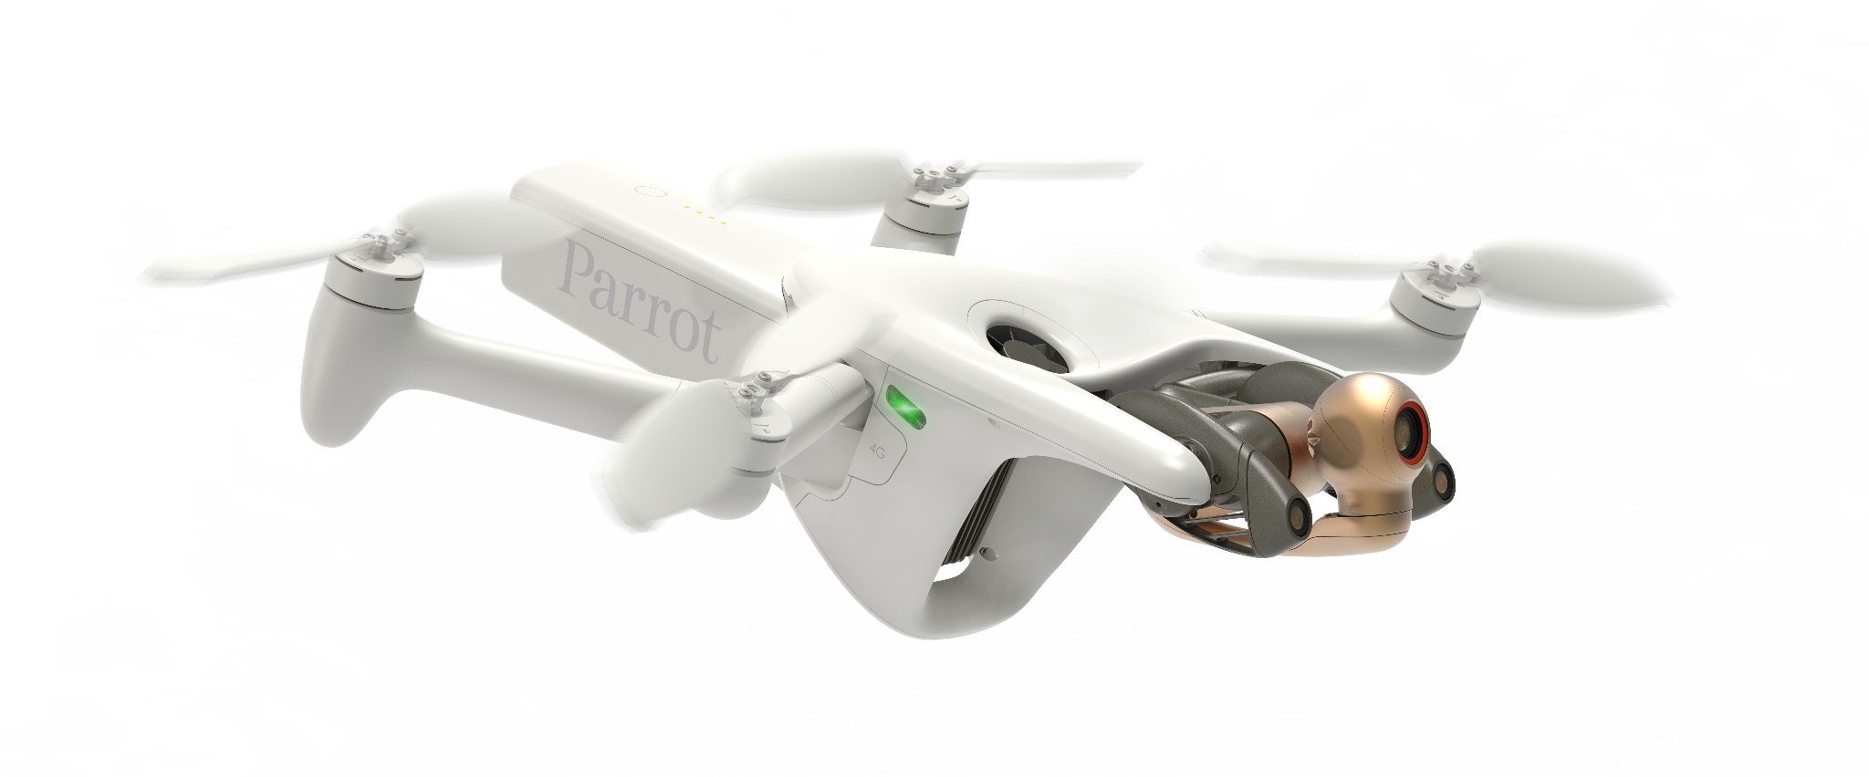
M4
Task Matrix and Rollovers

Slide 8
M3 Task Rollover
M4 Task Matrix
M4 Tasks
Drone Integration
Multi-agent Coordination
Note:
-Made ROS2 code for drones, but could not run the code due to lack of connection support for macOS.
Note:
-Repairing the Limos posed as a blocker for this task.
Younghoon
Cho
Yavanni
Ensley
Jaylin “Pop”
Ollivierre

Slide 9
M3 Task Rollover
M4 Task Matrix
M4 Tasks
Task | Yav | Young | Pop
Drone integration (Parrot) | 33% | 33% | 33%
Multi-agent Coordination | 33% | 33% | 33%
Unitree Go2 Setup | 33% | 33% | 33%
Concurrent Map Sharing | 33% | 33% | 33%
Target Sharing | 33% | 33% | 33%
Target engagement algorithm | 33% | 33% | 33%
Robot Operator | 33% | 33% | 33%
Younghoon
Cho
Yavanni
Ensley
Jaylin “Pop”
Ollivierre

Slide 10
M3 Task Rollover
M4 Task Matrix
M4 Tasks
Concurrent Map Sharing
Target Sharing
Target Engagement Algorithm
Note:
-Build a map that contains relevant information
-Robots in network, Target(s), and Local objects
Note:
-When a target is found, the robot will inform the Robot Operator and notify the other agents.
Note:
-Create an efficient algorithm for the robots to collaborate and surround the target.
Yavanni
Ensley
Younghoon
Cho
Jaylin “Pop”
Ollivierre

Slide 11
M3 Task Rollover
M4 Task Matrix
M4 Tasks
Unitree Go2 Setup
Robot Operator
Note:
-All three Unitree Go2’s have been powered on and tested to ensure all functions work as intended.
-Need to reverse engineering the code to integrate with our Hazelcast setup.
Note:
When the robot sends the target ArUco, the operator will decide the confidence level.
Jaylin “Pop”
Ollivierre
Yavanni
Ensley
Younghoon
Cho

Slide 12
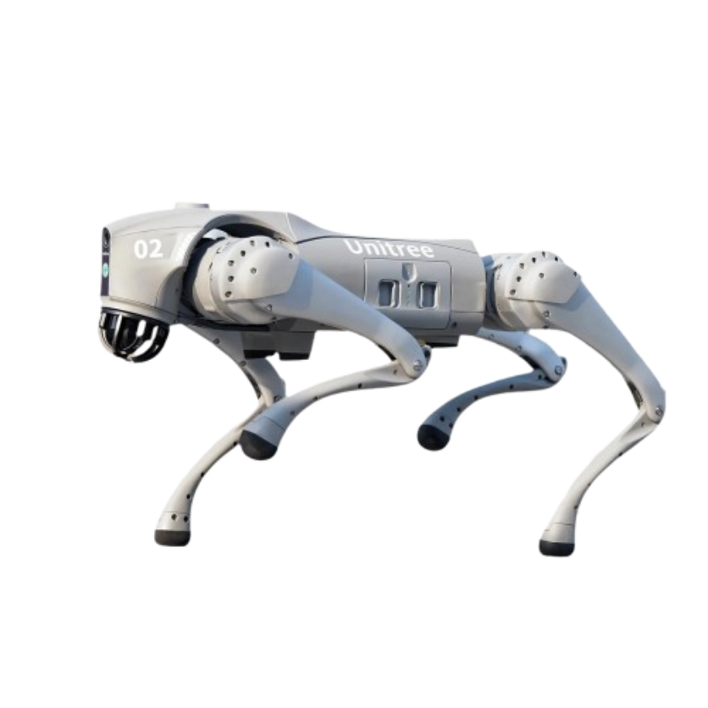
Demos
Multi-agent view
Multi-agent operation
Unitree Go2 Testing

Slide 13
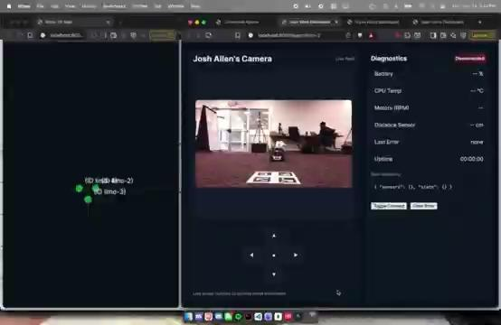
Multi-agent Operation
Unitree Go2 Testing

Slide 14
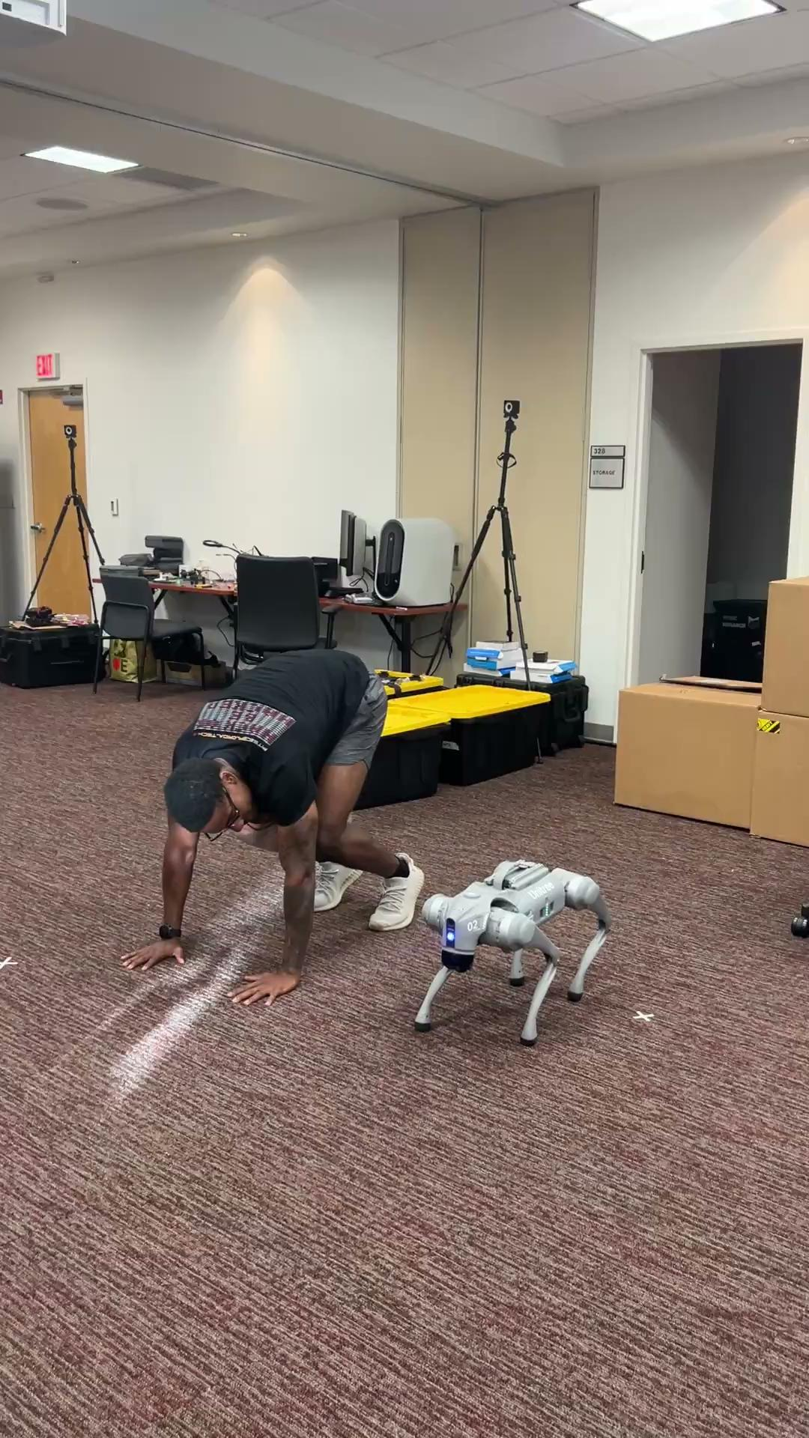
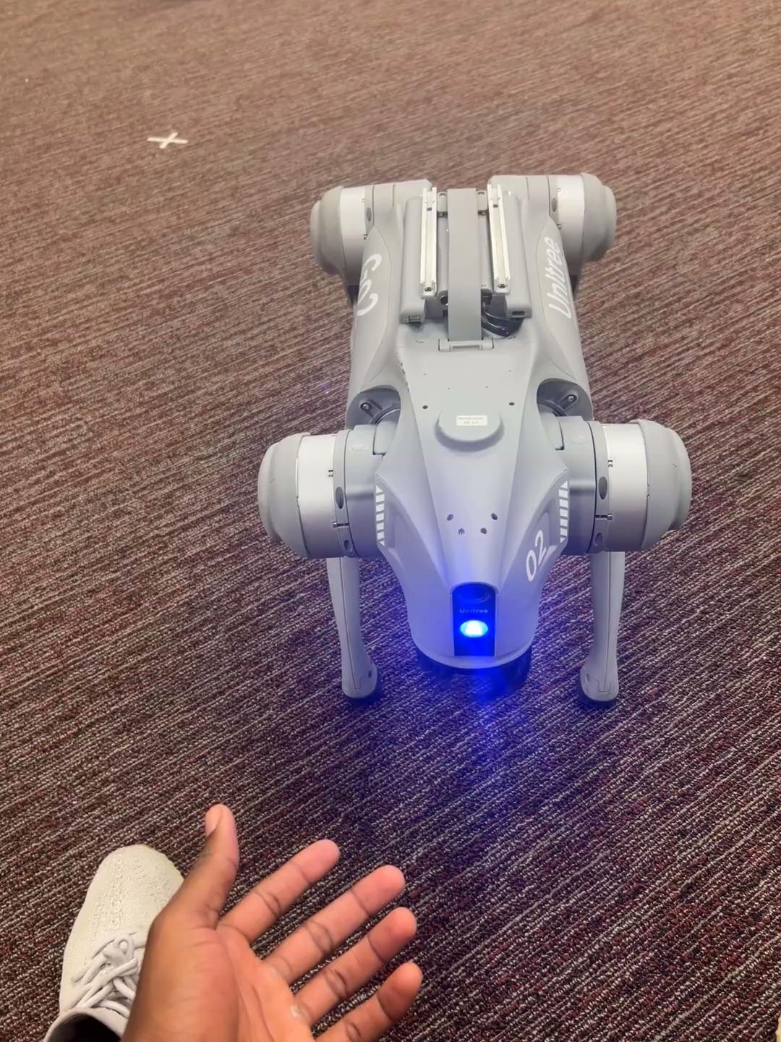
Multi-agent Operation
Unitree Go2 Testing

Slide 15
QUESTIONS?

