Slide 1

Ramco Nuthouse

Slide 2
Ramco Nuthouse 10.0
A Deep Dive into Javascript & its Ecosystem
June 28th, 2018
Speakers:
Vignesh T.V.
Mohan Kumar

Slide 3
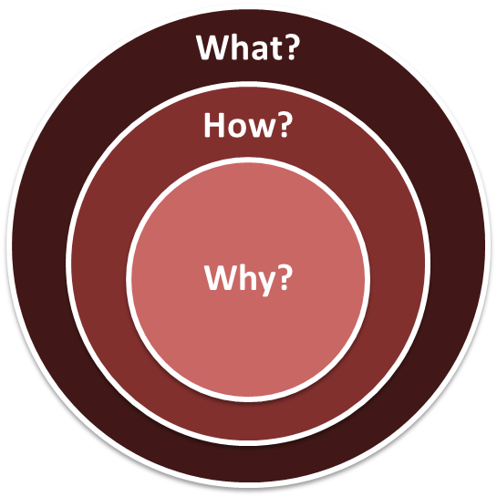
Javascript
Notes:
Valuable
The solution must deliver measurable value for site owners or interested group. It can be conversions, leads, subscriptions, etc.
Findable
Make it easy to find what your target audience is looking for, not only by optimizing search engines but focusing on internal navigation
Usable
Ease of use is extremely important; it must be intuitive and fluid. You need to create a funnel that leads your audience to your goal effectively
Desirable
Your target audience must have a strong desire to use your solution whether it’s for content, experience or emotions
Accessible
The solution must be easily accessible for your target audience – whether it’s technological requirements or people with disabilities
Credible
Your solution must be credible by all means. It has to build trust in your particular target audience by including important credibility factors

Slide 4
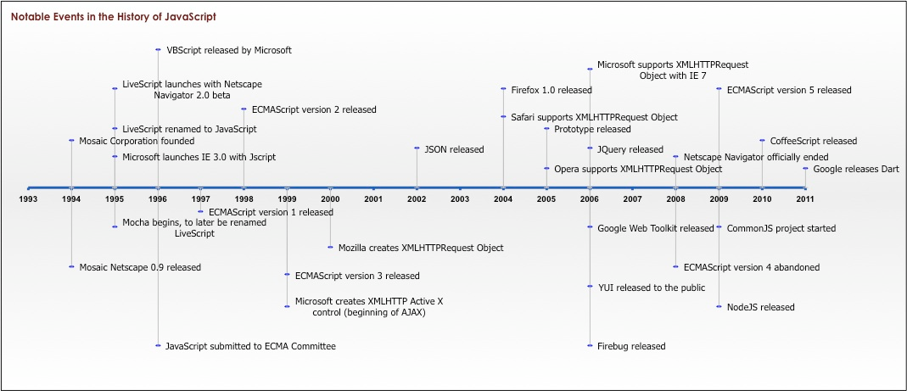
Notes:
Valuable
The solution must deliver measurable value for site owners or interested group. It can be conversions, leads, subscriptions, etc.
Findable
Make it easy to find what your target audience is looking for, not only by optimizing search engines but focusing on internal navigation
Usable
Ease of use is extremely important; it must be intuitive and fluid. You need to create a funnel that leads your audience to your goal effectively
Desirable
Your target audience must have a strong desire to use your solution whether it’s for content, experience or emotions
Accessible
The solution must be easily accessible for your target audience – whether it’s technological requirements or people with disabilities
Credible
Your solution must be credible by all means. It has to build trust in your particular target audience by including important credibility factors

Slide 5

And now...
Notes:
Valuable
The solution must deliver measurable value for site owners or interested group. It can be conversions, leads, subscriptions, etc.
Findable
Make it easy to find what your target audience is looking for, not only by optimizing search engines but focusing on internal navigation
Usable
Ease of use is extremely important; it must be intuitive and fluid. You need to create a funnel that leads your audience to your goal effectively
Desirable
Your target audience must have a strong desire to use your solution whether it’s for content, experience or emotions
Accessible
The solution must be easily accessible for your target audience – whether it’s technological requirements or people with disabilities
Credible
Your solution must be credible by all means. It has to build trust in your particular target audience by including important credibility factors

Slide 6
The Ecosystem

Slide 7

Javascript on the Client

Slide 8

Javascript on Server Side

Slide 9
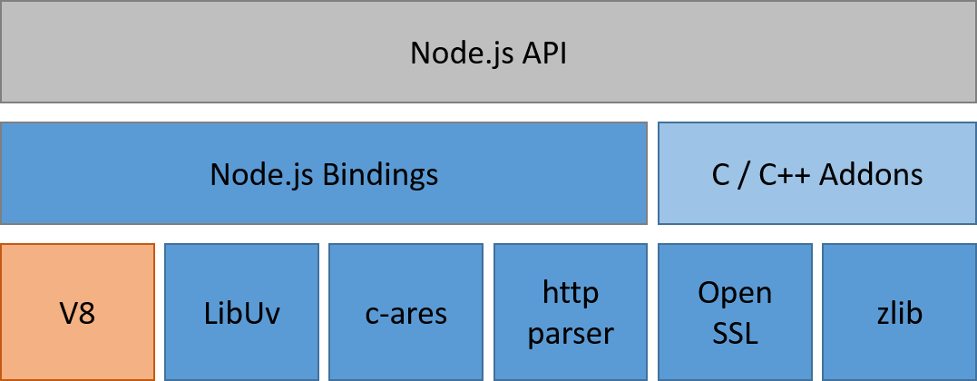

Slide 10

Javascript on Mobile

Slide 11
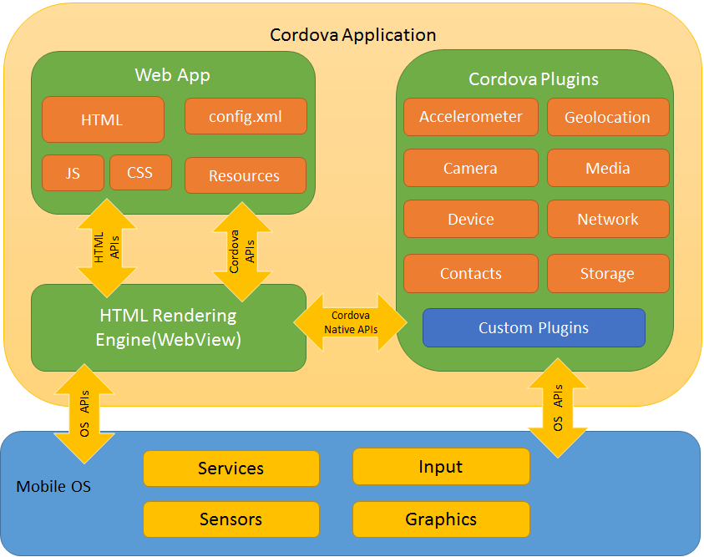

Slide 12
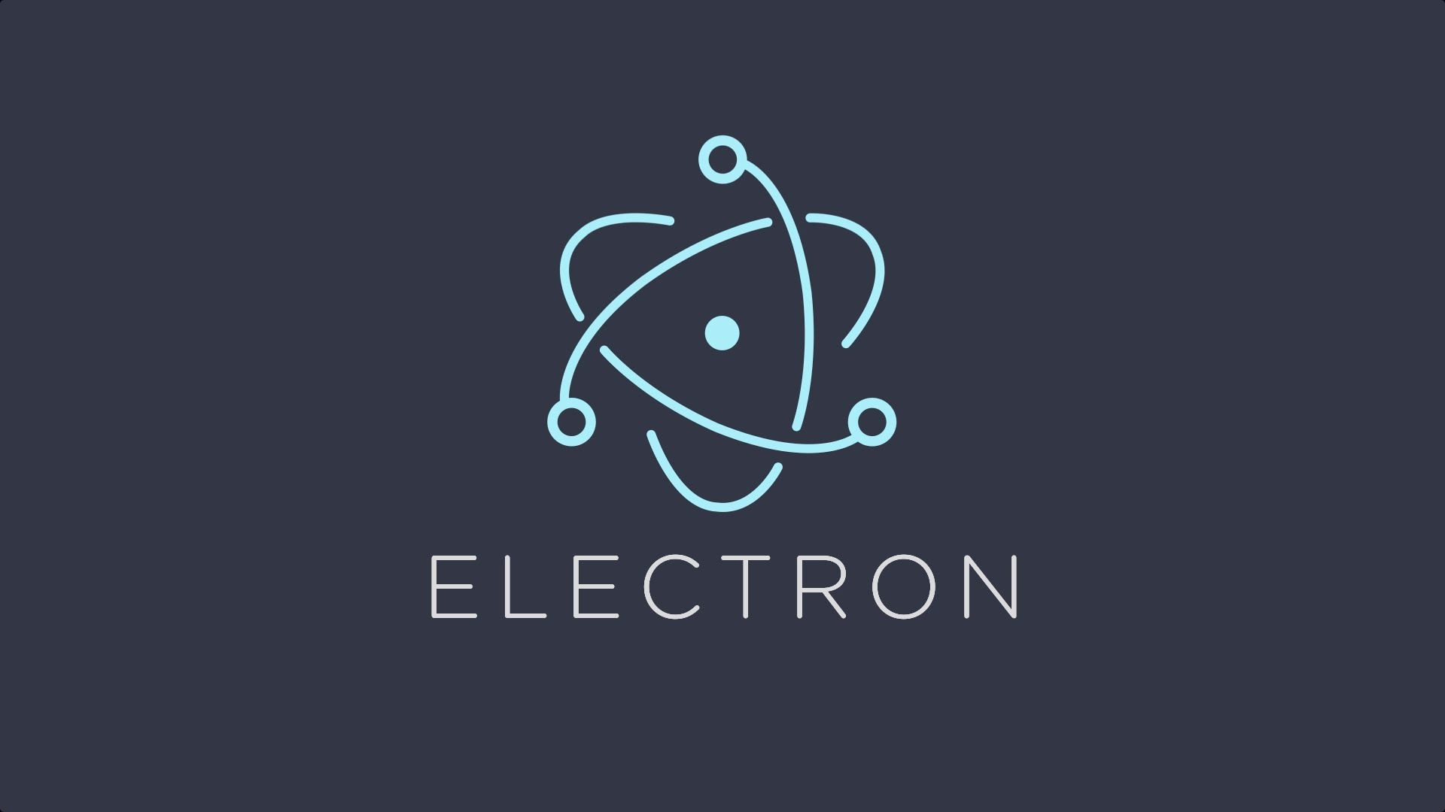
Javascript for Software

Slide 13
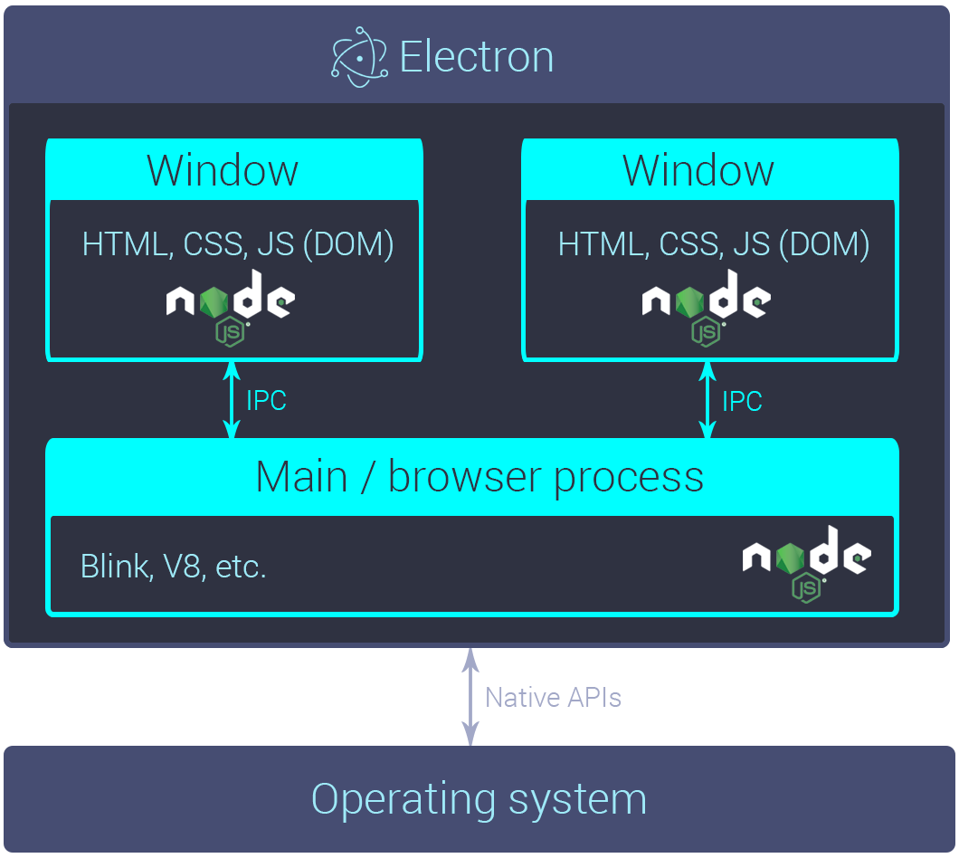

Slide 14


Javascript for Games

Slide 15
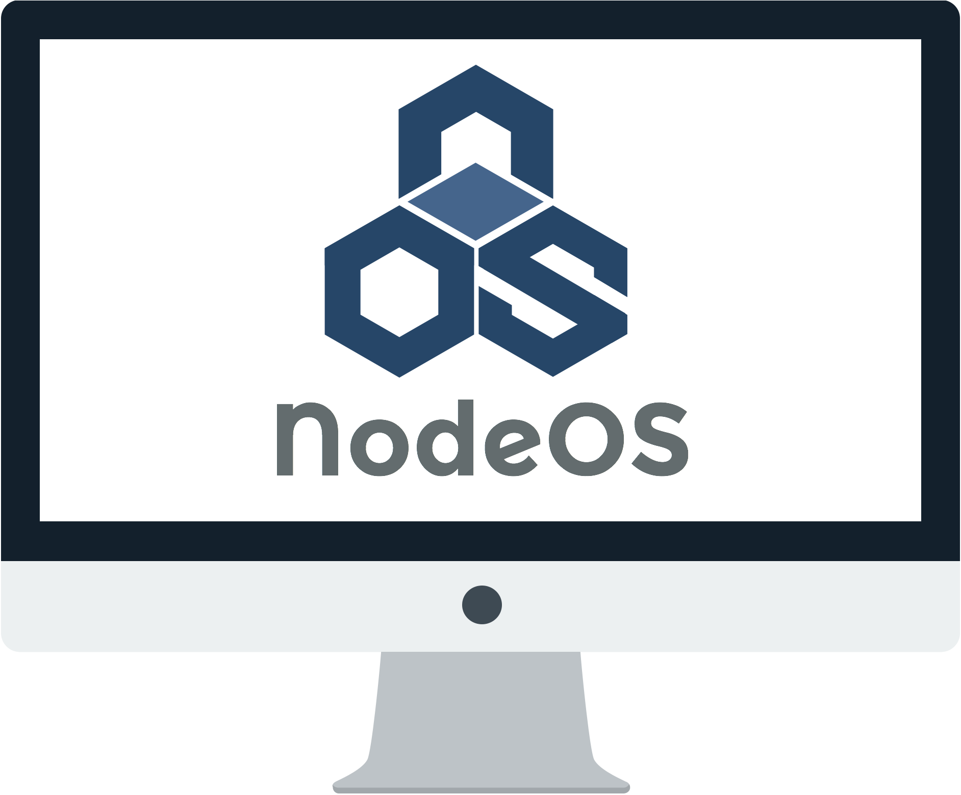
Javascript based Operating System

Slide 16

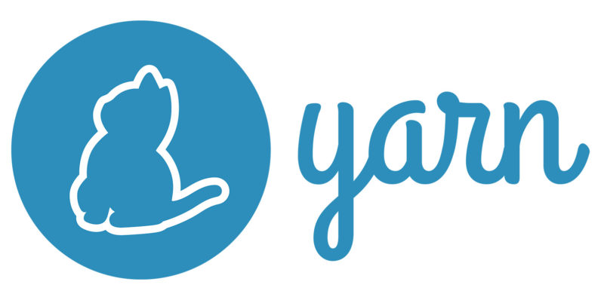
Package Manager for Javascript

Slide 17
Javascript Libraries

Slide 18
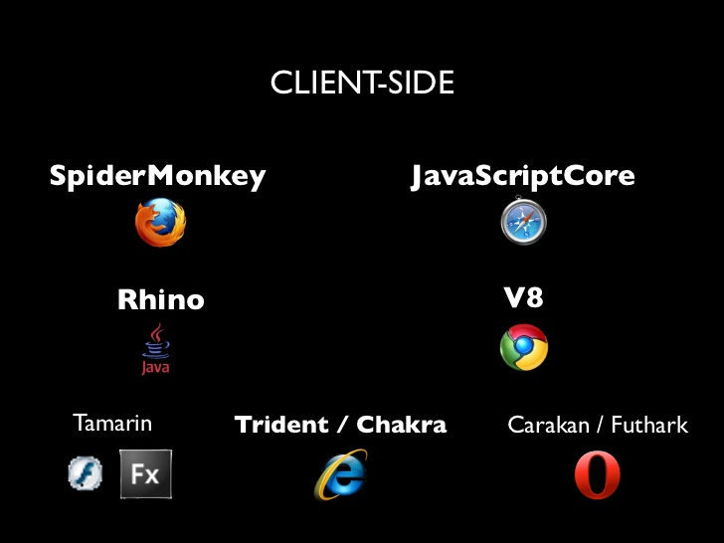
Javascript Engines

Slide 19

Javascript Build Tools

Slide 20
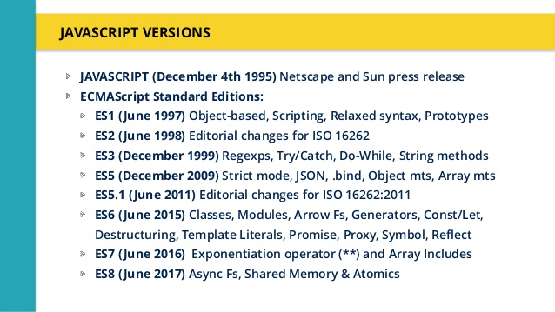

Slide 21
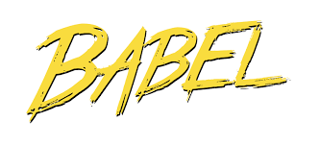
Javascript Transpilers

Slide 22

Now, what the heck?

Slide 23
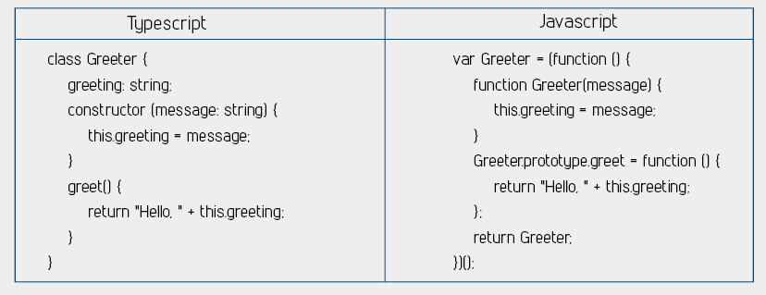

Slide 24
Now let’s dig deeper...

Slide 25
THANK YOU
https://thenuthouse.github.io
Inviting Speakers for our next and future sessions...

