Slide 2
Usability It is the ease of use and learnability of a tool or device.

Slide 3


Usability

Slide 4

Usability

Slide 5
Difference between Usability and User Experience
“ Can the user accomplish their goal?”
The ability to use.
“Did the user have a delightful experience while accomplishing the goal?”
Its about feelings.

Slide 6


Difference between Usability and User Experience

Slide 7
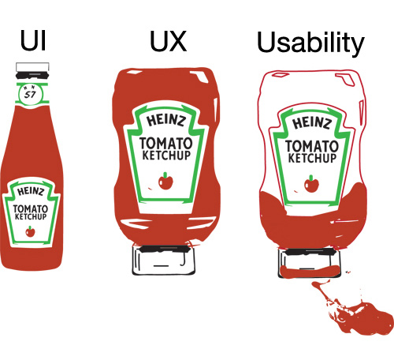
Difference between Usability and User Experience

Slide 8
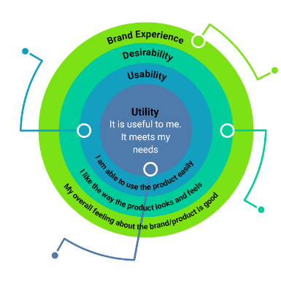
Relationship between Usability and User Experience
Functionality people
must be able to use
The way it looks and feels
must be pleasing
This helps create the overall
brand Experience
UX starts by being useful

Slide 9
Relationship between Psychology and Usability
Knowing how people react to visual stimuli allows the crafting of an effective design, with out psychology you are guessing.

Slide 10
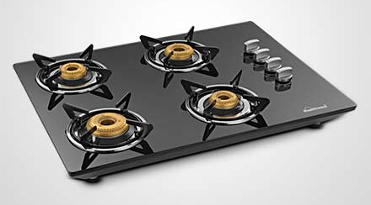
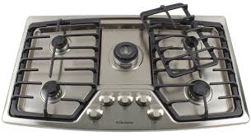
Relationship between Psychology and Usability

Slide 11
Principles in psychology
Hicks law – Time and effort
Increasing the number of choices will increase decision time.
Fitts law - Hit area of target
The time required to rapidly move to a target area is a function of the distance to the target and the size of the target.

Slide 12
Few principles in psychology
Millers law - memory and focus
that the number of objects an average person can hold in working memory is about seven
Gesalt law - principle of grouping
it states that objects that are near, or proximate to each other, tend to be grouped together.

Slide 13
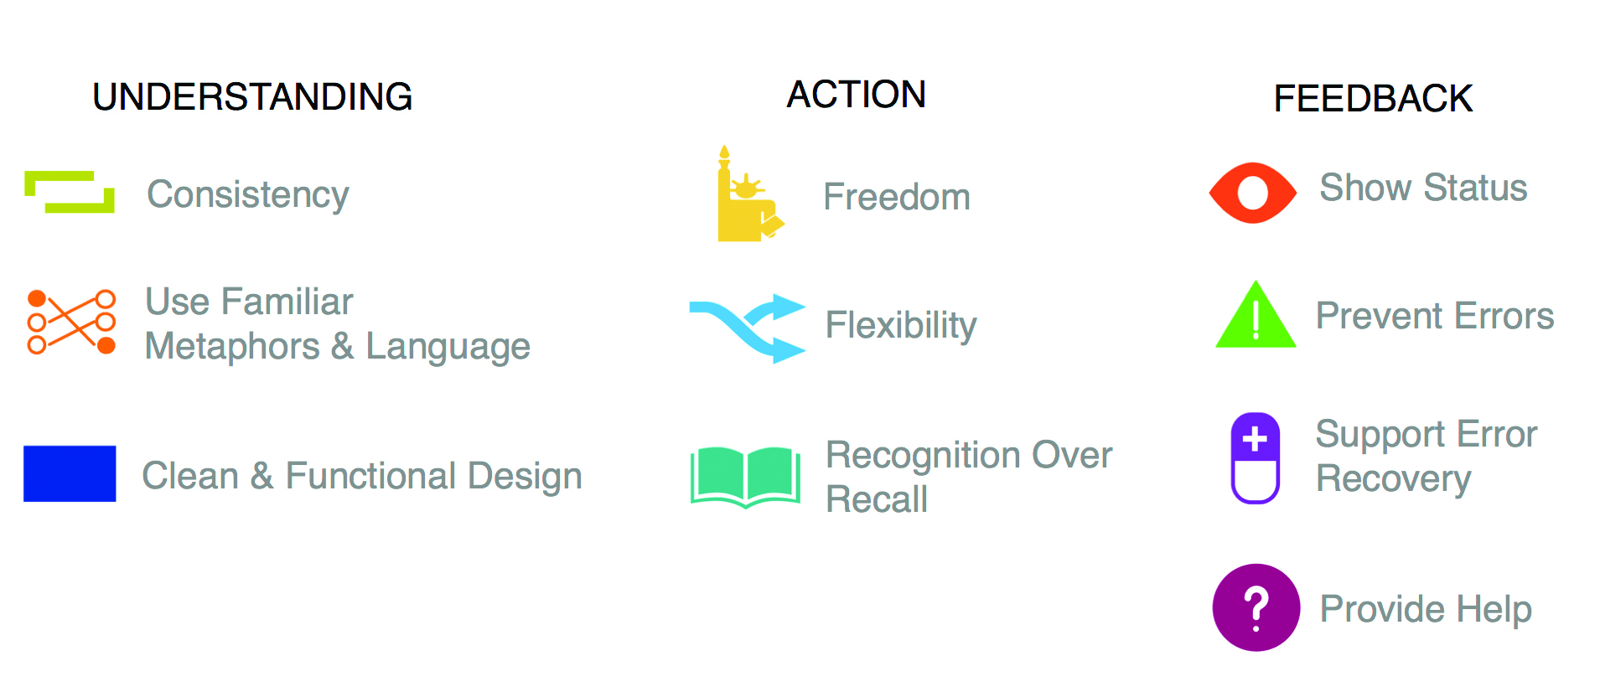
Usability Heuristics

Slide 14
Finally…
Usability It is the ease of use and learnability of a tool or device.
5 E’s of Usability
Effective
Efficient
Engaging
Error Tolerant
Easy to Learn

