Slide 1
Ramco Nuthouse
The fun is about to start..
Notes:
<number>

Slide 2
Ramco Nuthouse 3.0
User Experience, Material Design & Polymer
Nov 29st, 2017
Notes:
<number>

Slide 3

User Experience
Wikipedia
User Experience (UX) refers to a person's emotions and attitudes about using a particular product, system or service. It includes the practical, experiential, affective, meaningful and valuable aspects of human–computer interaction and product ownership. Additionally, it includes a person’s perceptions of system aspects such as utility, ease of use and efficiency.
<number>
Notes:
Valuable
The solution must deliver measurable value for site owners or interested group. It can be conversions, leads, subscriptions, etc.
Findable
Make it easy to find what your target audience is looking for, not only by optimizing search engines but focusing on internal navigation
Usable
Ease of use is extremely important; it must be intuitive and fluid. You need to create a funnel that leads your audience to your goal effectively
Desirable
Your target audience must have a strong desire to use your solution whether it’s for content, experience or emotions
Accessible
The solution must be easily accessible for your target audience – whether it’s technological requirements or people with disabilities
Credible
Your solution must be credible by all means. It has to build trust in your particular target audience by including important credibility factors
<number>

Slide 4
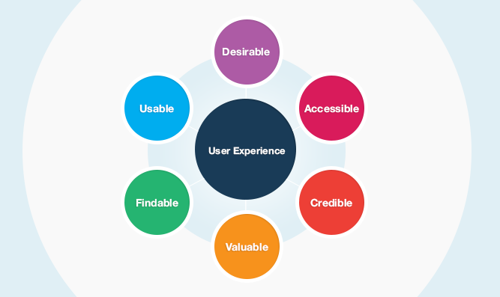
<number>
Notes:
<number>

Slide 5
History...
Evolution of design
https://web.archive.org/
Notes:
<number>

Slide 6
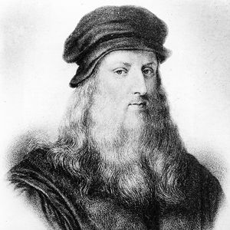
LEONARDO DA VINCI’S KITCHEN NIGHTMARE
– Developed a series of conveyor belts in the kitchen to bring food to cooks faster
– Created a large oven to cook food at higher temperatures than normal (at the time)
– Designed a sprinkler system for safety, in case a fire broke out
– Invited local artists to carve individual entrees into works of art for guests to eat
1995: Don Norman, the first user experience professional
2007: the iPhone
<number>
Notes:
<number>

Slide 7
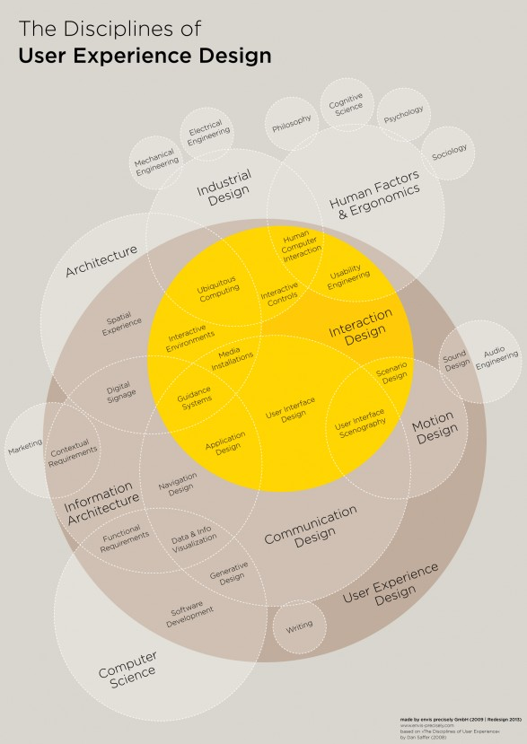
<number>
Notes:
<number>

Slide 8
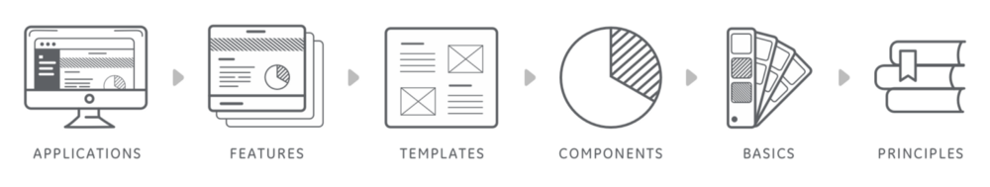
<number>
Notes:
<number>

Slide 9

Design Systems
GE Predix Design System: https://medium.com/ge-design/ges-predix-design-system-8236d47b0891
Microsoft Design System:
https://developer.microsoft.com/en-us/windows/apps/design
Apple Design System
https://developer.apple.com/design/
Google Material Design
https://material.io/
https://vimeo.com/132580829
https://www.slideshare.net/davcron/the-ge-design-system-and-thoughts-about-craft-at-scale
<number>
Notes:
<number>

Slide 10
WHY?
<number>
Notes:
<number>

Slide 11
Material Design
By Google
https://material.io
Notes:
<number>

Slide 12

<number>
Notes:
<number>

Slide 13
Principles of Material Design
Notes:
<number>

Slide 14
Guidelines
https://material.io/guidelines
Notes:
<number>

Slide 15
Video & Snacks Time
Notes:
<number>

Slide 16
Implementations
Notes:
<number>

Slide 17
Material Design Implementations
Material-UI: http://www.material-ui.com
Materialize http://materializecss.com/
Material for AngularJS & Angular https://material.angularjs.org https://material.angular.io/
Material Components
https://material.io/components/
Material Design Lite https://getmdl.io/
Polymer https://www.polymer-project.org
<number>
Notes:
<number>

Slide 18
Tools
Notes:
<number>

Slide 19
Material Design Tools
Color Tool: https://material.io/color
Remixer https://material.io/remixer/
Resizer https://material.io/resizer
Device Metrics https://material.io/devices/
Material Icons https://material.io/icons/
Stage & Gallery Work in progress...
https://github.com/material-foundation
<number>
Notes:
<number>

Slide 20
Examples
Notes:
<number>

Slide 21
Some Material Design Examples
Youtube: https://www.youtube.com/
Empsense https://empsense.ramco.com/app
Google Inbox https://inbox.google.com/
Your Android Phone (>=Lollipop)
Google Plus https://plus.google.com/
Nuthouse Website https://thenuthouse.github.io/
<number>
Notes:
<number>

Slide 22
Polymer... A quick walkthrough
https://www.polymer-project.org/
https://www.webcomponents.org/
Notes:
<number>

Slide 23
Quick Comparison Bootstrap vs MDL
http://demo.tutorialzine.com/2015/07/comparing-bootstrap-with-mdl/
Notes:
<number>

Slide 24
THANK YOU
https://thenuthouse.github.io
Inviting Speakers for our next and future sessions...
Notes:
<number>

