Slide 1
Ramco Nuthouse
The fun is about to start..
Notes:
1

Slide 2

Ramco Nuthouse 4.0
Cyber Security & Networking
Dec 20th, 2017
By Vignesh T.V.
www.tvvignesh.com
Notes:
1

Slide 3
What is Cybersecurity?
Wikipedia
Cyber security, computer security or IT security is the protection of computer systems from the theft and damage to their hardware, software or information, as well as from disruption or misdirection of the services they provide.
1
Notes:
Valuable
The solution must deliver measurable value for site owners or interested group. It can be conversions, leads, subscriptions, etc.
Findable
Make it easy to find what your target audience is looking for, not only by optimizing search engines but focusing on internal navigation
Usable
Ease of use is extremely important; it must be intuitive and fluid. You need to create a funnel that leads your audience to your goal effectively
Desirable
Your target audience must have a strong desire to use your solution whether it’s for content, experience or emotions
Accessible
The solution must be easily accessible for your target audience – whether it’s technological requirements or people with disabilities
Credible
Your solution must be credible by all means. It has to build trust in your particular target audience by including important credibility factors
1

Slide 4
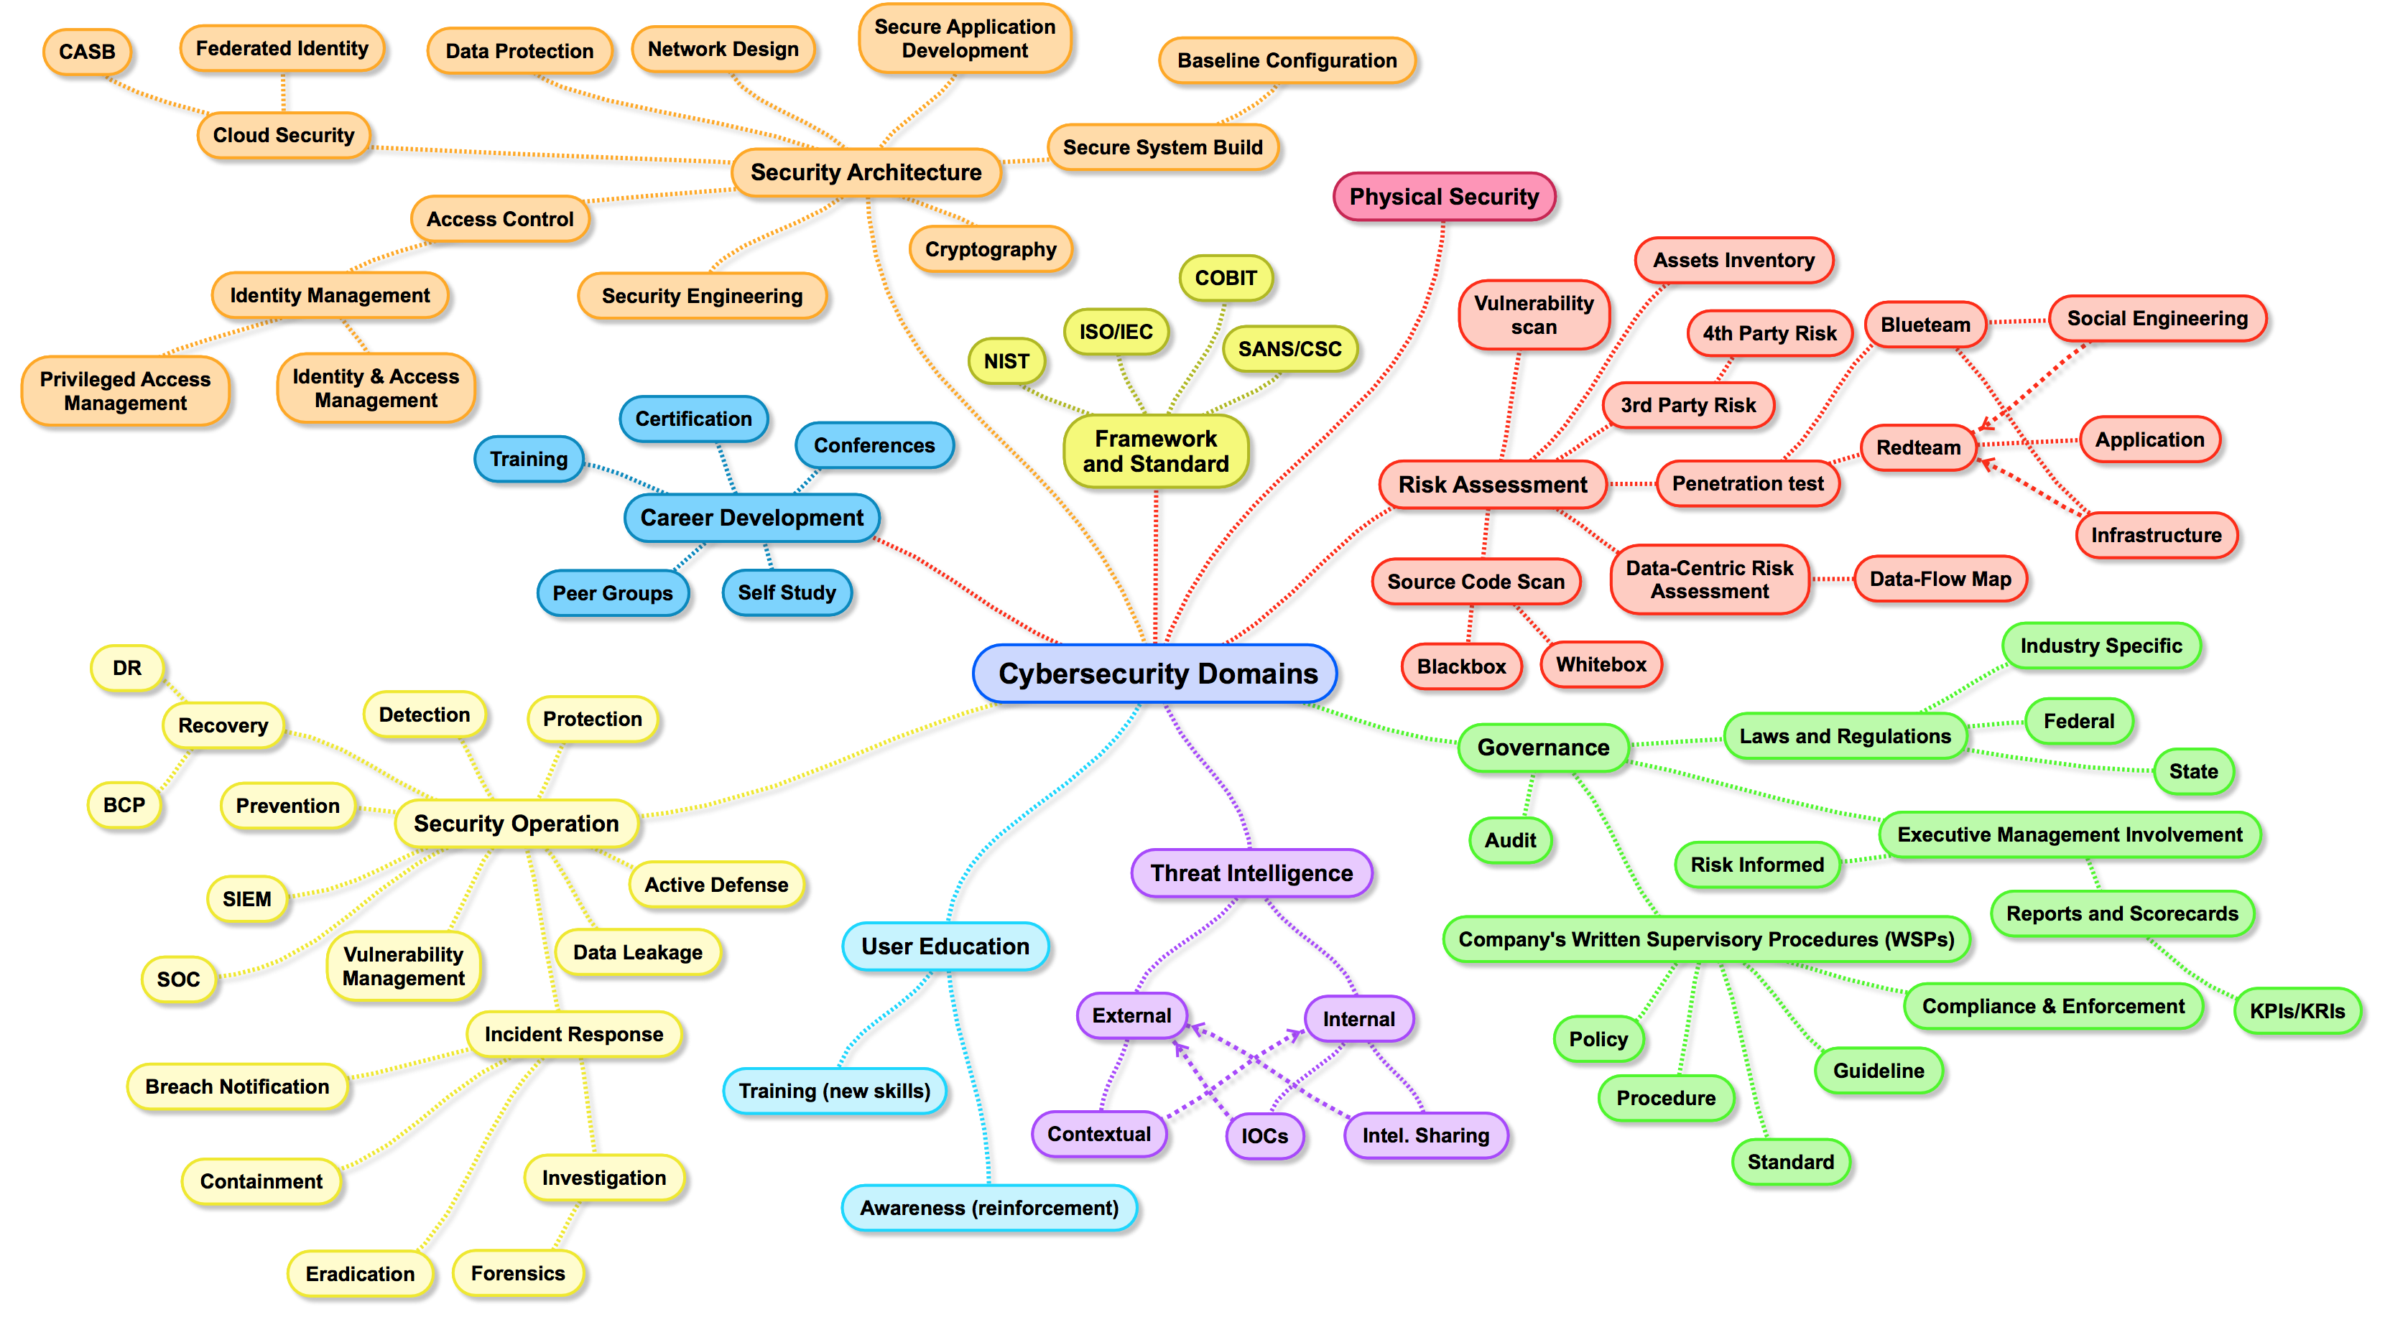
1
Source: LinkedIn
Notes:
Valuable
The solution must deliver measurable value for site owners or interested group. It can be conversions, leads, subscriptions, etc.
Findable
Make it easy to find what your target audience is looking for, not only by optimizing search engines but focusing on internal navigation
Usable
Ease of use is extremely important; it must be intuitive and fluid. You need to create a funnel that leads your audience to your goal effectively
Desirable
Your target audience must have a strong desire to use your solution whether it’s for content, experience or emotions
Accessible
The solution must be easily accessible for your target audience – whether it’s technological requirements or people with disabilities
Credible
Your solution must be credible by all means. It has to build trust in your particular target audience by including important credibility factors
1

Slide 5
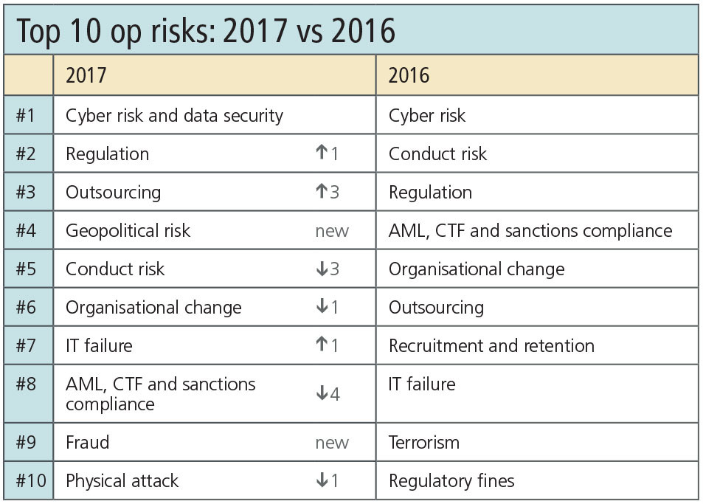
Why Cybersecurity?
Source: https://www.risk.net
1
Notes:
Valuable
The solution must deliver measurable value for site owners or interested group. It can be conversions, leads, subscriptions, etc.
Findable
Make it easy to find what your target audience is looking for, not only by optimizing search engines but focusing on internal navigation
Usable
Ease of use is extremely important; it must be intuitive and fluid. You need to create a funnel that leads your audience to your goal effectively
Desirable
Your target audience must have a strong desire to use your solution whether it’s for content, experience or emotions
Accessible
The solution must be easily accessible for your target audience – whether it’s technological requirements or people with disabilities
Credible
Your solution must be credible by all means. It has to build trust in your particular target audience by including important credibility factors
1

Slide 6
Live stats
FireEye
https://www.fireeye.com/cyber-map/threat-map.html
Digital Attack Map
http://www.digitalattackmap.com/
Checkpoint Live Map
https://threatmap.checkpoint.com/ThreatPortal/livemap.html
1
Notes:
Valuable
The solution must deliver measurable value for site owners or interested group. It can be conversions, leads, subscriptions, etc.
Findable
Make it easy to find what your target audience is looking for, not only by optimizing search engines but focusing on internal navigation
Usable
Ease of use is extremely important; it must be intuitive and fluid. You need to create a funnel that leads your audience to your goal effectively
Desirable
Your target audience must have a strong desire to use your solution whether it’s for content, experience or emotions
Accessible
The solution must be easily accessible for your target audience – whether it’s technological requirements or people with disabilities
Credible
Your solution must be credible by all means. It has to build trust in your particular target audience by including important credibility factors
1

Slide 7
Why Cybersecurity? Some history..
Deloitte finds “hidden” costs can amount to 90 percent of the total business impact on an organization, and will most likely be experienced two years or more after the event.
Some popular hacks
Equifax hack – Apache Struts
Yahoo – Twice @ 2016 – Forged Cookies
WannaCry
Petya & variants
Healthcare sector – 43+ incidents in 2016, 41+ in 2017
HBO? Game of thrones? Leak or hack?? And more.....
1
Notes:
Valuable
The solution must deliver measurable value for site owners or interested group. It can be conversions, leads, subscriptions, etc.
Findable
Make it easy to find what your target audience is looking for, not only by optimizing search engines but focusing on internal navigation
Usable
Ease of use is extremely important; it must be intuitive and fluid. You need to create a funnel that leads your audience to your goal effectively
Desirable
Your target audience must have a strong desire to use your solution whether it’s for content, experience or emotions
Accessible
The solution must be easily accessible for your target audience – whether it’s technological requirements or people with disabilities
Credible
Your solution must be credible by all means. It has to build trust in your particular target audience by including important credibility factors
1

Slide 8
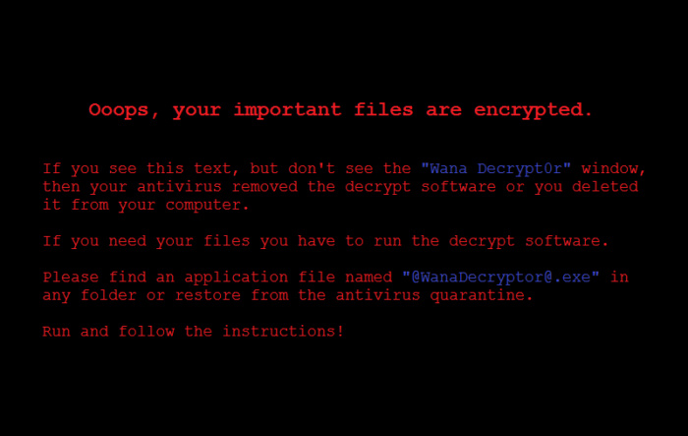
Wanna Cry
1
Notes:
Valuable
The solution must deliver measurable value for site owners or interested group. It can be conversions, leads, subscriptions, etc.
Findable
Make it easy to find what your target audience is looking for, not only by optimizing search engines but focusing on internal navigation
Usable
Ease of use is extremely important; it must be intuitive and fluid. You need to create a funnel that leads your audience to your goal effectively
Desirable
Your target audience must have a strong desire to use your solution whether it’s for content, experience or emotions
Accessible
The solution must be easily accessible for your target audience – whether it’s technological requirements or people with disabilities
Credible
Your solution must be credible by all means. It has to build trust in your particular target audience by including important credibility factors
1

Slide 9
Top hacker groups
Lizard Squad
Syrian Electronic Army
LulzSec
Anonymous
The Level Seven Crew
Network Crack Program Hacker (NCPH) Group
Chaos Computer Club (CCC) And more...
1
Notes:
Valuable
The solution must deliver measurable value for site owners or interested group. It can be conversions, leads, subscriptions, etc.
Findable
Make it easy to find what your target audience is looking for, not only by optimizing search engines but focusing on internal navigation
Usable
Ease of use is extremely important; it must be intuitive and fluid. You need to create a funnel that leads your audience to your goal effectively
Desirable
Your target audience must have a strong desire to use your solution whether it’s for content, experience or emotions
Accessible
The solution must be easily accessible for your target audience – whether it’s technological requirements or people with disabilities
Credible
Your solution must be credible by all means. It has to build trust in your particular target audience by including important credibility factors
1

Slide 10
How hackers operate?
The quieter you become, the more you are able to hear – Offensive security (my personal fav.)
Never leave any trace (do it quiet)
Play with the mind of the user (social engineering)
Virtualize
Distribute
Hide everything (VPN, TOR, Proxy)
Cat & Mouse game
Targeted attack
Go with the crowd
Keep backup plans
1
Notes:
Valuable
The solution must deliver measurable value for site owners or interested group. It can be conversions, leads, subscriptions, etc.
Findable
Make it easy to find what your target audience is looking for, not only by optimizing search engines but focusing on internal navigation
Usable
Ease of use is extremely important; it must be intuitive and fluid. You need to create a funnel that leads your audience to your goal effectively
Desirable
Your target audience must have a strong desire to use your solution whether it’s for content, experience or emotions
Accessible
The solution must be easily accessible for your target audience – whether it’s technological requirements or people with disabilities
Credible
Your solution must be credible by all means. It has to build trust in your particular target audience by including important credibility factors
1

Slide 11
Some terms
Virus
Worms
Trojans
Bots
Spyware
Adware
Scareware (rogue security, ransomware, scam) All together called malware
Firewall
Anti-virus (obvious but still..)
Exploit
Backdoor
1
Notes:
Valuable
The solution must deliver measurable value for site owners or interested group. It can be conversions, leads, subscriptions, etc.
Findable
Make it easy to find what your target audience is looking for, not only by optimizing search engines but focusing on internal navigation
Usable
Ease of use is extremely important; it must be intuitive and fluid. You need to create a funnel that leads your audience to your goal effectively
Desirable
Your target audience must have a strong desire to use your solution whether it’s for content, experience or emotions
Accessible
The solution must be easily accessible for your target audience – whether it’s technological requirements or people with disabilities
Credible
Your solution must be credible by all means. It has to build trust in your particular target audience by including important credibility factors
1

Slide 12
Types of attacks
DOS/DDOS (ping flood, ping of death, smurf attack, etc.)
SQL Injection
Cross-site scripting (XSS)
Phising
Malware (Virus, Worms, Trojans, Bots, etc.)
Session hijacking or Man in the middle attack, Packet sniffing
Credential Reuse
Brute force
Social Engineering
Port Scanning
Spoofing (referrer, caller id, email, GPS, etc.)
Cross-site request forgery (CSRF)
And more..
1
Notes:
Valuable
The solution must deliver measurable value for site owners or interested group. It can be conversions, leads, subscriptions, etc.
Findable
Make it easy to find what your target audience is looking for, not only by optimizing search engines but focusing on internal navigation
Usable
Ease of use is extremely important; it must be intuitive and fluid. You need to create a funnel that leads your audience to your goal effectively
Desirable
Your target audience must have a strong desire to use your solution whether it’s for content, experience or emotions
Accessible
The solution must be easily accessible for your target audience – whether it’s technological requirements or people with disabilities
Credible
Your solution must be credible by all means. It has to build trust in your particular target audience by including important credibility factors
1

Slide 13
How do we prevent attacks? (as a user)
3 T’s of security
Common Sense & Validation
Switch ON Autoupdates
Password principles
Anti-virus & Firewalls
Https (SSL) communications
Backups
Download sensibly
Use AD Blockers, check status bar before clicking
Validate the trust with service provider (Check for CIA)
Two factor Authentication
Biometrics
Report Abuse
1
Notes:
Valuable
The solution must deliver measurable value for site owners or interested group. It can be conversions, leads, subscriptions, etc.
Findable
Make it easy to find what your target audience is looking for, not only by optimizing search engines but focusing on internal navigation
Usable
Ease of use is extremely important; it must be intuitive and fluid. You need to create a funnel that leads your audience to your goal effectively
Desirable
Your target audience must have a strong desire to use your solution whether it’s for content, experience or emotions
Accessible
The solution must be easily accessible for your target audience – whether it’s technological requirements or people with disabilities
Credible
Your solution must be credible by all means. It has to build trust in your particular target audience by including important credibility factors
1

Slide 14
How do we prevent attacks? (as a developer)
Keep your tech stack updated with bug/vulnerability fixes
Close unused/important ports
Add middlewares for validations, escape/strip characters and unwanted elements
Always use SSL for transmitting secure packets
Cryptography (Encryption & Encoding)
Https (SSL) communications
Scheduled backups
Blacklist suspicious IPs
Do Load Testing & provide fallbacks on overload
Provide tools like Onscreenkeyboard or biometric where possible to avoid keyloggers
Check, filter and validate all entrypoints with proper authorization including APIs
Validate sessions and cookies since they can be hijacked
Provide a system of isolation to isolate the fault area from rest of the system.
Follow OWASP or similar guidelines for credentials and other data. And more...
1
Notes:
Valuable
The solution must deliver measurable value for site owners or interested group. It can be conversions, leads, subscriptions, etc.
Findable
Make it easy to find what your target audience is looking for, not only by optimizing search engines but focusing on internal navigation
Usable
Ease of use is extremely important; it must be intuitive and fluid. You need to create a funnel that leads your audience to your goal effectively
Desirable
Your target audience must have a strong desire to use your solution whether it’s for content, experience or emotions
Accessible
The solution must be easily accessible for your target audience – whether it’s technological requirements or people with disabilities
Credible
Your solution must be credible by all means. It has to build trust in your particular target audience by including important credibility factors
1

Slide 15
Bullet proof hosting?
1
Notes:
Valuable
The solution must deliver measurable value for site owners or interested group. It can be conversions, leads, subscriptions, etc.
Findable
Make it easy to find what your target audience is looking for, not only by optimizing search engines but focusing on internal navigation
Usable
Ease of use is extremely important; it must be intuitive and fluid. You need to create a funnel that leads your audience to your goal effectively
Desirable
Your target audience must have a strong desire to use your solution whether it’s for content, experience or emotions
Accessible
The solution must be easily accessible for your target audience – whether it’s technological requirements or people with disabilities
Credible
Your solution must be credible by all means. It has to build trust in your particular target audience by including important credibility factors
1

Slide 16
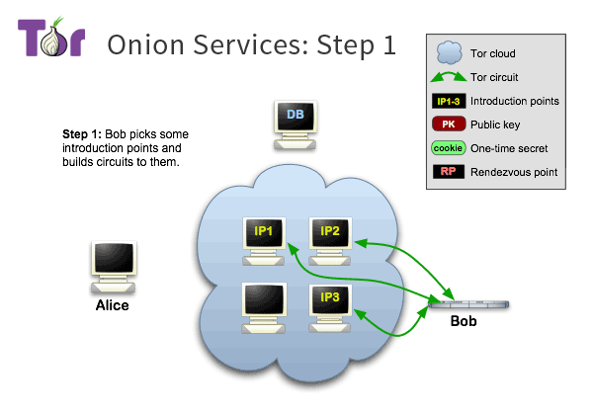
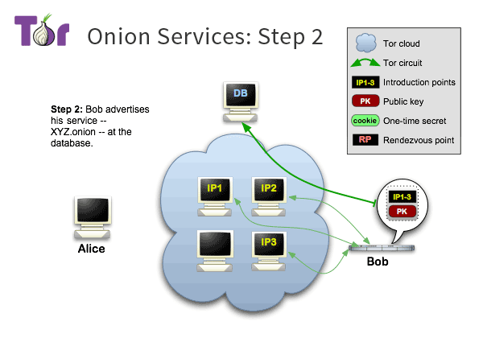
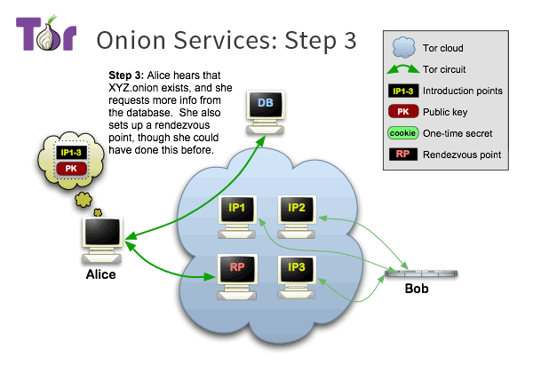
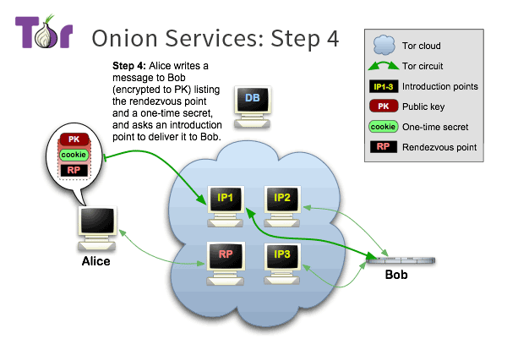
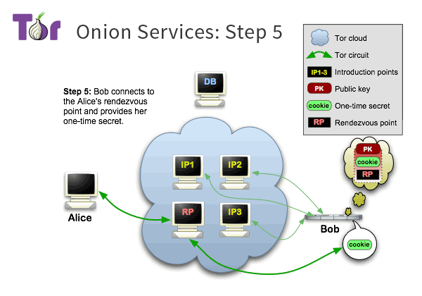
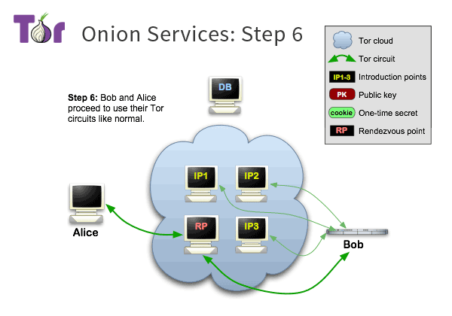
Tor
1
Notes:
Valuable
The solution must deliver measurable value for site owners or interested group. It can be conversions, leads, subscriptions, etc.
Findable
Make it easy to find what your target audience is looking for, not only by optimizing search engines but focusing on internal navigation
Usable
Ease of use is extremely important; it must be intuitive and fluid. You need to create a funnel that leads your audience to your goal effectively
Desirable
Your target audience must have a strong desire to use your solution whether it’s for content, experience or emotions
Accessible
The solution must be easily accessible for your target audience – whether it’s technological requirements or people with disabilities
Credible
Your solution must be credible by all means. It has to build trust in your particular target audience by including important credibility factors
1

Slide 17
Some references on Tor
https://www.torproject.org
https://www.expressvpn.com/blog/best-onion-sites-on-dark-web/
Alternatives?
https://freenetproject.org/
https://geti2p.net/en/
1
Notes:
Valuable
The solution must deliver measurable value for site owners or interested group. It can be conversions, leads, subscriptions, etc.
Findable
Make it easy to find what your target audience is looking for, not only by optimizing search engines but focusing on internal navigation
Usable
Ease of use is extremely important; it must be intuitive and fluid. You need to create a funnel that leads your audience to your goal effectively
Desirable
Your target audience must have a strong desire to use your solution whether it’s for content, experience or emotions
Accessible
The solution must be easily accessible for your target audience – whether it’s technological requirements or people with disabilities
Credible
Your solution must be credible by all means. It has to build trust in your particular target audience by including important credibility factors
1

Slide 18
Some important tools & resources
Kali Linux https://www.kali.org/
Wireshark https://www.wireshark.org
Exploit DB https://www.exploit-db.com/
Metasploit Unleashed
https://www.offensive-security.com/metasploit-unleashed/
Metasploitable http://sourceforge.net/projects/metasploitable/files/Metasploitable2/
VirtualBox https://www.virtualbox.org/
1
Notes:
1

Slide 19
Some more links..
https://www.youtube.com/watch?v=KwJyKmCbOws
http://www.gameofhacks.com/
https://bkimminich.gitbooks.io/pwning-owasp-juice-shop/content/
https://securitythoughts.wordpress.com/2010/03/22/vulnerable-web-applications-for-learning/
1
Notes:
1

Slide 20
Security Certifications
Systems Security Certified Practitioner (SSCP)
CompTIA Security+
CCNA Security
EC-Council Certified Ethical Hacker
CompTIA Advanced Security Practitioner (CASP)
GIAC GSEC
Certified Information Systems Security Professional (CISSP)
Offensive Security Certified Professional (OSCP)
1
Notes:
1

Slide 21
Summary
Notes:
<number>

Slide 22
THANK YOU
https://thenuthouse.github.io
Inviting Speakers for our next and future sessions...
Notes:
<number>

