Slide 1
Ramco Nuthouse
The fun is about to start..

Slide 2
Ramco Nuthouse 8.0
Event Sourcing, CQRS & GraphQL
Apr 26th, 2018

Slide 3
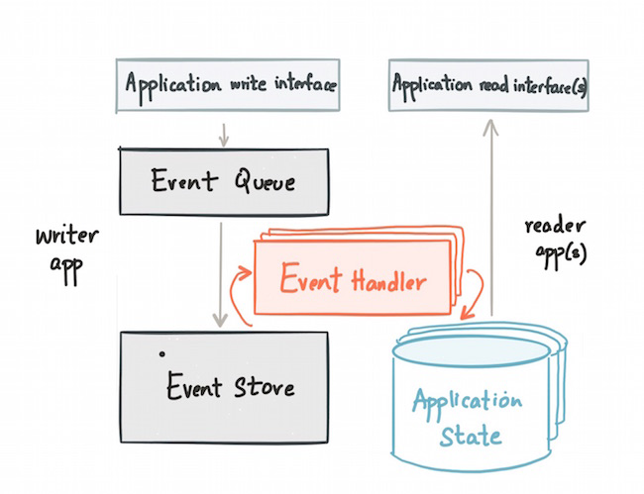
Event Sourcing
Notes:
Valuable
The solution must deliver measurable value for site owners or interested group. It can be conversions, leads, subscriptions, etc.
Findable
Make it easy to find what your target audience is looking for, not only by optimizing search engines but focusing on internal navigation
Usable
Ease of use is extremely important; it must be intuitive and fluid. You need to create a funnel that leads your audience to your goal effectively
Desirable
Your target audience must have a strong desire to use your solution whether it’s for content, experience or emotions
Accessible
The solution must be easily accessible for your target audience – whether it’s technological requirements or people with disabilities
Credible
Your solution must be credible by all means. It has to build trust in your particular target audience by including important credibility factors

Slide 4
Accounting, Medical, Legal..
Notes:
Valuable
The solution must deliver measurable value for site owners or interested group. It can be conversions, leads, subscriptions, etc.
Findable
Make it easy to find what your target audience is looking for, not only by optimizing search engines but focusing on internal navigation
Usable
Ease of use is extremely important; it must be intuitive and fluid. You need to create a funnel that leads your audience to your goal effectively
Desirable
Your target audience must have a strong desire to use your solution whether it’s for content, experience or emotions
Accessible
The solution must be easily accessible for your target audience – whether it’s technological requirements or people with disabilities
Credible
Your solution must be credible by all means. It has to build trust in your particular target audience by including important credibility factors

Slide 5
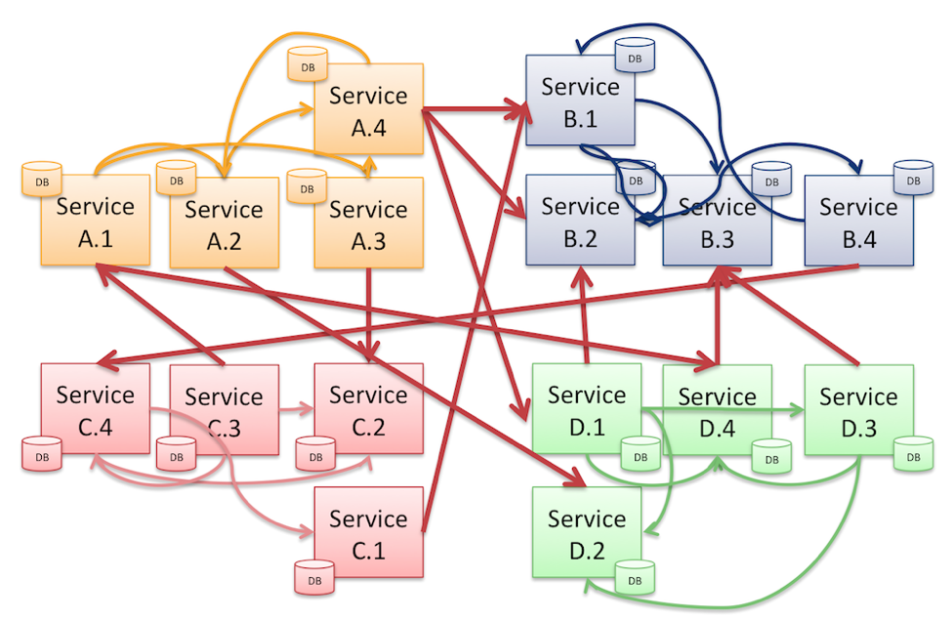
Notes:
Valuable
The solution must deliver measurable value for site owners or interested group. It can be conversions, leads, subscriptions, etc.
Findable
Make it easy to find what your target audience is looking for, not only by optimizing search engines but focusing on internal navigation
Usable
Ease of use is extremely important; it must be intuitive and fluid. You need to create a funnel that leads your audience to your goal effectively
Desirable
Your target audience must have a strong desire to use your solution whether it’s for content, experience or emotions
Accessible
The solution must be easily accessible for your target audience – whether it’s technological requirements or people with disabilities
Credible
Your solution must be credible by all means. It has to build trust in your particular target audience by including important credibility factors

Slide 6
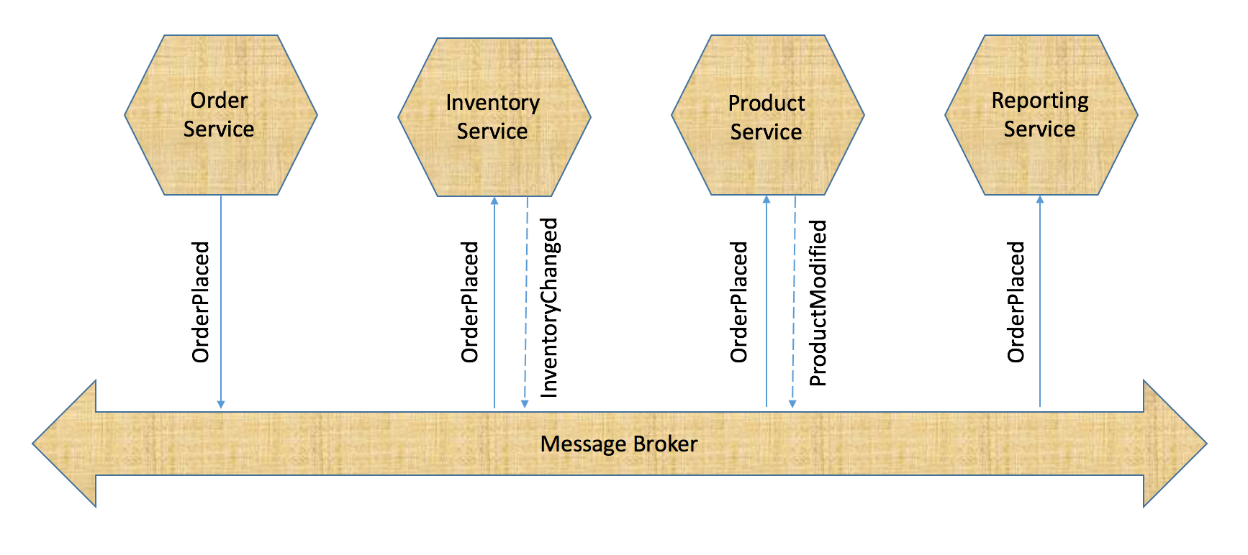
Notes:
Valuable
The solution must deliver measurable value for site owners or interested group. It can be conversions, leads, subscriptions, etc.
Findable
Make it easy to find what your target audience is looking for, not only by optimizing search engines but focusing on internal navigation
Usable
Ease of use is extremely important; it must be intuitive and fluid. You need to create a funnel that leads your audience to your goal effectively
Desirable
Your target audience must have a strong desire to use your solution whether it’s for content, experience or emotions
Accessible
The solution must be easily accessible for your target audience – whether it’s technological requirements or people with disabilities
Credible
Your solution must be credible by all means. It has to build trust in your particular target audience by including important credibility factors

Slide 7
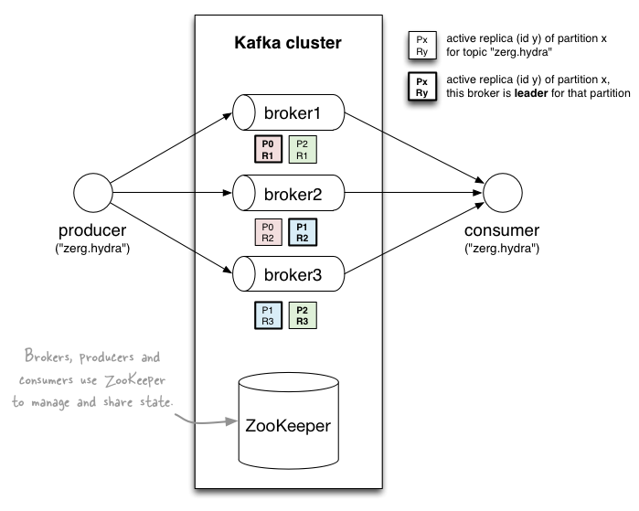
Notes:
Valuable
The solution must deliver measurable value for site owners or interested group. It can be conversions, leads, subscriptions, etc.
Findable
Make it easy to find what your target audience is looking for, not only by optimizing search engines but focusing on internal navigation
Usable
Ease of use is extremely important; it must be intuitive and fluid. You need to create a funnel that leads your audience to your goal effectively
Desirable
Your target audience must have a strong desire to use your solution whether it’s for content, experience or emotions
Accessible
The solution must be easily accessible for your target audience – whether it’s technological requirements or people with disabilities
Credible
Your solution must be credible by all means. It has to build trust in your particular target audience by including important credibility factors

Slide 8
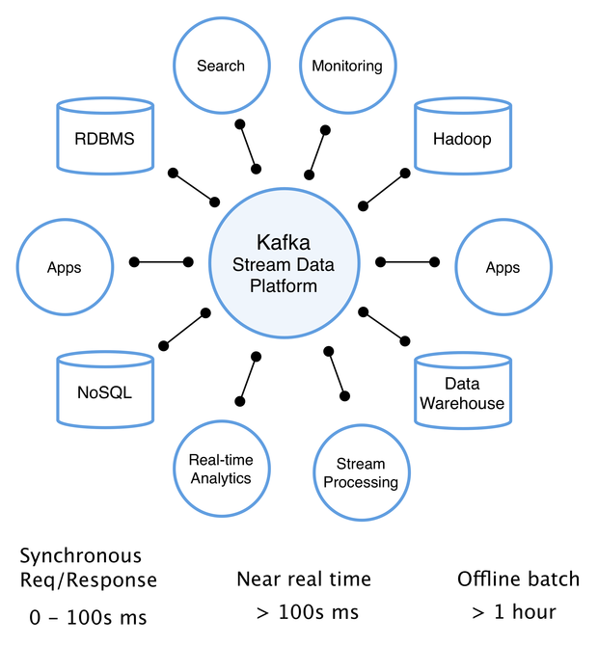
Notes:
Valuable
The solution must deliver measurable value for site owners or interested group. It can be conversions, leads, subscriptions, etc.
Findable
Make it easy to find what your target audience is looking for, not only by optimizing search engines but focusing on internal navigation
Usable
Ease of use is extremely important; it must be intuitive and fluid. You need to create a funnel that leads your audience to your goal effectively
Desirable
Your target audience must have a strong desire to use your solution whether it’s for content, experience or emotions
Accessible
The solution must be easily accessible for your target audience – whether it’s technological requirements or people with disabilities
Credible
Your solution must be credible by all means. It has to build trust in your particular target audience by including important credibility factors

Slide 9
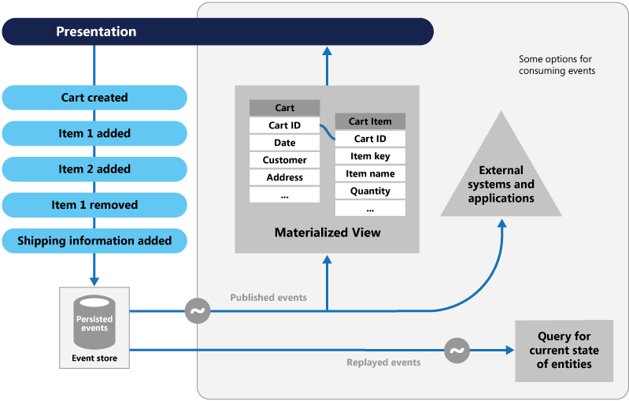
Notes:
Valuable
The solution must deliver measurable value for site owners or interested group. It can be conversions, leads, subscriptions, etc.
Findable
Make it easy to find what your target audience is looking for, not only by optimizing search engines but focusing on internal navigation
Usable
Ease of use is extremely important; it must be intuitive and fluid. You need to create a funnel that leads your audience to your goal effectively
Desirable
Your target audience must have a strong desire to use your solution whether it’s for content, experience or emotions
Accessible
The solution must be easily accessible for your target audience – whether it’s technological requirements or people with disabilities
Credible
Your solution must be credible by all means. It has to build trust in your particular target audience by including important credibility factors

Slide 10
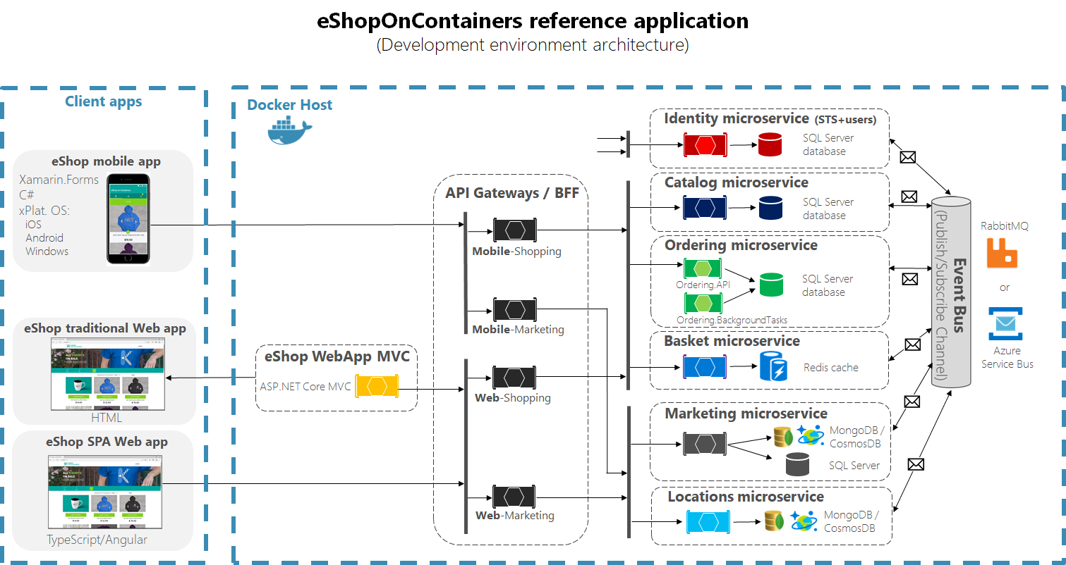
Notes:
Valuable
The solution must deliver measurable value for site owners or interested group. It can be conversions, leads, subscriptions, etc.
Findable
Make it easy to find what your target audience is looking for, not only by optimizing search engines but focusing on internal navigation
Usable
Ease of use is extremely important; it must be intuitive and fluid. You need to create a funnel that leads your audience to your goal effectively
Desirable
Your target audience must have a strong desire to use your solution whether it’s for content, experience or emotions
Accessible
The solution must be easily accessible for your target audience – whether it’s technological requirements or people with disabilities
Credible
Your solution must be credible by all means. It has to build trust in your particular target audience by including important credibility factors

Slide 11
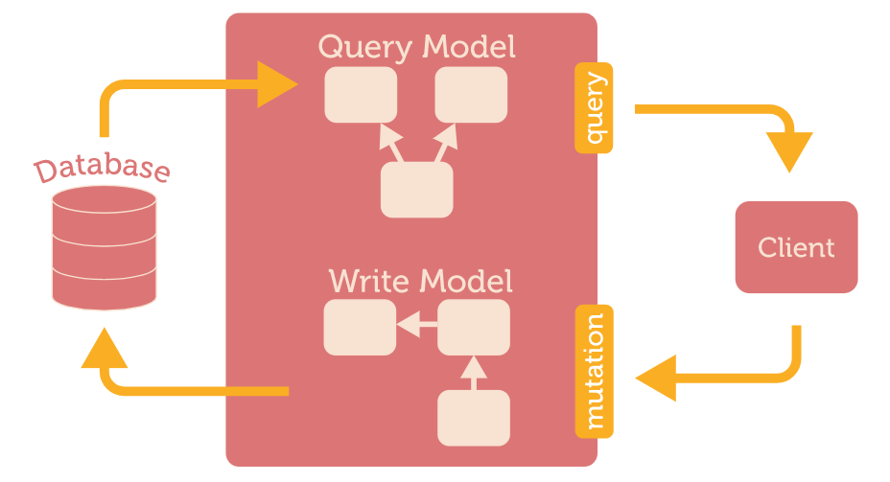
CQRS – Command Query Responsibility Segregation
https://gist.github.com/OlegIlyenko/a5a9ab1b000ba0b5b1ad
Notes:
Valuable
The solution must deliver measurable value for site owners or interested group. It can be conversions, leads, subscriptions, etc.
Findable
Make it easy to find what your target audience is looking for, not only by optimizing search engines but focusing on internal navigation
Usable
Ease of use is extremely important; it must be intuitive and fluid. You need to create a funnel that leads your audience to your goal effectively
Desirable
Your target audience must have a strong desire to use your solution whether it’s for content, experience or emotions
Accessible
The solution must be easily accessible for your target audience – whether it’s technological requirements or people with disabilities
Credible
Your solution must be credible by all means. It has to build trust in your particular target audience by including important credibility factors

Slide 12
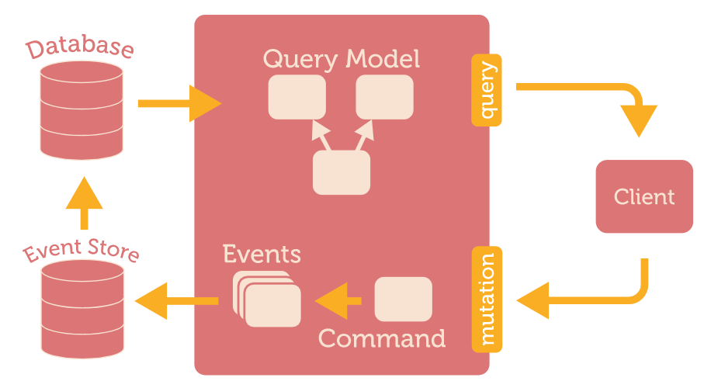
CQRS + Event Sourcing
https://gist.github.com/OlegIlyenko/a5a9ab1b000ba0b5b1ad
Notes:
Valuable
The solution must deliver measurable value for site owners or interested group. It can be conversions, leads, subscriptions, etc.
Findable
Make it easy to find what your target audience is looking for, not only by optimizing search engines but focusing on internal navigation
Usable
Ease of use is extremely important; it must be intuitive and fluid. You need to create a funnel that leads your audience to your goal effectively
Desirable
Your target audience must have a strong desire to use your solution whether it’s for content, experience or emotions
Accessible
The solution must be easily accessible for your target audience – whether it’s technological requirements or people with disabilities
Credible
Your solution must be credible by all means. It has to build trust in your particular target audience by including important credibility factors

Slide 13
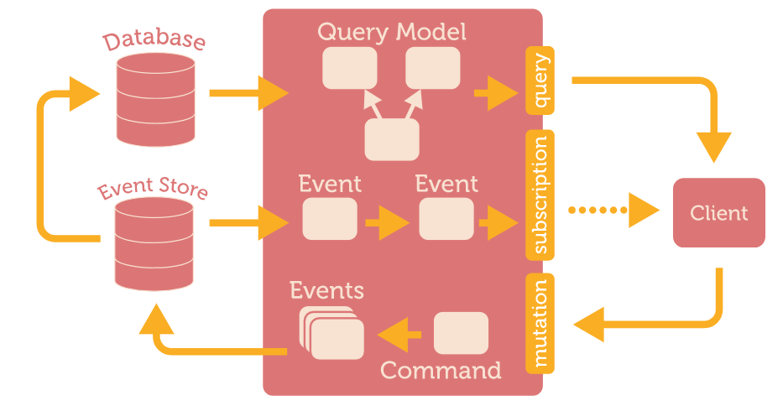
CQRS + Event Sourcing + Event Subscriptions
https://gist.github.com/OlegIlyenko/a5a9ab1b000ba0b5b1ad
Notes:
Valuable
The solution must deliver measurable value for site owners or interested group. It can be conversions, leads, subscriptions, etc.
Findable
Make it easy to find what your target audience is looking for, not only by optimizing search engines but focusing on internal navigation
Usable
Ease of use is extremely important; it must be intuitive and fluid. You need to create a funnel that leads your audience to your goal effectively
Desirable
Your target audience must have a strong desire to use your solution whether it’s for content, experience or emotions
Accessible
The solution must be easily accessible for your target audience – whether it’s technological requirements or people with disabilities
Credible
Your solution must be credible by all means. It has to build trust in your particular target audience by including important credibility factors

Slide 14

GraphQL
Wikipedia
GraphQL is a data query language developed internally by Facebook in 2012 before being publicly released in 2015. It provides an alternative to REST and ad-hoc webservice architectures. It allows clients to define the structure of the data required, and exactly the same structure of the data is returned from the server. It is a strongly typed runtime which allows clients to dictate what data is needed. This avoids both the problems of over-fetching as well as under-fetching of data.
Notes:
Valuable
The solution must deliver measurable value for site owners or interested group. It can be conversions, leads, subscriptions, etc.
Findable
Make it easy to find what your target audience is looking for, not only by optimizing search engines but focusing on internal navigation
Usable
Ease of use is extremely important; it must be intuitive and fluid. You need to create a funnel that leads your audience to your goal effectively
Desirable
Your target audience must have a strong desire to use your solution whether it’s for content, experience or emotions
Accessible
The solution must be easily accessible for your target audience – whether it’s technological requirements or people with disabilities
Credible
Your solution must be credible by all means. It has to build trust in your particular target audience by including important credibility factors

Slide 15
An overview
Powerful Client-side queries Clients can just get the data as needed without any extra junk
Protocol/Transport independent You can use HTTP/TCP/RPC or any protocol for graphql to be used.
Hierarchial Schema Follows a hierarchical schema structure
Single Endpoint for everything There are no multiple endpoints like what you have in REST. Every operation uses a single endpoint.
Resolver functions for data extraction Data is extracted by using resolver functions which are written against every attribute of data to be extracted.
Data from multiple sources Ability to process, query and manage data from multiple data sources at the same time.
Specification, Not an implementation GraphQL is just a specification from Facebook. Implementations available both on client & server side.

Slide 16
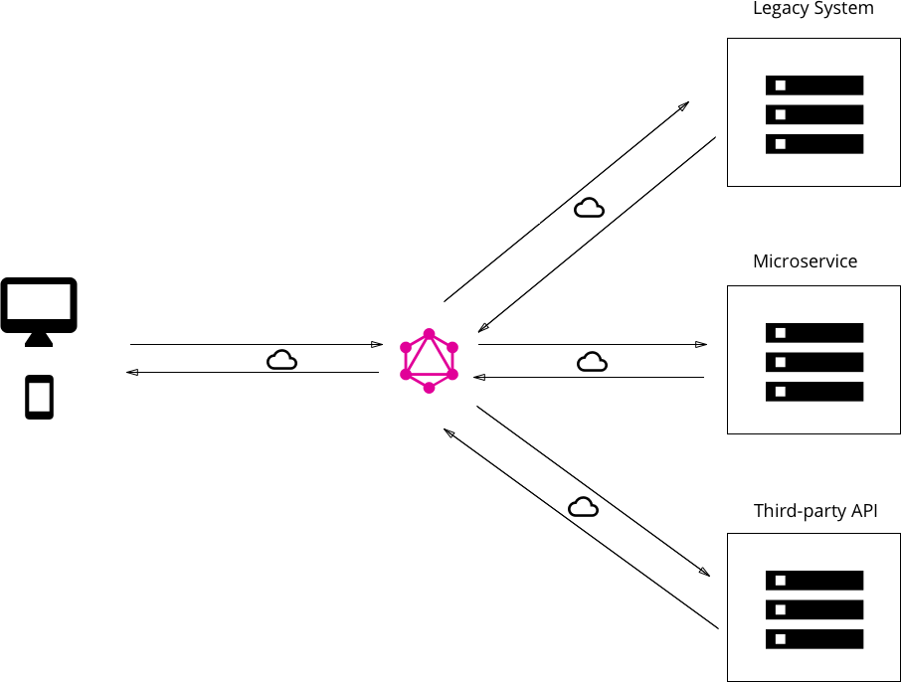
ARCHITECTURE

Slide 17
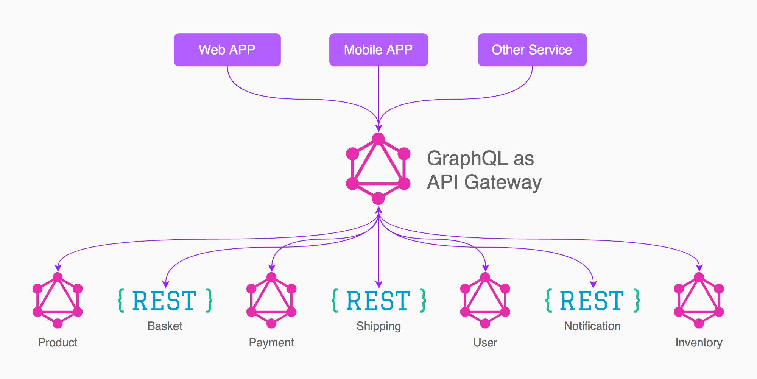
ARCHITECTURE

Slide 18
ARCHITECTURE
Database
Cache
3rd party APIs
GraphQL Server
JWT Token
Authentication
API Gateway
Tenant Microservice
Client
Client
Client

Slide 19
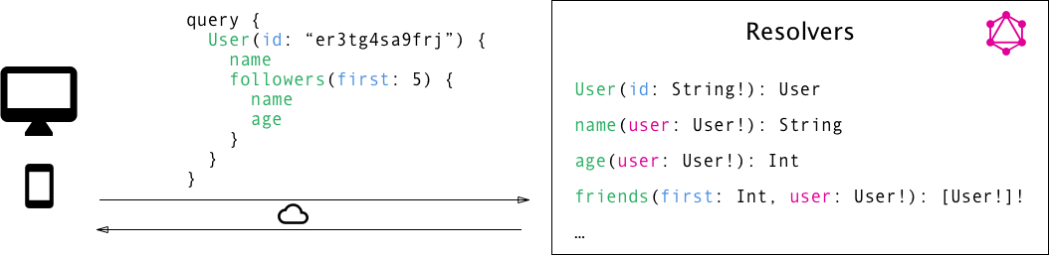
ARCHITECTURE

Slide 20


GraphQL Server
Server side in Node.js with express following the graphql specifications
Option to use either Apollo/express-graphql as a library on the server side
Schema & Resolver functions defined through helper methods provided by the SDK
Call made to the GraphQL can either be a normal REST call or can use any protocol passing the graphql query along with it.
The queries can be tested through GraphiQL, the graphical editor for GraphQL
Apollo GraphQL server can be used since it is open source, has good community support and optional enterprise support as well. Only javascript libs available from apollo as of now.

Slide 21
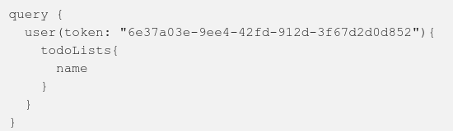
Authentication
While authentication can remain the same as what we have for REST APIs by passing token via headers, it is better to pass the token in the body as an attribute to make the query protocol independent.

Slide 22

Tenant Resolution
A microservice can provide with the database connection host name and credentials when an access token is passed to it as opposed to storing it as an XML configuration. GraphQL will request for this info when needed via the API gateway to understand which DB it should talk to.
Dataloader (Cache) is also separated by tenants to ensure clear data isolation.

Slide 23
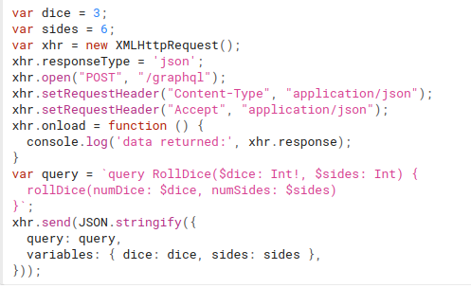
Data sources
There can be multiple data sources to which GraphQL can talk to. Queries at the same level are executed in parallel.
GraphQL Client
There can be multiple data sources to which GraphQL can talk to. Queries at the same level are executed in parallel.

Slide 24
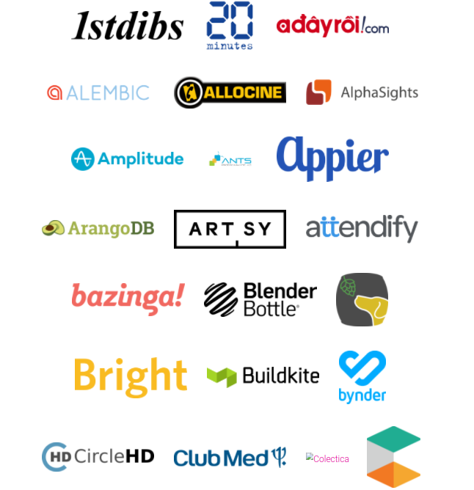
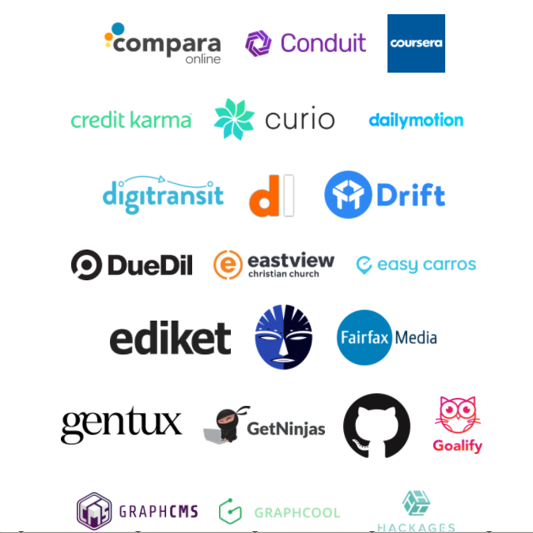
Enterprise Adoption

Slide 25
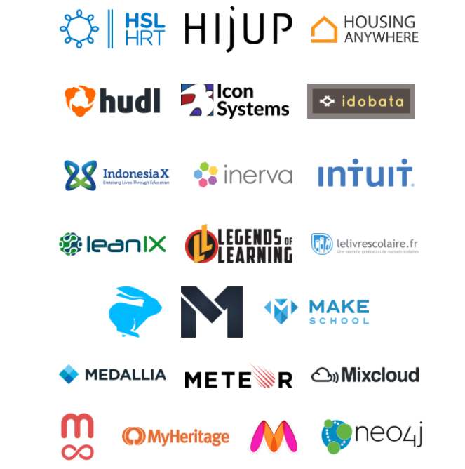
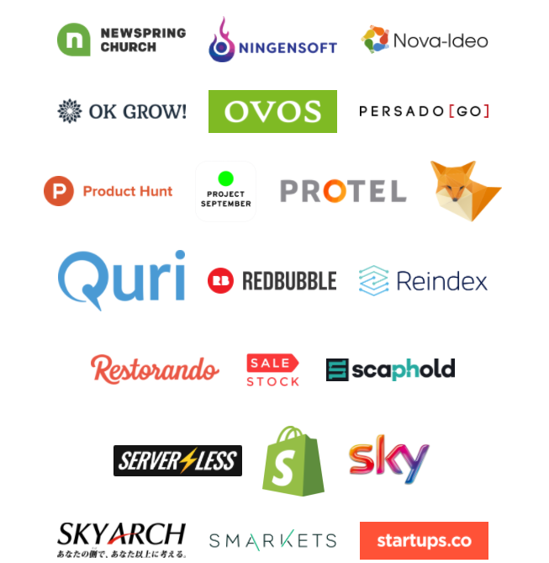
Enterprise Adoption

Slide 26
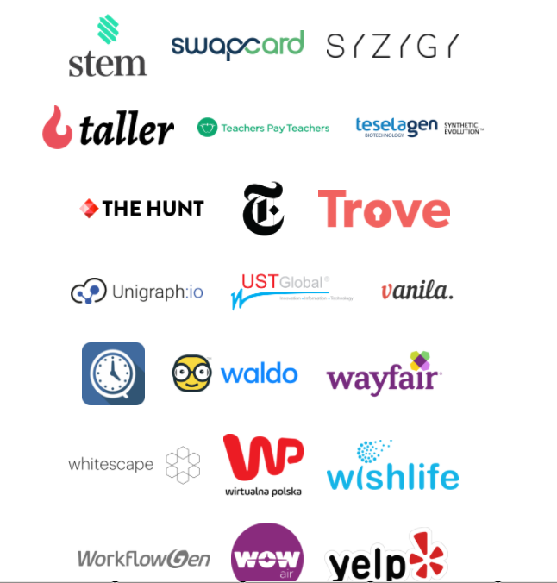

Enterprise Adoption

Slide 27
REFERENCES
https://github.com/chentsulin/awesome-graphql
https://dev-blog.apollodata.com/graphql-explained-5844742f195e
https://blog.risingstack.com/graphql-overview-getting-started-with-graphql-and-nodejs/
https://www.compose.com/articles/using-graphql-with-mongodb/
https://medium.com/the-ideal-system/graphql-and-mongodb-a-quick-example-34643e637e49
http://graphql.org/learn/best-practices/
https://dev-blog.apollodata.com/tutorial-building-a-graphql-server-cddaa023c035
https://github.com/graphql/graphql-js
https://medium.freecodecamp.org/rest-apis-are-rest-in-peace-apis-long-live-graphql-d412e559d8e4
https://medium.com/the-ideal-system/graphql-and-mongodb-a-quick-example-34643e637e49
https://medium.com/graphql-mastery/setting-up-basic-graphql-server-in-node-js-with-express-c25eeaa819c2
https://www.reindex.io/blog/building-a-graphql-server-with-node-js-and-sql/
https://about.sourcegraph.com/graphql/graphql-at-massive-scale-graphql-as-the-glue-in-a-microservice-architecture/

Slide 28
SAMPLES
https://github.com/RisingStack/graphql-server
https://github.com/reindexio/graphql-nodejs-newsfeed
https://github.com/a7v8x/express-graphql-demo/tree/feature/1-setting-up-basic-graphql-server-in-nodejs-with-express
VIDEOS
https://youtu.be/UBGzsb2UkeY

Slide 29
Pros
Powerful queries for the client side
Protocol independent
Cons
Performance issues if nested a lot (needs to be moderated)
Caching is difficult (but libraries enable it)
Resolver functions & Schema implementation needed for data to be exposed (this is unavoidable but one time effort)

Slide 30
Important Notes in Production
Multi-tenant cache – One object for every tenant - https://github.com/facebook/dataloader/issues/114
Multitenant Schema - https://gist.github.com/yoadsn/44c68bb55d1fb56cfd9baea6cb740880
Best practices in production - https://hackernoon.com/graphql-tips-after-a-year-in-production-419341db52e3
Caching - https://www.apollographql.com/docs/engine/caching.html http://graphql.org/learn/caching/
Authentication - https://medium.com/the-graphqlhub/graphql-and-authentication-b73aed34bbeb https://dev-blog.apollodata.com/a-guide-to-authentication-in-graphql-e002a4039d1
Case Studies - https://www.graphql.com/case-studies/
What I learnt working with GraphQL - https://medium.com/techahoy/what-i-learnt-about-graphql-dafa8b2b6f67

Slide 31
Questions?

Slide 32
THANK YOU
https://thenuthouse.github.io
Inviting Speakers for our next and future sessions...

