Slide 1
Ramco Nuthouse
The fun is about to start..

Slide 2
Ramco Nuthouse 9.0
Caching & Redis
May 17th, 2018

Slide 3
What is Redis?
Notes:
Valuable
The solution must deliver measurable value for site owners or interested group. It can be conversions, leads, subscriptions, etc.
Findable
Make it easy to find what your target audience is looking for, not only by optimizing search engines but focusing on internal navigation
Usable
Ease of use is extremely important; it must be intuitive and fluid. You need to create a funnel that leads your audience to your goal effectively
Desirable
Your target audience must have a strong desire to use your solution whether it’s for content, experience or emotions
Accessible
The solution must be easily accessible for your target audience – whether it’s technological requirements or people with disabilities
Credible
Your solution must be credible by all means. It has to build trust in your particular target audience by including important credibility factors

Slide 4
Why Redis?
Notes:
Valuable
The solution must deliver measurable value for site owners or interested group. It can be conversions, leads, subscriptions, etc.
Findable
Make it easy to find what your target audience is looking for, not only by optimizing search engines but focusing on internal navigation
Usable
Ease of use is extremely important; it must be intuitive and fluid. You need to create a funnel that leads your audience to your goal effectively
Desirable
Your target audience must have a strong desire to use your solution whether it’s for content, experience or emotions
Accessible
The solution must be easily accessible for your target audience – whether it’s technological requirements or people with disabilities
Credible
Your solution must be credible by all means. It has to build trust in your particular target audience by including important credibility factors

Slide 5
What’s the difference?
Notes:
Valuable
The solution must deliver measurable value for site owners or interested group. It can be conversions, leads, subscriptions, etc.
Findable
Make it easy to find what your target audience is looking for, not only by optimizing search engines but focusing on internal navigation
Usable
Ease of use is extremely important; it must be intuitive and fluid. You need to create a funnel that leads your audience to your goal effectively
Desirable
Your target audience must have a strong desire to use your solution whether it’s for content, experience or emotions
Accessible
The solution must be easily accessible for your target audience – whether it’s technological requirements or people with disabilities
Credible
Your solution must be credible by all means. It has to build trust in your particular target audience by including important credibility factors

Slide 6
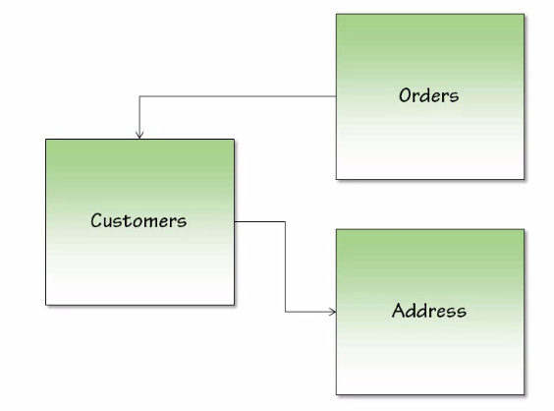
Relational Databases

Slide 7
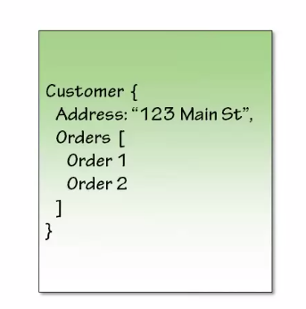
NoSQL Databases

Slide 8
Indexes?
Notes:
Valuable
The solution must deliver measurable value for site owners or interested group. It can be conversions, leads, subscriptions, etc.
Findable
Make it easy to find what your target audience is looking for, not only by optimizing search engines but focusing on internal navigation
Usable
Ease of use is extremely important; it must be intuitive and fluid. You need to create a funnel that leads your audience to your goal effectively
Desirable
Your target audience must have a strong desire to use your solution whether it’s for content, experience or emotions
Accessible
The solution must be easily accessible for your target audience – whether it’s technological requirements or people with disabilities
Credible
Your solution must be credible by all means. It has to build trust in your particular target audience by including important credibility factors

Slide 9
An example..
Notes:
Valuable
The solution must deliver measurable value for site owners or interested group. It can be conversions, leads, subscriptions, etc.
Findable
Make it easy to find what your target audience is looking for, not only by optimizing search engines but focusing on internal navigation
Usable
Ease of use is extremely important; it must be intuitive and fluid. You need to create a funnel that leads your audience to your goal effectively
Desirable
Your target audience must have a strong desire to use your solution whether it’s for content, experience or emotions
Accessible
The solution must be easily accessible for your target audience – whether it’s technological requirements or people with disabilities
Credible
Your solution must be credible by all means. It has to build trust in your particular target audience by including important credibility factors

Slide 10
Where is it being used?
Notes:
Valuable
The solution must deliver measurable value for site owners or interested group. It can be conversions, leads, subscriptions, etc.
Findable
Make it easy to find what your target audience is looking for, not only by optimizing search engines but focusing on internal navigation
Usable
Ease of use is extremely important; it must be intuitive and fluid. You need to create a funnel that leads your audience to your goal effectively
Desirable
Your target audience must have a strong desire to use your solution whether it’s for content, experience or emotions
Accessible
The solution must be easily accessible for your target audience – whether it’s technological requirements or people with disabilities
Credible
Your solution must be credible by all means. It has to build trust in your particular target audience by including important credibility factors

Slide 11
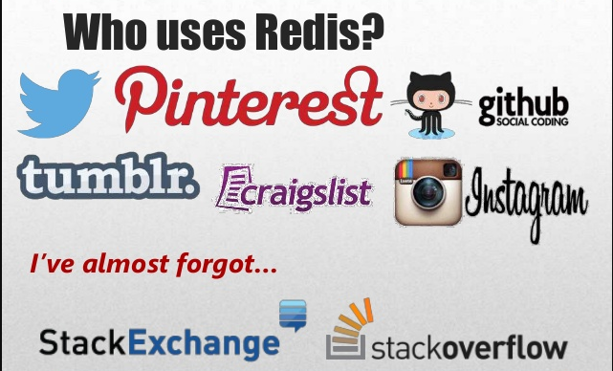

Slide 12
So, how do we try it?
Notes:
Valuable
The solution must deliver measurable value for site owners or interested group. It can be conversions, leads, subscriptions, etc.
Findable
Make it easy to find what your target audience is looking for, not only by optimizing search engines but focusing on internal navigation
Usable
Ease of use is extremely important; it must be intuitive and fluid. You need to create a funnel that leads your audience to your goal effectively
Desirable
Your target audience must have a strong desire to use your solution whether it’s for content, experience or emotions
Accessible
The solution must be easily accessible for your target audience – whether it’s technological requirements or people with disabilities
Credible
Your solution must be credible by all means. It has to build trust in your particular target audience by including important credibility factors

Slide 13
http://try.redis.io/
Notes:
Valuable
The solution must deliver measurable value for site owners or interested group. It can be conversions, leads, subscriptions, etc.
Findable
Make it easy to find what your target audience is looking for, not only by optimizing search engines but focusing on internal navigation
Usable
Ease of use is extremely important; it must be intuitive and fluid. You need to create a funnel that leads your audience to your goal effectively
Desirable
Your target audience must have a strong desire to use your solution whether it’s for content, experience or emotions
Accessible
The solution must be easily accessible for your target audience – whether it’s technological requirements or people with disabilities
Credible
Your solution must be credible by all means. It has to build trust in your particular target audience by including important credibility factors

Slide 14
Platforms available
Notes:
Valuable
The solution must deliver measurable value for site owners or interested group. It can be conversions, leads, subscriptions, etc.
Findable
Make it easy to find what your target audience is looking for, not only by optimizing search engines but focusing on internal navigation
Usable
Ease of use is extremely important; it must be intuitive and fluid. You need to create a funnel that leads your audience to your goal effectively
Desirable
Your target audience must have a strong desire to use your solution whether it’s for content, experience or emotions
Accessible
The solution must be easily accessible for your target audience – whether it’s technological requirements or people with disabilities
Credible
Your solution must be credible by all means. It has to build trust in your particular target audience by including important credibility factors

Slide 15
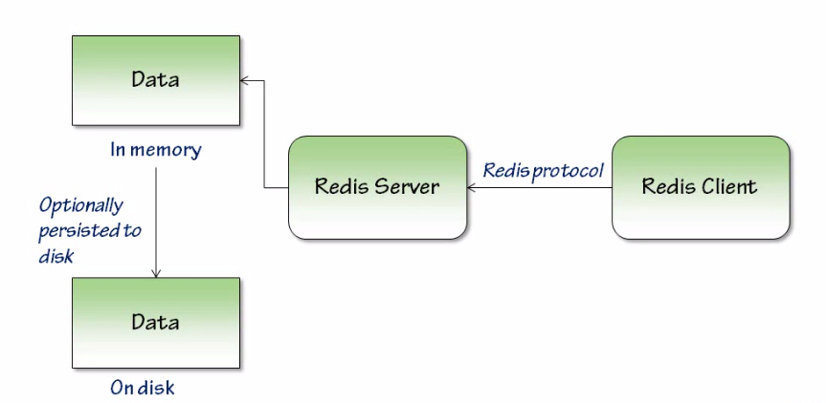
Architecture
Notes:
Valuable
The solution must deliver measurable value for site owners or interested group. It can be conversions, leads, subscriptions, etc.
Findable
Make it easy to find what your target audience is looking for, not only by optimizing search engines but focusing on internal navigation
Usable
Ease of use is extremely important; it must be intuitive and fluid. You need to create a funnel that leads your audience to your goal effectively
Desirable
Your target audience must have a strong desire to use your solution whether it’s for content, experience or emotions
Accessible
The solution must be easily accessible for your target audience – whether it’s technological requirements or people with disabilities
Credible
Your solution must be credible by all means. It has to build trust in your particular target audience by including important credibility factors

Slide 16
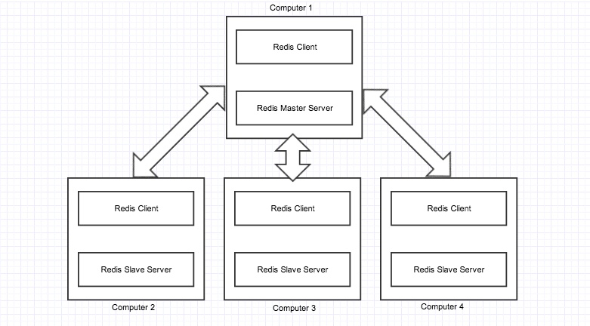
Architecture
Notes:
Valuable
The solution must deliver measurable value for site owners or interested group. It can be conversions, leads, subscriptions, etc.
Findable
Make it easy to find what your target audience is looking for, not only by optimizing search engines but focusing on internal navigation
Usable
Ease of use is extremely important; it must be intuitive and fluid. You need to create a funnel that leads your audience to your goal effectively
Desirable
Your target audience must have a strong desire to use your solution whether it’s for content, experience or emotions
Accessible
The solution must be easily accessible for your target audience – whether it’s technological requirements or people with disabilities
Credible
Your solution must be credible by all means. It has to build trust in your particular target audience by including important credibility factors

Slide 17
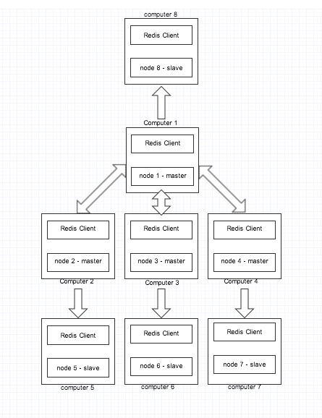
Architecture – With Clustering & Replication
Notes:
Valuable
The solution must deliver measurable value for site owners or interested group. It can be conversions, leads, subscriptions, etc.
Findable
Make it easy to find what your target audience is looking for, not only by optimizing search engines but focusing on internal navigation
Usable
Ease of use is extremely important; it must be intuitive and fluid. You need to create a funnel that leads your audience to your goal effectively
Desirable
Your target audience must have a strong desire to use your solution whether it’s for content, experience or emotions
Accessible
The solution must be easily accessible for your target audience – whether it’s technological requirements or people with disabilities
Credible
Your solution must be credible by all means. It has to build trust in your particular target audience by including important credibility factors

Slide 18
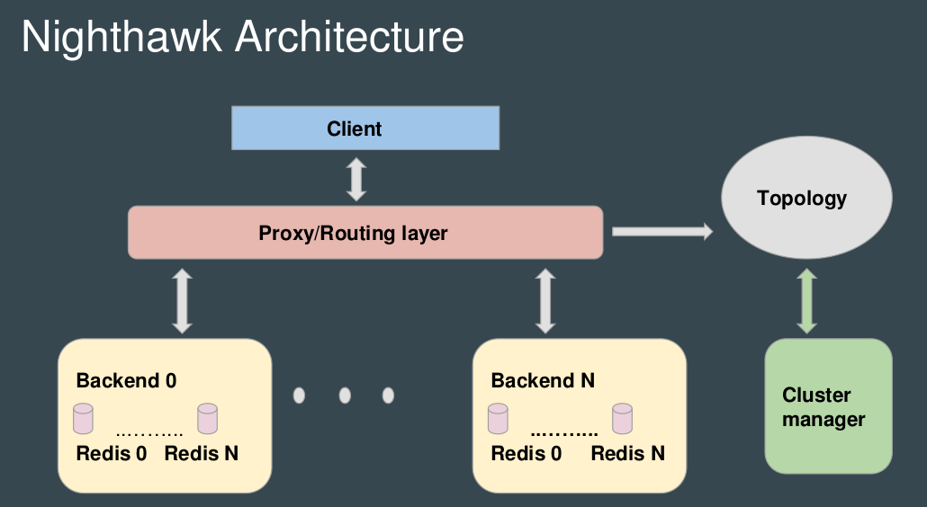

Slide 19
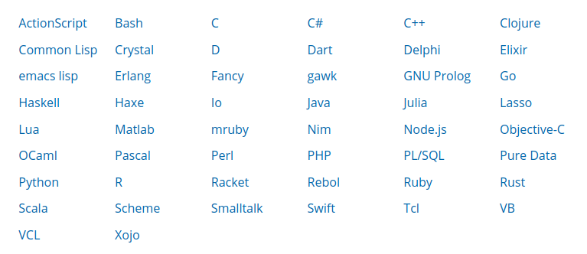
REDIS CLIENTS
RESP (REdis Serialization Protocol): https://redis.io/topics/protocol
Notes:
Valuable
The solution must deliver measurable value for site owners or interested group. It can be conversions, leads, subscriptions, etc.
Findable
Make it easy to find what your target audience is looking for, not only by optimizing search engines but focusing on internal navigation
Usable
Ease of use is extremely important; it must be intuitive and fluid. You need to create a funnel that leads your audience to your goal effectively
Desirable
Your target audience must have a strong desire to use your solution whether it’s for content, experience or emotions
Accessible
The solution must be easily accessible for your target audience – whether it’s technological requirements or people with disabilities
Credible
Your solution must be credible by all means. It has to build trust in your particular target audience by including important credibility factors

Slide 20
Data Types
Strings, Lists, Sets, Hashes, Sorted Sets
Notes:
Valuable
The solution must deliver measurable value for site owners or interested group. It can be conversions, leads, subscriptions, etc.
Findable
Make it easy to find what your target audience is looking for, not only by optimizing search engines but focusing on internal navigation
Usable
Ease of use is extremely important; it must be intuitive and fluid. You need to create a funnel that leads your audience to your goal effectively
Desirable
Your target audience must have a strong desire to use your solution whether it’s for content, experience or emotions
Accessible
The solution must be easily accessible for your target audience – whether it’s technological requirements or people with disabilities
Credible
Your solution must be credible by all means. It has to build trust in your particular target audience by including important credibility factors

Slide 21
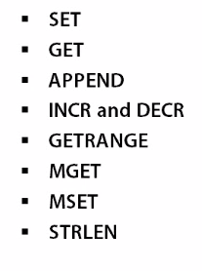
STRINGS
Notes:
Valuable
The solution must deliver measurable value for site owners or interested group. It can be conversions, leads, subscriptions, etc.
Findable
Make it easy to find what your target audience is looking for, not only by optimizing search engines but focusing on internal navigation
Usable
Ease of use is extremely important; it must be intuitive and fluid. You need to create a funnel that leads your audience to your goal effectively
Desirable
Your target audience must have a strong desire to use your solution whether it’s for content, experience or emotions
Accessible
The solution must be easily accessible for your target audience – whether it’s technological requirements or people with disabilities
Credible
Your solution must be credible by all means. It has to build trust in your particular target audience by including important credibility factors

Slide 22
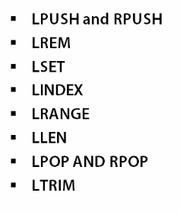
LISTS
Notes:
Valuable
The solution must deliver measurable value for site owners or interested group. It can be conversions, leads, subscriptions, etc.
Findable
Make it easy to find what your target audience is looking for, not only by optimizing search engines but focusing on internal navigation
Usable
Ease of use is extremely important; it must be intuitive and fluid. You need to create a funnel that leads your audience to your goal effectively
Desirable
Your target audience must have a strong desire to use your solution whether it’s for content, experience or emotions
Accessible
The solution must be easily accessible for your target audience – whether it’s technological requirements or people with disabilities
Credible
Your solution must be credible by all means. It has to build trust in your particular target audience by including important credibility factors

Slide 23
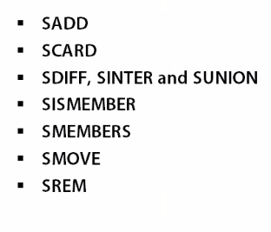
SETS
Notes:
Valuable
The solution must deliver measurable value for site owners or interested group. It can be conversions, leads, subscriptions, etc.
Findable
Make it easy to find what your target audience is looking for, not only by optimizing search engines but focusing on internal navigation
Usable
Ease of use is extremely important; it must be intuitive and fluid. You need to create a funnel that leads your audience to your goal effectively
Desirable
Your target audience must have a strong desire to use your solution whether it’s for content, experience or emotions
Accessible
The solution must be easily accessible for your target audience – whether it’s technological requirements or people with disabilities
Credible
Your solution must be credible by all means. It has to build trust in your particular target audience by including important credibility factors

Slide 24
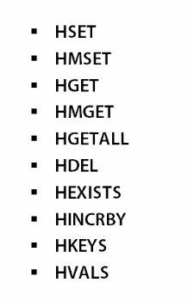
HASHES
Notes:
Valuable
The solution must deliver measurable value for site owners or interested group. It can be conversions, leads, subscriptions, etc.
Findable
Make it easy to find what your target audience is looking for, not only by optimizing search engines but focusing on internal navigation
Usable
Ease of use is extremely important; it must be intuitive and fluid. You need to create a funnel that leads your audience to your goal effectively
Desirable
Your target audience must have a strong desire to use your solution whether it’s for content, experience or emotions
Accessible
The solution must be easily accessible for your target audience – whether it’s technological requirements or people with disabilities
Credible
Your solution must be credible by all means. It has to build trust in your particular target audience by including important credibility factors

Slide 25
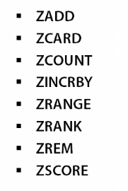
SORTED SETS
Notes:
Valuable
The solution must deliver measurable value for site owners or interested group. It can be conversions, leads, subscriptions, etc.
Findable
Make it easy to find what your target audience is looking for, not only by optimizing search engines but focusing on internal navigation
Usable
Ease of use is extremely important; it must be intuitive and fluid. You need to create a funnel that leads your audience to your goal effectively
Desirable
Your target audience must have a strong desire to use your solution whether it’s for content, experience or emotions
Accessible
The solution must be easily accessible for your target audience – whether it’s technological requirements or people with disabilities
Credible
Your solution must be credible by all means. It has to build trust in your particular target audience by including important credibility factors

Slide 26
TYPE keyname
Notes:
Valuable
The solution must deliver measurable value for site owners or interested group. It can be conversions, leads, subscriptions, etc.
Findable
Make it easy to find what your target audience is looking for, not only by optimizing search engines but focusing on internal navigation
Usable
Ease of use is extremely important; it must be intuitive and fluid. You need to create a funnel that leads your audience to your goal effectively
Desirable
Your target audience must have a strong desire to use your solution whether it’s for content, experience or emotions
Accessible
The solution must be easily accessible for your target audience – whether it’s technological requirements or people with disabilities
Credible
Your solution must be credible by all means. It has to build trust in your particular target audience by including important credibility factors

Slide 27
PUB-SUB IN REDIS
Notes:
Valuable
The solution must deliver measurable value for site owners or interested group. It can be conversions, leads, subscriptions, etc.
Findable
Make it easy to find what your target audience is looking for, not only by optimizing search engines but focusing on internal navigation
Usable
Ease of use is extremely important; it must be intuitive and fluid. You need to create a funnel that leads your audience to your goal effectively
Desirable
Your target audience must have a strong desire to use your solution whether it’s for content, experience or emotions
Accessible
The solution must be easily accessible for your target audience – whether it’s technological requirements or people with disabilities
Credible
Your solution must be credible by all means. It has to build trust in your particular target audience by including important credibility factors

Slide 28
TRANSACTIONS
Notes:
Valuable
The solution must deliver measurable value for site owners or interested group. It can be conversions, leads, subscriptions, etc.
Findable
Make it easy to find what your target audience is looking for, not only by optimizing search engines but focusing on internal navigation
Usable
Ease of use is extremely important; it must be intuitive and fluid. You need to create a funnel that leads your audience to your goal effectively
Desirable
Your target audience must have a strong desire to use your solution whether it’s for content, experience or emotions
Accessible
The solution must be easily accessible for your target audience – whether it’s technological requirements or people with disabilities
Credible
Your solution must be credible by all means. It has to build trust in your particular target audience by including important credibility factors

Slide 29
CONFIGURATION
Notes:
Valuable
The solution must deliver measurable value for site owners or interested group. It can be conversions, leads, subscriptions, etc.
Findable
Make it easy to find what your target audience is looking for, not only by optimizing search engines but focusing on internal navigation
Usable
Ease of use is extremely important; it must be intuitive and fluid. You need to create a funnel that leads your audience to your goal effectively
Desirable
Your target audience must have a strong desire to use your solution whether it’s for content, experience or emotions
Accessible
The solution must be easily accessible for your target audience – whether it’s technological requirements or people with disabilities
Credible
Your solution must be credible by all means. It has to build trust in your particular target audience by including important credibility factors

Slide 30
SECURITY
Notes:
Valuable
The solution must deliver measurable value for site owners or interested group. It can be conversions, leads, subscriptions, etc.
Findable
Make it easy to find what your target audience is looking for, not only by optimizing search engines but focusing on internal navigation
Usable
Ease of use is extremely important; it must be intuitive and fluid. You need to create a funnel that leads your audience to your goal effectively
Desirable
Your target audience must have a strong desire to use your solution whether it’s for content, experience or emotions
Accessible
The solution must be easily accessible for your target audience – whether it’s technological requirements or people with disabilities
Credible
Your solution must be credible by all means. It has to build trust in your particular target audience by including important credibility factors

Slide 31
COMMAND OBFUSCATION
Notes:
Valuable
The solution must deliver measurable value for site owners or interested group. It can be conversions, leads, subscriptions, etc.
Findable
Make it easy to find what your target audience is looking for, not only by optimizing search engines but focusing on internal navigation
Usable
Ease of use is extremely important; it must be intuitive and fluid. You need to create a funnel that leads your audience to your goal effectively
Desirable
Your target audience must have a strong desire to use your solution whether it’s for content, experience or emotions
Accessible
The solution must be easily accessible for your target audience – whether it’s technological requirements or people with disabilities
Credible
Your solution must be credible by all means. It has to build trust in your particular target audience by including important credibility factors

Slide 32
CLUSTERING
https://redis.io/topics/cluster-tutorial
Notes:
Valuable
The solution must deliver measurable value for site owners or interested group. It can be conversions, leads, subscriptions, etc.
Findable
Make it easy to find what your target audience is looking for, not only by optimizing search engines but focusing on internal navigation
Usable
Ease of use is extremely important; it must be intuitive and fluid. You need to create a funnel that leads your audience to your goal effectively
Desirable
Your target audience must have a strong desire to use your solution whether it’s for content, experience or emotions
Accessible
The solution must be easily accessible for your target audience – whether it’s technological requirements or people with disabilities
Credible
Your solution must be credible by all means. It has to build trust in your particular target audience by including important credibility factors

Slide 33
ANYTHING ELSE?
Notes:
Valuable
The solution must deliver measurable value for site owners or interested group. It can be conversions, leads, subscriptions, etc.
Findable
Make it easy to find what your target audience is looking for, not only by optimizing search engines but focusing on internal navigation
Usable
Ease of use is extremely important; it must be intuitive and fluid. You need to create a funnel that leads your audience to your goal effectively
Desirable
Your target audience must have a strong desire to use your solution whether it’s for content, experience or emotions
Accessible
The solution must be easily accessible for your target audience – whether it’s technological requirements or people with disabilities
Credible
Your solution must be credible by all means. It has to build trust in your particular target audience by including important credibility factors

Slide 34
Questions?

Slide 35
THANK YOU
https://thenuthouse.github.io
Inviting Speakers for our next and future sessions...

