Slide 1
Using NLP for Lyrics Generation
Hazem Reda 49-0785
Omar Ashraf 49-5964

Slide 2
Text Generation
What is Text generation
Our objective
It is a fascinating field within natural language processing (NLP) that involves creating coherent and contextually appropriate text based on given input. This technology has significant applications in areas such as chatbots, content creation, and creative writing.
The primary objective of this project is to develop a model capable of generating song lyrics, leveraging an LSTM-based architecture to capture the sequential nature of the text.

Slide 3
Milestone 2

Slide 4
Data Preprocessing
Converting to lowercase
Tokenization
Lemmatization
Removing stop words and punctuation

Slide 5
Model Architecture
The model architecture employed in this project is an LSTM-based network, which includes an embedding layer, two LSTM layers, and a dense output layer with softmax activation.
Embedding Layer: This layer converts words into continuous vector representations, facilitating the model's ability to capture semantic meanings.
LSTM Layers: Two stacked LSTM layers are used to capture the sequential dependencies in the lyrics.
Dense Layer: The final dense layer with softmax activation is responsible for predicting the next word in the sequence.

Slide 6
The Training Process
Data Split: The dataset is divided into training and validation sets using an 80-20 split.
Batch Size and Epochs: Training is performed with a batch size of 128 over 20 epochs.
Loss Function and Optimizer: The model is compiled using categorical cross-entropy as the loss function and the Adam optimizer.
Sequence Generation: Sequences are generated for input-output pairs to train the model effectively, employing a custom data generator to handle large datasets efficiently.

Slide 7
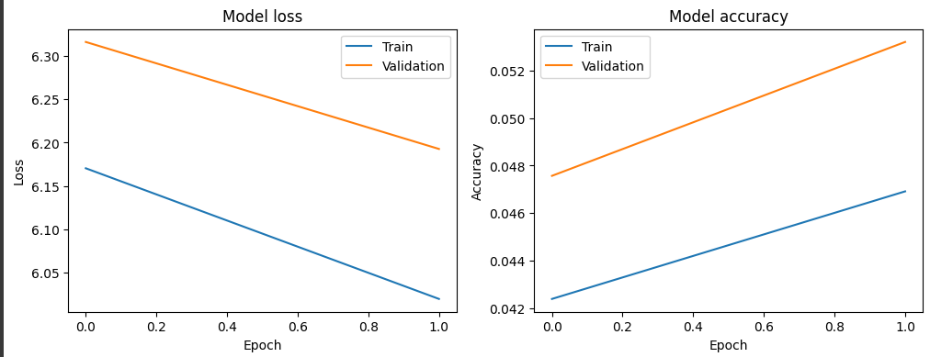
Evaluation and Results
Validation Metrics: The model's performance is evaluated on the validation set, resulting in the following metrics:
Validation Loss: 6.353457927703857
Validation Accuracy: 0.04410751163959503

Slide 8
Findings and Challenges faced
Performance and Findings:
The model demonstrates a reasonable ability to generate lyrics, though there is room for improvement generating actual words but ones that are repeated and not contextually fitting.
Challenges Encountered:
Memory Issues: Addressing memory limitations during training by optimizing data handling and batch processing.
Data Preprocessing: Challenges in tokenizing and structuring the diverse dataset effectively.

Slide 9
Milestone 3

Slide 10
Data Preprocessing
Converting to lowercase
Tokenization
Lemmatization
Removing stop words and punctuation

Slide 11
Model Architecture
The model architecture employed in this project is an LSTM-based network, which includes an embedding layer, two LSTM layers, and a dense output layer with softmax activation.
Embedding Layer: This layer converts words into continuous vector representations, facilitating the model's ability to capture semantic meanings.
LSTM Layers: Two stacked LSTM layers are used to capture the sequential dependencies in the lyrics.
Dense Layer: Two stacked dense layers with softmax activation and relu are responsible for predicting the next word in the sequence.

Slide 12
The Training Process
Data Split: The dataset is divided into training and validation sets using an 80-20 split.
Batch Size and Epochs: Training is performed with a batch size of 32 over 15 epochs.
Loss Function and Optimizer: The model is compiled using categorical cross-entropy as the loss function and the Adam optimizer.
Sequence Generation: Sequences are generated for input-output pairs to train the model effectively, employing a custom data generator to handle large datasets efficiently.

Slide 13
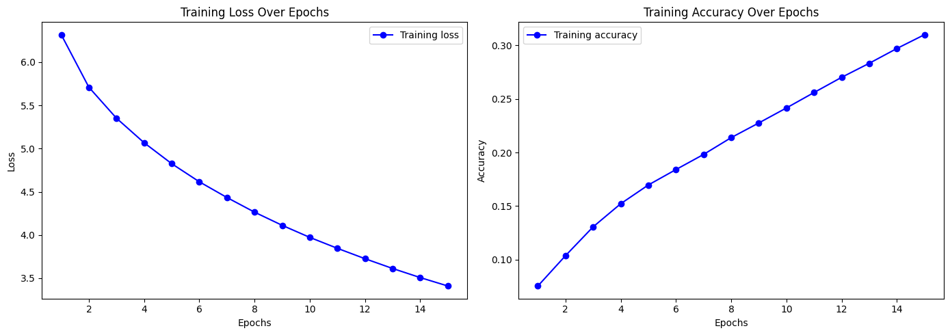
Evaluation and Results
Training Metrics: The model's performance is evaluated on the Training set, resulting in the following metrics:
Training Loss: 6.3181
Training Accuracy: 0.0754

Slide 14
Findings and Challenges faced
Performance and Findings:
The model demonstrated successful learning from the training data, as indicated by the declining loss values and increasing accuracy throughout the training process.
Challenges Encountered:
Overfitting: Without validation data, it’s challenging to assess over fitting.
Data Preprocessing: Effectively tokenizing and structuring the diverse dataset to suit the model training requirements.

