Slide 1

Pulse Width Modulation (PWM)

Slide 2
PWM: What is it and how does it work?
Digital signals have two positions
on or off, interpreted in shorthand as 1 or 0
Analog signals can be
on, off, half-way, two-thirds the way to on, and an infinite number of positions between 0 and 1
To take an analog input signal (e.g., temperature) into a microcontroller
by using an analog-to-digital converter
But what about outputs?

Slide 3
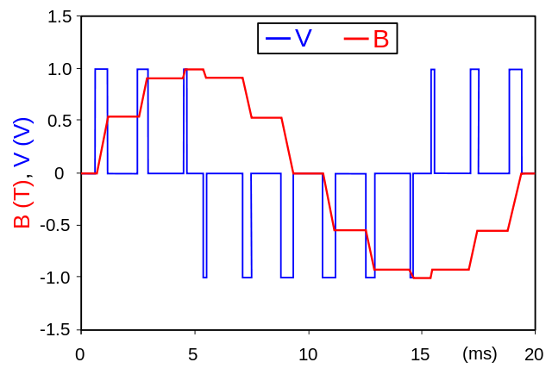
PWM: What is it and how does it work?
PWM is not true analog output
PWM “fakes” an analog-like result by applying power in pulses, or short bursts of regulated voltage
Is a fancy term for describing a type of digital signal

Slide 4
Applications
PWM is a way to control analog devices with a digital output
variable-speed motors (like servo motors)
dimmable lights (LEDs)
Actuators
speakers (Drive buzzer with different loudness)
…

Slide 5
ADC(Analog to Digital Converter)

Slide 6

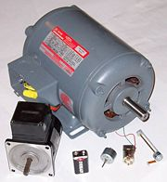
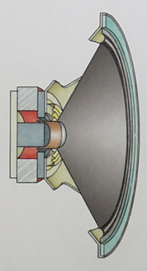
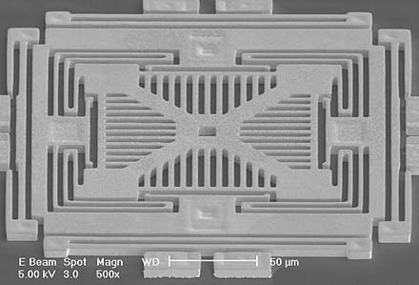
We live in an analog world
Everything in the physical world is an analog signal
Sound, light, temperature, pressure
Need to convert into electrical signals
Transducers: converts one type of energy to another
Electro-mechanical, Photonic, Electrical, …
Examples
Microphone/speaker
Thermocouples
Accelerometers

Slide 7
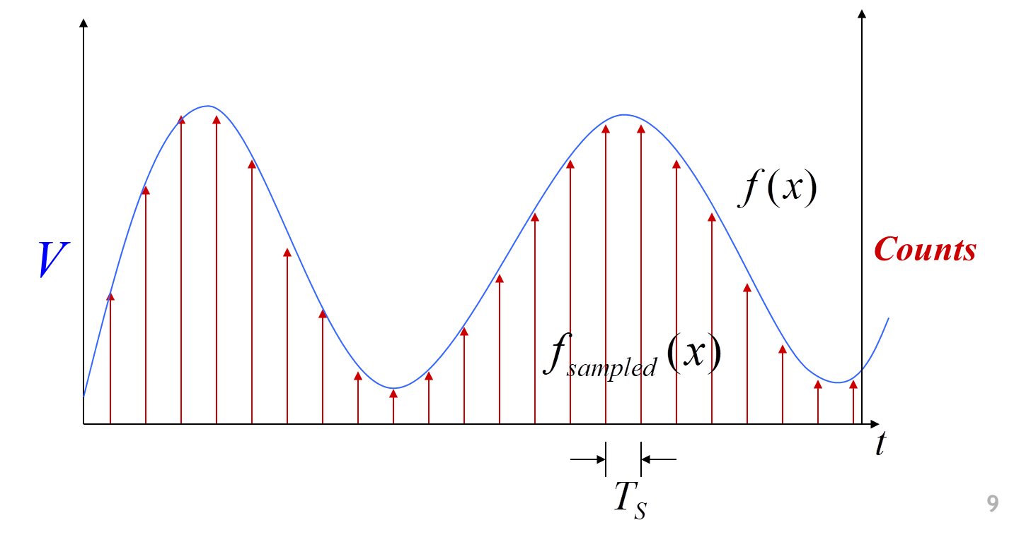
Representing an analog signal digitally
How do we represent an analog signal?
As a time series of discrete values
On MCU: read the ADC data register periodically

Slide 8
Applications
Read data from different sensors like:
Photocells(LDR)
Ultrasonic
IR
Temperature
RFID reader
Potentiometer
…

