Slide 1
امیرحسین خوش بین 9631024
سوال 2 تئوری

Slide 2
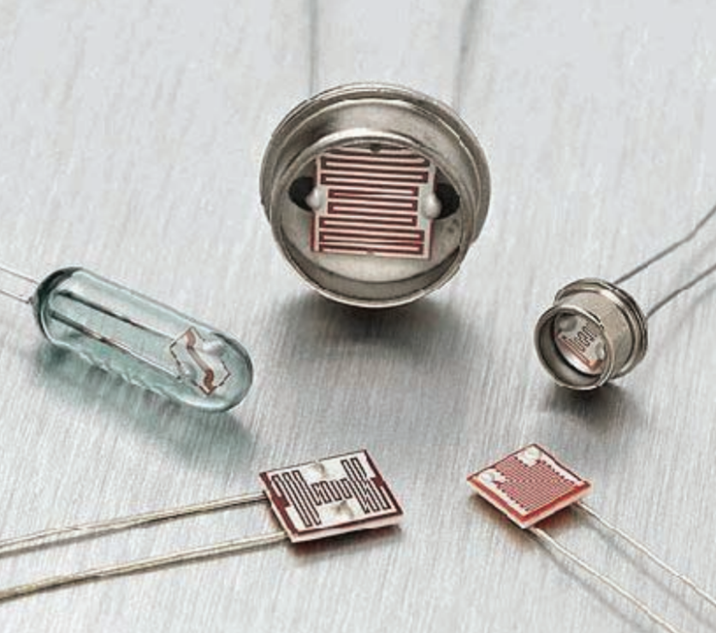
LDR (Light Dependant Resistor)
A light dependant resistor also know as a LDR, photoresistor, photoconductor or photocell, is a resistor whose resistance increases or decreases depending on the amount of light intensity. LDRs (Light Dependant Resistors) are a very useful tool in a light/dark circuits

Slide 3
Applications
turn on a light when the LDR is in darkness or to turn o a light when the LDR is in light.
Streetlights
fire alarms
Smoke alarms
. Alarm clock
. Photographic light meters,

Slide 4
How it Works
How it Works The way an LDR works is that they are made of many semi-conductive materials with high resistance. The reason they have a high resistance is that are very few electrons that are free and able to move because they are held in a crystal lattice and are unable to move. When light falls on the semi conductive material it absorbs the light photons and the energy is transferred to the electrons, which allow them to break free from the crystal lattice and conduct electricity and lower the resistance of the LDR.

