Slide 1

Node MCU low power modes

Slide 2
Modes
Modem Sleep
Light Sleep
Deep Sleep
Power Off

Slide 3
Power Consumption
Parameter | Power consumption
Modem-Sleep | 15 mA
Light-Sleep | 0.9 mA
Deep-Sleep | 10 µA
Power Off | 0.5 µA

Slide 4
Modem-Sleep
Modem-Sleep requires the CPU to be working, as in PWM or I2S applications. According to 802.11 standards (like U-APSD), it saves power to shut down the WiFi Modem circuit while maintaining a WiFi connection with no data transmission.
example: 300ms – 3ms
Power: 15mA

Slide 5
Light-Sleep
During Light-Sleep, the CPU may be suspended in applications like WiFi switch. Without data transmission, the WiFi Modem circuit can be turned off and CPU suspended to save power according to the 802.11 standard (U-APSD).
example: 300ms-3ms
Power: 0.9mA

Slide 6
Deep-Sleep
Deep-Sleep does not require WiFi connection to be maintained. For application with long time lags between data transmission, e.g. a temperature sensor that checks the temperature every 100s, sleep 300s and waking up to connect to the AP (taking about 0.3~1s), the overall average current is less than 1mA.

Slide 7
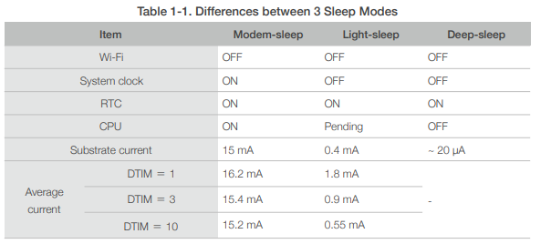
Comparison

Slide 8
THE END

