Slide 1
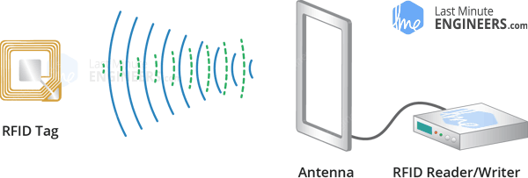
RFID (Radio Frequency Identification)
Two main component:
interrogator/Reader
Radio frequency module
antenna
transponder/tag attached to an object
Microchip to store and process information
antenna

Slide 2
Applications
Attendee Tracking (e.g entering somewhere)
Access Control (e.g Gates in metro)
Asset Tracking (e.g Shops)
Library Systems(Document Tracking)
Tool Tracking
Healthcare
....

Slide 3
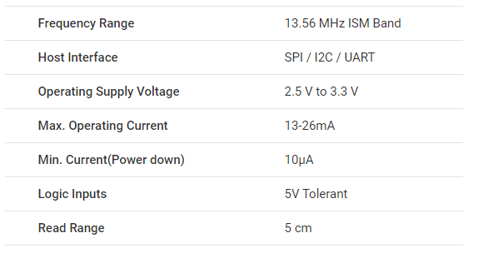
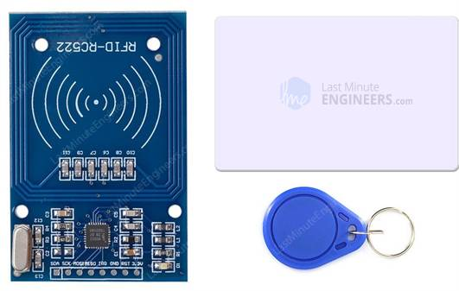
RC522 RFID Reader/writer

Slide 4
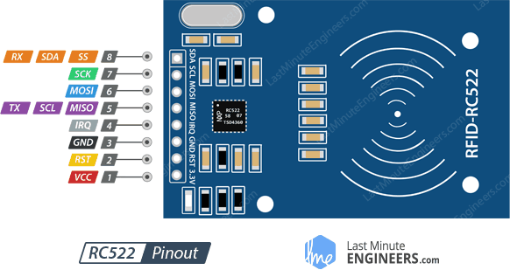
Pinout
IRQ is an interrupt pin that can alert the microcontroller when RFID tag comes into its vicinity.
MISO / SCL / Tx pin acts as Master-In-Slave-Out when SPI interface is enabled, acts as serial clock when I2C interface is enabled and acts as serial data output when UART interface is enabled.
MOSI (Master Out Slave In) is SPI input to the RC522 module.
SCK (Serial Clock) accepts clock pulses provided by the SPI bus Master i.e. Arduino.
SS / SDA / Rx pin acts as Signal input when SPI interface is enabled, acts as serial data when I2C interface is enabled and acts as serial data input when UART interface is enabled. This pin is usually marked by encasing the pin in a square so it can be used as a reference for identifying the other pins.

