Slide 1
Candidate Task for AI Innovation Role - “Headroom Analysis”
Marian Bartos
Basel, August 2025

Slide 2
Purpose of this document
Objective:
Design a pretotype using Vibe coding to demonstrate a solution that can help streamline headroom calculations and market analysis for various brands. The solution should consolidate data from internal and external sources and provide insights to support growth strategy development.
Deliverables:
A working Vibe code mock-up, GitHub repo here:
A brief technical explanation of the design and how it solves the business challenge in this presentation.

Slide 3



Context: Reduce manual effort & accelerate insight generation
Challenges & opportunity
Expected business outcome
Challenges
Very time-consuming to understand market drivers
Performance information fragmented across finance, markets, analysts, partners
Heavy reliance on manual consolidation and validation
Current approach not scalable across the organization
User pain points:
“Data validation needed from Oracle, financial team, partners, open sources”
“Consolidating performance information from finance team, inputs from markets, analysts”
Opportunities
Leverage automation and AI to streamline analysis
Consolidate data from internal and external sources
Establish a consistent, repeatable starting point for evaluations
Enable faster identification of growth opportunities per market/brand
Support strategy definition with transparent, data-driven insights
Significant time savings on data gathering & analysis
Faster adaptation to changing market conditions
Unified, consistent approach across markets and brands

Slide 4
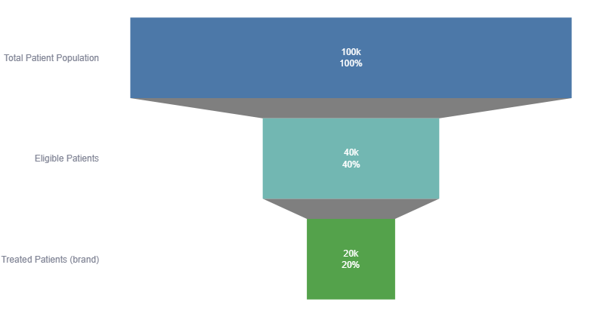
Population To Sales funnel forms the basis of headroom analysis for any brand
MVP
Total Patient Population — epidemiology base (incidence/prevalence). Anchored in annual registry data (e.g., Robert Koch Institute, internal brand forecasts, etc…). Structural refresh only when new epidemiology is published.
Eligible Patients — meet label/guideline criteria for the brand
Accessible Patients — within payer coverage/reimbursement constraints. E.g. in Germany, payer access is national, but practical accessibility may depend on prescriber uptake and hospital formularies; in MVP this is proxied by Access_Score.
Treated Patients — actually on the selected brand’s therapy in the period (proxied by that brand’s units sold)
Sales (Units × Price) — commercial output from treated units at net price
Headroom = Potential – Actual — compare potential treated (b × Adoption Ceiling) vs actual treated (d); size of prize in units and €, valuing with price per unit from (e)

Slide 5
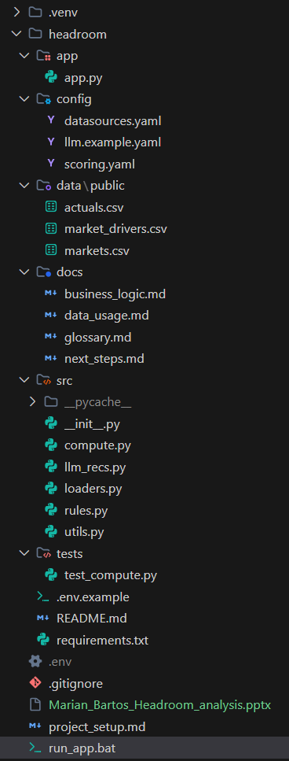
MVP model design (rapid prototype)
MVP
MVP model design (fast, simple, national)
Scope: National-level (e.g. Germany, Oncology) per brand/quarter
Data: Simple CSV inputs; annual epidemiology interpolated into quarters; quarterly sales + access drivers.
Funnel: Potential vs Actual (Total → Eligible → Accessible → Treated → Sales).
Access: Proxy via Access_Score, blended into ROI ranking. (to be expanded e.g. sales execution)
Prioritization: Headroom (size of prize) × ROI score (ease of capture).
Output: Funnel visualization, ROI ranking, Recommended Action (Accelerate/Nurture/Monitor).
Value: Cuts manual consolidation from weeks → minutes, enforces consistent method across brands/markets.
Schema
Dashboard (streamlit lib)
python
csv

Slide 6
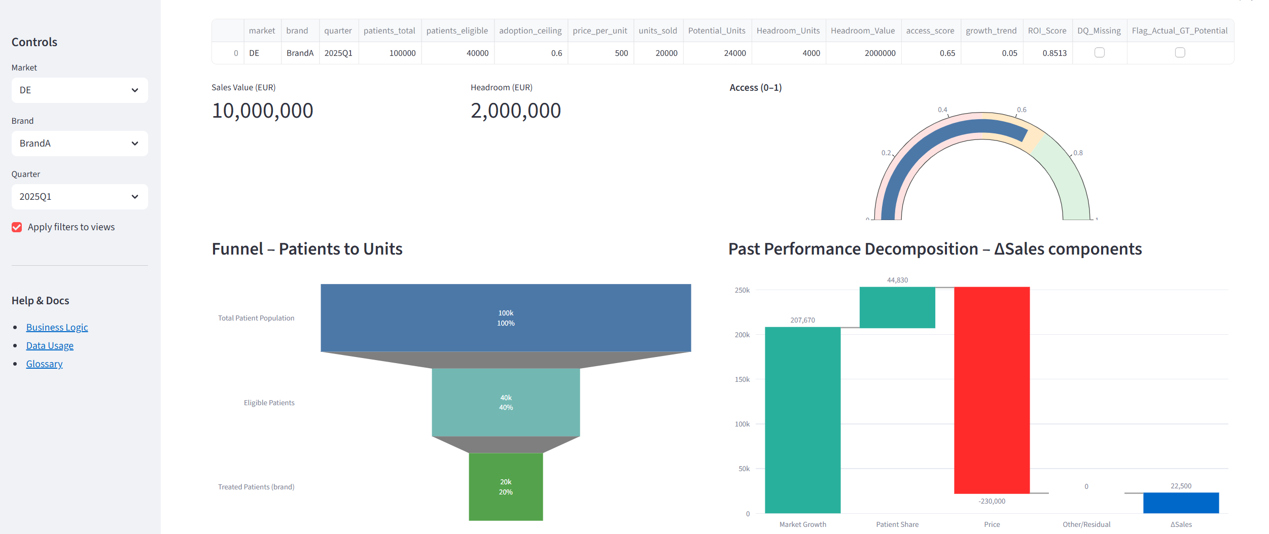
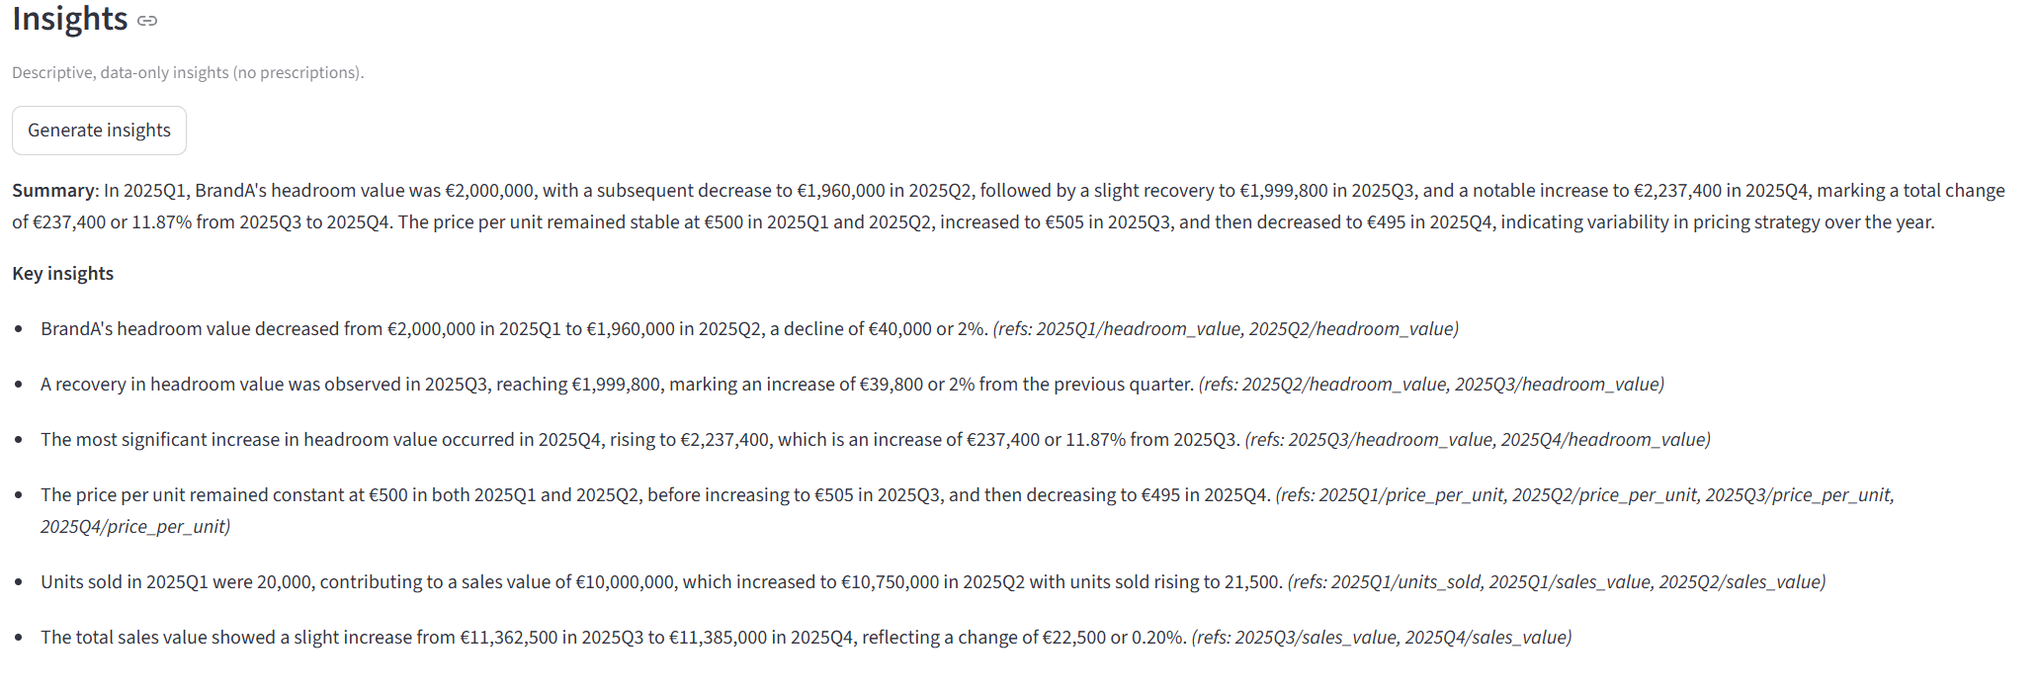
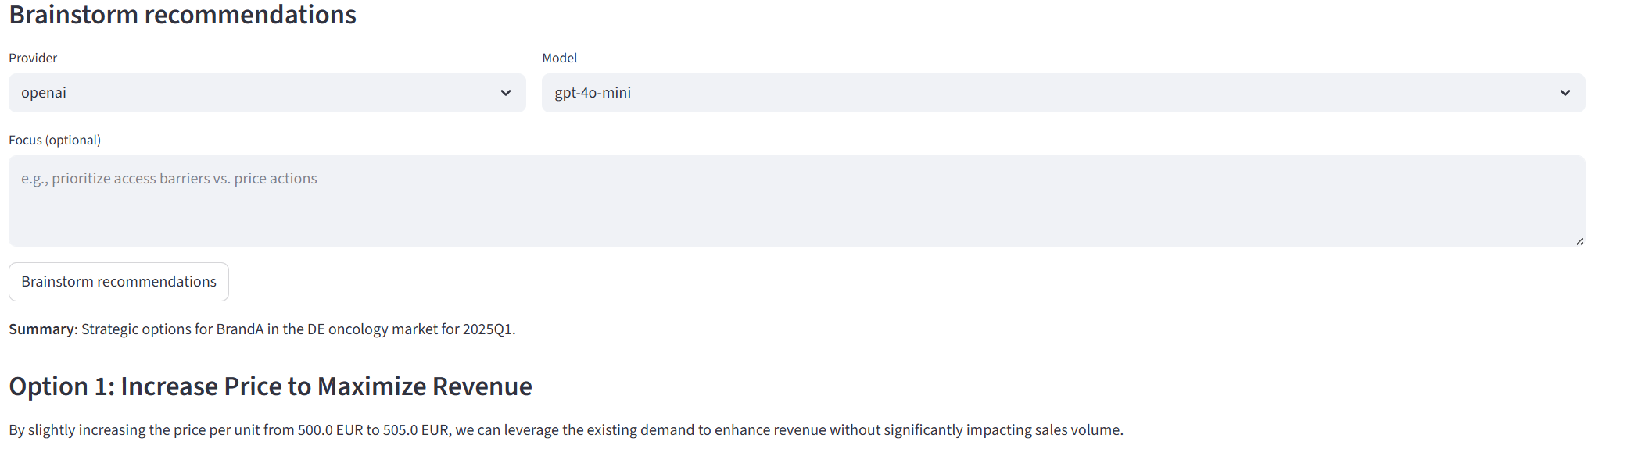
MVP
Dive deeper into execution (coverage, SoV, resources, call planning/call execution, channels…)
Understand the performance drivers
Understand the patient potential headroom
Use AI to generate insights
Use AI to ideate and build option space
Source: Streamlit library

Slide 7
Future Enhancements (granular, predictive, strategic +agentic)
Granularity: Sub-national insights (region, territory, HCP specialty).
Segmentation: Add line-of-therapy (L1/2/3) for treatment patterns; eventually behavioral segmentation.
Targeting: Introduce propensity-to-switch signals + coverage/concentration curve analysis.
Funnel: Explicit calculation of Accessible Patients (not just Access_Score proxy).
Data Infrastructure: Direct pipeline to e.g. Oracle/Snowflake, Data Lakes.
Strategic use: Field force sizing, GTM redesign, lifecycle management.
Vision: Move from descriptive headroom sizing → actionable targeting & investment optimization.
+Agentic: Autonomous agents monitor data refresh, detect anomalies, simulate scenarios, and recommend next-best actions — reducing manual intervention.

Slide 8
Thank you
marian.bartos@gmail.com
+41 76 525 55 18

