Slide 1
Two light traffic intersection
Kayden Stiehl

Slide 2
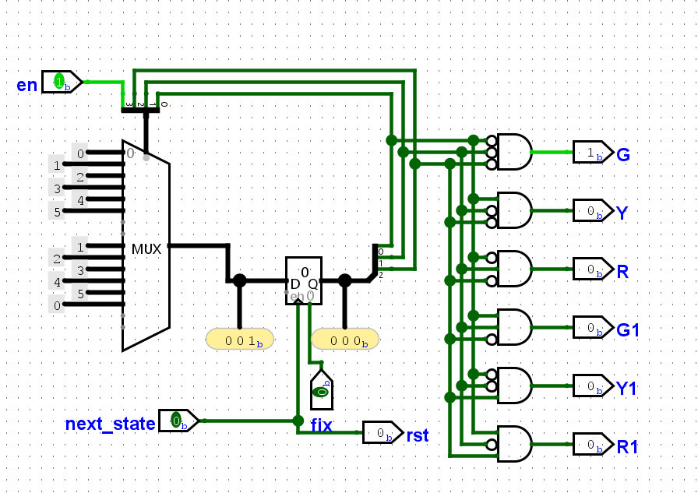
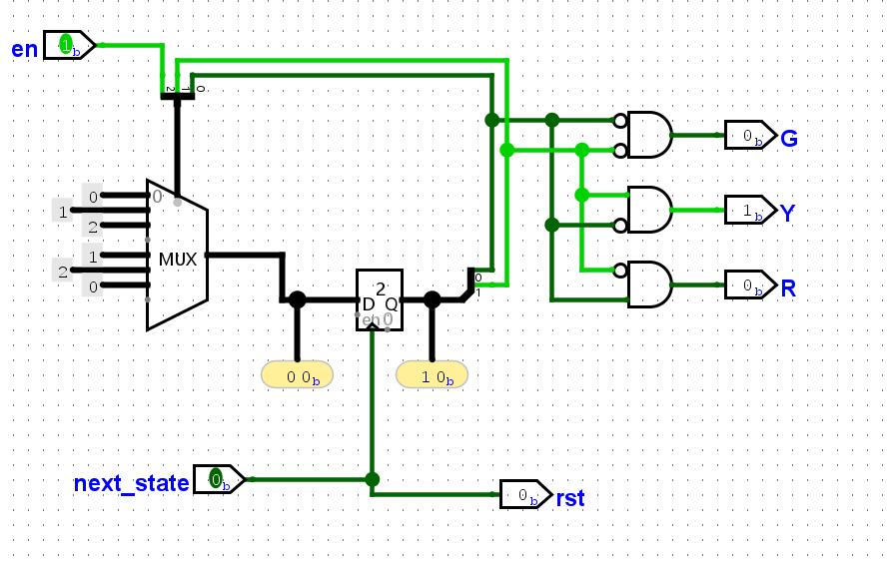
I Fixed the FSM from Lab 07 to have 5 outputs

Slide 3
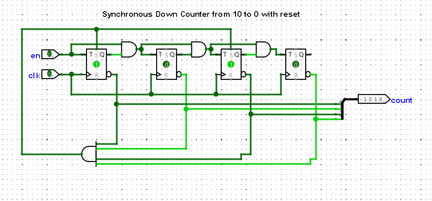
I created a down counter from 10-0 to prepare to
implement a pedestrian crossing button

Slide 4
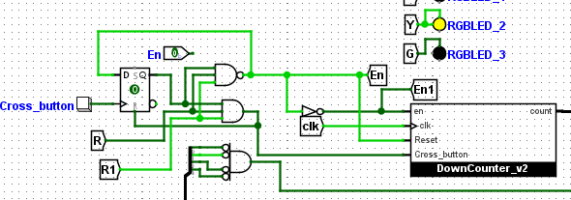
I was trying to figure out how to get the
timer to reset but I was unable to figure it out
I was able to get the traffic lights to switch, and this holds the value for the button
press but it doesn’t count all the way down from 10. It only flashes the number 10
and then continues to switch the lights

