Slide 1
Lab 07
Kayden Stiehl

Slide 2
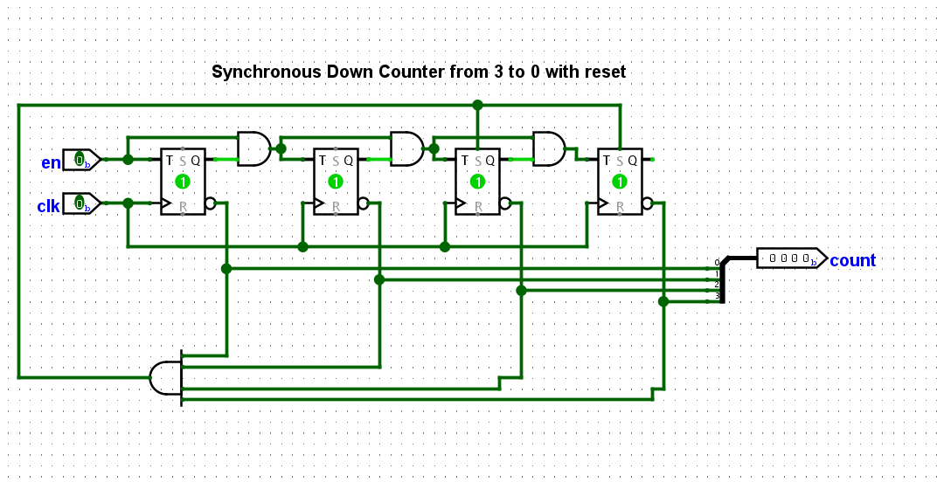
Countdown fixed from 3-0 instead of 10-0

Slide 3
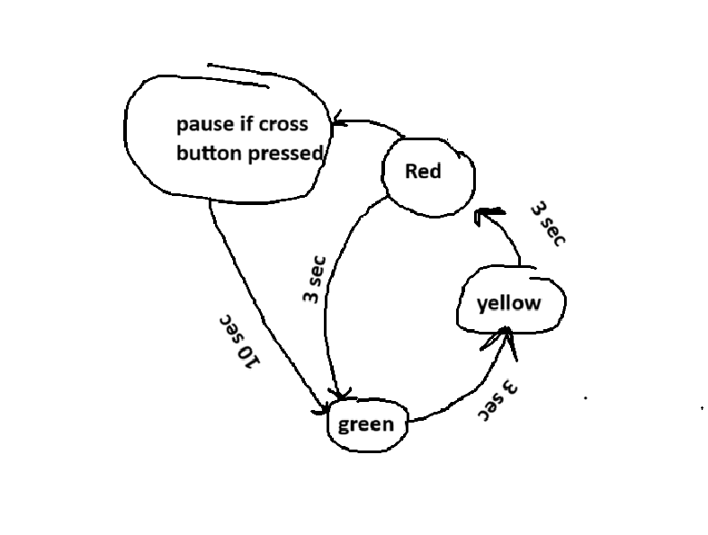
Initial FSM for traffic light

Slide 4
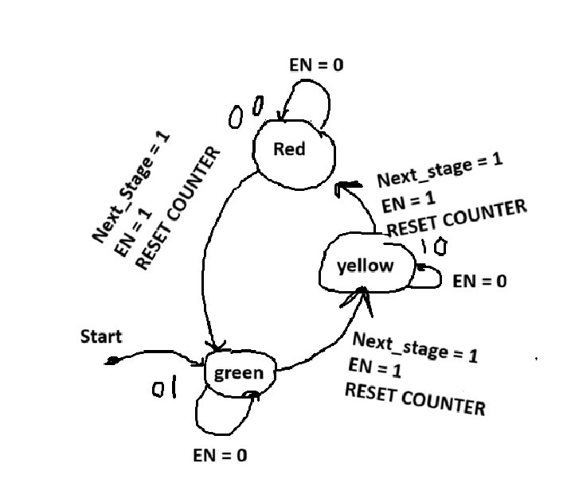
Final FSM for traffic light
Starts on red and after an enable and next_stage input it moves to the next output(color) then continues using the same logic and cycles through these three outputs.

Slide 5
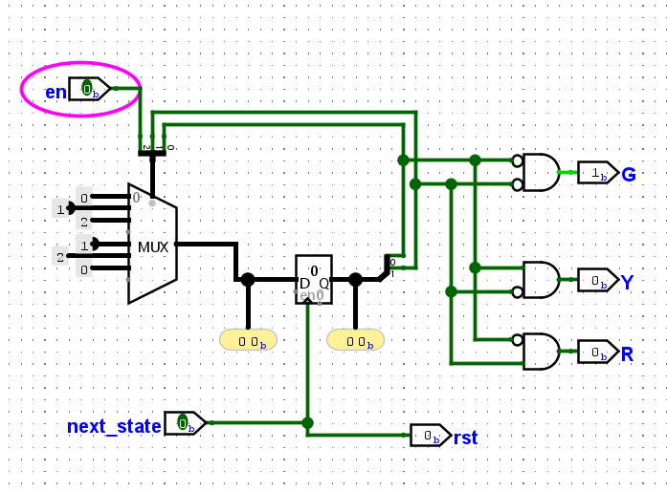
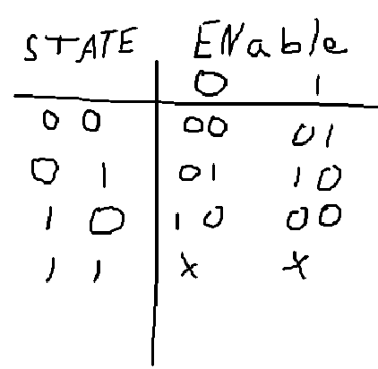
FSM + truth table

Slide 6
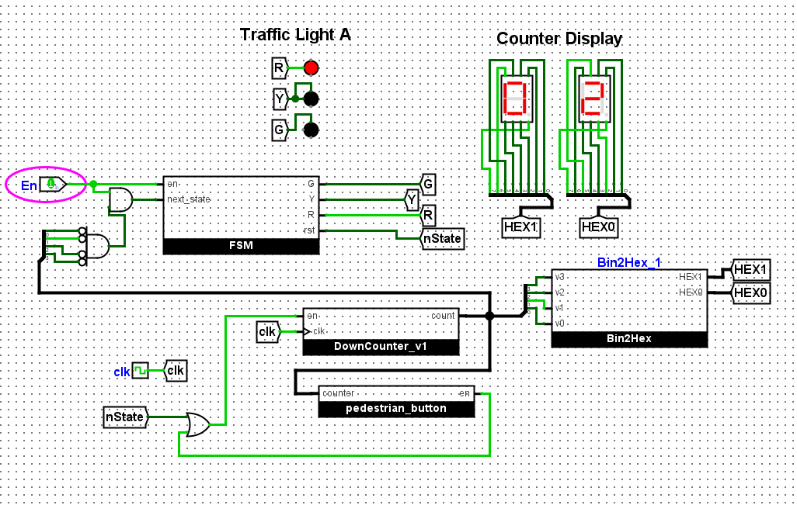
Final result
Color changes from green to yellow to red every three seconds and continuously repeats while the counter counts down from 3-0

