Slide 1
Lab 06
Kayden Stiehl

Slide 2
Counter Templates

Slide 3
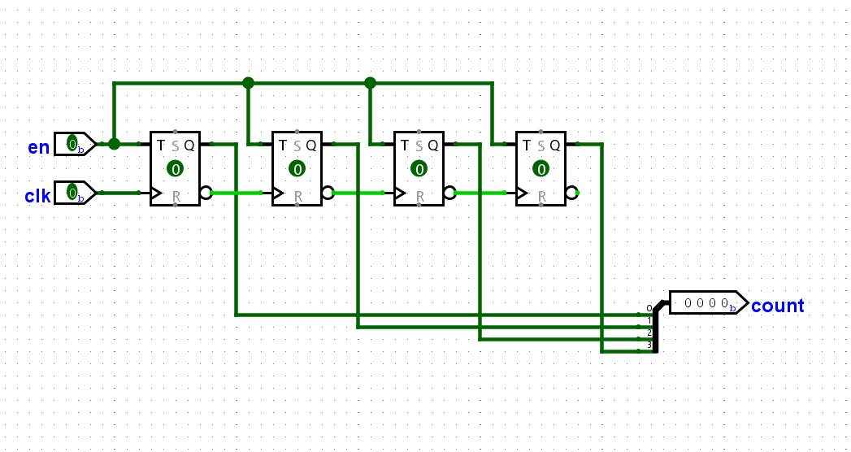
Up Counter

Slide 4
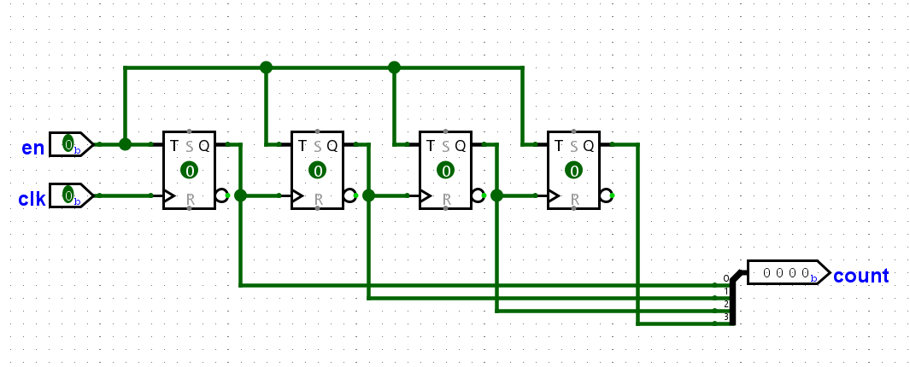
Down Counter

Slide 5
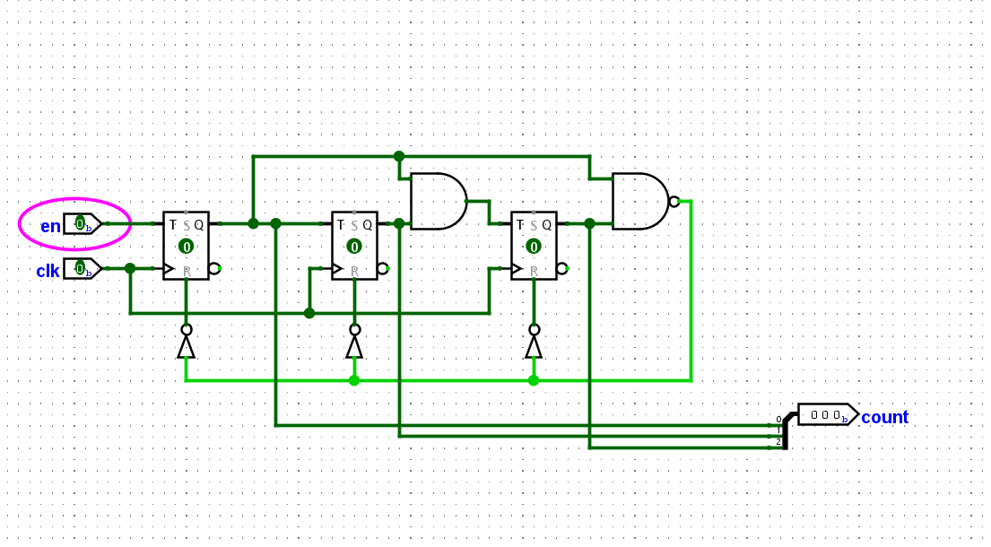
Modulo-5 Counter

Slide 6
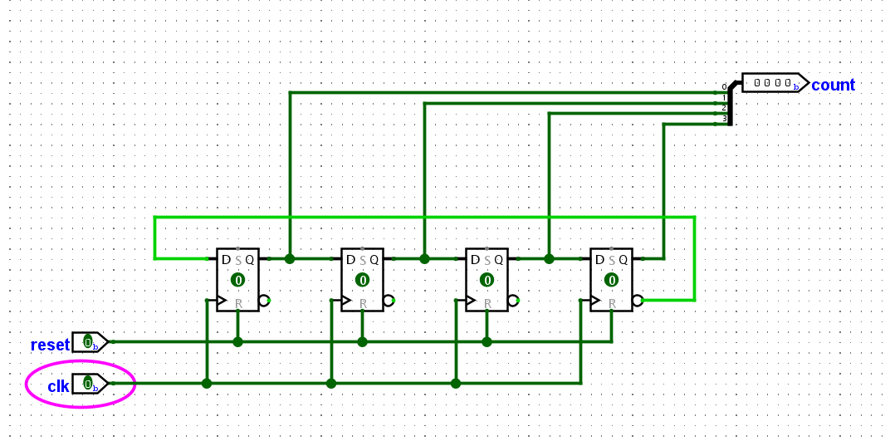
Johnson Counter

Slide 7
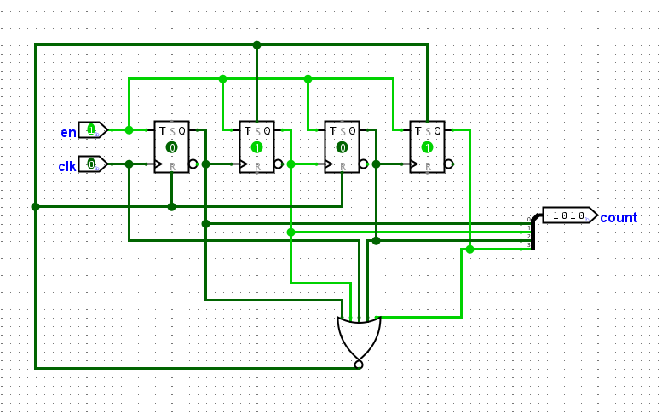
Down Counter (from 10)

