Slide 1


Climate Risk Assessment
November 2, 2023

Slide 2
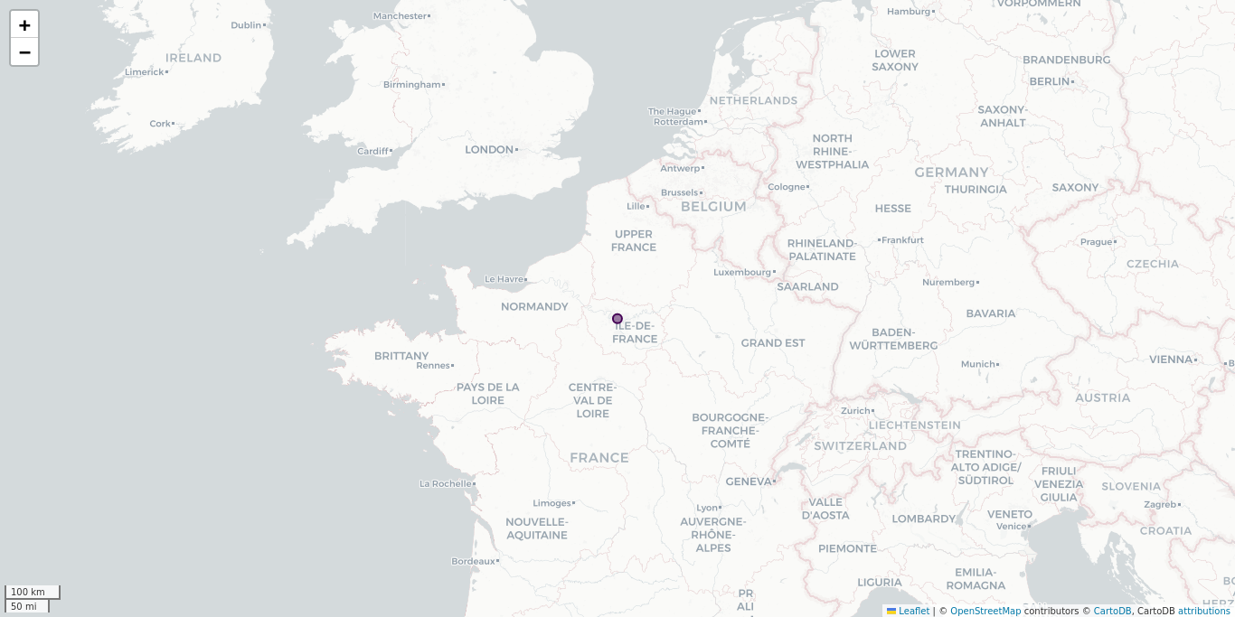
Global exposure

Slide 3
Risk levels by site

Slide 4
Hazard scores for site FRA

Slide 5

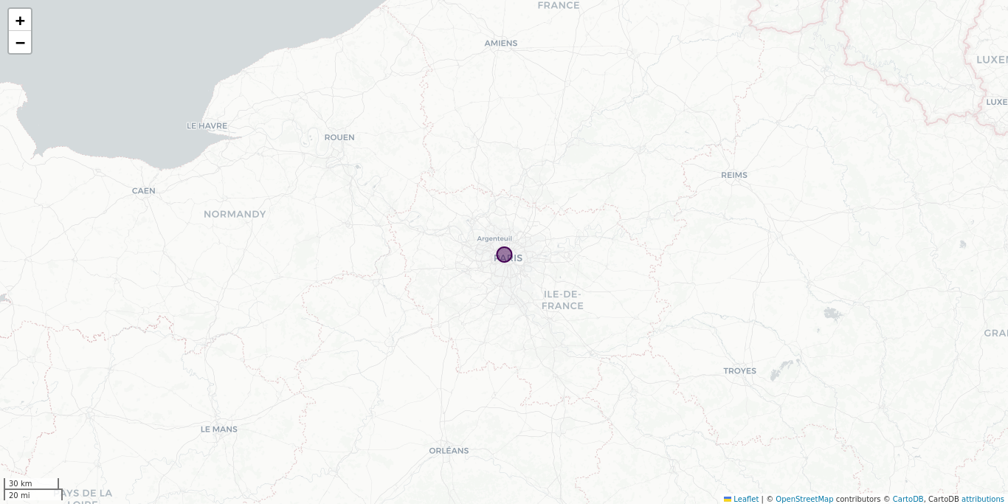







Current Hazard Levels
Site FRA
Earthquake
Storm surge
Extratropical storm
Tornado
Flash flood
Tropical cyclone
Latitude: 48.87, Longitude: 2.32 PARIS France
Elevation: 45 m
Hail
Tsunami
Lightning
Volcano
River flood
Wildfire

Slide 6
Climate Hazard Scores
Site FRA
RCP2.6
RCP4.5
RCP8.5
2030
2100
2030
2100
2030
2100
Drought
3.0
5.0
3.5
3.5
5.5
5.0
4.5
5.0
7.5
Current
2100
Current
2100
Current
2100
Fire weather
2.8
2.5
3.0
2.5
2.8
3.5
3.8
4.0
2.8
3.2
3.5
4.8
Current
2100
Current
2100
Current
2100
Heat stress
2.8
3.8
3.5
3.5
2.8
4.2
4.4
4.6
2.8
3.8
4.6
6.0
Current
2100
Current
2100
Current
2100
High precipitation
2.3
2.3
2.3
2.3
2.3
2.3
2.3
2.7
2.3
2.3
2.7
3.0
Current
2100
Current
2100
River flood
7.0
7.0
7.0
7.0
7.0
7.0
7.0
7.0
2100
2100
2100
Sea level rise
0.0
0.0
0.0
Current
2100
Current
2100
Tropical cyclone
0
0
0
0
0
0
0
0

Slide 7

IPCC temperature stress: annual view
Site FRA
Current
RCP2.6
RCP4.5
RCP8.5
2030
2050
2100
2030
2050
2100
2030
2050
2100
Number of days with TX* above 40°C
0.31
1.02
1.11
1.16
0.89
1.37
2.01
1.01
1.79
7.3
Change
+0.72
+0.8
+0.86
+0.58
+1.07
+1.7
+0.7
+1.49
+7.0
Number of frost days**
34.8
26.9
24.1
23.2
25.2
22.9
17.0
25.8
19.4
6.91
Change
-7.91
-10.6
-11.5
-9.53
-11.9
-17.7
-9.02
-15.4
-27.9
Heating degree-days***
2172
1909
1849
1814
1882
1791
1616
1877
1689
1230
Change
-263
-323
-358
-289
-381
-556
-295
-483
-942
Cooling degree-days***
99.4
164
188
189
158
196
258
167
233
492
Change
+64.7
+89.4
+89.6
+59.1
+96.7
+158
+68.3
+133
+392
*TX: maximum temperature **Frost days: days with a minimum temperature below 0°C ***Illustrates the energy demand for heating/cooling

Slide 8
IPCC projected temperatures: annual view (in °C)
Site FRA
Current
RCP2.6
RCP4.5
RCP8.5
2030
2050
2100
2030
2050
2100
2030
2050
2100
Mean of daily mean
10.96
12.13
12.45
12.52
12.19
12.69
13.51
12.36
13.25
15.78
Change
+ 1.18
+ 1.49
+ 1.57
+ 1.23
+ 1.73
+ 2.55
+ 1.4
+ 2.29
+ 4.82
Mean of daily minimum
7.57
8.68
8.93
9.05
8.76
9.2
10.02
8.79
9.64
12.06
Change
+ 1.12
+ 1.36
+ 1.49
+ 1.2
+ 1.63
+ 2.45
+ 1.23
+ 2.07
+ 4.5
Mean of daily maximum
14.66
15.99
16.36
16.44
16.04
16.54
17.42
16.12
17.08
19.74
Change
+ 1.33
+ 1.7
+ 1.78
+ 1.38
+ 1.88
+ 2.76
+ 1.46
+ 2.42
+ 5.09
Maximum of daily maximum
33.76
36.02
36.72
36.65
35.97
37.18
38.18
36.09
37.66
41.65
Change
+ 2.26
+ 2.96
+ 2.89
+ 2.21
+ 3.42
+ 4.42
+ 2.34
+ 3.91
+ 7.89

Slide 9
IPCC precipitations: annual view
Site FRA
Current
RCP2.6
RCP4.5
RCP8.5
2030
2050
2100
2030
2050
2100
2030
2050
2100
Mean daily precipitation (mm/day)
2.3
2.34
2.3
2.35
2.33
2.29
2.28
2.28
2.29
2.25
Change
+1.5%
-0.0%
+2.3%
+1.3%
-0.4%
-0.8%
-0.7%
-0.5%
-2.3%
Number of consecutive dry days
20.35
20.85
21.63
21.31
20.48
21.27
23.25
20.85
22.6
27.94
Change
+0.5
+1.28
+0.96
+0.13
+0.92
+2.9
+0.5
+2.25
+7.59
Mean daily snowfall (mm/day)
0.07
0.05
0.04
0.04
0.05
0.04
0.03
0.04
0.03
0.01
Change
-0.03
-0.03
-0.04
-0.03
-0.04
-0.05
-0.03
-0.05
-0.07

Slide 10
Framework and modelling approach

Slide 11
Scoring method
Peril | Weight
Earthquake | 12.5%
Extratropical storm | 10.4%
Flash flood | 10.4%
Hail | 6.5%
Lightning | 6.5%
River flood | 10.4%
Storm surge | 6.5%
Tornado | 6.5%
Tropical cyclone | 10.4%
Tsunami | 6.5%
Volcano | 6.5%
Wildfire | 6.5%

Slide 12
Current Hazard Levels
Earthquake: five zones based on the modified Mercalli scale (MM) with an exceedance probability of 10% in 50 years (equivalent to a return period of 475 years) for medium subsoil conditions. Extratropical storm (winter storm): fives zones based on peak wind speed (3 sec gust in km/h). The most exposed areas are located between 30° and 70° north and south of the equator. The resolution of the storm map is 0.01 degrees (approximately 1 km). Flash flood: six zones representing the frequency and intensity of flash floods, based on meteorological, soil, terrain and hydrographic (slope and flow accumulation) data. The resolution of the flash flood map is 250 m. Hail: six zones representing the frequency and intensity of hailstorms, based on global standardized records of meteorological data (temperature, precipitation, lightning activity). Lightning: six zones representing the global frequency of lightning strokes per km² and year. Lightning frequency is determined by counting the total number of lightning flashes independently of whether they strike the ground or not. River flood: four zones representing the threat of extreme floods. The resolution of the river flood map is 30 m. Storm surge: four zones, based on distance to coasts or shores of large lakes, wind speed and bathymetry (underwater depth of lake or ocean floors), without considering dykes. The resolution of the storm surge map is 30 m. Tornado: four zones based on meteorological data. Tornadoes occur worldwide at latitudes between 20° and 60°, but are most frequent in the US. Tropical cyclone: six zones representing the probable maximum wind speed with an exceedance probability of 10% in 10 years (equivalent to a return period of 100 years). The score is based on the Saffir-Simpson scale. The resolution of the tropical cyclone map is approximately 5 km. Tsunami: five zones based on height above sea level, distance from coasts, simulations of wave heights and maximum expansion, and historical tsunami and earthquake data. The resolution of the tsunami map is approximately 90 m. Volcano: four zones based on volcano activity, using the Volcano Explosivity Index (VEI). Secondary effects that can occur as a result of the large-scale distribution of volcanic particles (e.g. climate impacts, supraregional ash deposits) are not considered. Wildfire: five zones based on ignition of the fire, vegetation, meteorological conditions and topography. The effects of wind, arson and fire-prevention measures are not considered. The resolution of the wildfire map is approximately 1 km.

