Slide 1


CONNIFY: CONNECT SAFELY
Presented By
GANGASH S (2303811710421044)
GIRIJESH R (2303811710421046)
GODFREY T R (2303811710421047)
GRISH NARAYANAN S (2303811710421048)
Under the Guidance of
Mrs. R. SATHYA, M.E., (Ph.D)
ASSISTANT PROFESSOR,
DEPT OF CSE,
KRCT.

Slide 2

CONTENTS
PROBLEM IDENTIFICATION
ABSTRACT
OBJECTIVES AND SCOPE OF THE PROJECT
LITERATURE SURVEY
EXISTING SYSTEM
PROPOSED SYSTEM
ARCHITECTURE DIAGRAM OF PROPOSED SYSTEM
MODULE DESCRIPTION
HARDWARE AND SOFTWARE REQUIREMENTS
UI PROTOTYPE SCREENS
IMPLEMENTATION DETAILS
TEST CASES / EXPERIMENTAL ANALYSIS
OUTPUT SCREENSHOTS
CONCLUSION
REFERENCES
PRODUCT PUBLICATION PROOF

Slide 3
PROBLEM IDENTIFICATION
Location Exposure: Existing apps send raw GPS coordinates to centralized servers, enabling tracking, stalking and location profiling.
GPS Sensor Jitter: Coordinate rounding and plain hashing fail because small GPS drift changes the hash, so people standing 3 m apart do not match.
Unverified Stranger Identity: Static passwords, public profiles and unverifiable logs leave users open to impersonation and unsafe meetups.
No Integrated Safety: Messaging and location apps lack temporary trust, offline fallback and emergency tools in a single workflow.

Slide 4
ABSTRACT
Connify is a decentralized, zero-knowledge platform that enables safe connections between nearby strangers without revealing their identities or exact locations. Its SHARP protocol uses a 9-cell neighbourhood, a 1024-bit Bloom filter, and BCH(15,7) error correction, sharing only 8-bit syndromes and blinded SHA-256 hashes. It supports Ed25519-based QR handshakes, short-lived JIT trust capsules, Socket.IO chat, WebRTC voice, offline fallback, behavioral risk analysis, and a hash-chained audit ledger. The app is live on Google Play (com.connify).

Slide 5
OBJECTIVES
SHARP Protocol: Design zero-knowledge spatial proximity discovery using GF(2⁴) BCH error correction.
Mobile Application: Build a cross-platform React Native / TypeScript app for secure communication between strangers.
Backend Services: Develop a high-performance Fastify, Prisma ORM and MongoDB backend with REST and WebSocket support.
Deployment: Publish the production application on the Google Play Store (com.connify).

Slide 6
SCOPE OF THE PROJECT
Connection Categories: Social Meetup, Co-presence, Activity Partner, Escort / Walk-Together and Local Information Sharing (22 categories in total).
Platform Coverage: Android and iOS through React Native and Expo, with 25 screens; published for Android 15+ (SDK 36).
Connectivity: Online through REST and Socket.IO; offline through Wi-Fi mDNS, BLE mesh and SMS fallback.
Safety Coverage: Timed Safety Guard, 115 dB siren, fake call, hazard map, duress PIN and tamper-evident audit ledger.

Slide 7
LITERATURE SURVEY
Urmila and Shubham (2014): User-sensitive location sharing that shares obfuscated regions instead of exact positions, balancing accuracy and privacy.
Miller and Myers (2018): Proximity detection using beacon-based reference lists instead of exact coordinates; coverage and tracking risks remain.
Grönvall, Westerlund and Pink (2020): Cryptographic location-sharing scheme for friends and strangers, verified with ProVerif security analysis.
Rajasekaran et al. (2022): BLE security and privacy survey: wireless discovery needs careful device identification and permission design.

Slide 8
EXISTING SYSTEM
Centralized Location Servers: GPS coordinates are sent to servers that calculate distances and identify nearby users.
Profile-Based Discovery: Users connect through public profiles, usernames or contact details.
Separate Communication Tools: Messaging and voice features are not tied to privacy-preserving proximity or temporary trust.
Wireless Discovery Only: Bluetooth and Wi-Fi discovery depends on device support and does not guarantee identity verification.

Slide 9
LIMITATIONS OF EXISTING SYSTEM
No Cryptographic Privacy: Cloud backends see raw coordinates, creating a large surveillance attack surface.
No Sensor-Drift Handling: No commercial app uses BCH error correction to turn noisy GPS into exact zero-knowledge matching.
Weak Stranger Trust: Permanent connections and static credentials allow impersonation, luring and unsafe encounters.
No Safety or Offline Support: Few emergency tools, and features depend heavily on internet connectivity.

Slide 10
PROPOSED SYSTEM
Privacy-Preserving Discovery: The SHARP Protocol matches nearby users using parity syndromes and blinded hashes; raw coordinates never leave the device.
Secure Identity: Hardware-backed Ed25519 keys, QR handshake and 2-hour JIT trust capsules (only the SHA-256 digest is stored).
Real-Time Communication: Socket.IO chat with no server chat logs, and WebRTC peer-to-peer voice calls.
Hybrid Networking and Safety: Wi-Fi mDNS, BLE and SMS fallback with an integrated personal safety suite.

Slide 11
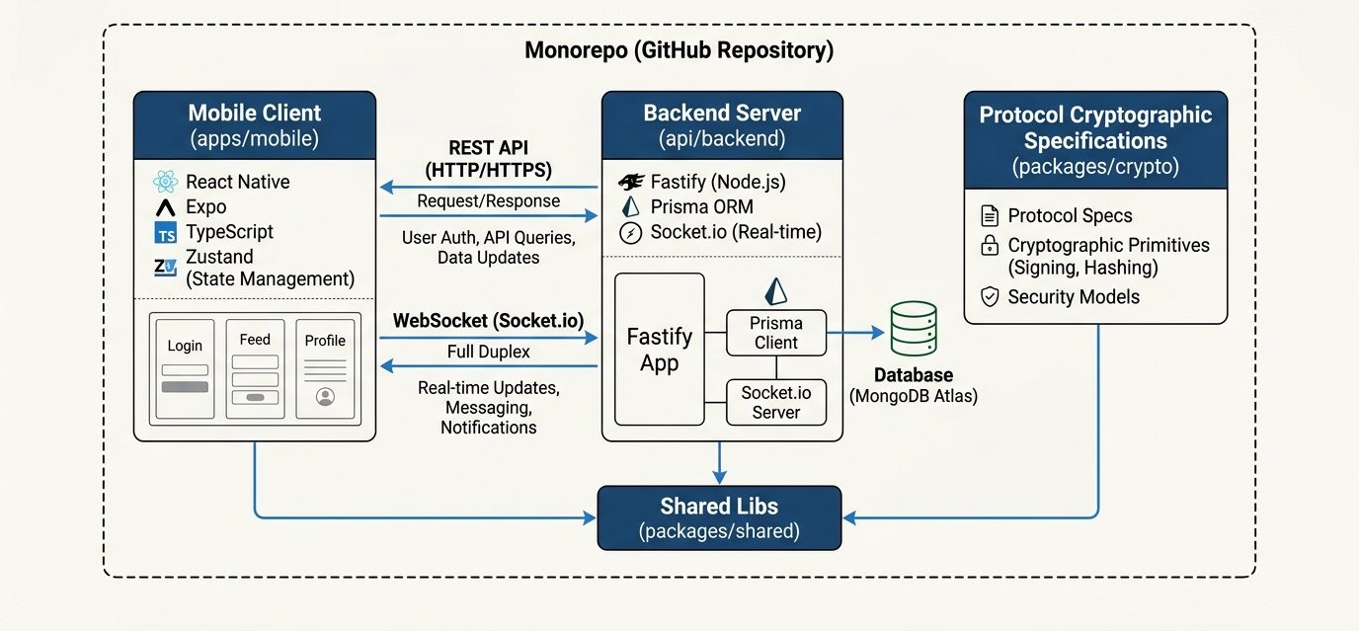
ARCHITECTURE DIAGRAM OF PROPOSED SYSTEM

Slide 12
ADVANTAGES OF PROPOSED SYSTEM
Absolute Location Privacy: Cloud servers never receive raw latitude or longitude.
Immunity to GPS Drift: BCH(15,7) over GF(2⁴) corrects up to 2 bit-errors per 7-bit block.
Hardware-Secured Identity: Private keys stay in Android KeyStore / iOS Keychain and cannot be extracted or cloned.
Production Ready: Live on Google Play with anonymous stranger connection and built-in safety tools.

Slide 13
MODULE DESCRIPTION (1 OF 2)
Device Authorization and Security: Passwordless Ed25519 keypair in the hardware keystore, biometric gating and challenge-response JWT login.
SHARP Proximity Matching: 3-decimal GPS quantization, 9-cell expansion, 1024-bit Bloom filter and 146 BCH syndromes with client-side decoding.
Request Episodes and Capsule Issuance: 22 request categories, MongoDB 2dsphere indexing and 2-hour Ed25519-signed JIT trust capsules.
Cryptographic Handshake Verification: QR scan with single-use nonce against replay attacks, plus a covert duress PIN that alerts guardians.

Slide 14
MODULE DESCRIPTION (2 OF 2)
Real-Time Chat and VoIP: Ephemeral Socket.IO rooms with in-memory chat and WebRTC signaling for peer-to-peer audio.
Hybrid Online and Offline Mesh Fallback: HTTPS/WSS, Wi-Fi mDNS, BLE and SMS, with an offline queue synced in order on reconnection.
Personal Safety Suite: 115 dB siren with strobe, Timed Safety Guard, fake call simulator and AI-assisted hazard map.
Behavioral Risk Engine and Audit Ledger: Velocity cap (more than 2 broadcasts in 10 min), 10-second location watchdog and SHA-256 hash-chained audit ledger.

Slide 15
HARDWARE AND SOFTWARE
Hardware: Development System: Intel Core i5 or equivalent, 8 GB RAM minimum (16 GB preferred) and adequate storage.
Hardware: Mobile Device: Android or iOS smartphone with GPS, camera (QR), microphone, speaker and wireless interfaces; internet for backend services.
Software: Frontend: React Native, Expo, React and TypeScript, developed with Visual Studio Code, npm and Git.
Software: Backend and Networking: Node.js, Fastify, Prisma ORM and MongoDB, with Socket.IO and WebRTC.

Slide 16
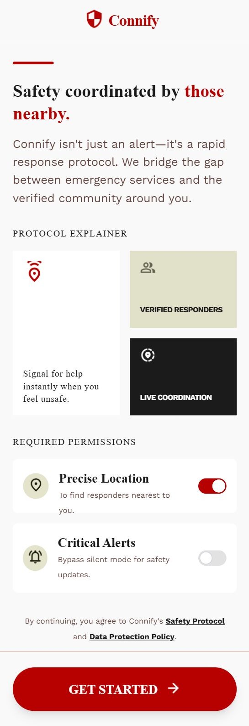
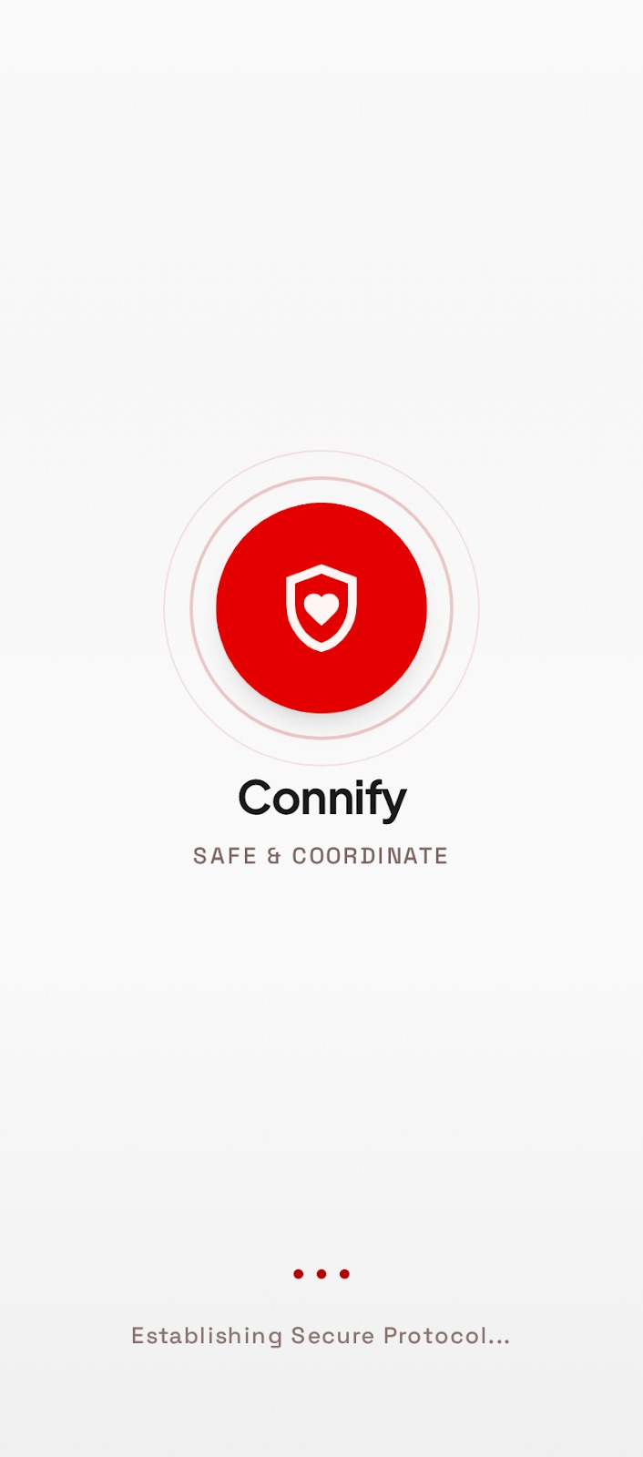
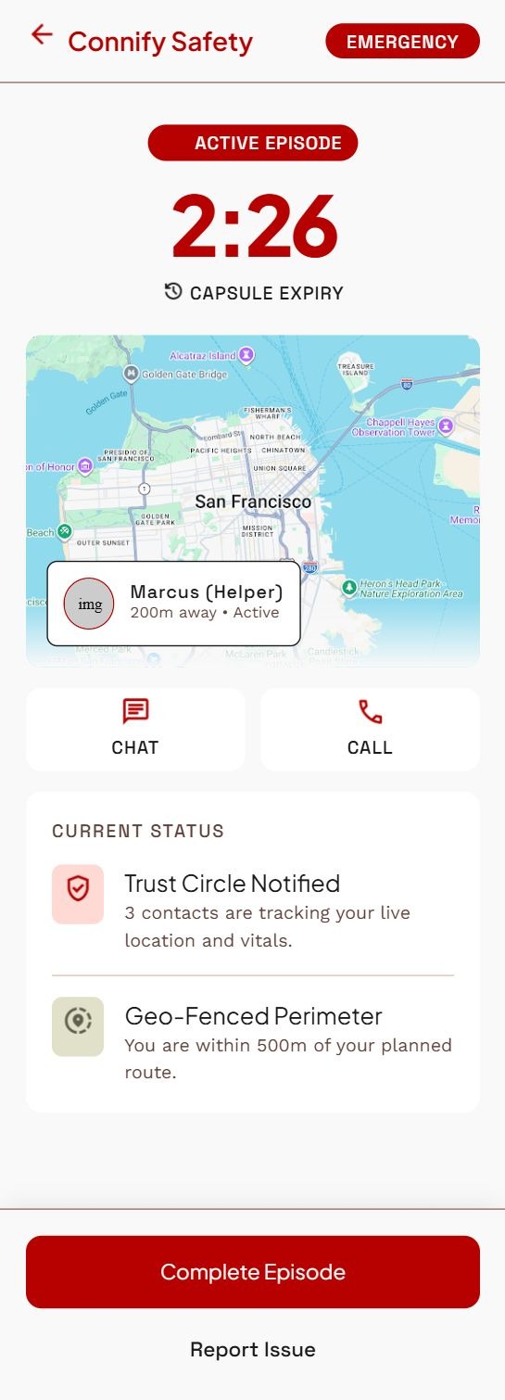
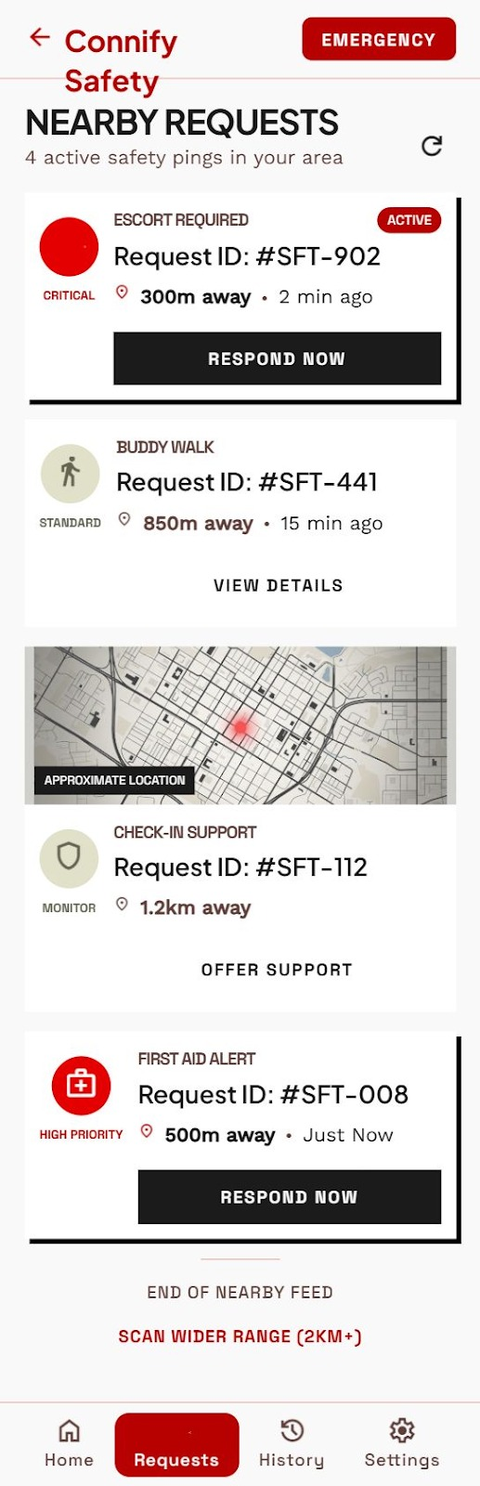
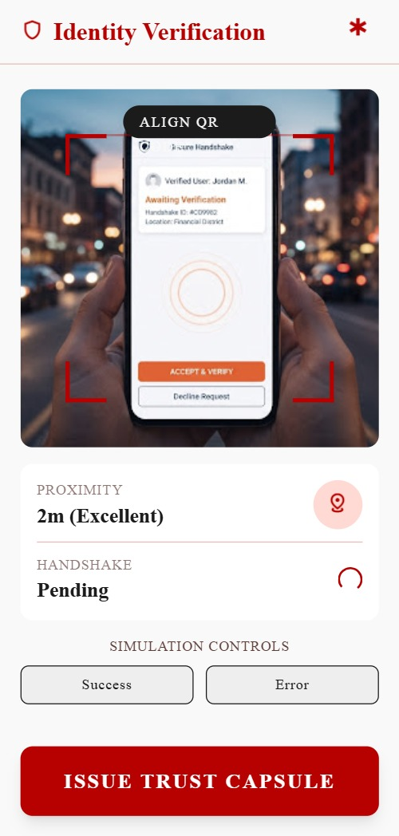
UI PROTOTYPE

Slide 17
IMPLEMENTATION DETAILS
Technologies Used: React Native 0.86, Expo 57 and TypeScript for the app; Node.js 22, Fastify 5, Prisma and MongoDB Atlas for the backend.
Frontend: 25 screens, Zustand state management, Axios API client, VisionCamera QR scanning and hardware keychain storage.
Backend: REST APIs for devices, episodes and capsules, Socket.IO rooms and a 10-second location watchdog.
Database Integration: MongoDB with 2dsphere indexing, 15 to 30 minute episode expiry and SHA-256 hashed capsule tokens.

Slide 18
SHARP IMPLEMENTATION
Quantize and Expand: GPS is truncated to 3 decimals (about 111 m) and expanded into a 9-cell neighbourhood.
Bloom Filter: A 1024-bit vector is built using four FNV-1a hash functions per cell.
BCH Syndromes: 146 blocks of 7 bits are encoded with BCH(15,7) over GF(2⁴) into 8-bit parity syndromes.
Match and Correct: Only syndromes and 9 blinded SHA-256 hashes are sent; the peer decodes locally and corrects up to 2 bit-errors per block.

Slide 19
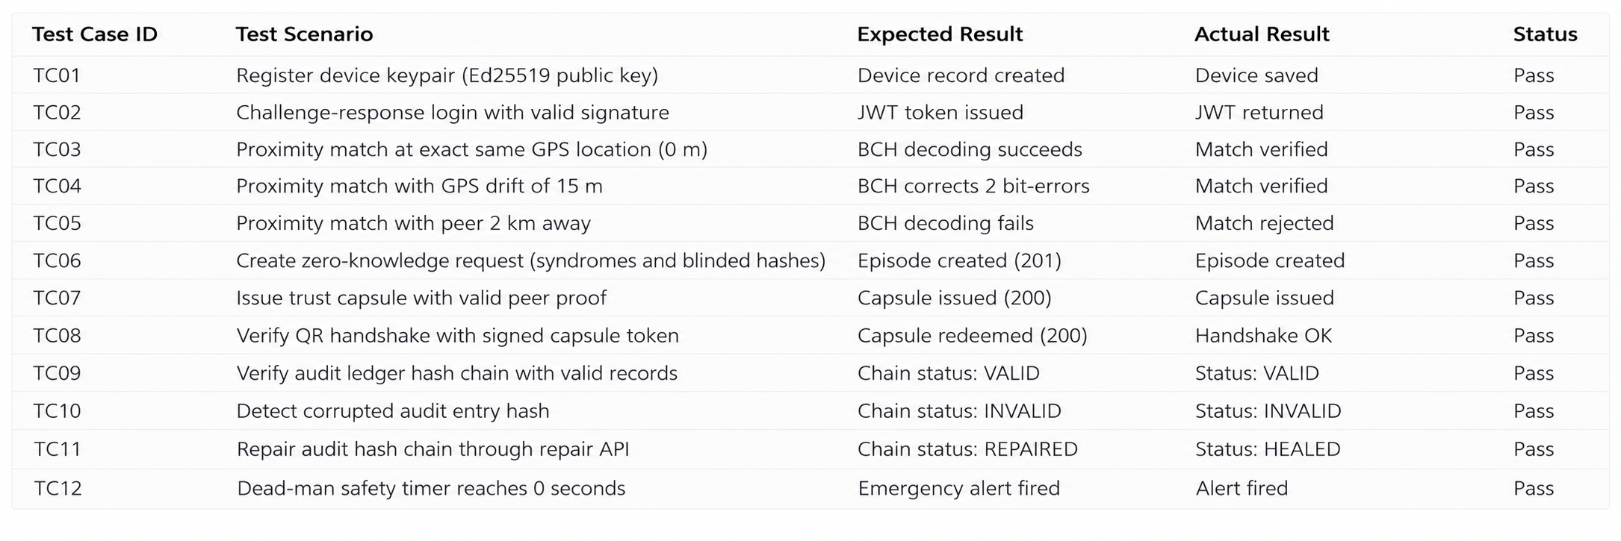
TEST CASES

Slide 20
EXPERIMENTAL ANALYSIS
Accuracy: 100% true-positive match under 5 to 15 m GPS drift and zero false matches beyond 100 m.
Speed: Syndrome generation under 3.2 ms, BCH decoding under 12.8 ms and full matching under 85 ms.
Payload: 434 bytes per request, 89.2% smaller than JSON coordinate polling.
Backend: Average API response of 48.5 ms; a 1,000-record audit chain verified in 203.9 ms.

Slide 21
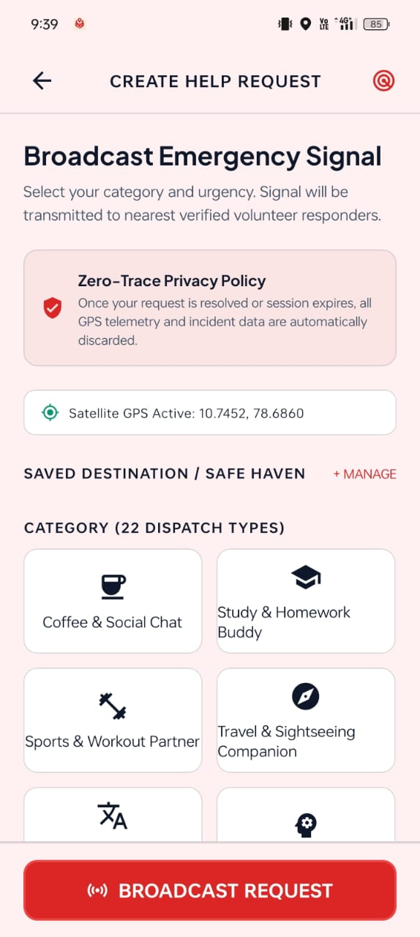
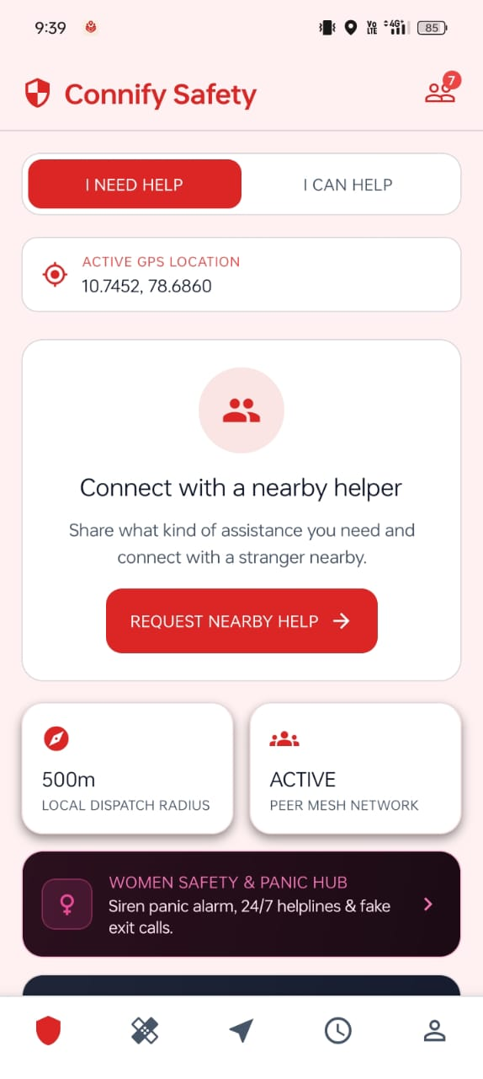
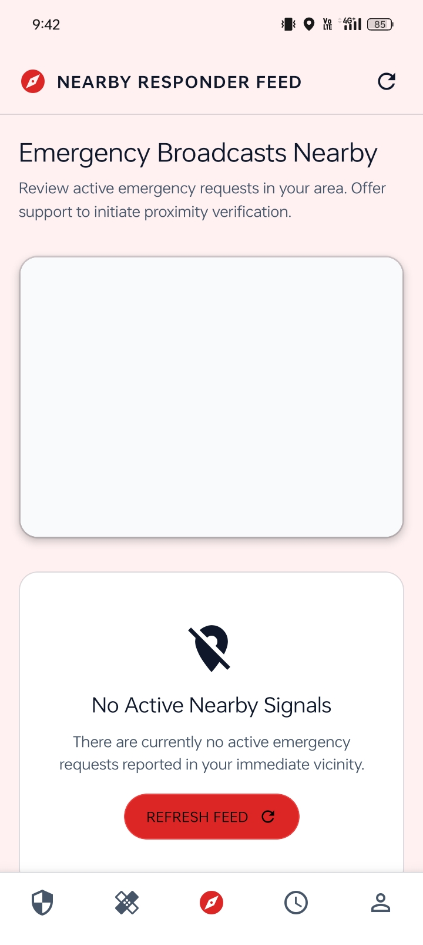
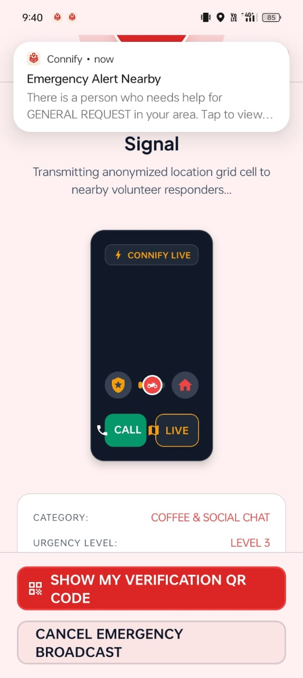
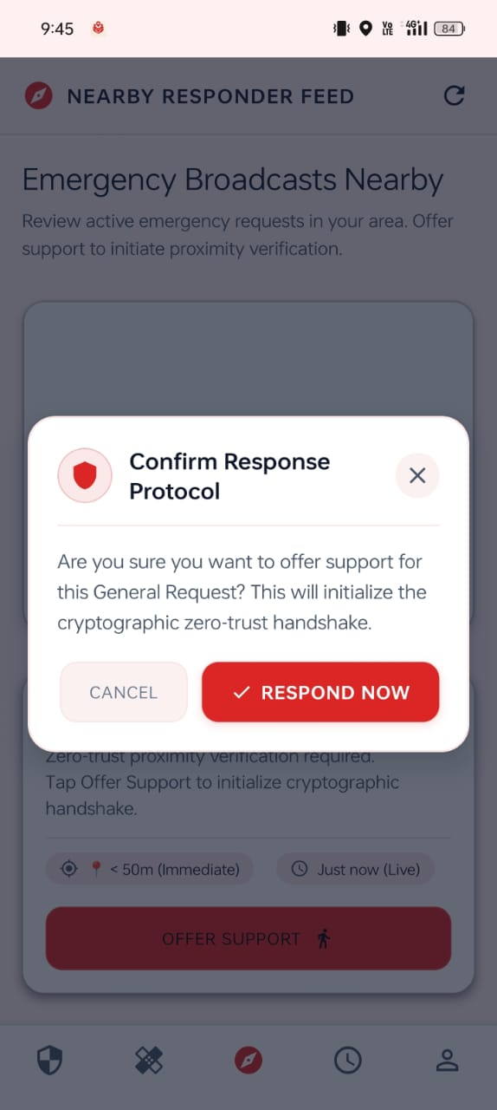
OUTPUT SCREENSHOT

Slide 22
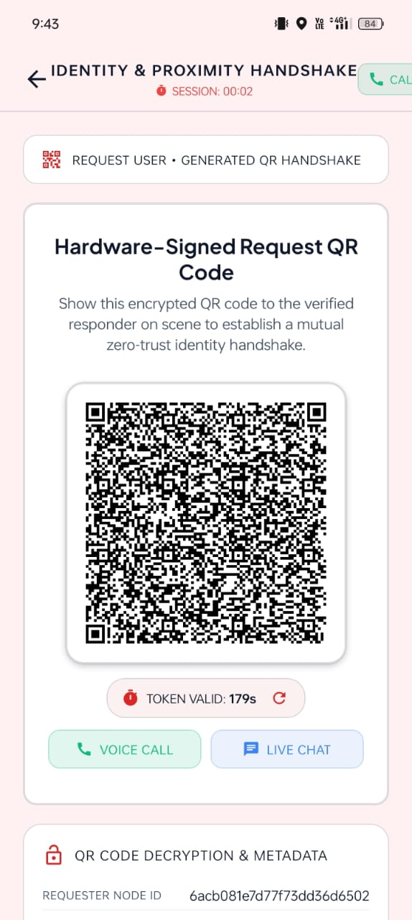
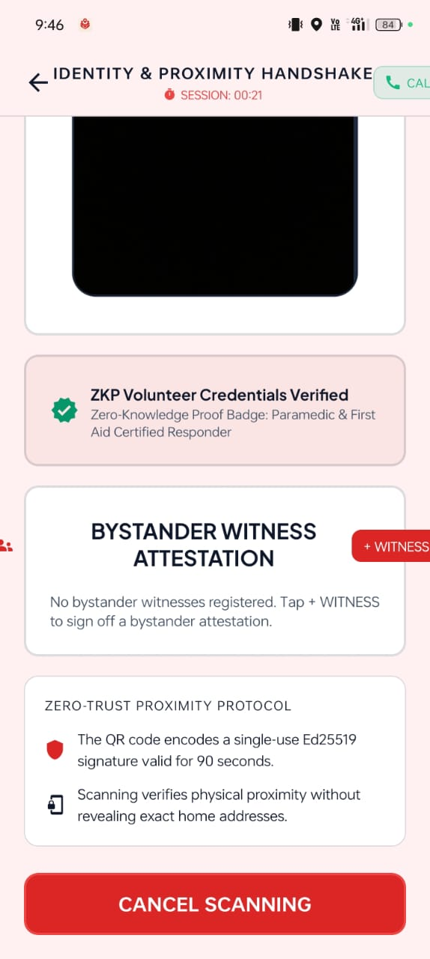
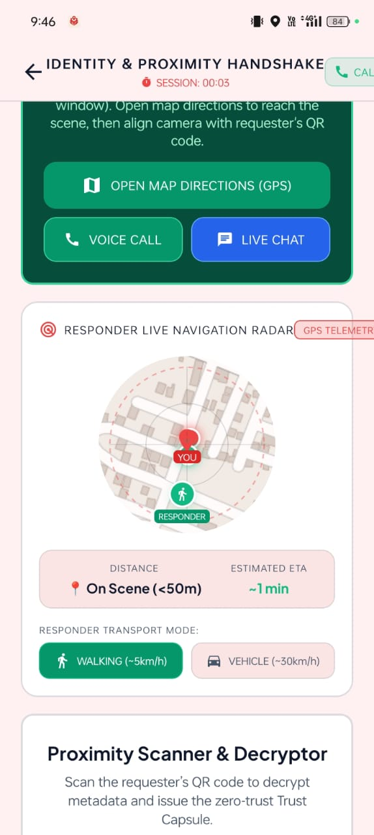
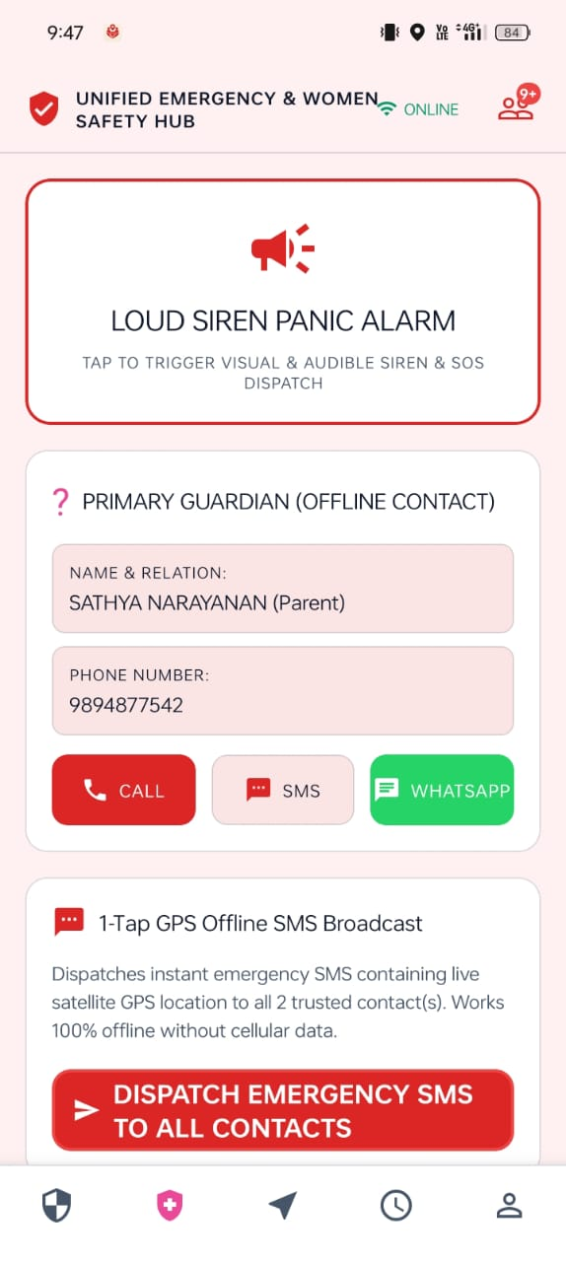
OUTPUT SCREENSHOT

Slide 23
CONCLUSION
Achieved: Connify (v4.8.6) delivers SHARP zero-knowledge matching, and all 9 project objectives were verified as achieved.
Validated: 100% match under GPS drift, zero false positives, 39 of 39 tests passed and a 434-byte payload.
Key Contributions: Zero-knowledge spatial matching, hardware-backed identity, hybrid online/offline networking and a tamper-evident audit ledger.
Future Work: C++/Rust JSI acceleration, multi-hop BLE mesh, satellite messaging, post-quantum cryptography and zk-SNARK audit rollups.

Slide 24
REFERENCES
[1]: Josefsson, S. & Liusvaara, I. 2017, ‘Edwards-Curve Digital Signature Algorithm (EdDSA)’, RFC 8032, IETF.
[2]: NIST 2015, ‘Secure Hash Standard (SHS)’, FIPS Publication 180-4, U.S. Department of Commerce.
[3]: Alvestrand, H. 2021, ‘Overview: Real-Time Protocols for Browser-Based Applications’, RFC 8825, IETF.
[4]: Cheshire, S. & Krochmal, M. 2013, ‘Multicast DNS’, RFC 6762, IETF.

Slide 25
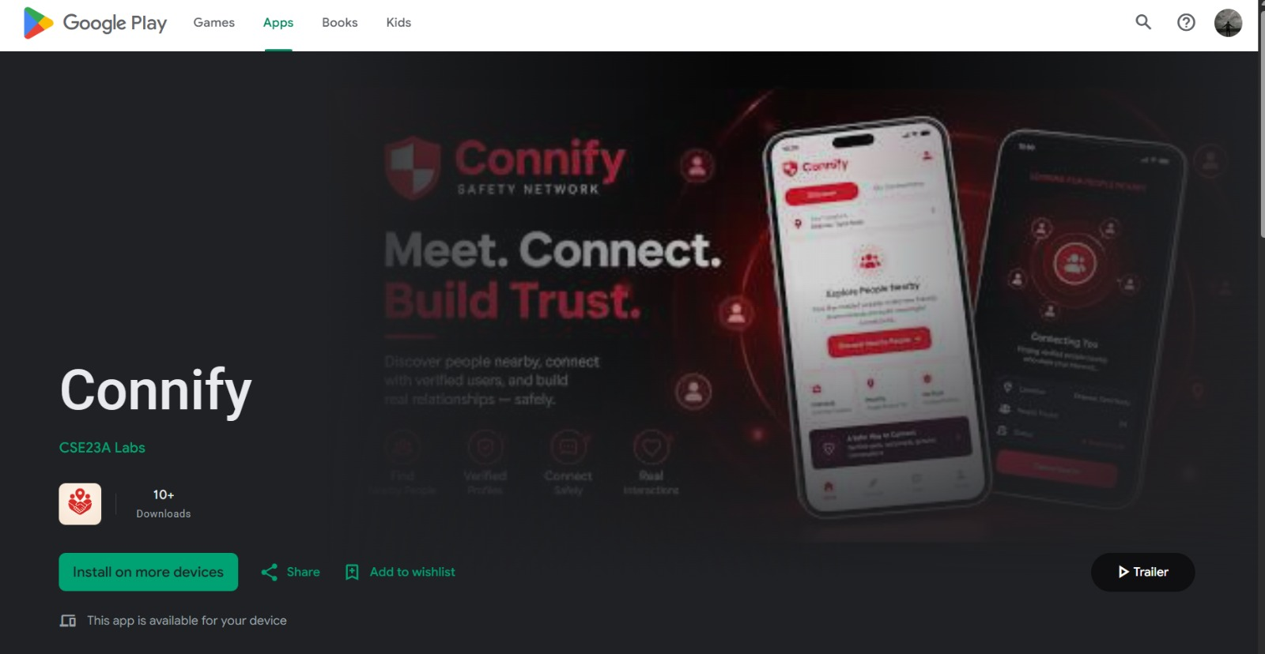
PRODUCT PUBLICATION PROOF

Slide 26
Queries ????

