Slide 1
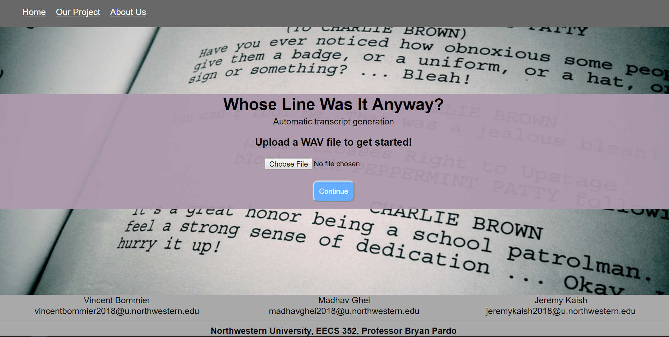
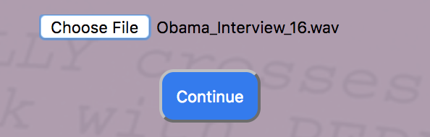
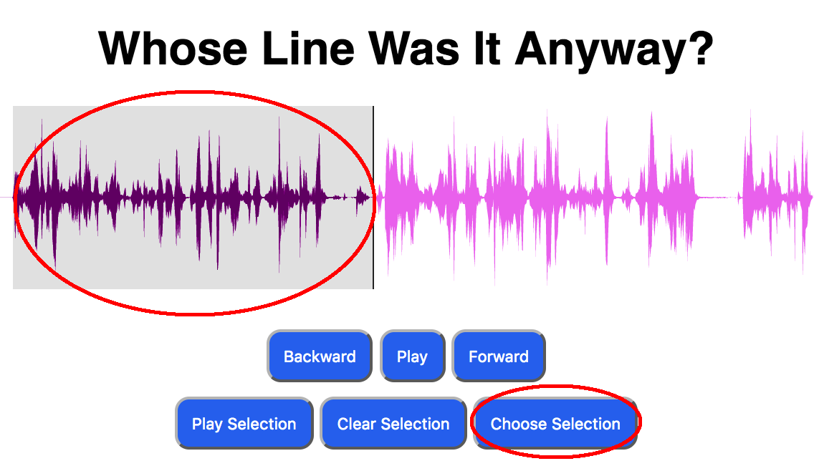
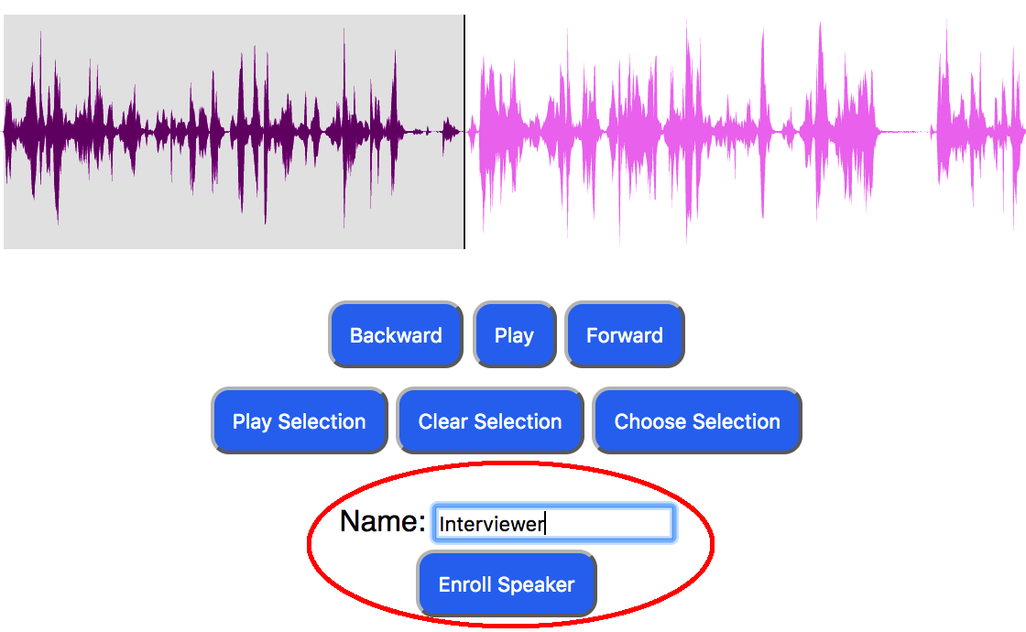
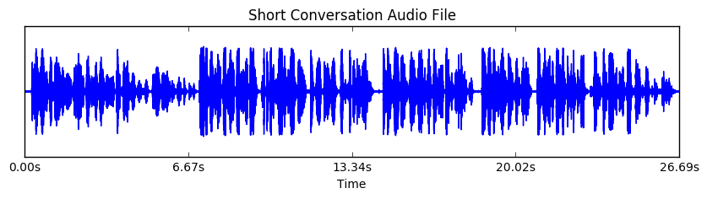
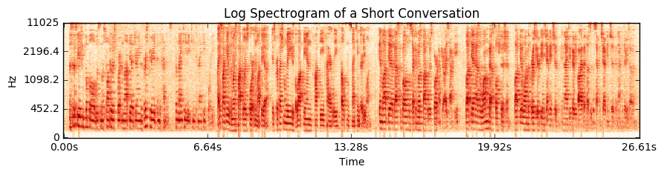
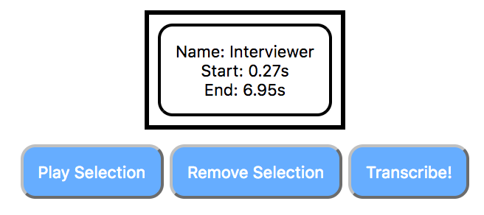
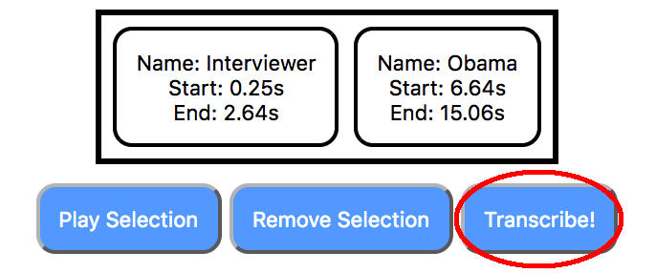
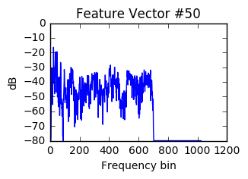
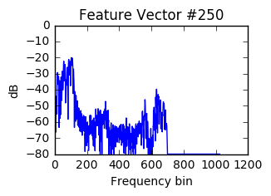
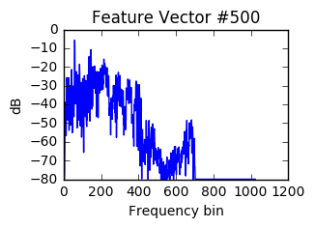
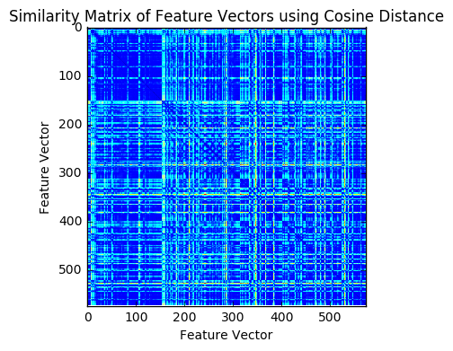
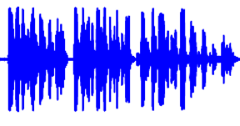
Whose Line Was It Anyway?
Professor Bryan Pardo
EECS352: Machine Perception of Music and Audio
Northwestern University
Vincent Bommier, Jeremy Kaish, and Madhav Ghei
vincentbommier2018@u.northwestern.edu, jeremykaish2018@u.northwestern.edu, madhavghei2018@u.northwestern.edu
The Problem
The Interface
Performance of the Transcription Software
Provide a tool for transcription or auto captioning
Potential use cases: transcribing interviews, podcasts, captioning videos, etc.
Journalists could streamline their workflow, avoid doing transcription by hand
Speech transcription and speaker ID tools already exist but don’t work in parallel
We combined these tools to identify multiple speakers in a single audio file, while assigning transcribed words to their respective speakers
Goal: one streamlined interface for creating transcriptions from an audio file
1a
How the Project Works (High Level)
User submits a wave file (16kHz sample rate, monophonic)
User trains the Speaker Recognition API by selecting at least one piece of audio for every speaker in the conversation
Self-similarity matrix automatically determines where to split between speakers
Segments audio into multiple distinct audio files (one speaker per file)
Transcription API and Speaker Recognition API run on every segmented file
Identified speaker is prepended to its respective transcription
Results are printed to screen for user to see.
1b
2a
2b
How we Built and Tested the Project
Python 3 backend: Audio segmentation, transcription and speaker recognition
Microsoft Bing API used for speaker identification and speech to text
HTML/CSS/JavaScript frontend
Wavesurfer.js library for displaying and manipulating waveforms
Performance assessed by f-score of transcription:
This also measured the performance of our audio segmentation and speaker identification/speech to text API
Testing data: primarily consisted of two files:
NPR Interview with President Obama
Three of us reading a Wikipedia article on sports in Latvia
2c
2d
Obama_Interview_16.wav Transcript:
(High Confidence) Interviewer: as you look into the moment in history that you occupy do you think you could put into a sentence what you were trying to accomplish in the work
(High Confidence) Obama: try to do it in a sentence because were fortunate in many ways we don’t face an existential crisis
3a
Conclusions
Log spectrograms gave the best results for our choice of feature vector
Transcription is hard to perform perfectly (or even close to perfectly) well
Noisy audio files destroy Bing’s API
This tool could be a good start at something that could be optimized further
But it’s not good enough for professional use just yet
_{Change of speaker detected}
_{Audio Segment}
1. Home screen
a. Home screen
b. User uploads .wav file (system will reject if not wav format)
2. Waveform editing/segmentation screen
a. User selects portion of audio
b. User assigns name to current speaker, enrolls them (trains the API)
c. Repeat for each speaker
d. Click to transcribe!
3. Generated transcript is displayed!
References
Transcription API
Recognition API
Bongjun Kim and Bryan Pardo. 2017. I-SED: an Interactive Sound Event Detector. In ACM International Conference on Intelligent User Interfaces. Retrieved from http://music.cs.northwestern.edu/publications/Kim_Pardo_IUI2017.pdf.
Steve Rubin, Floraine Berthouzoz, Gautham J. Mysore, Wilmot Li, and Maneesh Agrawala. 2013. Content-Based Tools for Editing Audio Stories. In UIST 2013, October 2013. pp. 113-122. Retrieved from http://vis.berkeley.edu/papers/audiostories/audiostories.pdf.
Waveforms on the interface were created with wavesurfer.js. Retrieved from https://wavesurfer-js.org/
Theodoros Giannakopoulos. 2015. pyAudioAnalysis: An Open-Source Python Library for Audio Signal Analysis. In PLoS ONE 10(12). Retrieved from http://journals.plos.org/plosone/article/file?id=10.1371/journal.pone.0144610&type=printable.
Müller, Meinard. Fundamentals of Music Processing: Audio, Analysis, Algorithms, Applications. Springer, 2015.
Labeled Transcription

