Slide 1
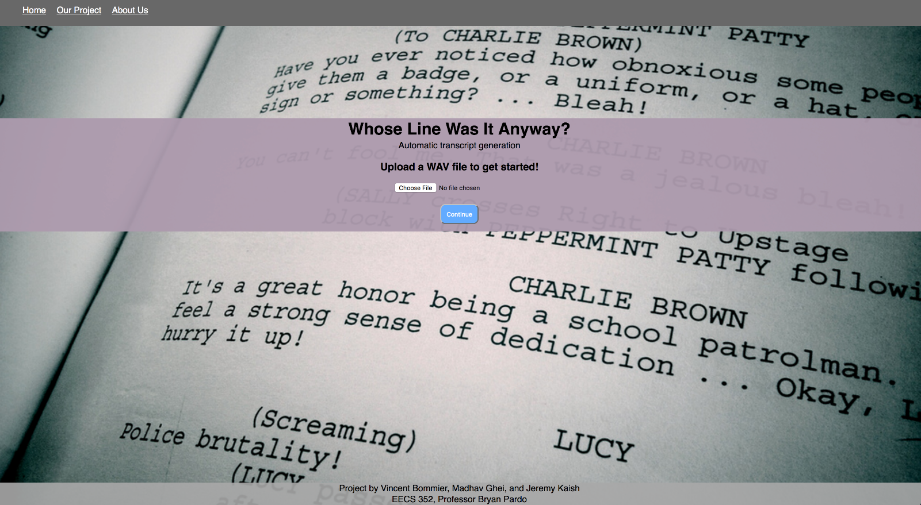
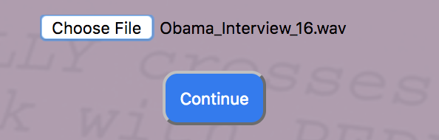
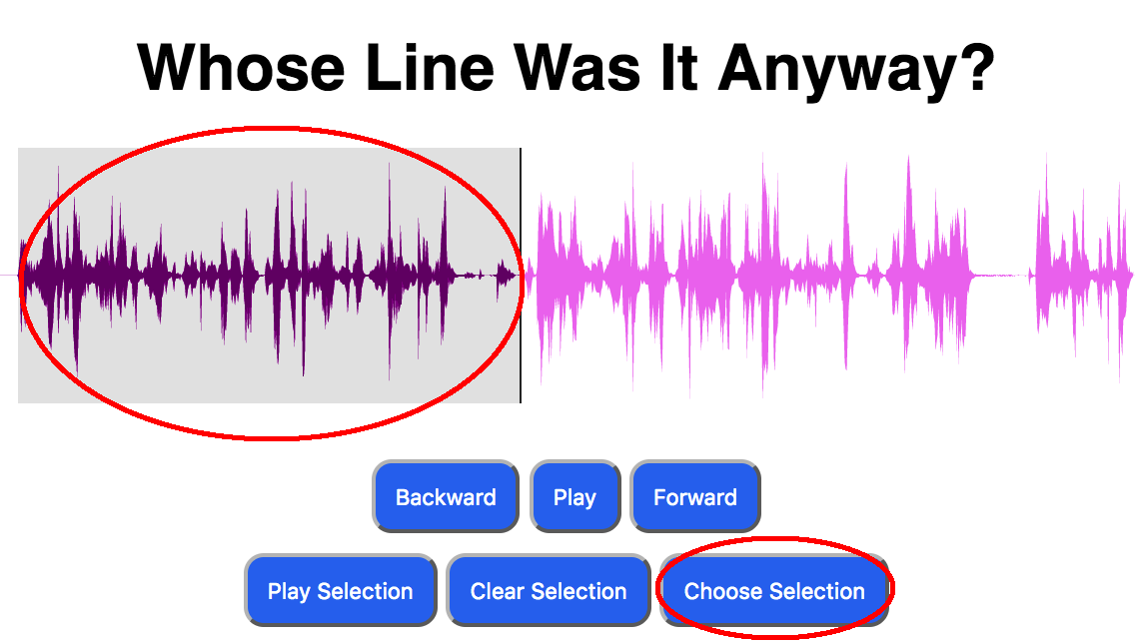
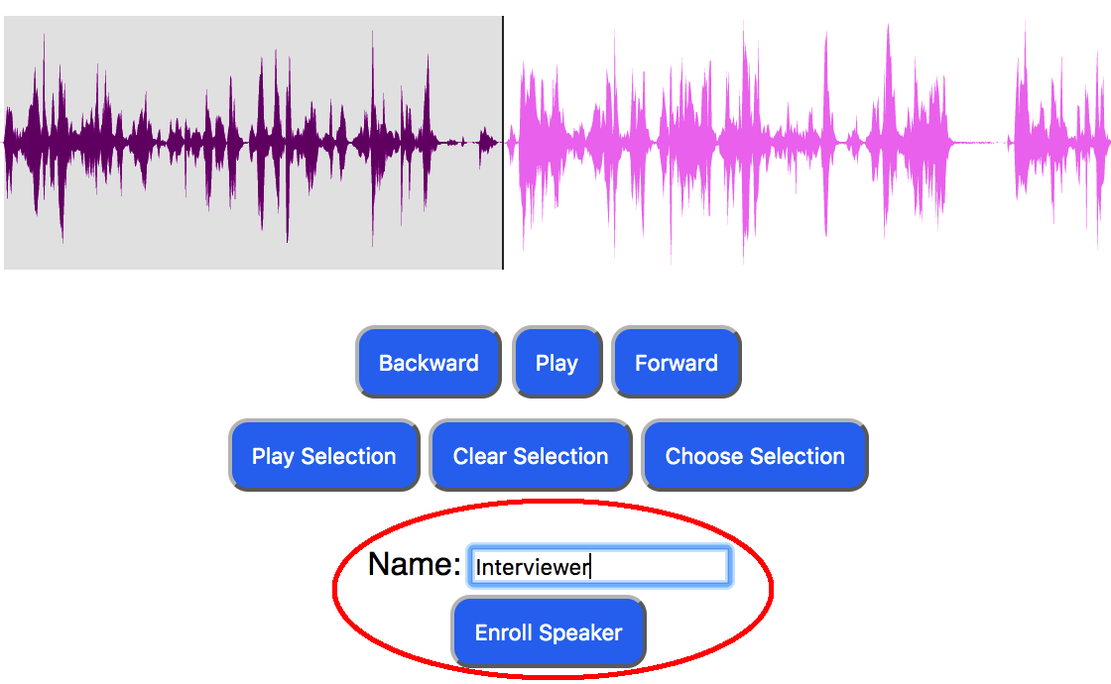
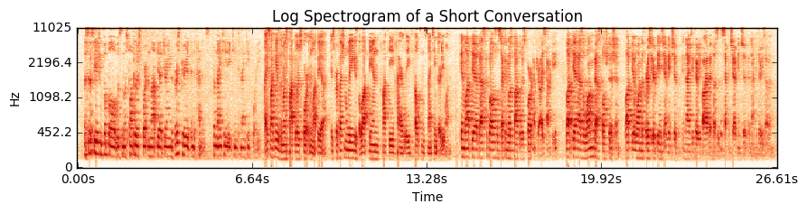
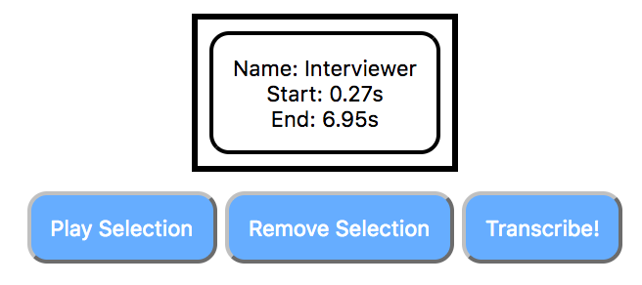
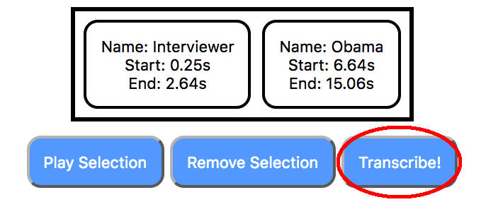
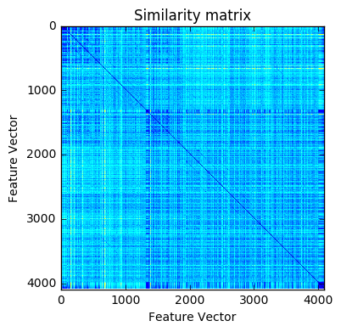
Whose Line Was It Anyway?
Professor Bryan Pardo
EECS352: Machine Perception of Music and Audio
Northwestern University
Vincent Bommier, Jeremy Kaish, and Madhav Ghei
vincentbommier2018@u.northwestern.edu, jeremykaish2018@u.northwestern.edu, madhavghei2018@u.northwestern.edu
The Problem
Performance of the Transcription Software
The Interface
Provide a tool for transcription or auto captioning
Potential use cases: transcribing interviews, podcasts, captioning videos, etc.
Journalists could use this to streamline their workflow, and avoid the menial/time-consuming task of transcription by hand
Aims to reduce the amount of work a journalist must spend on transcription
Tools for speech transcription and speaker ID already exist but do not work in parallel
We combined these tools to identify multiple speakers in a single audio file, while assigning transcribed words to their respective speakers
Our goal is to make one streamlined interface for creating transcriptions from an audio file
1a
1b
2a
2b
2c
2d
How the Project Works (High Level)
How we Built and Tested the Project
1. Home screen
a. Home screen
b. User uploads .wav file (system will reject if not wav format)
2. Waveform editing/segmentation screen
a. User selects portions of audio in which only one speaker is talking
b. User assigns a name to the speaker of the current selection and enrolls the speaker (training the speaker recognition API)
c. User repeats this for each speaker in the file (once per speaker)
d. Once satisfied with the selections, the user only needs to press transcribe and the text will be generated!
3. Generated transcript is displayed!
Users submit wave file (16kHz sample rate, monophonic)
User selects portions of audio in which only one person is talking
Repeat for each speaker in conversation
Profile created for each speaker, trains the Speaker ID API to fingerprint each speaker
Program uses self-similarity matrix to automatically determine where to split between speakers
Segments audio into multiple distinct audio files
Speech-to-text is run on every file in order
Speaker ID is run on every file, and prepends identified speaker to their associated audio clip.
Results printed to screen for user to see.
Python 3 backend: Audio segmentation, transcription and speaker recognition
Microsoft Bing API used for speaker identification and speech to text
HTML/CSS/JavaScript frontend
Wavesurfer.js library for displaying and manipulating waveforms
Performance assessed by f-score of transcription:
This also measured the performance of our audio segmentation and speaker identification/speech to text API
Testing data: primarily consisted of two files:
NPR Interview with President Obama
Three of us reading a Wikipedia article on sports in Latvia
Conclusions
After all the work we have done, we can see that transcription is a very hard task to accomplish perfectly well. Noisy recordings contributed to worse performance on some recordings, as well as certain limitations in the performance of Bing’s API (on both the speaker recognition and transcription front).
In the end, however, we believe our tool could be a good start at creating a tool that could help journalists transcribe their interviews. It integrates some machine learning by utilizing the Bing API, as well as audio signal processing by constructing a self similarity matrix to determine how to segment the audio into individual speakers. Overall, we learned quite a bit!
Change in speakers
Speaker #1’s dialogue
References
Speaker #2’s dialogue
Bongjun Kim and Bryan Pardo. 2017. I-SED: an Interactive Sound Event Detector. In ACM International Conference on Intelligent User Interfaces. Retrieved from http://music.cs.northwestern.edu/publications/Kim_Pardo_IUI2017.pdf.
Steve Rubin, Floraine Berthouzoz, Gautham J. Mysore, Wilmot Li, and Maneesh Agrawala. 2013. Content-Based Tools for Editing Audio Stories. In UIST 2013, October 2013. pp. 113-122. Retrieved from http://vis.berkeley.edu/papers/audiostories/audiostories.pdf.
Waveforms on the interface were created with wavesurfer.js. Retrieved from https://wavesurfer-js.org/
Theodoros Giannakopoulos. 2015. pyAudioAnalysis: An Open-Source Python Library for Audio Signal Analysis. In PLoS ONE 10(12). Retrieved from http://journals.plos.org/plosone/article/file?id=10.1371/journal.pone.0144610&type=printable.

