Slide 1
The Barriers of Babel: How Language Intersects Accessibility
Mitchell Evan
Principal Accessibility Engineer

Slide 2
Who is excluded because of language and disability?

Slide 3
Exploring these hypotheses
Dominant languages = support
Middle = some problems
Long tail = no support
Notes:
Discovery needed: What’s in the middle category?
There’s less to say about the “no support”, it’s kind of obvious: add support. To find the middle, and understand what matters, I started with a big picture…

Slide 4
What is a “language?”
It depends who you ask.
Mutually intelligibility
On the web, use the IANA Language Subtag registry.
<html lang="en">
<p lang="es">
Notes:
Linguists and speakers don’t always agree.

Slide 5
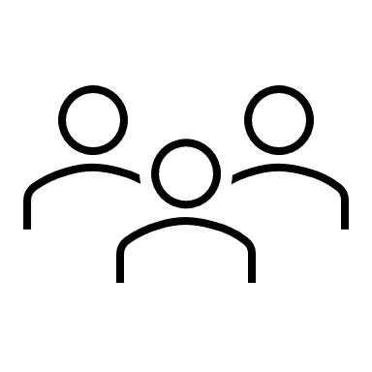

How many languages are there?
Wikipedia: 350
Text-to-speech languages: 125
Sacred texts: 2200
World: 7000
Written messages: 4000
Notes:
Round numbers, and they will continue to change over time. My sources are at the end of these slides.

Slide 6
Sample of ~100 living languages
Notes:
Some of the statistics I wanted to look at, I could merge directly into the list of 7000 languages in the IANA registry, but other questions required effort for each individual language. So I knew I didn’t have the resources to cover all 700, and I picked 100 as an arbitrary but doable number of languages to survey.

Slide 7
Not-so-random sample
55: random from the subtag registry
20: official
22: India 8th Schedule
2: participant’s languages
Total: 99
(plus 5 sign languages)
Notes:
Quickly I found that purely random was not going to work, because it would be mostly the “long tail” of obvious profound lack of access.
55 random from the IANA registry of 7000.
20 from a list of languages that were considered an “official” language in some region of the world.
Then I turned a corner, and added all 22 languages of India have a sort of official status in Schedule 8 of the constitution.
Finally, I added two more languages, Italian and Sicilian, for reasons.
5 sign languages, because of relevance to disability inclusion

Slide 8
Analysis of the sample
OS UI languages
39
99
31
TTS languages
my sample
problems
long tail = no support

Slide 9
Long tail: no support for OS UI or TTS
Long tail = no support
Dyula (dyu): 2.6 million — Burkina Faso (West Africa)
Dogri (dgo): 2.6 million — Kashmir (South Asia)
Southern Aymara (ayc): around 1 million — Peru (South America)
Balkan Romani (rmn): 600,000 — Balkan countries (Europe) …
Libon Bikol (lbl): 70,000 — Philippines (Southeast Asia) …
Apinayé (apn): 2,300 — Brazil (South America)
Heiltsuk (hei): 95 — Canada (North America)
Notes:
I hesitated to include numbers of speakers, because what do they mean? Do lower numbers mean less importance, or more urgency to address historical injustices?

Slide 10
OS UI no, TTS yes
Middle = some problems
People must use a lingua franca for their OS UI.
Javanese (jv): 68 million — Java (Indonesia, Southeast Asia)
India 8th Schedule (South Asia)
Maithili (mai): 13.6 million — Android TTS
Konkani (knn): 2.6 million — Android TTS and NVDA+eSpeak
5 other languages: 17.7 million — Android TTS

Slide 11

Quiz: true or false?
This audio is mostly unintelligible. The next slide has a clearer version of the same text.

Slide 12
Try again: TTS matching the content
Hunter-gatherers settled the islands starting around three thousand BC, likely arriving on canoes from Central and South America.

Slide 13
How does the TTS gap affect people?
Notes:
The support gap forces the content language and the OS language to differ. Similar situation for two well supported languages, which made it easier to find study participants.

Slide 14
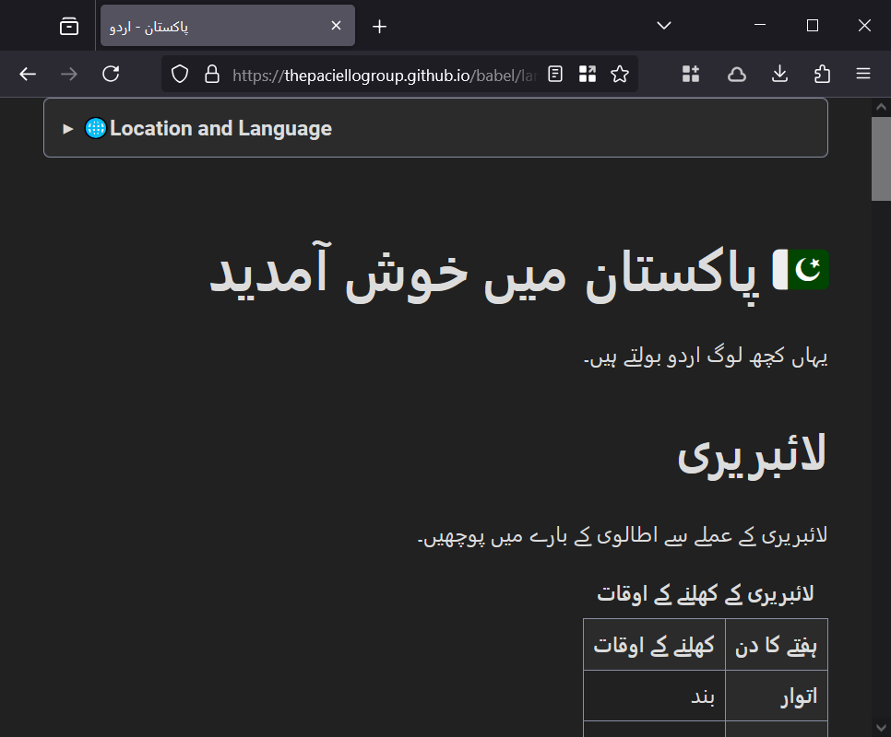
A demo page in Urdu

Slide 15
Participant: Spanish and English
Hector (name changed), L1 Spanish, works in English, blind
Hector uses multiple screen readers. For our interview he used NVDA with speech and braille. Windows UI and NVDA UI are set to English.
On the Spanish demo page:
With NVDA automatic language switching, Spanish element names are mispronounced on focus.
With Spanish specified in an NVDA Configuration Profile, element names are correctly pronounced as Spanish, while English element roles are mispronounced as Spanish.
Insights:
Elsewhere on the web, automatic language switching is problematic because a lot of content is marked up wrong.
Coping strategies. He can handle hearing English role names like “table” and “heading” mispronounced as Spanish, especially when combined with braille.
Hector first learned English braille with the wrong braille table.

Slide 16
Participant: Italian, Calabrian, English
Lucy, L1 English, blind. Grew up with a Calabrian dialect (Sangiovannese?). Lucy described her Italian skill as low, not “proper” Italian.
For our interview Lucy used JAWS with speech. Windows UI and JAWS UI are set to English.
On the Italian demo page:
With JAWS automatic language switching, Italian element names are mispronounced on focus, and roles are announced in English.
Lucy described her Italian skill as low, not “proper” Italian.
Insights:
Languages in Italy are informally called “dialects.” In reality, standard Italian is a bridge language for multiple regional languages and language continua.
It’s likely we just didn’t find a combination of content and TTS speech matching Lucy’s home language.
English UI roles mixed with Italian content is “jarring”.

Slide 17
Participant: German, English, Polish
Thomas (name changed) uses the “T2S” Android app, a text-to-speech tool for dyslexia. German is his primary language; also Polish at home; now speaks English as a professional language.
His Android OS language is set to English. The T2S app does not provide automatic language switching.
Thomas reported no access problems on the German demo page.
Insights:
Thomas uses multiple strategies including Google Lens for images of text, combined with T2S features to read aloud from the clipboard. Thomas rarely falls back to reading text visually, but can do so with reduced efficiency.
For Thomas, T2S is better than Android TTS because it reads only the visible text he wants, not things like element roles.
Manual language switching is fast and works well for Thomas.

Slide 18
Overall insights for TTS
People are more linguistically diverse than the internet is, so multilingual user journeys are common.
Advanced coping strategies are better than I expected (like mispronounced element roles), but screen readers need improvements.

Slide 19
Dominant languages
Dominant languages = support
<html lang="en">
Accessibility theory says: Required for correct pronunciation
Reality: Search results and content negotiation funnel users to their preferred language.
Language of page is important for multilingual users.

Slide 20
Sign language observations
Participant: Monica; American Sign Language and English; Deaf linguist
Participant: Anja (name changed); German, German Sign Language, and English; hearing interpreter
Insights:
Sign language means video.
Writing systems exist in academia only, so digital sign language experiences are never monolingual (e.g., German text UI with German Sign Language videos).
Video messaging is easy, but video creation workflows for websites are more burdensome for sign language content creators.
Notes:
The situation with sign languages is technologically different but has some parallels. In a digital context, sign language today means video: One-to-one, many-to-many (meeting platforms); one-to-many (live and on-demand).

Slide 21
Actions for better language access
Notes:
Turning our attention back to text-to-speech

Slide 22
Ideas for users, feasible today
Set content preferences in the platform
Set up input methods
Compare apps, assistive technologies, speech engines
Try a different voice speed or pitch per language
Complain if something doesn’t work well
Notes:
Set your OS content preferences: so websites and apps will offer content in languages you know.
Input methods: e.g. word completion, script

Slide 23
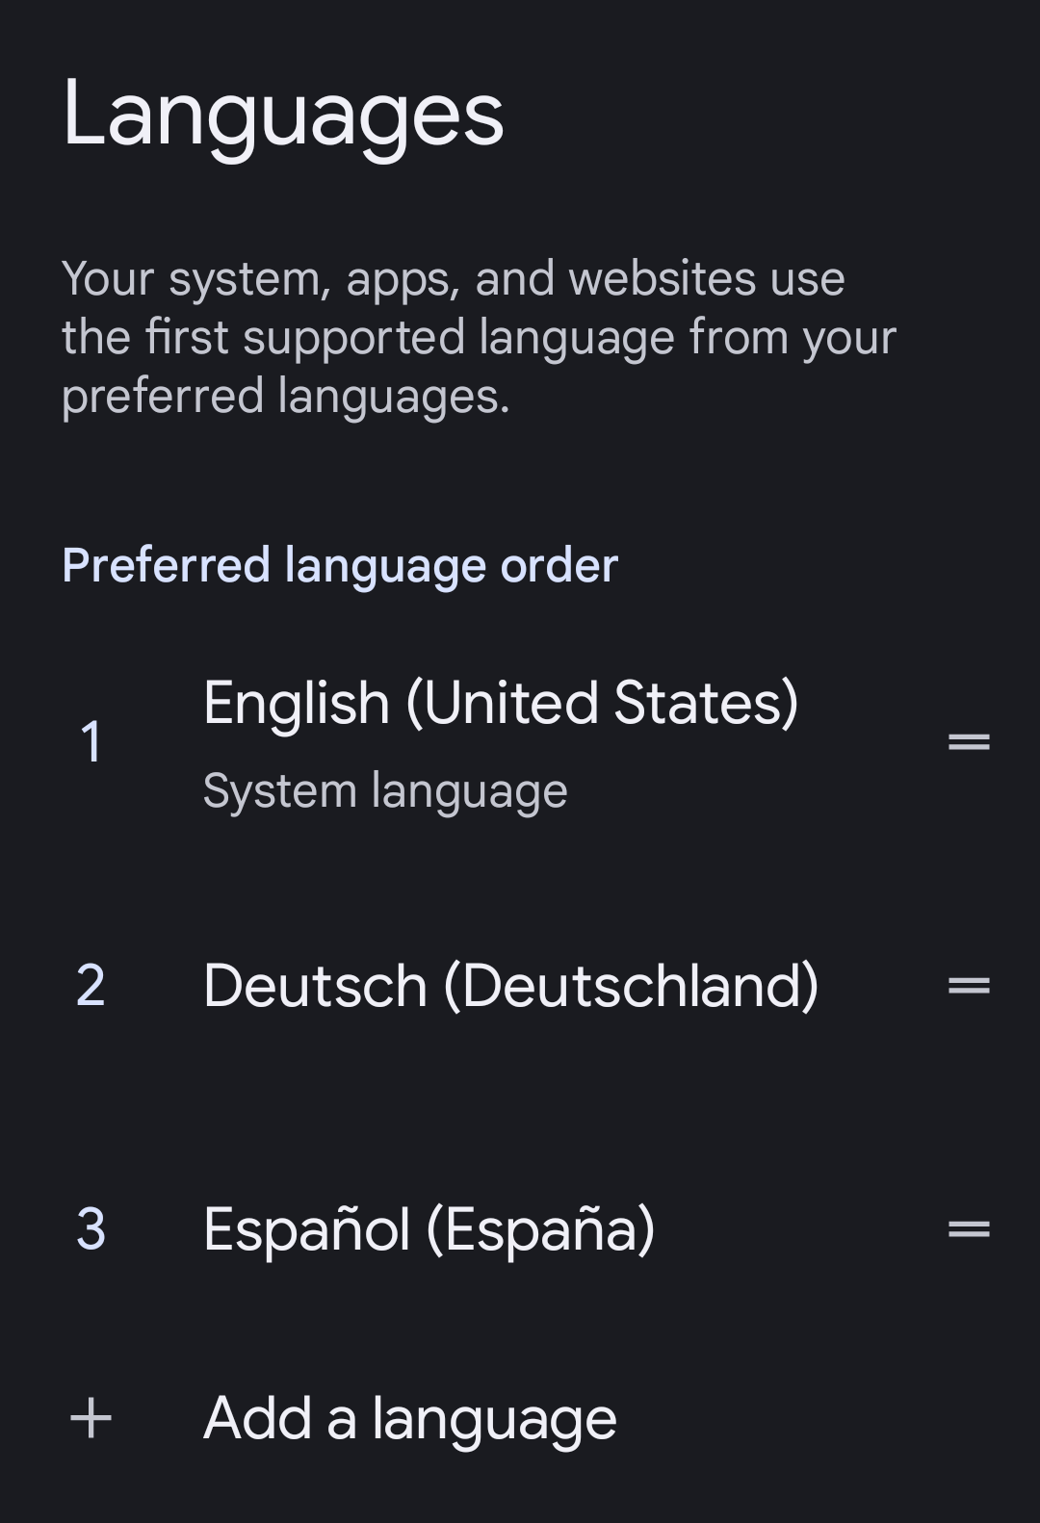
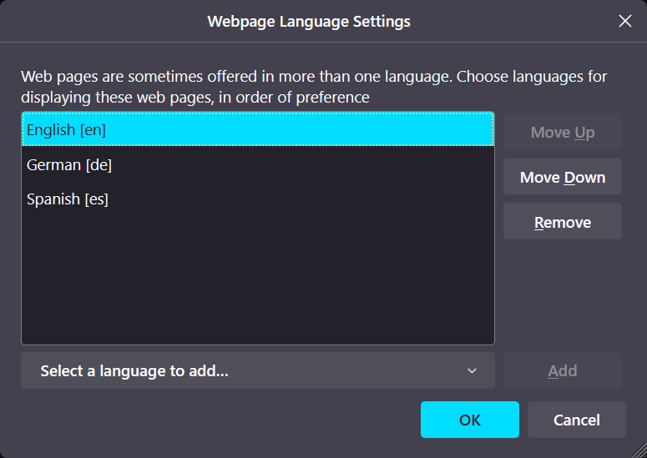
Preferred languages in OS and browser
Firefox (Windows)
Android

Slide 24
Ideas for web and app dev teams
Recruit a culturally diverse team
Localize all the things
If a language has incomplete AT support, add a lingua franca
Consider recorded content for sign languages and unsupported languages
Documentation and support: explain languages and AT compatibility
Eschew obfuscation
Notes:
And then we get into fallbacks…
A better supported language that your audience is likely to know. If you have been using a smaller language, and were looking for reasons to add an international language like Arabic or French or English, this is another reason to do it.

Slide 25
Ideas for AT and platform
Fix known bugs
Somehow fix the label problems
Offer language switching for element roles and properties
Announce the name of a language
Accelerate adding more languages and scripts, in culturally appropriate ways
AT user interface
Speech synthesizers
Braille
Voice recognition

Slide 26
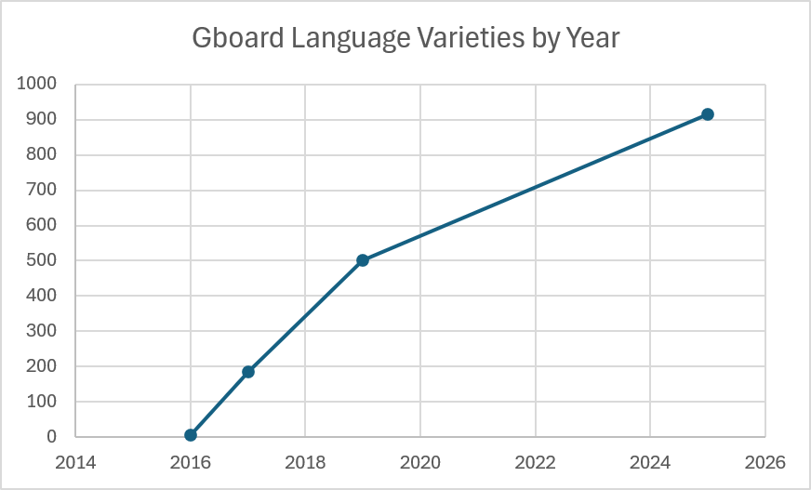
Language growth in Gboard
Notes:
916 language varieties, around 650 languages

Slide 27
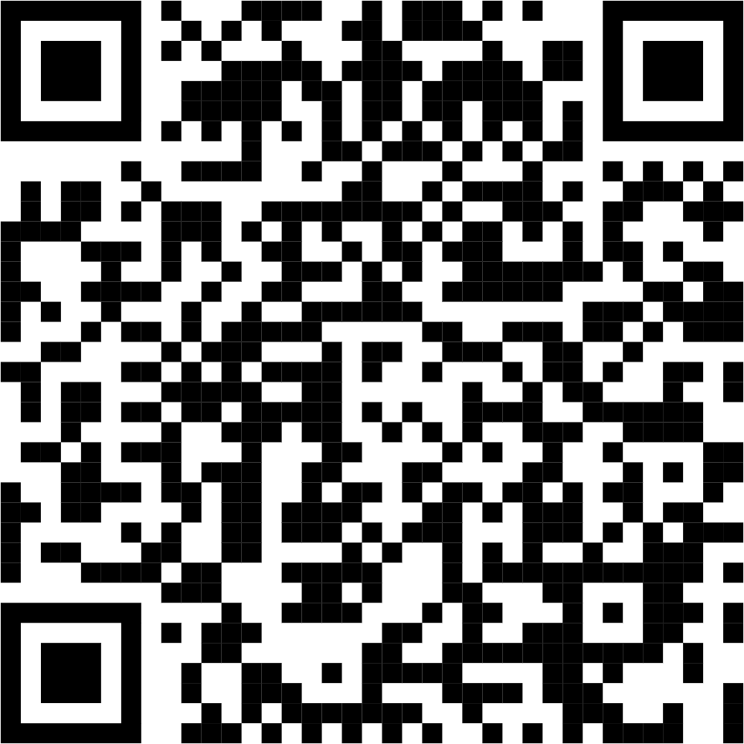
Questions?
Presentation and demos: thepaciellogroup.github.io/babel

Slide 28
Up Next …
Time | Session Title | Speaker(s) | Room
2:20 PM | A Call to Action: The Case for Accessibility Bounties in the Wild West of Free Open-Source Software Development | Jason Hester | Platinum 5
3:20 PM | Talk to Me JAWS: 10 Tips to Make Documents More Screen Reader Friendly | Elizabeth Whitaker and Cori Perlander | Platinum 5
4:20 PM | When Web Accessibility Enthusiasm Actively Harms | Ian Lloyd | Platinum 5
Tomorrow: 9:20 AM | What It Really Means to Shift Left: Transforming Your Program to Get Results | Mark Miller and Jaunita George | Platinum 5
Presentation and demos: thepaciellogroup.github.io/babel

Slide 29
Thank you! to these great people
Anja (name changed) — German Sign Language
David Sloan — study methodology
David Swallow — study methodology
Edgar Lozano elozano@tpgi.com — Urdu
Haritha Radhakrishnan — languages of India
Hector (name changed) — Spanish
Lucy Greco lucy@accessaces.com — Italian
Monica Keller-Knörzer contactmonicakeller@gmail.com — American Sign Language
Shelomita Savitri, LinkedIn — Javanese
Thomas (name changed) — German
Venkat Bitra — languages of India

Slide 30
More research and innovation needed
All the languages, all the human diversity (age, disability, technical skills, literacy)
How to prioritize? A civil society question
Hypotheses to investigate:
Do smaller languages perpetuate the digital divide?
Do digital lingua francas erode cultural diversity?
Live and recorded media
Input modes
Content management systems
Symbolic communication, AAC
Dialects and idiolects

Slide 31
Sources
For most language support statistics, see Excel files in Research (GitHub)
Slide “How many languages are there?”
World 7000: Choosing a language tag, IANA Language Subtag registry (W3C Internationalization); Excel files in GitHub link above
Wikipedia 350: List of Wikipedias retrieved 2025-01-25
Sacred texts 2200: Bible Languages and Translations - Bible.com retrieved 2025-01-25
Written messages 4000: Ethnologue: How many languages in the world are unwritten? 2023-01-27 at Archive.org retrieved 2025-03-08
Text-to-speech languages 125: see Excel files in GitHub link above
Slide “Not-so-random sample”: 8th Schedule to the Constitution of India
Language demo pages created for this project
Slide “Participant: Italian, Calabrian, English”: Finding Italy language samples of a participant's regional lect (GitHub issue #55)
Slide “Language growth in Gboard”: see “Gboard” Excel in GitHub link above

Slide 32
Further Reading
2022-2032 International Decade of Indigenous Languages (UNESCO)
Analysing support for text layout on the Web (W3C Internationalization) — includes gaps for text sizing and spacing
The Script Encoding Initiative

