Slide 1
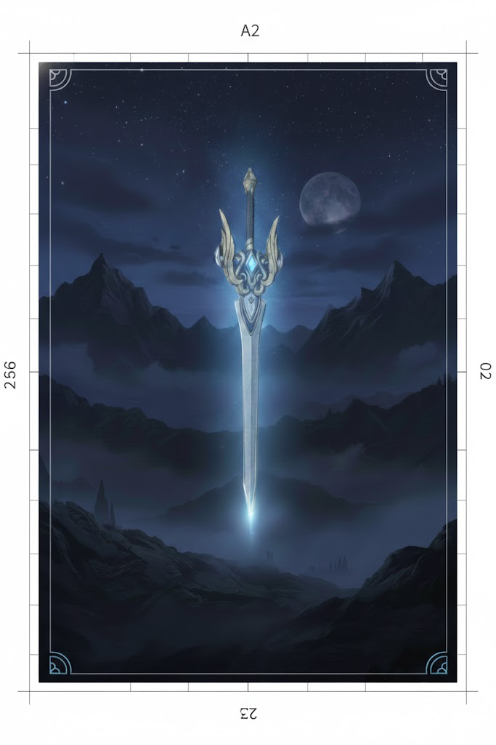

Slide 2
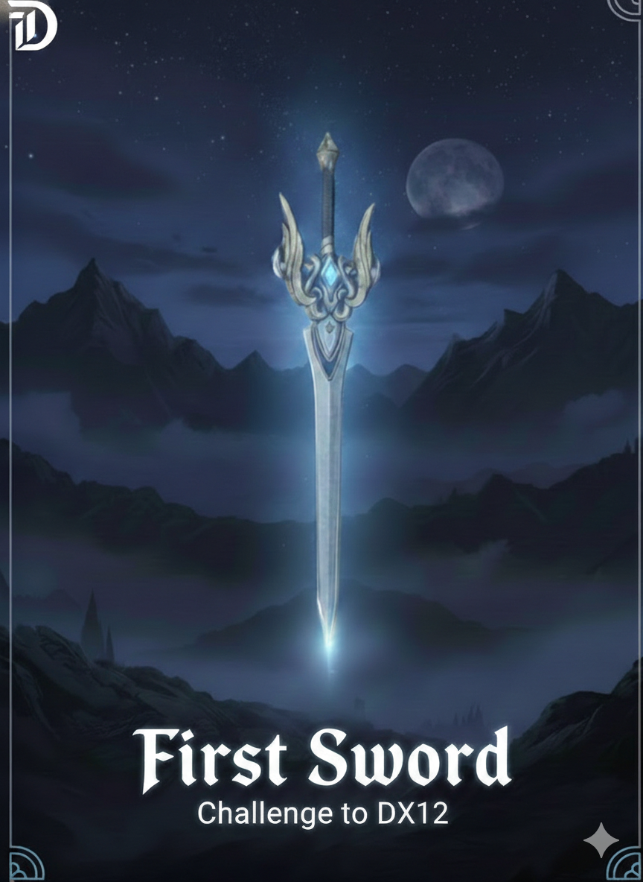

Slide 3
First Sword

Slide 4
First Sword
Drive by DirectX12
Drive by DirectX12

Slide 5
First Sword

Slide 6
