Slide 1
Week 2
man pages, more Unix commands and command line arguments
Altering .bash_profile to control terminal behavior for protection and efficiency
Viewing and editing text files (less or TextWrangler or nano)
File compression, decompression
Using Unix tools to work with some DNA sequencing data

Slide 2
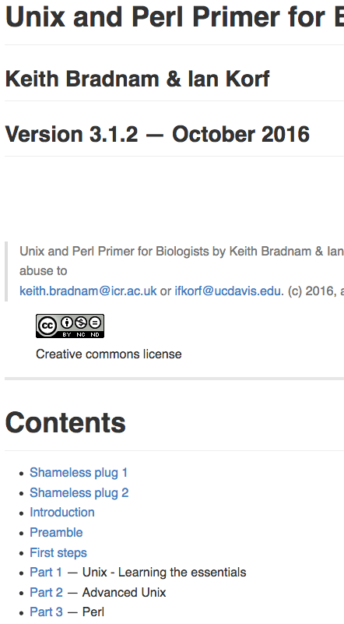
- For this week, focus on U10-U28
- Go through all of Unix Part 1, and be prepared for Unix Part 2 to be very helpful.
http://korflab.ucdavis.edu/Unix_and_Perl/current.html

Slide 3
Changing command names with aliases is useful, but risky
$ alias ls = “ls –l”
Changes the default behavior of ls, looks useful
$ alias mv = “cp”
Potentially bad
**Store carefully thought out aliases in .bash_profile, and maybe don’t mess with aliases any more than you need to

Slide 4
Removing files or directories (can be dangerous)
$ rm file.txt
Will remove file. PERMANENTLY. FOREVER.
Use the –i option as protection
$ rm –i file.txt
remove file.txt?
Recommended: alter your bash profile to always call rm –i when typing rm at the command prompt

Slide 5
.bash_profile
Contains specifications that control the way the bash terminal works
Aliases allow you to create a customized name for a command, or a set of commands with specified options
Aliases can be set in the .bash_profile to improve efficiency and safeguard against bad consequences.
- Follow U27 in the Bradnam and Korf primer (http://korflab.ucdavis.edu/Unix_and_Perl/current.html; also see page 87 of Haddock and Dunn for noclobber).

Slide 6
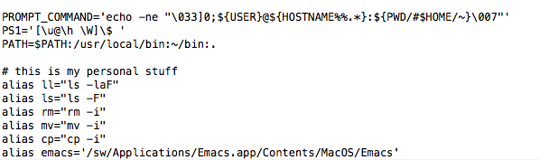
.bash_profile:
This file resides in your home directory. It is a “hidden” file. The “.” in front of such a file prevents it from being normally listed with ls
$ less .bash_profile
.

Slide 7
.bash_profile (or .profile)
We want to add alias commands to this file in order to make your shell safer.
-for e.g., rm is dangerous with its default behavior
If this file doesn’t exist, the simply make it and name it .bash_profile. Below is a recommended alias list, also detailed in the primer for the week.
alias ll="ls -laF"
alias ls="ls -F"
alias rm="rm -i"
alias mv="mv -i"
alias cp="cp -i"

Slide 8
In class: Editing your .bash_profile
Go to the bash profile section of unixII_primer.md, follow closely to understand and alter .bash_profile.
Check with one of us to ensure that you have this set correctly later in class today or first thing Thursday.

Slide 9
Unix tools to get a good handle on this week:
wc
grep
less
ps
history
cat
gzip
gunzip
top
kill
cut
paste
grep
&
*
>
|
**everything related to moving, copying or syncing files:
cp, mv, mkdir, rmdir, rm
rsync
This one is important: read man page, and try out on some test directories before next week

Slide 10
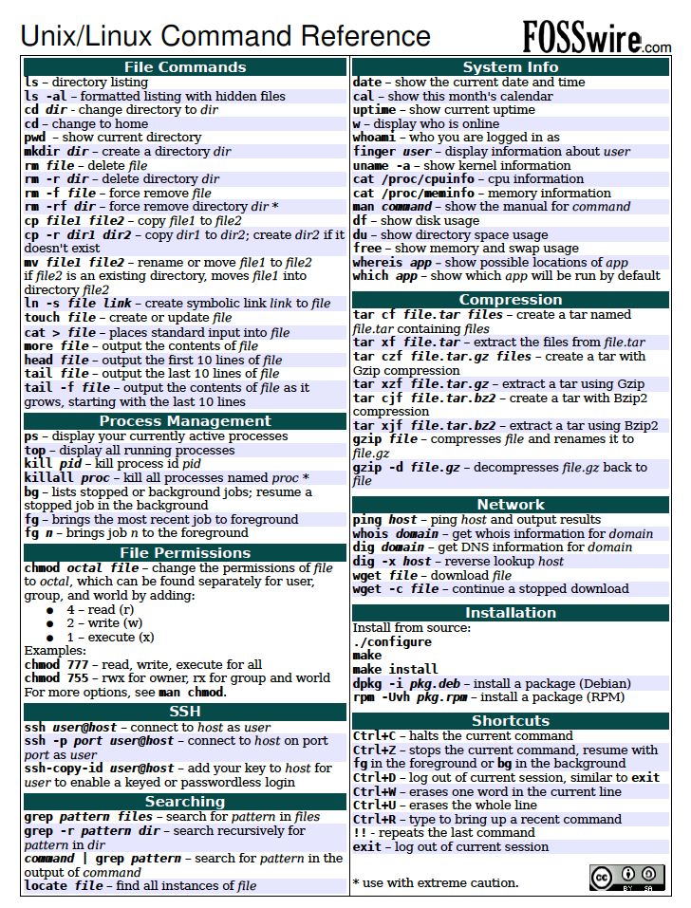
Unix cheat sheet on course webpage under “unix_resources”
I suggest keeping his on hand for now, but being comfortable with most of these commands before working on any computing clusters
There is a similar python cheat sheet in the same location

Slide 11
When to use a text viewer rather than editor:
You might not know which program your computer would ‘automatically’ use to open that file
You don’t know the size of the file. Big data will typically be too big to open with one of your text editing programs.
Sometimes you just want to look, and want to make sure you don’t accidentally edit a file (such as a complicated program)

Slide 12
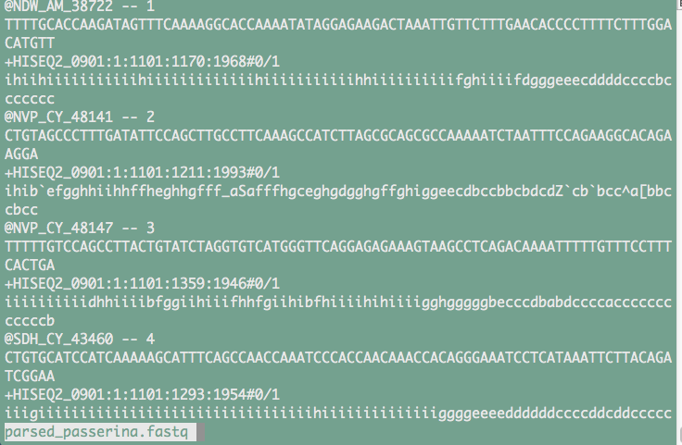
Viewing files (but not editing):
$ less data.fastq
q exits, “/” allows you to search for a pattern, space bar scrolls down a page, b goes up a page. See $ man less

Slide 13
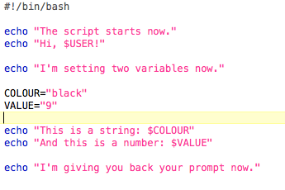
Editing text files outside of the terminal
TextWrangler: good for working on programs because it has syntax recognition.
$ open simple.sh OR $ open –a TextWrangler simple.sh

Slide 14
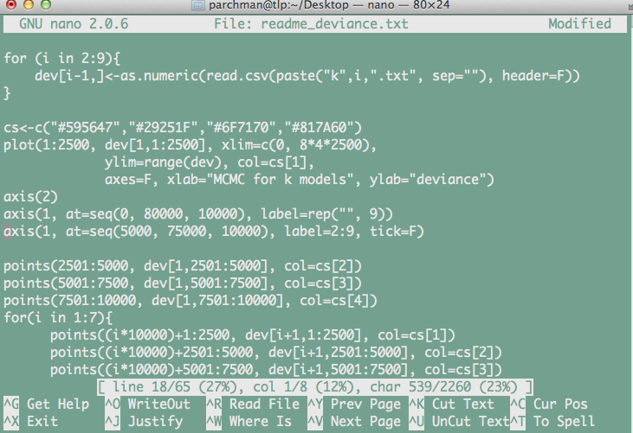
Editing text inside the terminal
Sometimes it will be easier to edit text files from within the terminal (e.g., when you are connected to a remote server or HPC system)
nano: A simple unix text editing program. Learn the basics.

Slide 15
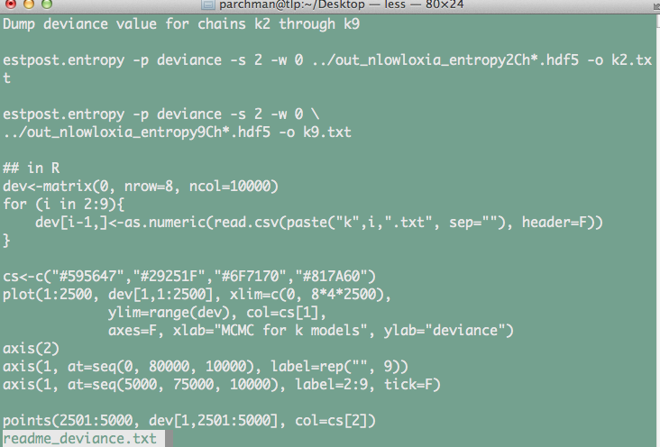
A word on line endings:
While working in Unix and Python you will quickly realize that line endings are themselves characters, although they are hidden
You nearly always want to use UNIX line endings.
Text file with Unix line endings, viewed with less

Slide 16
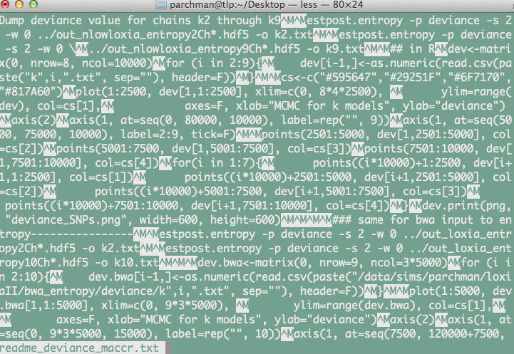
Same file with but with Mac line endings, viewed with less

Slide 17
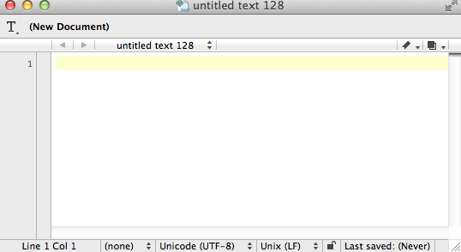
You can change line endings simply in Text Wrangler.
- Later we will write a shell script to do this automatically

Slide 18
File compression/decompression
$ gzip sample_passerina.fastq
This will compress sample_passerina.fastq and rename it sample_passerina.fastq.gz
$ gunzip sample_passerina.fastq.gz
This will decompress sample_passerina.fastq.gz

Slide 19
What is STDOUT?
When you execute a unix command, this is what prints to the terminal.
For example:
$ ls
-STDOUT is the printout of directory contents
$ tail file.txt
-STDOUT will be the last part of that file
We will often want to “redirect” (>,>>) that output to another file or “pipe” (|) it into another program

Slide 20
Redirection (>,>>)
$ ls > directory_contents.txt
$ cat *data.txt > loggerdata_alldays.txt
$ cat newdata.txt >> loggerdata_alldays.txt

Slide 21
Other tools for working with text files:
$ cat sample_passerina.fastq #prints entire contents to shell
$ cat sample_passerina.fastq | less #pipes output to less (so you will see 1 page at a time)
$ head –n 1000 sample_passerina.fastq #prints first 1000 lines to shell
$ head –n 1000 sample_passerina.fastq > 10000lines.fastq #writes the first 1000 lines to a new file

Slide 22
grep: regular expression engine, text extraction.
- Among the most widely used Unix commands in data science
Works one line at a time for a given file, fast
Returns lines containing pattern matches
The pattern can be an exact pattern, or a flexible regular expression, which we will learn about A LOT more when we start learning perl
File contents of fruitlist:
applesauce
apple fritters
peach ice cream
Squash is not a fruit
banana
scrapple
strawberry
Apple festival
$ grep apple fruitlist.txt
Will return all lines containing the pattern match

Slide 23
$ grep [options] <pattern> <file>
$ grep apple fruitlist.txt > applelines.txt
#Will write the lines containing the pattern match to the file “applelines.txt”
$ grep –c apple fruitlist.txt
#Will return the COUNT of the number of lines containing the pattern match
$ grep –V apple fruitlist.txt
#Will return the lines that DON’T match the pattern

Slide 24
Process monitoring/control
$ top #shows a list of what processes are running on your computer
**quit top with “q”
$ ps aux #shows process ids (PID), you can use these with kill
$ kill 9031 #kills a job with a supplied PID e.g.:
Use Ctrl-C to Interrupt a Job running in the shell
Append a "&" to a command to start it in the background

Slide 25
Before next week
Make sure you have at least looked at, if not gone through all of the examples in the Bradnam and Korf primer through U29 (http://korflab.ucdavis.edu/Unix_and_Perl/current.html#part1).
2. Feel solid about chapters 4 and 5 in Haddock and Dunn, have a peek at Chapter 16.
3. Go very thoroughly through unixII_primer.md, and unix_assignment_2.md.
**Note, I wont ask you to turn anything in this week, but will starting next week.

Slide 26
Independent project idea discussion?
Could be as simple as writing perl scripts for everyone in the class to have for really simple things
OR
As complex as genome assembly pipeline.

