Slide 1
Software Bug Tracking & Reporting Tool
Parth Maru

Slide 2
Agenda
Introduction
Features
Tech stack
System overview and user journey

Slide 3
Introduction
BugTracker is a comprehensive web-based bug tracking and reporting system designed for software development teams.
Eliminates the manual, time consuming process of checking duplicate bugs and assigning bugs to teams and users.

Slide 4
Features
Basic Features:
Encrypted authentication.
Project and teams-based workflows.
Detailed bug creation along with feature to attach documents.
Bug comments and user notifications.
In-depth analytics of bugs and users based on projects.
Advanced Features:
Real time duplicate bug detection.
Automatic teams and user assignment.
Gamification and leaderboard.

Slide 5
Tech Stack
Frontend Tech
Backend Tech
Database
React
Tailwind CSS
Shadcn UI
Radix UI
Java
SpringBoot
JWT encryption
Web-Sockets
Postgres DB
Flyway DB migration
DB caching

Slide 6
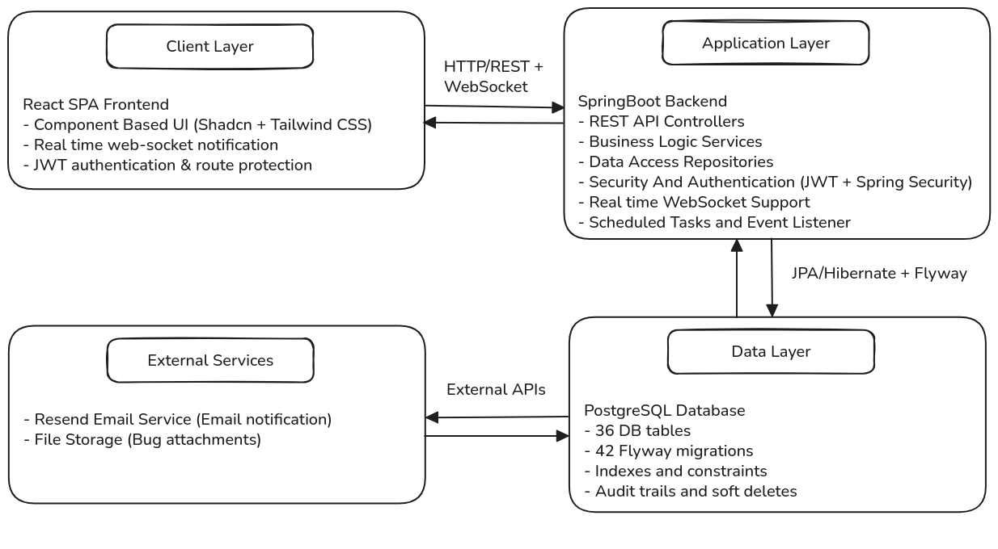
System Architecture

Slide 7
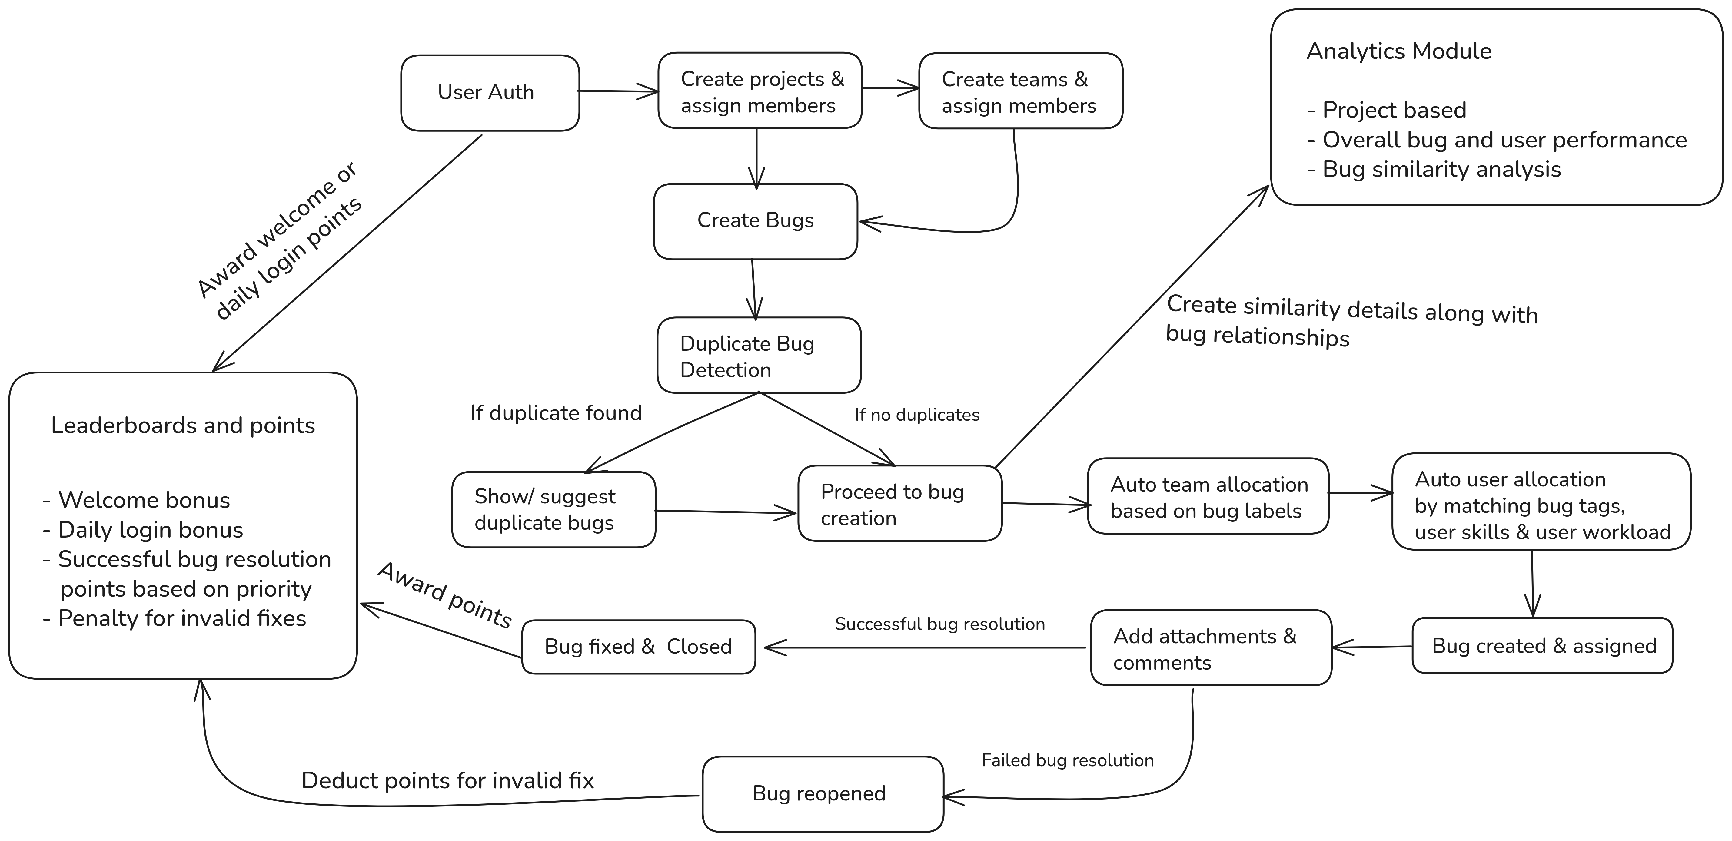
System Overview & User Journey

Slide 8
Thank You 😊

