Slide 1


NSO App
Cory Clow
Jason Wuertz
CS 212
November 28, 2013

Slide 2

Application Description
Why is this relevant?
Who will use it?
Notes:
The first week of university for new students can be a very intimating and challenging experience.
The purpose of this application is to make this new and frightening experience as smooth and as stress-free as possible for students attending the University of Prince Edward Island for the first.
This app aims to make organizing the New Student Orientation week for the participating students very relaxed and hopes to provide an interface to allow for a very pleasurable experience.
It also provides some general information about the campus and other useful applications for general day-to-day organization for both NSO students and students who are not participating in the New Student Orientation week.

Slide 3
Goals
Inform students off all NSO events
Allow users to quickly access and add contacts
Allow users to add alarm events
Provide easy access to campus info which
Easy access to a campus map for navigation of the school grounds
Notes:
-as students meet new people throughout the week, they can easily add them to their contact list
-users can create alarms for events they are interested in

Slide 4
Features
Tab View Controller
Table Views
Segmented Controller
UI Web View
Alarms
Contact List
Notes:
-This is the main way that users will navigate the application, from feature to feature.
-Table views are used for displaying several different aspects of data. The NSO events, alarm events, and contacts are all displayed using table views.
-Used for choosing between 3 different choices of campus information
-Used for displaying information about the campus. The UIWebView is used to display the gym information which is the actual UPEI gym website which is online. For the library and Wave information, the UIWebView is used to display both offline HTML code and pdf files. A UIWebView is also used to display the campus map which is a pdf as well.

Slide 5
Frameworks
AddressBook.framework/AddressBookUI.framework
The framework allows users to store people’s contact information in a centralized database, which can be shared between applications. This framework was utilized in our create/view contacts part of our application.
CoreData.framework
This framework utilizes a built in SQLite feature which allows the application to store data using data persistence. This framework is employed in the NSO events aspect of our application to save the particulars about each NSO event and display them every time the application loads.
CoreGraphics.framework
Used for cell sizing in the table for for NSO Events

Slide 6
Limitations
We would like to be able to click on the events in the NSO Events tab and instantly create an alarm event.
Contacts would like to be editable
Add/Delete/Edit events

Slide 7

NSO Events Table
Table Organization
Information Organization
Data Storage
Notes:
Tbl Org:
2 UITableViewControllers
Day
Events
Data Storage
Core Data was used to organize information,
data persistence was not used,
the information is regenerated on app launch
due to small amount of data
more flexible to changes
Info org:
day name = title
day date = subtitle
event title,time,location make title and subtitles
event description special field that resizes based on how much description
event hourse used for sorting

Slide 8
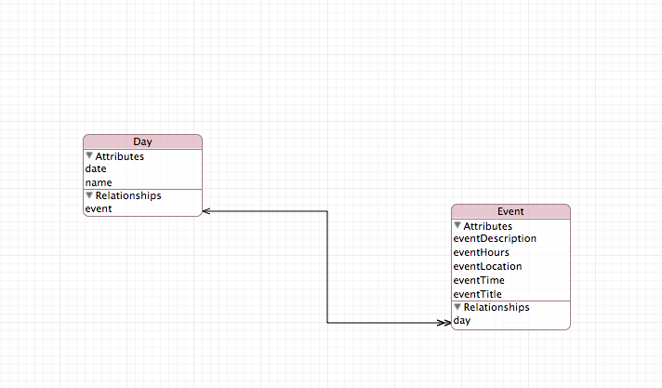
Core Data

Slide 9

Contact List
TableViewController
Customized Rows
Notes:
-as mentioned before, the addressbook framework was used
ABAddressBookRef addressBook;
NSMutableArray *menuArray;
-used a plist file to store the data for the choices that the user can select
-used static cells in the table view and the style of the cell custom to make the rows act like buttons so it is more aesthetically appealing for the user
-peoplepickerNavigationController(display) and newPersonViewControllers(new person) part of addressbook framework

Slide 10

Alarm
TableViewController
Swipe to delete
Different Notifications

Slide 11
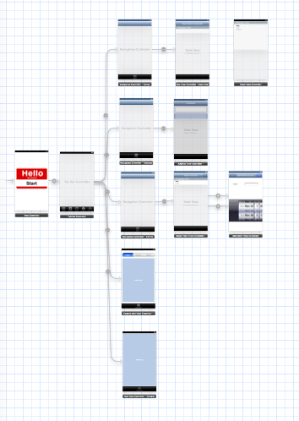
Implementation
Git
StoryBoard

Slide 12

DEMO!

