Slide 1
Online Grocery Delivery System
By: Yamil Diaz

Slide 2
Introduction
The Online Grocery Delivery System allows customers to quickly order groceries online and have them delivered at their conveniences
The system connects customers, store managers, and delivery staff through one platform
Customers browse items, place orders, pay online, and track their deliveries in real time.
Store managers manage product listings and inventory, and delivery staff update delivery statuses.

Slide 3
Roadmap
Next we will show how users can:
Login
Browse/Add to Cart
Adjust quantity of items
Add and remove items in cart
Checkout/Pay
Add customer information: full name, email, address, phone number, and card number
Track Order

Slide 4
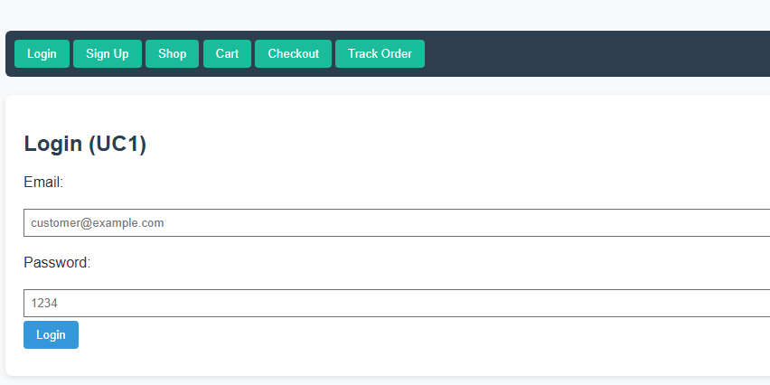
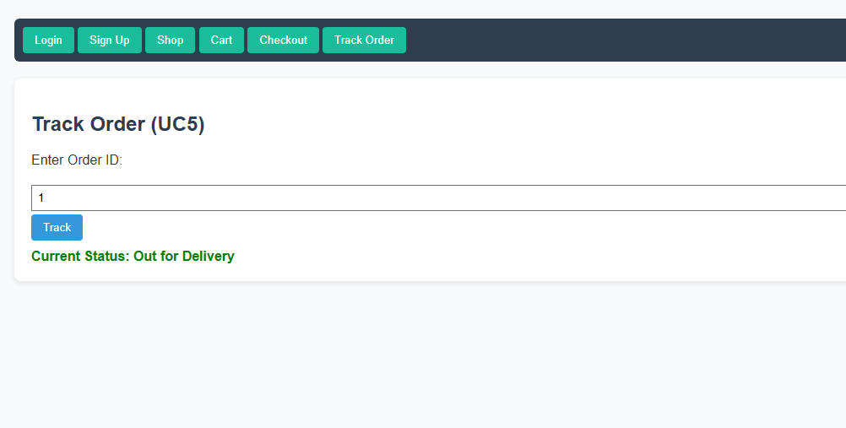
Live Demonstration

