Slide 1


Slide 2

Problem
Losing a pet is terrifying
Finding a lost pet is confusing
Homeless animals are being exterminated

Slide 3
Cause
No universal procedure
Lack of structured data

Slide 4
Solution
“911 for pets”
Comprehensive database of homeless animals

Slide 5
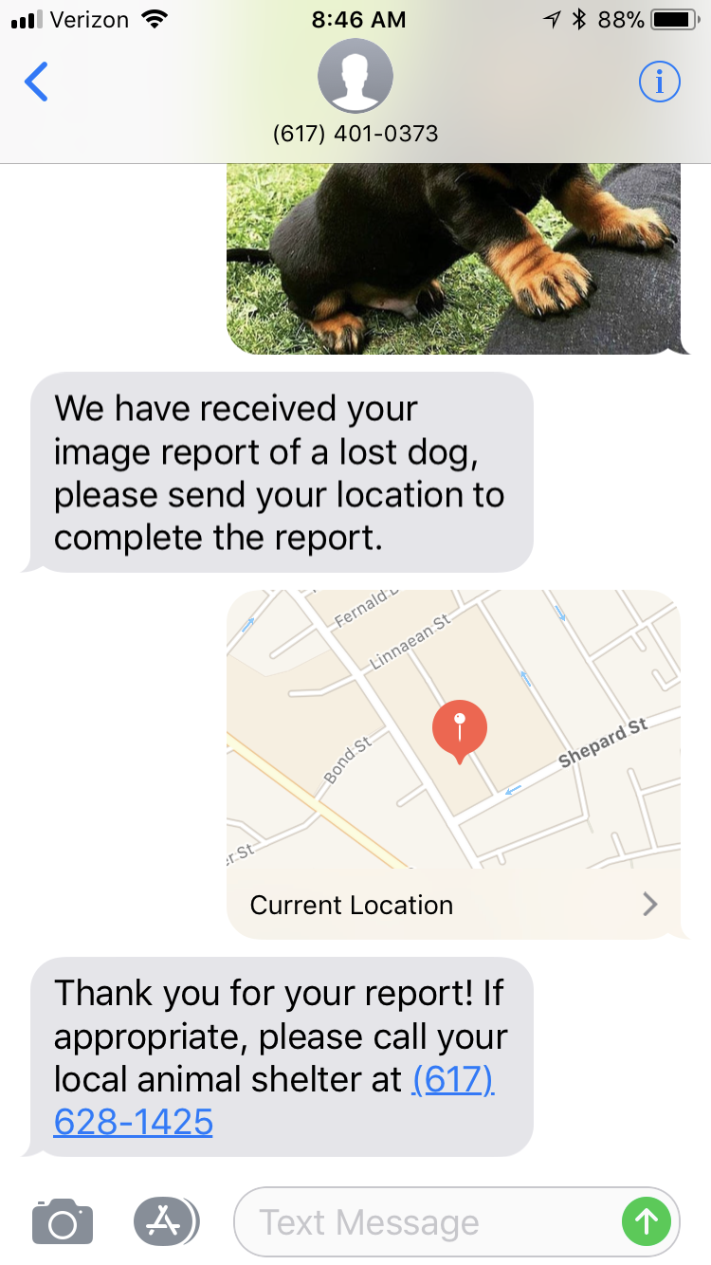
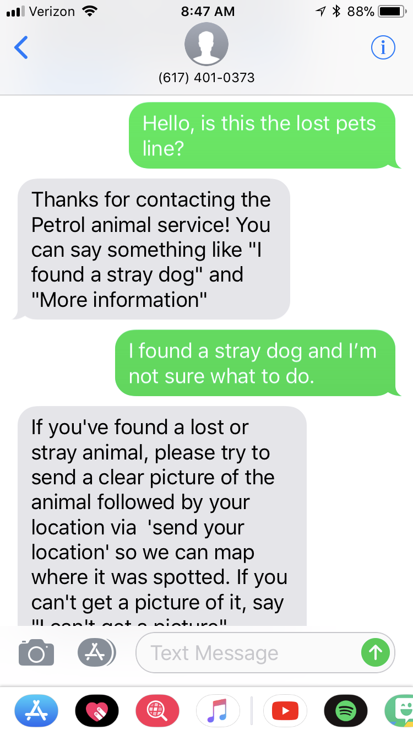
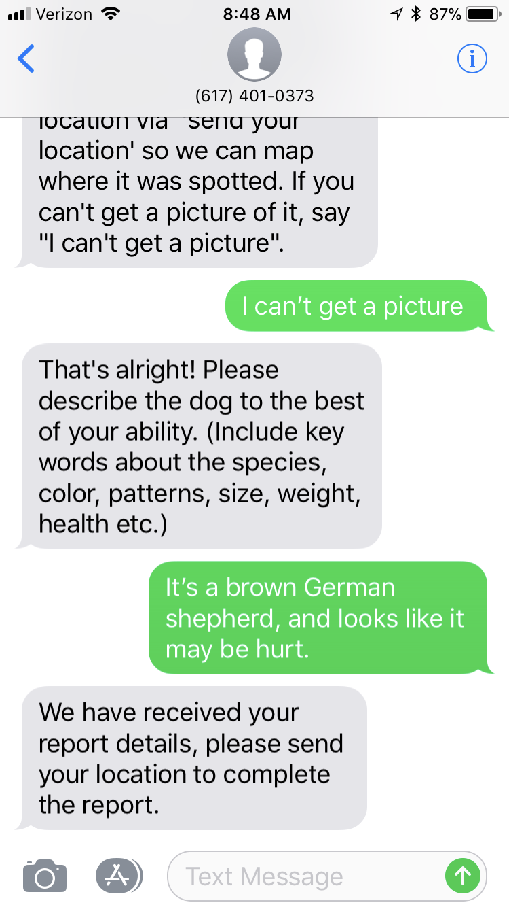

Slide 6






