Slide 1
Literal suffixes for size_t and ptrdiff_t
P0330 – A C++20 Paper
JeanHeyd Meneide
phdofthehouse@gmail.com – Twitter: @thephantomderp
https://thephd.github.io/vendor/future_cxx/papers/d0330.html

Slide 2
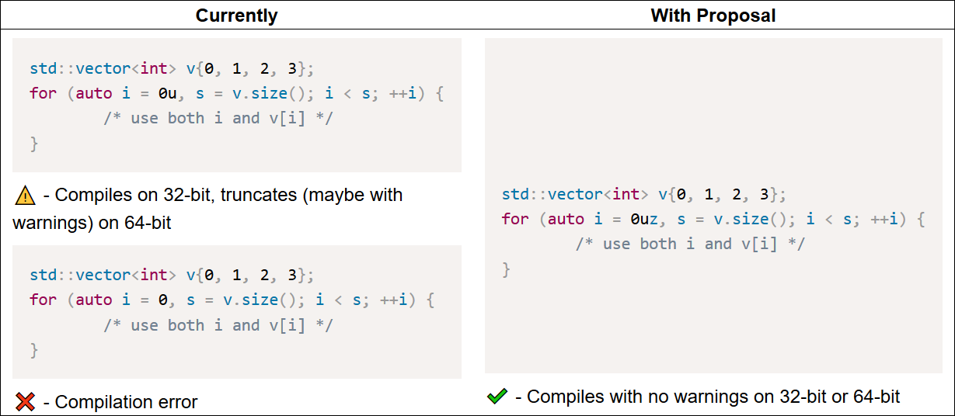
Before/After

Slide 3
History
Originally proposed as Library User-Defined Literals in C++17 timeframe
Written by Rein Halbersma, presented by Walter E. Brown
Last-minute course-change from LWG, just before it was actually accepted:
“This is not a library concern (any more); EWG has taken ownership. The types in question (size_t and ptrdiff_t) are not library types, but rather core language types.” – LWG, 2018

Slide 4
Design
Uses the suffix z
Cannot use s: is in clash with upcoming sf – short float paper
Avoid sz: clash with short float that makes sz harder to understand
zu/uz – size_t
Core language allows u to appear on either side of a literal
Equivalent to type of decltype(sizeof(0))
z – ptrdiff_t
Equivalent to type of decltype((char*)nullptr – (char*)nullptr)

Slide 5
What about t and z?
Some advocated for t (ptrdiff_t) and uz/zu (size_t) to be separate suffixes
If used by themselves, then we leave a problem with ut/tu and plain z
unsigned ptrdiff_t and signed size_t do not exist in the standard (!!)
int main() { signed decltype(sizeof(0)) x = 0; unsigned decltype((char*)nullptr - (char*)nullptr) y = 0; return x - y; }

Slide 6
The Type You Are Looking For is in Another CastleStandard
main.cpp:2:32: warning: long, short, signed or unsigned used invalidly for 'x' [-Wpedantic] main.cpp:3:56: warning: long, short, signed or unsigned used invalidly for 'y' [-Wpedantic]
C++ does not define what these types are
That is a much more complicated and involved paper
Not even POSIX defines what an unsigned ptrdiff_t would be (you do have ssize_t)
Maybe intptr_t, maybe uintptr_t ??

Slide 7
Wording Complete
Paper is Core-ready
Reviewed by Tim Song prior to meeting
Reviewed by Walter E. Brown prior to meeting

Slide 8
Polls
Forward to EWG and CWG to handle for C++20?
Strongly in Favor | In Favor | Neutral | Against | Strongly Against

Slide 9
Extra Polls (if needed)
Have t for ptrdiff_t and uz/zu for size_t, then leave it up to somebody to figure out what ut/tu for unsigned ptrdiff_t and z for signed size_t?
Strongly in Favor | In Favor | Neutral | Against | Strongly Against

