Slide 1
Named Character Escape Sequences
P1097 – Targeting C++20
R. Martinho Fernandes | cpp@rmf.io
Presented By: JeanHeyd Meneide & Tom Honermann
phdofthehouse@gmail.com & tom@honermann.net
https://wg21.link/p1097

Slide 2
What… Are these?
u8"´"
u8"́"
u8"´"
u8"А"
u8"Ꭺ"
u8"ꓮ"
u8"𐊠"

Slide 3
What Are These?
u8"\u00B4"
u8"\u0301"
u8"\u1FFD"
u8"\uD090"
u8"\u13AA"
u8"\uA4EE"
u8"\U0016F40"

Slide 4
What Are These?
u8"\N{ACUTE ACCENT}"
u8"\N{COMBINING ACUTE ACCENT}"
u8"\N{GREEK OXIA}"
u8"\N{CRYLLIC CAPITAL LETTER A}"
u8"\N{CHEROKEE LETTER GO}"
u8"\N{LISU LETTER A}"
u8"\N{MIAO LETTER ZZYA}"

Slide 5
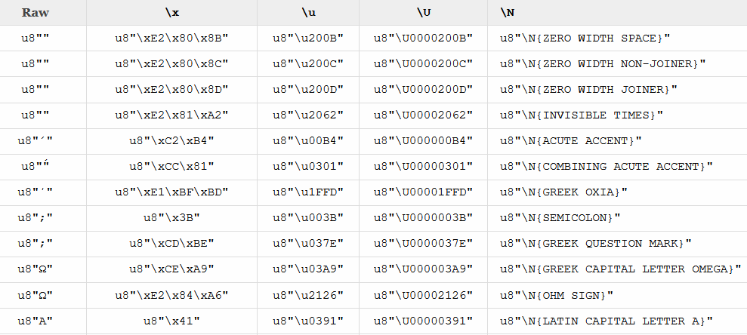
Motivation…

Slide 6
What’s in a Name?
Readability
Know what is actually being put in your string
Consistency
Identifiers are created out of ASCII alpha-numeric characters with dashes and spaces
All name -> character mappings are absolutely stable (even the mistakes…)

Slide 7
Name Aliases
Shorthand for longer names that sometimes make it even shorter than their U-codes
"\N{NO-BREAK SPACE}" // matches Name for U+00A0
"\N{KANNADA LETTER LLLA}" // matches correction alias for U+0CDE
"\N{NBSP}" // matches abbreviation alias for U+00A0
"\N{LINE FEED}" // matches control character alias for U+000A
"\N{LF}" // matches abbreviation alias for U+000A

Slide 8
Minutae
In UAX #44 – Unicode Character Database (https://www.unicode.org/reports/tr44/#UAX44-LM2):
Extremely loose forward-compatible matching is demonstrated (ignore underscore, medial hyphen, spaces, etc..)
Most languages do not do complete loose matching
Python: Case insensitivity
Perl: Exact match

Slide 9
Matching for C++
Proposed: Case Insensitivity
Simplest, reasonably easy to implement
Some impedance mismatch with {ZERO-WIDTH-SPACE} versus {ZERO-WIDTH SPACE}
Compiler can error on inability to find a proper escape sequence to prevent silent spelling errors
E.g.:
"\N{nbsp}" // matches abbreviation alias for U+00A0
"\N{LiNe fEED}" // matches control character alias for U+000A
"\N{lF}" // matches abbreviation alias for U+000A

Slide 10
Wording
The paper has wording and is ready to send to Core

Slide 11
Questions?
Do we want named escape sequences? (Recommended: Yes)
“\N{NO-BREAK SPACE}”
Do we want to support name aliases? (Recommended: Yes)
“\N{NBSP}”
Do we want case-insensitive matching? (Recommended: Yes)
“\N{nO-BreAK SpAcE}”
Do we want full UAX #44 LM2 name matching?
“\N{no_bREA_k S P A C E}”
“\N{No_BR E A_K_S-P-A-C_E}”

