Slide 1
Literal suffixes for size_t and ptrdiff_t
P0330 – A C++20 Paper
JeanHeyd Meneide
phdofthehouse@gmail.com – Twitter: @thephantomderp
https://thephd.github.io/vendor/future_cxx/papers/d0330.html

Slide 2
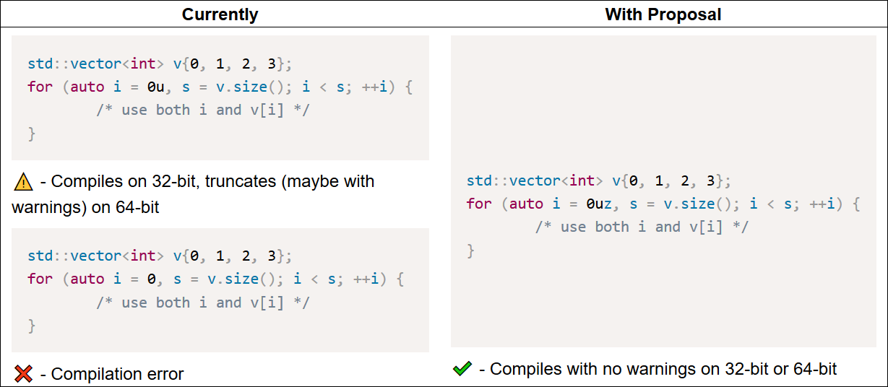
Before/After

Slide 3
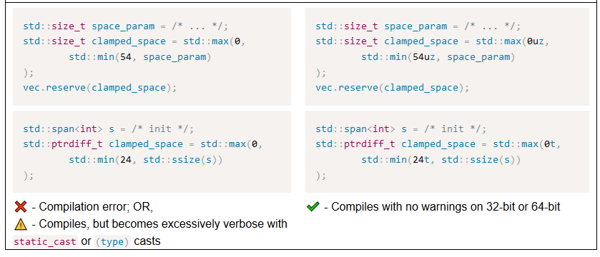
Before/After II

Slide 4
Literals are Sensitive to Implementations
32 bit vs. 64 bit
Signed vs. Unsigned
Accidentally degrading math results by using wrong-sized value (VC++ streams…)
Size issues from one compiler/platform to another (long on GCC versus VC++)
Worked around with…
Macros
static_casts for template arguments, or providing explicit template arguments
Explicitly forbidding use of regular types and only use std:: types

Slide 5
History
Originally proposed as Library User-Defined Literals in C++17 timeframe
Written by Rein Halbersma, presented by Walter E. Brown
EWG: “We want to solve this problem with a language extension”
Strongly favored (2 | 15 | 0 | 2 | 2), Albuquerque 2017
Last-minute course-change from LWG, just before it was actually accepted:
“This is not a library concern (any more); EWG has taken ownership. The types in question (size_t and ptrdiff_t) are not library types, but rather core language types.” – LWG, 2018

Slide 6
Design
Uses the suffixes z (signed size_t), t (ptrdiff_t)
Cannot use s: is in clash with upcoming sf – short float paper
Avoid sz: clash with short float that makes sz harder to understand
Core language allows u to appear on either side of a literal
size_t (zu/uz) | signed size_t (z)
Equivalent to type of decltype(sizeof(0))
ptrdiff_t (t) | unsigned ptrdiff_t (tu/ut)
Equivalent to type of decltype((char*)nullptr – (char*)nullptr)

Slide 7
Design II
“Two Suffixes? Aren’t size_t and ptrdiff_t duals of one another?”
Not necessarily: arm7-apple-darwin has
using size_t = unsigned long;
using ptrdiff_t = int;

Slide 8
Wording Complete
Paper is Core-ready
Reviewed by Tim Song prior to meeting
Reviewed by Walter E. Brown prior to meeting
Despite not having a standard library typedef for “corresponding signed/unsigned type of size_t/ptrdiff_t”, Hubert Tong and Jens Maurer donated wording

Slide 9
Polls
We want zu/uz and z as literal suffixes
SF | F | N | A | SA 3 | 2 | 1 | 2 | 1 Passes, but not with strong favor Would prefer not to see anymore terse suffixes for anything size_t being more common, should have a shorter prefix
We want ut/tu and t as literal suffixes
SF | F | N | A | SA 3 | 1 | 2 | 2 | 0 Passes, but not with strong favor It doesn’t seem like a commonly used type to warrant its own literal Would prefer not to see anymore terse suffixes for anything

