Slide 1

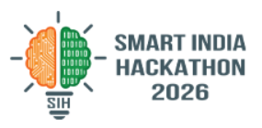


SMART INDIA HACKATHON 2026
  Problem Statement ID – SIH26038
  Problem Statement Title- Explainable AI for Diabetic Retinopathy Screening in Rural India
  Theme- MedTech / BioTech / HealthTech
  PS Category- Software
  Team ID- 178208
  Team Name (Registered on portal)- _Veyronix_

Slide 2
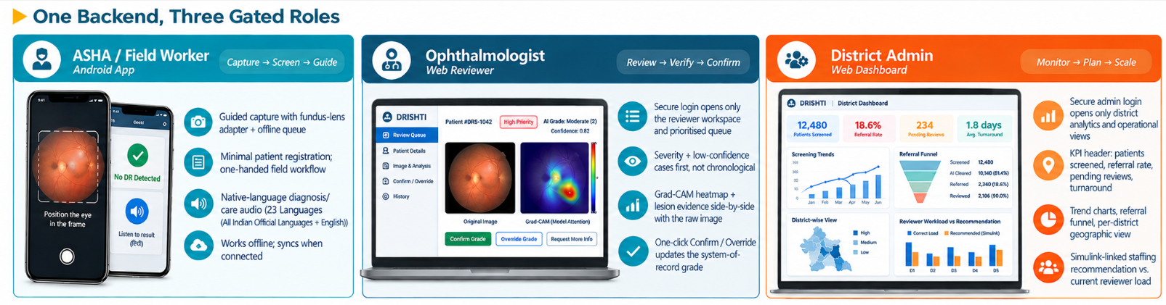




Veyronix
DRISHTI
Explainable AI Diabetic Retinopathy Screening for Rural India
Kiosk-style remote screening pipeline: A MATLAB + Python pipeline that grades diabetic retinopathy severity from a fundus photo, explains its reasoning with lesion-level evidence and Grad-CAM, routes uncertain cases to a human, and models district-level rollout capacity — so a single ophthalmologist can safely screen 100,000+ patients/year through ASHA workers and PHCs.
GitHub Repository: https://github.com/ThePhantom007/Drishti
Live Deployment: https://drishti-frontend-c9mj.onrender.com/
Human-in-the-loop safety
Calibrated confidence: gates referral to an ophthalmologist.
Validated cross-camera
Ben Graham normalisation and multi-source training, tested on an untouched external benchmark.
Native-language voice output
Diagnosis and care instructions read aloud in the patient's language for ASHA-led delivery.
Dual-path grading
Rule-based ICDR logic cross-checks the trained model.
@SIH Idea submission- Veyronix
2
Notes:
2

Slide 3

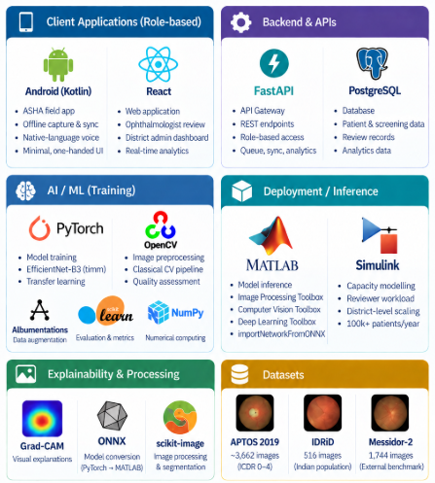
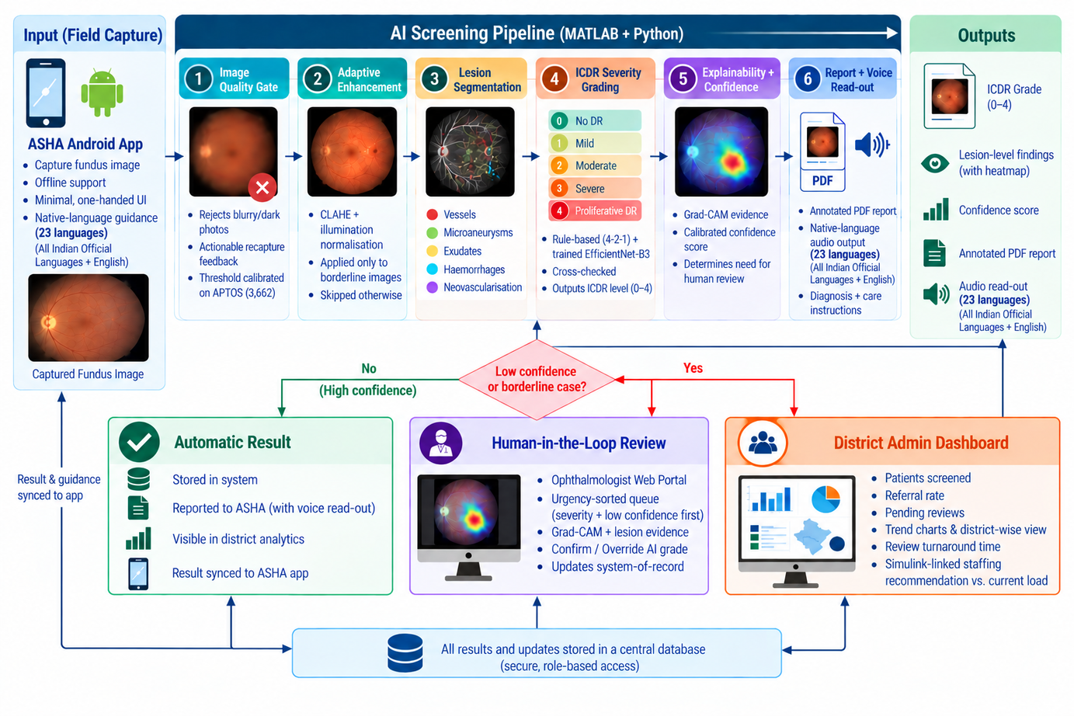
Veyronix
TECHNICAL APPROACH
Technology Stack
System Architecture & Data Flow
Train fast in PyTorch → export ONNX → import into MATLAB (importNetworkFromONNX) for inference + Grad-CAM — a hybrid: fastest iteration where it matters, MathWorks tooling where the problem statement calls for it.
@SIH Idea submission- Veyronix
3
Notes:
3

Slide 4
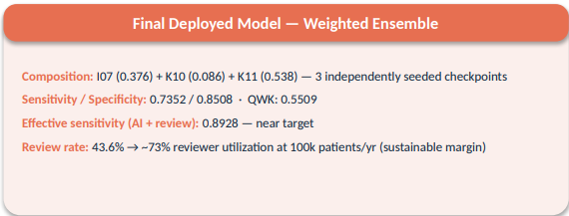
Veyronix
FEASIBILITY AND VIABILITY
Feasibility: Core classical-CV pipeline runs end-to-end today with no trained model required; the trained severity classifier is tested on Messidor-2, a benchmark completely untouched during training.
Iteration Evidence (external Messidor-2 benchmark)
Referable-DR sensitivity (target ≥ 0.90)
1.Baseline model
0.50
2.Ben Graham norm. + IDRiD data
0.62
3.Weighted ensemble
0.74
Key Risks — Identified & Addressed Through Testing
Risk | Why it matters | Mitigation strategy
Cross-camera domain shift | Confirmed via external Messidor-2 testing | Ben Graham color normalisation + multi-source (APTOS+IDRiD) training
Rare-class (severe/PDR) data scarcity | Causes unstable, biased predictions | Class-weighted sampling + ordinal-aware loss + seed/checkpoint selection
Silent misdiagnosis risk | Any AI-alone system can be confidently wrong | Calibrated confidence gates mandatory human review, never a silent miss
District rollout planning | Unknown staffing/bandwidth needs | Simulink capacity model sizes reviewers & bandwidth for target volume
Field-worker adoption & digital literacy​ | ASHA workers need a one-handed usable tool | Android deployment of a lightweight app with native language read-outs
Silent misdiagnosis risk | Any AI-alone system can be confidently wrong | Calibrated confidence gates mandatory human review, never a silent miss
@SIH Idea submission- Veyronix
4
Notes:
4

Slide 5
IMPACT AND BENEFITS
Veyronix
1
Social
  Early detection of preventable blindness for populations with least specialist access
  Native-language voice read-out of diagnosis + instructions removes the literacy/language barrier for ASHA-led rural deliver.y
  Turns ASHA workers & rural PHCs into real screening points
101M
people living with diabetes in India.
ICMR-INDIAB, 2023
2
12.5%
of diabetics develop diabetic retinopathy.
Lancet Glob. Health, 2022
Economic
  Frees scarce ophthalmologist time for genuinely referable cases only, via automatic triage
  Avoids costlier late-stage treatment and lost productivity from preventable blindness
  Simulink capacity model lets a district right-size staffing/bandwidth investment, not guess
~12.6M
Indians estimated to have DR nationally.
derived: 101M × 12.5%
3
Environmental
  Fewer screening-only trips to distant clinics — lower travel cost, time, and carbon footprint
  Reduces load on already overstretched public hospital infrastructure
  Deployable on existing smartphone + low-cost fundus-lens hardware, no new infrastructure
4.0%
have vision-threatening DR. (~4M people)
SMART-India study, 2022
@SIH Idea submission- Veyronix
5
Notes:
5

Slide 6
RESEARCH AND REFERENCES
Veyronix
Datasets, Methods & Sources
Category | Key Detail | Source
Datasets | APTOS 2019 Blindness Detection | Kaggle — primary training set (~3,662 graded fundus images)
Datasets | IDRiD (Indian Diabetic Retinopathy Image Dataset) | idrid.grand-challenge.org — segmentation masks + disease grading, Indian population
Datasets | Messidor-2 images + adjudicated grades | ADCIS (images) + Kaggle google-brain/messidor2-dr-grades (Krause et al.) — external validation benchmark
Methods | ICDR Severity Scale | Wilkinson et al., “Proposed International Clinical DR and DME Disease Severity Scales,” Ophthalmology, 2003
Methods | Confidence calibration | Guo et al., “On Calibration of Modern Neural Networks,” ICML 2017
Methods | Cross-camera color normalisation | Graham, B., Kaggle Diabetic Retinopathy Detection — winning solution, 2015
Public health | 101M Indians living with diabetes | Anjana et al., ICMR-INDIAB, Lancet Diabetes & Endocrinology, 2023
Public health | 12.5% DR / 4.0% vision-threatening DR prevalence | SMART-India study, Lancet Global Health, 2022
Feasibility | Low-cost smartphone fundus imaging validation​ | Wintergerst et al., smartphone-based fundus photography review, Ophthalmology, 2020​
@SIH Idea submission- Veyronix
6
Notes:
6

