Slide 1
Visit London
London Tourism Office

Slide 2
Welcome to London, a city where centuries of history sit side by side with modern life. Whether you’re wandering along the Thames, exploring world-class museums, or simply enjoying a pint in a cosy pub, you’ll find that there is something for every traveller around each corner.

Slide 3
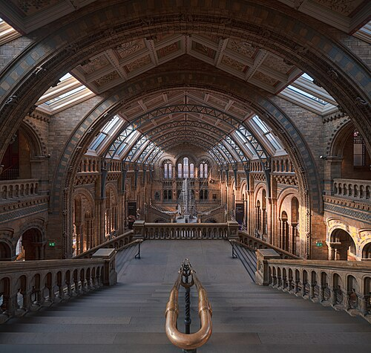
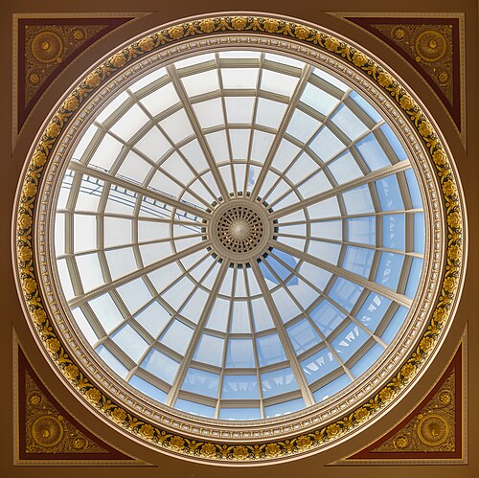
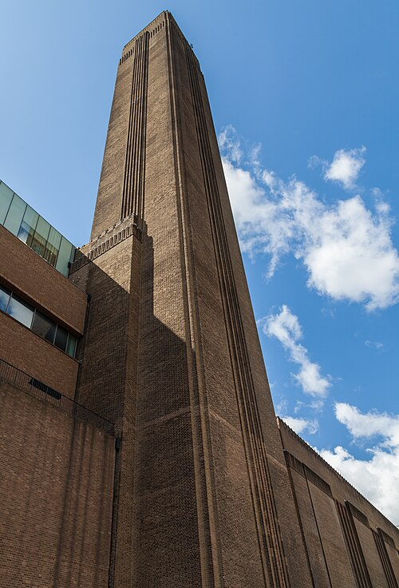
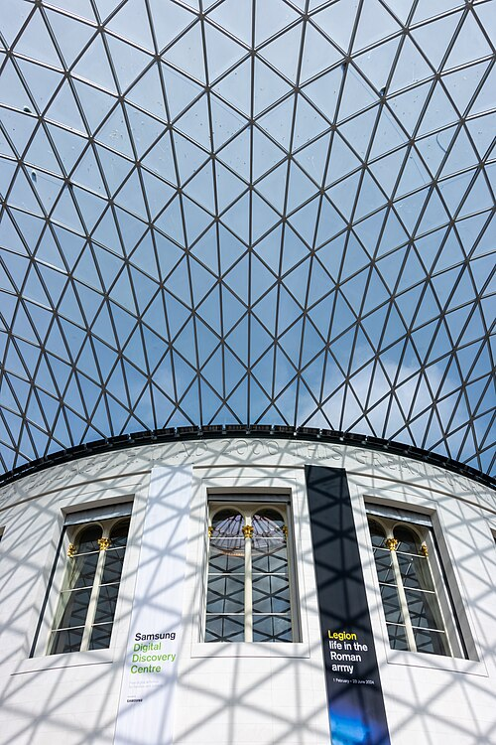
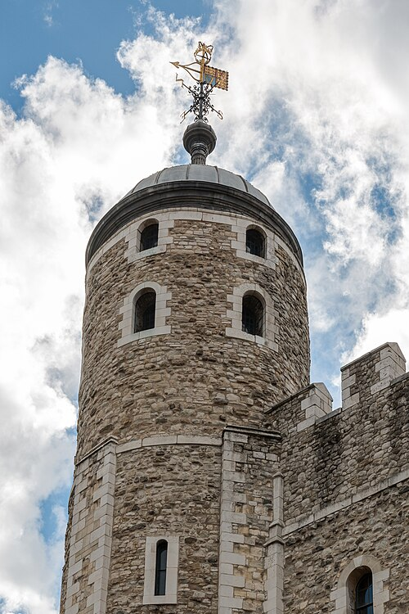
Five sights to start with
British Museum, Great Court. Photo: Mike Peel (www.mikepeel.net), CC BY-SA 4.0, via Wikimedia Commons.
Natural History Museum, Central Hall. Photo: Julian Herzog, CC BY 4.0, via Wikimedia Commons.
Tate Modern, the former Bankside Power Station. Photo: Diego Delso, CC BY-SA 4.0, via Wikimedia Commons.
National Gallery, entrance hall dome. Photo: Diego Delso, CC BY-SA 4.0, via Wikimedia Commons.
Tower of London, the White Tower. Photo: Dietmar Rabich, CC BY-SA 4.0, via Wikimedia Commons.
British Museum
Natural History Museum
Tate Modern
National Gallery
Tower of London
The glass roof of the Great Court above the Reading Room at the British Museum
The empty Central Hall of the Natural History Museum, looking towards the blue whale skeleton
The tall brick chimney of the former Bankside Power Station, now Tate Modern
The glass dome above the entrance hall of the National Gallery
A turret and weathervane of the White Tower at the Tower of London

Slide 4
Sights at a glance
Photo | Sight | Area | Price band | Nearest tube | More
Glass roof of the British Museum’s Great Court | British Museum | Bloomsbury | Free (special exhibitions extra) | Tottenham Court Road | Read more
Central Hall of the Natural History Museum | Natural History Museum | South Kensington | Free (special exhibitions extra) | South Kensington | Read more
Brick chimney of Tate Modern | Tate Modern | Bankside | Free (special exhibitions extra) | Blackfriars | Read more
Glass dome inside the National Gallery | National Gallery | Trafalgar Square | Free (special exhibitions extra) | Charing Cross | Read more
Turret of the White Tower at the Tower of London | Tower of London | Tower Hill | Paid ticket | Tower Hill | Read more

Slide 5
Photo credits: British Museum, Mike Peel, CC BY-SA 4.0; Natural History Museum, Julian Herzog, CC BY 4.0; Tate Modern and National Gallery, Diego Delso, CC BY-SA 4.0; Tower of London, Dietmar Rabich, CC BY-SA 4.0. All via Wikimedia Commons; details in images/ATTRIBUTION.md.

Slide 6
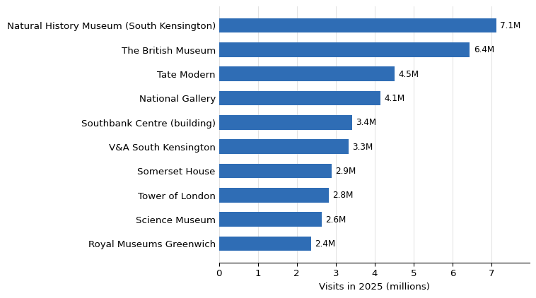
Visitor numbers
import csv
with open("data/attractions.csv", newline="", encoding="utf-8") as f:
rows = list(csv.DictReader(f))
top = max(rows, key=lambda r: int(r["visits_2025"]))
top_name = top["attraction"]
top_visits = int(top["visits_2025"])
total_visits = sum(int(r["visits_2025"]) for r in rows)
The most visited attraction in 2025 was the Natural History Museum (South Kensington), with 7,116,929 visits, out of 39,692,434 visits in total across the ten attractions listed.
Figure 1: Visits in 2025 to London’s ten most-visited ALVA attractions. Source: ALVA.

Slide 7
Getting around
🚇 Tube
🚌 Bus
🚲 Santander Cycles

Slide 8
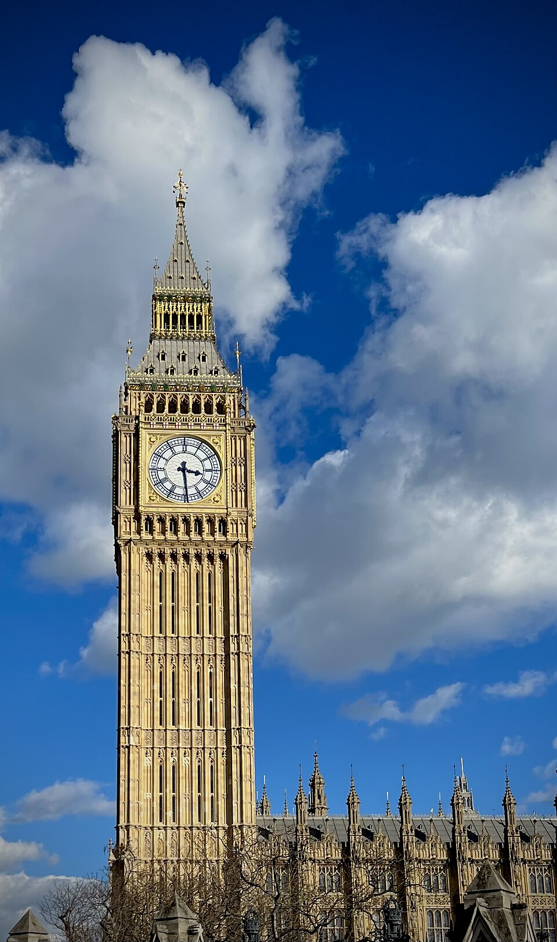
Plan your visit
Big Ben in the sun (Elizabeth Tower). Photo: John Dillenbeck, CC0, via Wikimedia Commons.
Tip from a local: Stand on the right on Tube escalators and leave the left side clear for people in a hurry.
Use the TfL Journey Planner to map out each day’s route by Tube, bus or bike.
Big Ben and the Elizabeth Tower rising against a bright sky, with the Palace of Westminster below

Slide 9
Before you go
[ ] Check opening times and book any timed tickets
[ ] Bring a contactless card or Oyster for the Tube and buses
[ ] Pack a light waterproof jacket

