Slide 1
Sign Language Recognition and Translation
01FB15ECS285
01FB15ECS291
UE15CS333 project submission

Slide 2
ABOUT THE PROJECT
Project idea: Sign Language Recognition and Translation involves image classification, the accuracy of the raw classifier may not be satisfactory for large sequential inputs, also the number of possible outputs generated for large sequence is very huge, we minimize this by applying language models over it. Language model with spell check and sentiment analyser.
Why you think this can be turned into a publishable work: The deaf and dumb community communicate through sign language and account to 0.01% of the world population that’s atleast 1 million people. Not everyone understands sign language and it varies from region to region, this enables easy communication among people. Issue with traditional sign language translation is that they tend to neglect sentiment of the person, which the community states has a lot of impact, not just sentiment but body language. We are trying to bridge that gap.

Slide 3
LITERATURE SURVEY AND EXISTING WORK
Serial No | Title, author, web URL (if any) | What was useful as a reference
1 | http://scikit-image.org/docs/dev/user_guide/tutorials.html | helped in image processing
2 | https://drive.google.com/drive/folders/1iZrDO7mlWUJtmgMWX4Qe3oAMiALkJrfz - NLP by Bhaskarjyoti Das | helped in conceptual and practical understanding of NLP
3 | https://www.theatlantic.com/technology/archive/2017/11/why-sign-language-gloves-dont-help-deaf-people/545441/ | understanding the issues faced by the community
4 | stackoverflow | reference for code development
5 | http://norvig.com/spell-correct.html | helped us build a spelling corrector

Slide 4
DATASET SOURCE AND PREPROCESSING DONE
Dataset source: https://github.com/mon95/Sign-Language-and-Static-gesture-recognition-using-sklearn/blob/master/Dataset.zip - for images
The first part of our project generates words from sequence of images
and this serves as dataset to our language model to work
on.(img_class_output.txt)
Pre-processing steps performed:
We didn’t require any text preprocessing since we generated the dataset.
For image processing it involved handlocalisation and segmentation, greyscaling, HOG feature extraction, cropping.

Slide 5
HIGH LEVEL DESIGN OF OUR IMPLEMENTATION
Image pre-
processing
Multiclass Classifier
Improve classifier accuracy
Output all possible words for given seq of images
Language enhancer over the set of words
Enhanced set of words is sentiment analysed
Final output is biased by the input sentiment
Image_classifier runs python 2.7 due to some issues with skimage
Note : Both the dataset and latest jupyter notebook ( python 3.0) have to be submitted for evaluation

Slide 6
MILESTONES
Serial no | Milestone description | Status (% complete) | Comments
1 | Dataset Acquisition | 50 | Need to acquire video dataset that represent phrases instead of plain lexical representation
2 | Image Preprocessing | 100
3 | Building a multiclass classifier | 100 | image tagging
4 | Listing all possible outputs from the model for seq of images | 100 | dataset for our language model
5 | Building language model to enhance the output from previous model | 100
6 | Adding sentiment bias over the enhanced language model | 100 | Gave us the preferred output

Slide 7
TOP CHALLENGES UNRESOLVED SO FAR
Issue #1 Adding the sentiment and language bias while classifying the images instead of after. Improves efficiency if achieved
Issue #2 Lack of proper dataset. Need video dataset of phrases instead of plain alphabetical representations of sign language
Issue #3 Improving efficiency of word lookup in case of mismatch to find the words with least levenshtein distance
Issue #4 Finding dataset with facial expressions and body language

Slide 8
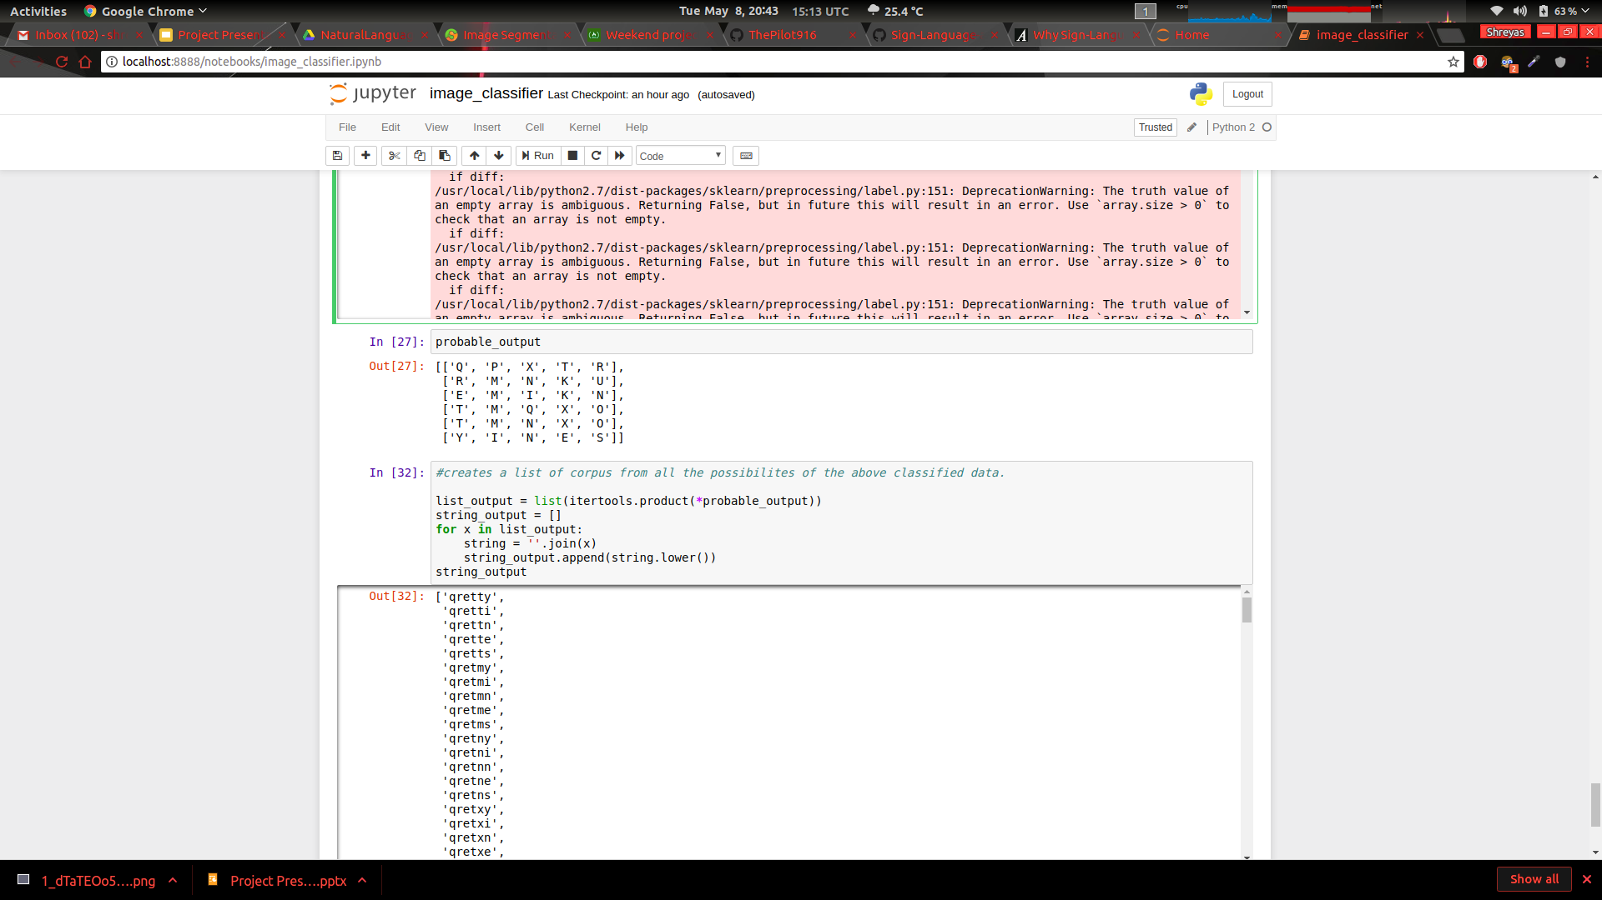
RESULTS, VISUALIZATION, METRIC
Raw image classifier gives top 5 classes for each input image. It’s seen in the 2D array
Below we can see all combinations of words formed from this 2D array with no language model added

Slide 9
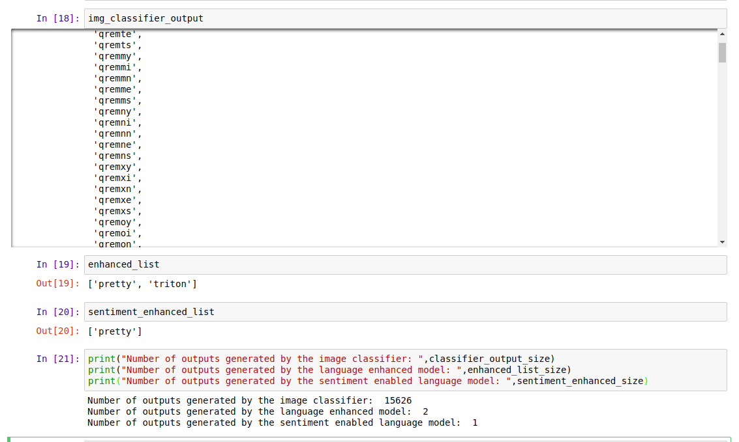
RESULTS, VISUALIZATION, METRIC
We can see that the raw classifier gave us 15626 number of possible words for input seq of images being PRETTY from user_3 - ‘user_3/P3.jpg','user_3/R5.jpg','user_3/E5.jpg','user_3/T8.jpg','user_3/T0.jpg','user_3/Y7.jpg'
Upon applying language model it dropped to only 2 words
Further by adding emotion bias to it, it dropped to 1 word which matched our input of PRETTY!

Slide 10
OUR GOING FORWARD PLAN (OPTIONAL)
Step 1 : Making the word lookup incase of mismatch more efficient
Step 2 : Obtaining video dataset of gestures representing phrases with body language and facial expressions
Step 3: Adding language model bias during classification of images to improve efficiency

Slide 11
OUR TOP THREE LEARNING IN THIS PROJECT
Learning # 1 : image preprocessing, multiclass classifiers
Learning # 2 : building language models, sentiment analysis
Learning # 3 : ability to combine multiple domains to obtain better operational efficiency and accuracy

