Slide 1
GloVe: Global Vectors for Word Representation
Presented by:
FANTASTIC FOUR

Slide 2
Introduction
GloVe is an unsupervised learning algorithm for obtaining vector representations for words
Training is performed on aggregated global word-word co-occurrence statistics from a corpus
Resulting representations showcase interesting linear substructures of the word vector space.

Slide 3
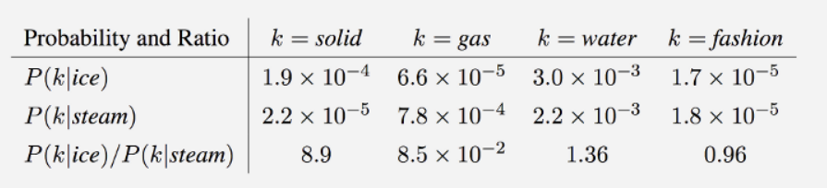
Model Overview
GloVe is essentially a log-bilinear model with a weighted least-squares objective.
Intuition – Ratios of word-word co-occurrence probabilities have the potential for encoding some form of meaning

Slide 4
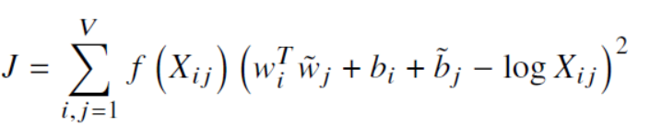

Cost function

Slide 5
Properties of GloVe
Nearest neighbours
Linear substructures

Slide 6
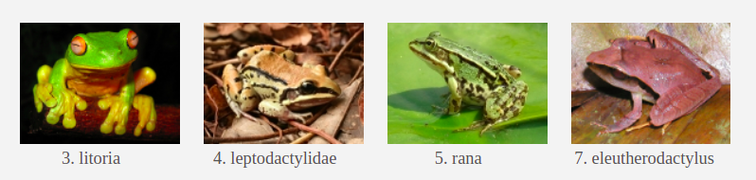
Nearest Neighbours
The Euclidean distance between two word vectors is a measure of semantic similarity of the corresponding words.

Slide 7
Linear Substructures
Nearest neighbor evaluations produce single scalar that quantifies the relatedness of two words.
Problematic since two given words almost always exhibit more intricate relationships.
A natural and simple candidate for an enlarged set of discriminative numbers is the vector difference between the two word vectors.
GloVe is designed in order that such vector differences capture as much as possible the meaning specified by the juxtaposition of two words

Slide 8

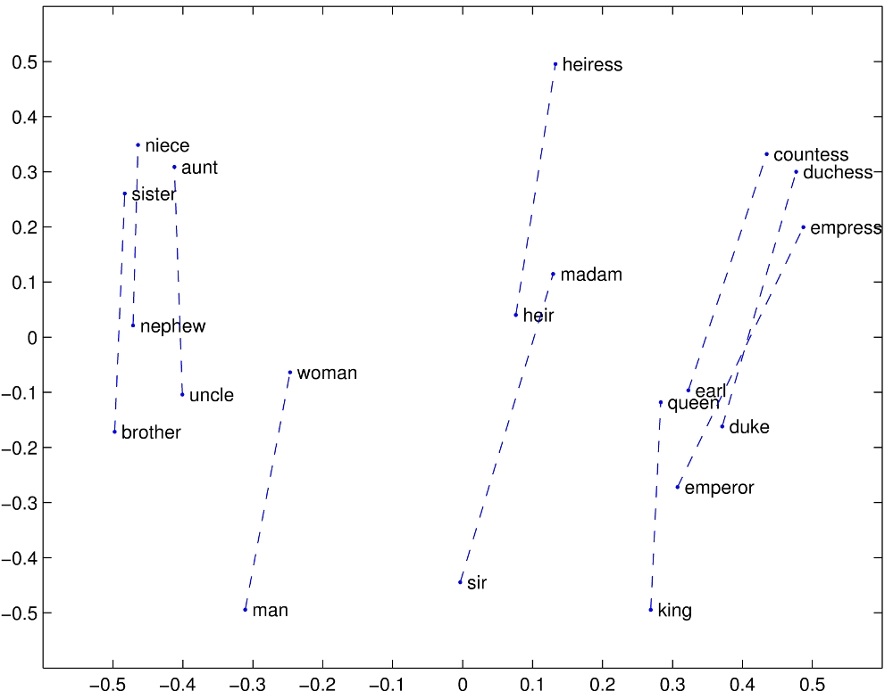
The underlying concept that distinguishes man from woman, i.e. sex or gender, may be equivalently specified by various other word pairs, such as king and queen or brother and sister.
The vector differences man - woman, king - queen, and brother - sister might all be roughly equal.

Slide 9
Results
Advantages
Disadvantages
Fast training
Good performance even with small corpus, and small vectors
Early stopping. We can stop training when improvements become small.
Uses a lot of memory: the fastest way to construct a term-co-occurrence matrix is to keep it in RAM as a hash map and perform co-occurrence increments in a global manner
Sometimes quite sensitive to initial learning rate

