Slide 1
Getting Started with UML
Introduction, Use Case, Class, and Entity Relationship Diagrams

Slide 2
Overview
What is Modeling?
What is UML?
A brief history of UML
Understanding the basics of UML
UML diagrams
Notes:
Overview of my presentation:
- Essence of modeling, UML, history of UML, Basics of UML, UML modeling tools

Slide 3
Modeling
Describing a system at a high level of abstraction
A model of the system
Used for requirements and specifications
Is it necessary to model software systems?
Notes:
1.
Describing the system at abstract level to comprehend its complexity
2.
Necessary to manage complexity
Good for quick understanding of the systems
Less chances of conflicting views b/w end-user and system designers

Slide 4
More Intro
UML Sketching vs. UML Blueprint
Platform Independent / Platform Specific

Slide 5
Development Process
Waterfall
Analysis, Design, Coding, and Testing
Iterative (Most Common)
Solve in Pieces

Slide 6
Planning Process
Predictive Planning
Adaptive Planning (Agile Development)
If you can easily list all requirements use Predive Planning

Slide 7
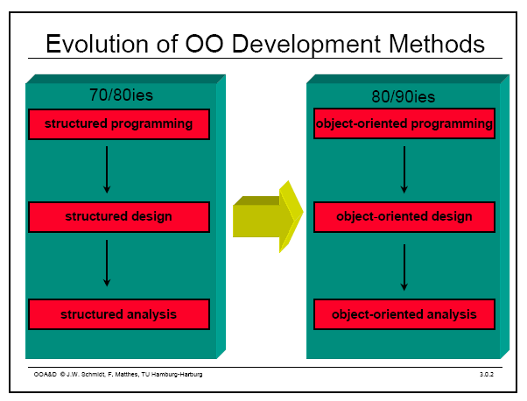
Object Oriented Modeling
Notes:
Evolution of analysis and design techniques
Transition from structured programming to object oriented programming

Slide 8
What is UML?
UML stands for “Unified Modeling Language”
It is a industry-standard graphical language for specifying, visualizing, constructing, and documenting the artifacts of software systems
The UML uses mostly graphical notations to express the OO analysis and design of software projects.
Simplifies the complex process of software design
Notes:
. What does UML stand for?
. Industry standard
. Graphical notation
. Modeling tool … simplifies software design process

Slide 9
Why UML for Modeling
Use graphical notation to communicate more clearly than natural language (imprecise) and code(too detailed).
Help acquire an overall view of a system.
UML is not dependent on any one language or technology.
UML moves us from fragmentation to standardization.
Notes:
. More precise than natural language … less detailed than source code
. Not dependent on any language
. Standardized by various groups

Slide 10
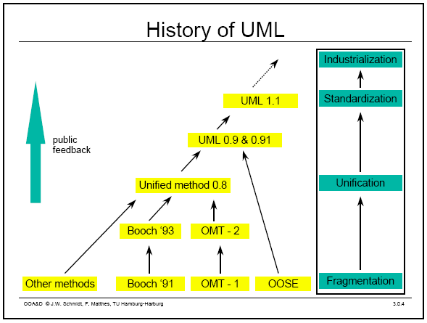
History of UML
Notes:
History:
- Rumbaugh – OMT – object modeling technique
Jacobson – OOSE
UML … unified approach since 1995
UML 1.5 current … UML 2.0 by the end of 2004

Slide 11
Types of UML Diagrams
Use Case Diagram
Class Diagram
Sequence Diagram
Collaboration Diagram
State Diagram
This is only a subset of diagrams … but are most widely used

Slide 12
Use Case Diagram
Used for describing a set of user scenarios
Mainly used for capturing user requirements
Work like a contract between end user and software developers

Slide 13
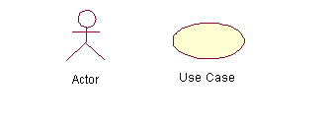
Use Case Diagram (core components)
Actors: A role that a user plays with respect to the system,including human users and other systems. e.g.,inanimate physical objects (e.g. robot); an external system that needs some information from the current system.
Use case: A set of scenarios that describing an interaction between a user and a system, including alternatives.
System boundary: rectangle diagram representing the boundary between the actors and the system.

Slide 14
Use Case Diagram(core relationship)
Association: communication between an actor and a use case; Represented by a solid line.
Generalization: relationship between one general use case and a special use case (used for defining special alternatives)
Represented by a line with a triangular arrow head toward the parent use case.

Slide 15
Use Case Diagram(core relationship)
Include: a dotted line labeled <<include>> beginning at base use case and ending with an arrows pointing to the include use case. The include relationship occurs when a chunk of behavior is similar across more than one use case. Use “include” in stead of copying the description of that behavior.
<<include>>
Extend: a dotted line labeled <<extend>> with an arrow toward the base case. The extending use case may add behavior to the base use case. The base class declares “extension points”.
<<extend>>

Slide 16
Use Case Diagrams
Use Case
Boundary
Actor
Library System
Borrow
Employee
Client
Order Title
Fine Remittance
Supervisor
A generalized description of how a system will be used.
Provides an overview of the intended functionality of the system

Slide 17
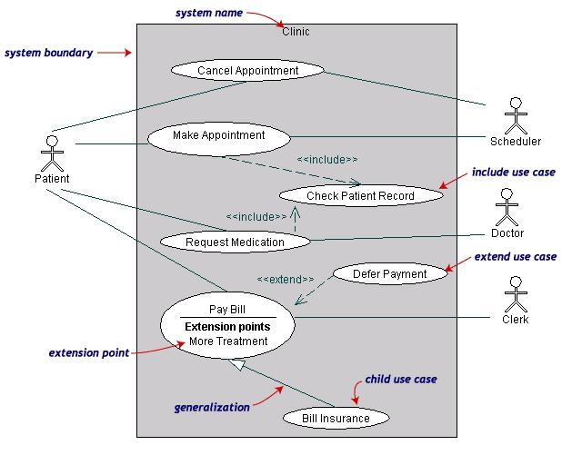
Use Case Diagrams(cont.)
(TogetherSoft, Inc)

Slide 18
Use Case Diagrams(cont.)
Pay Bill is a parent use case and Bill Insurance is the child use case. (generalization)
Both Make Appointment and Request Medication include Check Patient Record as a subtask.(include)
The extension point is written inside the base case
Pay bill; the extending class Defer payment adds the behavior of this extension point. (extend)

Slide 19
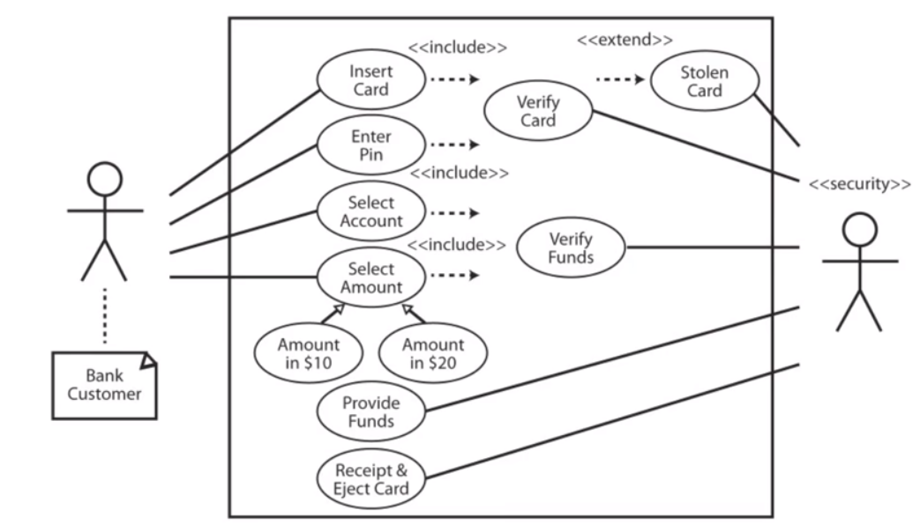
More Use Case

Slide 20
Description
The user enters their card and PIN. Security verifies the card. The user selects the account to use. They select an amount. Security verifies if the amount is available. The system comes to a conclusion on if the money is provided. The user selects funds as $10s or $20s. Security provides the funds if possible. Security provides a receipt and the user’s card.

Slide 21
Trigger
Machine receives a card
User enters a PIN
Actors
Customer
Bank Security

Slide 22
Preconditions
Secure connection to bank
Bank has cash
Goals
Secure client accounts
Provide customer with funds

Slide 23
Failed Conditions
Invalid card
Invalid PIN
Customer insufficient funds
ATM insufficient funds
Over daily limit
Stolen card
Extensions
If PIN is invalid 3 times, eat card
If card marked as stolen, eat card

Slide 24
Steps of Execution
1 Customer insers card
1a. Card is invalid
1b Eject card
2. Card is validated
3. Customer enters PIN
3a. PIN is invalid
3b PIN is invalid 3 times
3c mark card as stolen
4. PIN is validated
5 account is selected
6 amount is selected
7a over daily maximum
7b over account funds available
7c over funds in machine
7d ask for new amount
8 select $10 or $20
9 provide funds
10 provide receipt
11 eject card

Slide 25
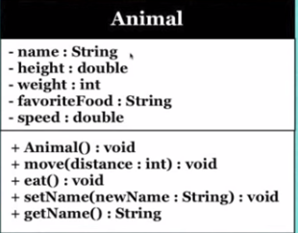
Class Diagrams
Classes: attributes, fields, or variables; methods, or behaviors
Class Diagrams
Abstraction: when creating objects, you want to eliminate as many details as possible
Encapsulation: protect fields and not allow outside code to affect them

Slide 26
Visibility
Public ( + ) : accessible to all
Protected ( # ) : class and subclass can access
Package / default ( ~ ) : Can be accessed by any class within the package
Private ( - ) : Class methods and not subclasses

Slide 27
Multiplicity
Allows you to declare certain rules for attributes that represent groups of objects
Set number [1..10]
Unknown number [*] – can decorate with {unique} {ordered} {notUnique} and {readOnly}
Static attributes

Slide 28
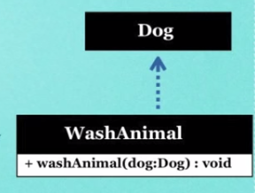
Class Dependence
Dependency: objects work briefly with objects of another class
Dependence is an example of class loose coupling
Ex: Dog is passed as a parameter and used as an output
WashAnimal doesn’t have an attribute of type Dog and Dog is only used temporarily by WashAnimal
Often ignored in class diagrams

Slide 29
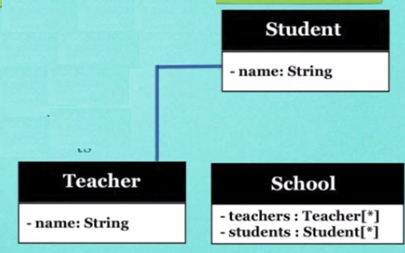
Associate Dependence
Classes have a direct association but don’t necessarily have attributes attributed
Ex: teachers have students but they may have different students

Slide 30
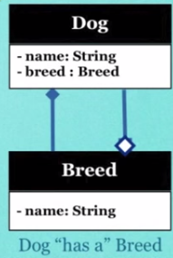
Aggregation and Composition
Breed has an aggregate relationship to Dog
Aggregation: Dog is the aggregate of many other objects that describe it like breed does. Breed may be used in many composite instances.
Composition: Dog owns the Attribute Breed

Slide 31
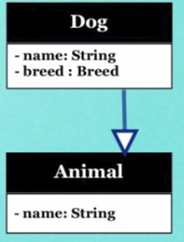
Inheritance
When a subclass is created from another class
All fields and methods are shared if they are marked as public, protected, or default

Slide 32
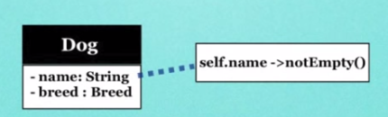
Constraints
Constraints define rules for parts of classes

Slide 33
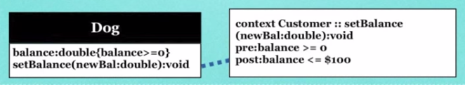
Pre and Post Condition Constraints
Preconditions must be true before a method is executed
Postconditions must be true after a method is executed
Define rules in curly braces or notes

Slide 34
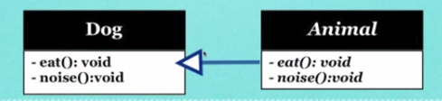
Abstract Class Diagrams
Some methods are defined as abstract so that subclasses have to implement them
Abstract class methods and names are italic

Slide 35
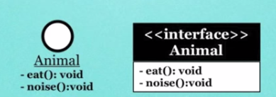
Interface Class Diagrams
Interfaces contain only abstract methods. Attributes are either static or constants

Slide 36
Entity
“An entity is a business object that represents a group, or category of data.”¹
Do we know a similar concept?
1) Stephens, R.K. and Plew. R.R., 2001. Database Design. SAMS, Indianapolis , IN.

Slide 37
Attribute
“An attribute is a sub-group of information within an entity.”¹
Do we know a similar concept?
1) Stephens, R.K. and Plew. R.R., 2001. Database Design. SAMS, Indianapolis , IN.

Slide 38
Entity Relationship Models
Mandatory Relationships
Optional Relationships
Many-to-Many Relationships
One-to-Many Relationships
One-to-One Relationships
Recursive Relationships

Slide 39
Mandatory, Many-to-Many
INSTRUCTOR
STUDENT
INSTRUCTOR
STUDENT

Slide 40
Optional, Many-to-Many
DEPARTMENT
STUDENT
DEPARTMENT
STUDENT

Slide 41
Optional/Mandatory, Many-to-Many
INSTRUCTOR
SKILL
INSTRUCTOR
SKILL

Slide 42
Optional/Mandatory, One-to-Many
PRODUCT
VENDOR
PRODUCT
VENDOR

Slide 43
Mandatory, One-to-One
AUTOMOBILE
ENGINE
AUTOMOBILE
ENGINE

Slide 44
Recursive
EMPLOYEE
supervises
is supervised by

Slide 45
Resolving Many-to-Many Relationships
Many-to-many relationships should be avoided. We can resolve a many-to-many relationship by dividing it into two one-to-many relationships.

Slide 46
Resolving Many-to-Many Relationships
SALES ORDERS
INV. ITEMS
SALES ORDERS
ORDER ITEMS
INV. ITEMS

Slide 47
Example (ER Diagram)
CUSTOMERS
CLERKS
SALES ORDERS
ORDER ITEMS
INV. ITEMS

