Slide 1
Label Propagation
Survey By: Lovro Subelj
University of Ljubljana, Faculty of Computer and Information Science, Ljubljana, Slovenia

Slide 2
Label Propagation
Label Propagation methods are community detection algorithms for undirected networks. No clear way to generalize method for directed graphs.
Pros | Cons
Simple: Conceptually and only a few lines of code to implement | Not very robust: We will see how to fix this
Fast: nearly O(m) where m is number of edges | Not very stable or accurate: We will see how to fix this too

Slide 3
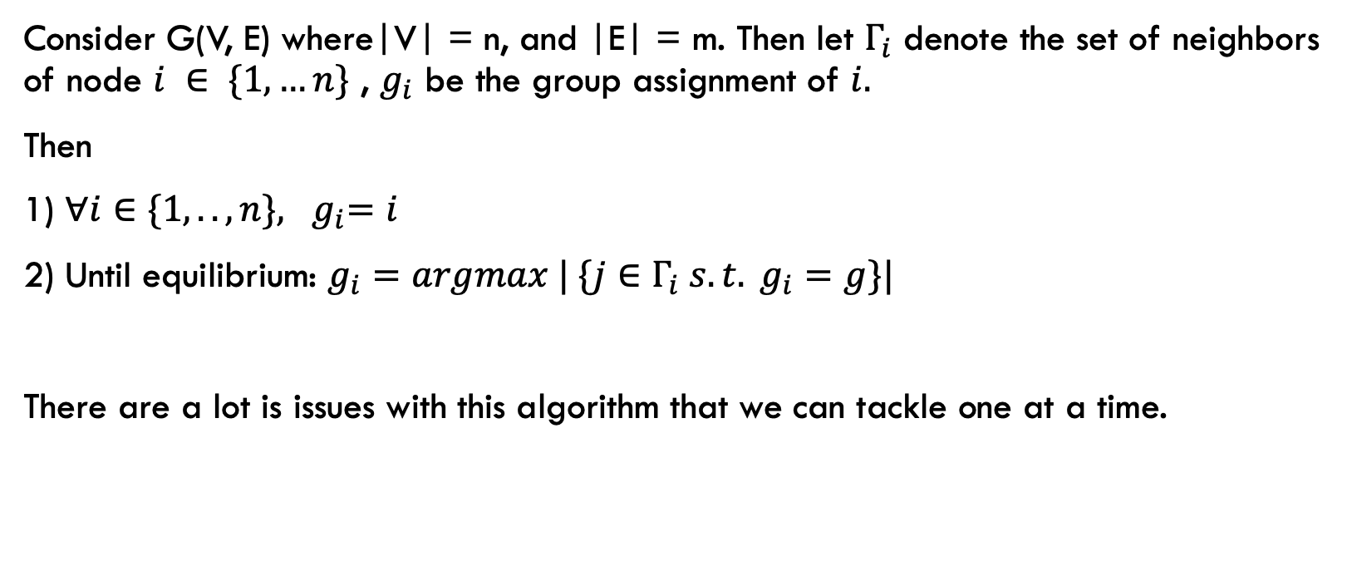
The Framework algorithm
Consider G(V, E) where|V| = n, and |E| = m. Then let $Γ_{i}$ denote the set of neighbors of node $i ∈ \{1, …n\}$ , $g_{i}$ be the group assignment of $i.$
Then
1) ${∀i∈\{1, .. , n\}, g}_{i}=i$
2) Until equilibrium: $g_{i}=argmax | \{j∈Γ_{i} s.t. g_{i}=g\}|$
There are a lot is issues with this algorithm that we can tackle one at a time.

Slide 4
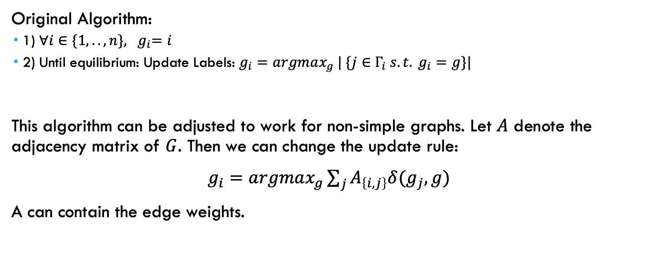
Non-Simple Graphs
Original Algorithm:
1) ${∀i∈\{1, .. , n\}, g}_{i}=i$
2) Until equilibrium: Update Labels: $g_{i}=argmax_{g} | \{j∈Γ_{i} s.t. g_{i}=g\}|$
This algorithm can be adjusted to work for non-simple graphs. Let $A$ denote the adjacency matrix of $G$. Then we can change the update rule:
$g_{i}=argmax_{g}\sum_{j}{A_{\left\{i,j\right\}}δ(g_{j}, g)}$
A can contain the edge weights.

Slide 5
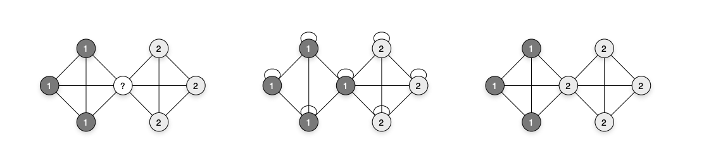
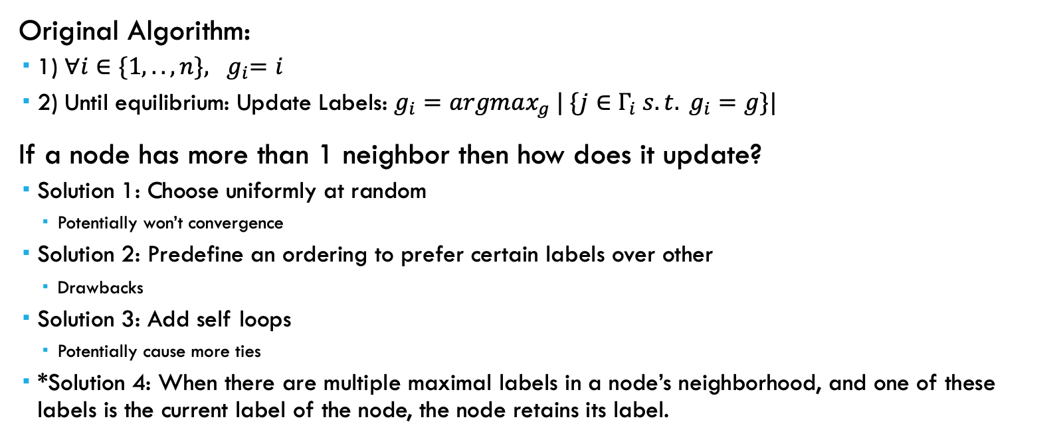
Resolving Ties
Original Algorithm:
1) ${∀i∈\{1, .. , n\}, g}_{i}=i$
2) Until equilibrium: Update Labels: $g_{i}=argmax_{g} | \{j∈Γ_{i} s.t. g_{i}=g\}|$
If a node has more than 1 neighbor then how does it update?
Solution 1: Choose uniformly at random
Potentially won’t convergence
Solution 2: Predefine an ordering to prefer certain labels over other
Drawbacks
Solution 3: Add self loops
Potentially cause more ties
*Solution 4: When there are multiple maximal labels in a node’s neighborhood, and one of these labels is the current label of the node, the node retains its label.

Slide 6
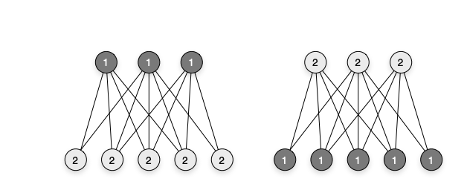
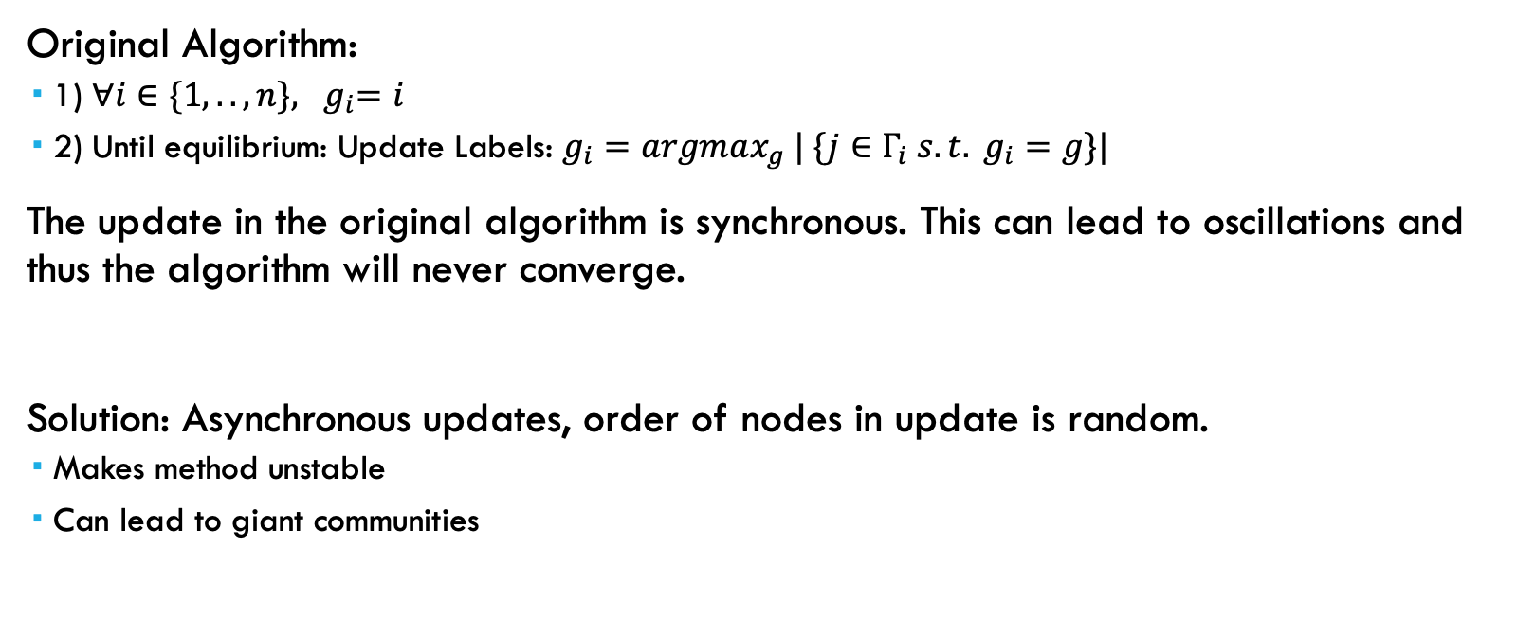
Order of Label Propagation
Original Algorithm:
1) ${∀i∈\{1, .. , n\}, g}_{i}=i$
2) Until equilibrium: Update Labels: $g_{i}=argmax_{g} | \{j∈Γ_{i} s.t. g_{i}=g\}|$
The update in the original algorithm is synchronous. This can lead to oscillations and thus the algorithm will never converge.
Solution: Asynchronous updates, order of nodes in update is random.
Makes method unstable
Can lead to giant communities

Slide 7
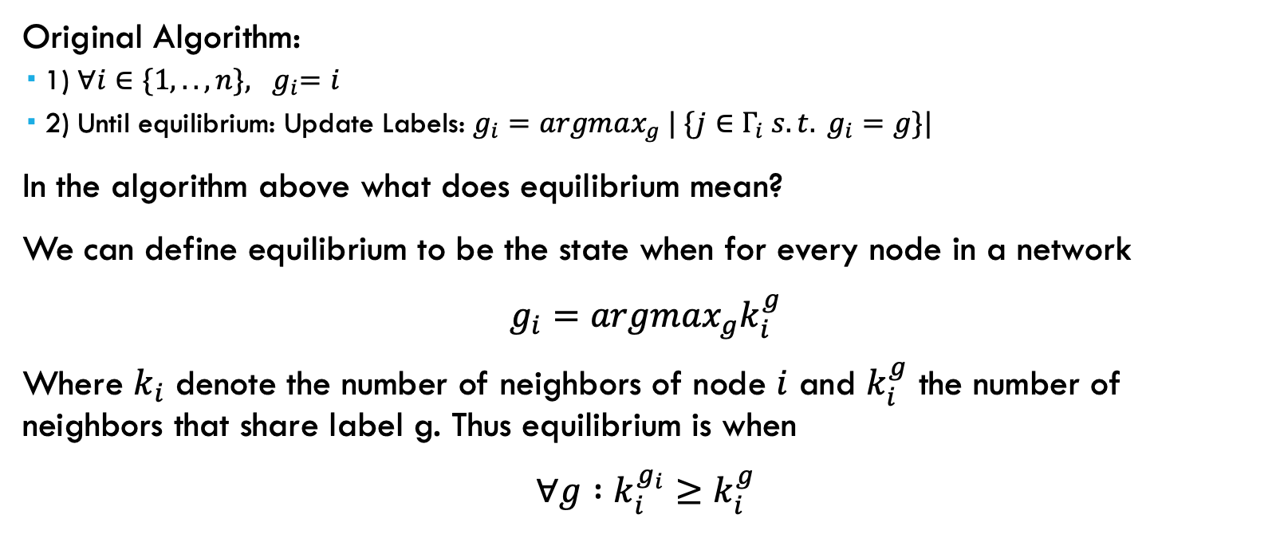
Label Equilibrium Criterium
Original Algorithm:
1) ${∀i∈\{1, .. , n\}, g}_{i}=i$
2) Until equilibrium: Update Labels: $g_{i}=argmax_{g} | \{j∈Γ_{i} s.t. g_{i}=g\}|$
In the algorithm above what does equilibrium mean?
We can define equilibrium to be the state when for every node in a network
$g_{i}=argmax_{g}k_{i}^{g}$
Where $k_{i}$ denote the number of neighbors of node $i$ and $k_{i}^{g}$ the number of neighbors that share label g. Thus equilibrium is when
$∀g :k_{i}^{g_{i}}≥k_{i}^{g}$

Slide 8
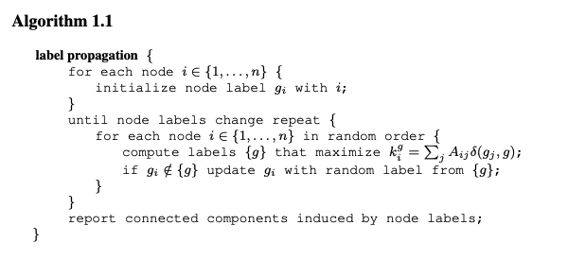
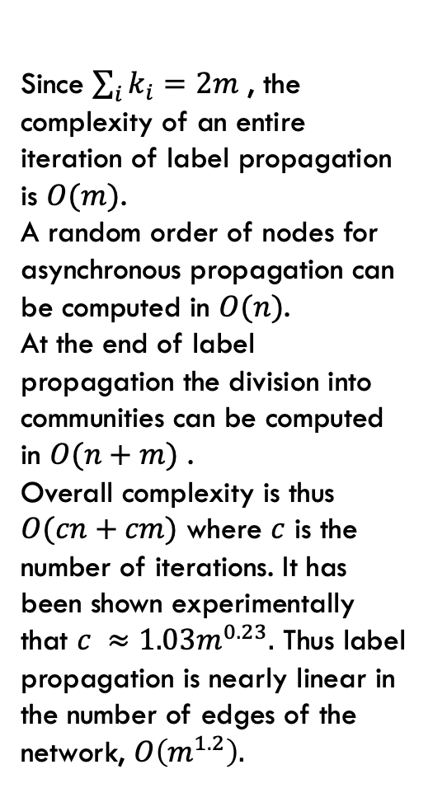
Algorithm and Complexity
Since $\sum_{i}{k_{i}=2m}$ , the complexity of an entire iteration of label propagation is $O(m)$.
A random order of nodes for asynchronous propagation can be computed in $O(n)$.
At the end of label propagation the division into communities can be computed in $O(n+m)$ .
Overall complexity is thus $O(cn+cm)$ where $c$ is the number of iterations. It has been shown experimentally that $c ≈1.03m^{0.23}.$ Thus label propagation is nearly linear in the number of edges of the network, $O\left(m^{1.2}\right).$

Slide 9
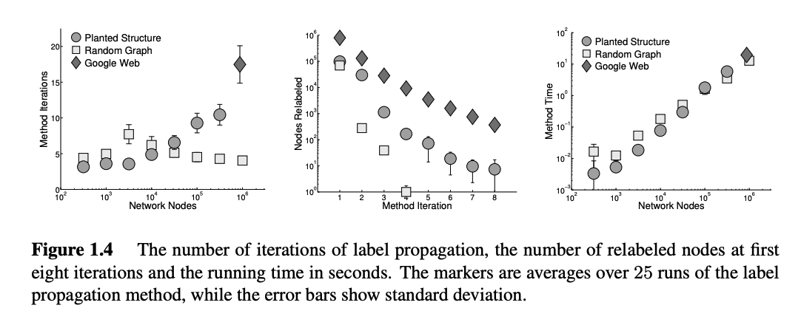
Algorithm and Complexity Cont.

Slide 10
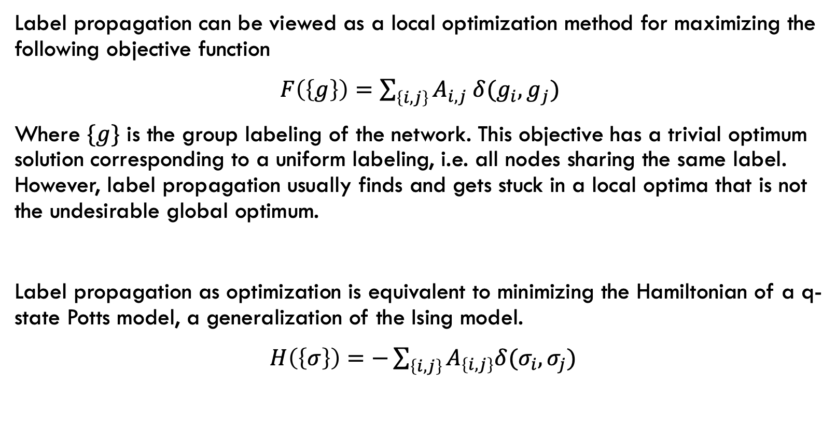
Label Propagation as Optimization
Label propagation can be viewed as a local optimization method for maximizing the following objective function
$F\left(\left\{g\right\}\right)=\sum_{\left\{i,j\right\}}{A_{i,j} δ(g_{i}, g_{j})}$
Where $\{g\}$ is the group labeling of the network. This objective has a trivial optimum solution corresponding to a uniform labeling, i.e. all nodes sharing the same label. However, label propagation usually finds and gets stuck in a local optima that is not the undesirable global optimum.
Label propagation as optimization is equivalent to minimizing the Hamiltonian of a q-state Potts model, a generalization of the Ising model.
$H\left(\left\{σ\right\}\right)=−\sum_{\left\{i,j\right\}}{A_{\left\{i,j\right\}}δ(σ_{i},σ_{j})}$

Slide 11
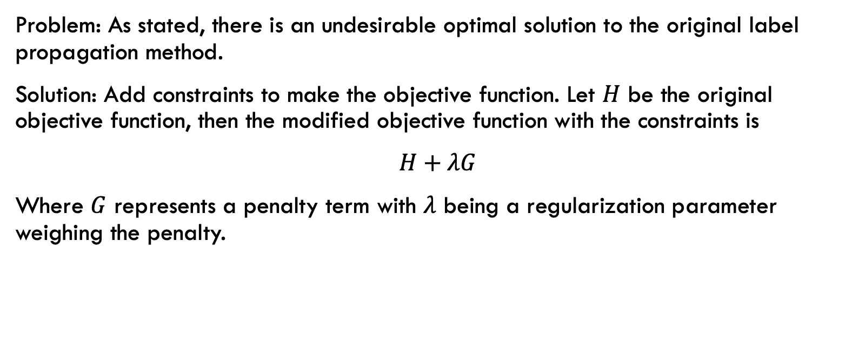
Advances of Label Propagation
Problem: As stated, there is an undesirable optimal solution to the original label propagation method.
Solution: Add constraints to make the objective function. Let $H$ be the original objective function, then the modified objective function with the constraints is
$H+λG$
Where $G$ represents a penalty term with $λ$ being a regularization parameter weighing the penalty.

Slide 12


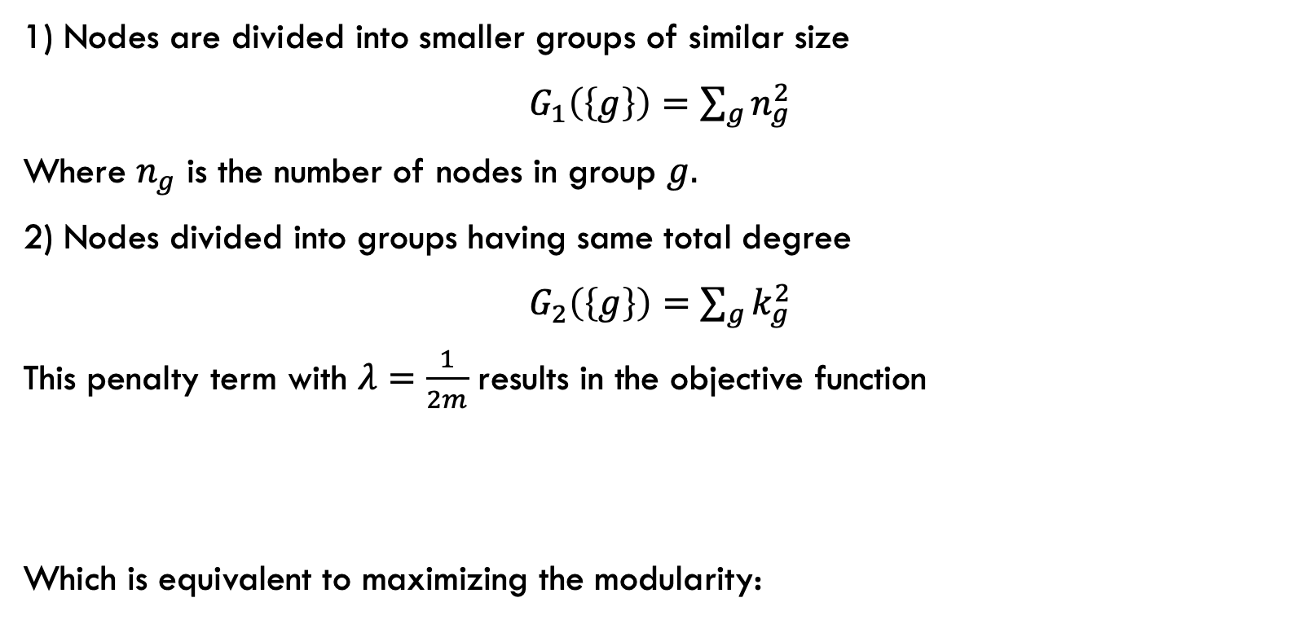
Penalty terms
1) Nodes are divided into smaller groups of similar size
$G_{1}\left(\left\{g\right\}\right)=\sum_{g}{n_{g}^{2}}$
Where $n_{g}$ is the number of nodes in group $g.$
2) Nodes divided into groups having same total degree
$G_{2}\left(\left\{g\right\}\right)=\sum_{g}{k_{g}^{2}}$
This penalty term with $λ=\frac{1}{2m}$ results in the objective function
Which is equivalent to maximizing the modularity:

Slide 13
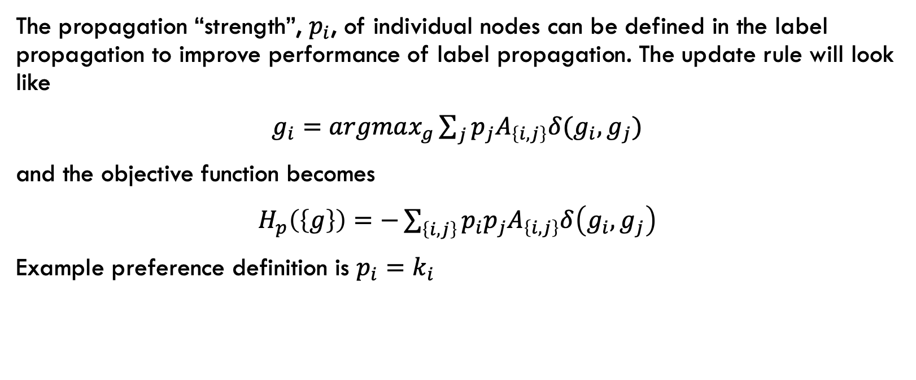
Label Propagation with Preferences
The propagation “strength”, $p_{i}$, of individual nodes can be defined in the label propagation to improve performance of label propagation. The update rule will look like
$g_{i}=argmax_{g}\sum_{j}{p_{j}A_{\left\{i,j\right\}}δ(g_{i}, g_{j})}$
and the objective function becomes
$H_{p}\left(\left\{g\right\}\right)=−\sum_{\left\{i,j\right\}}{p_{i}p_{j}A_{\left\{i,j\right\}}δ\left(g_{i}, g_{j}\right)}$
Example preference definition is $p_{i}=k_{i}$

Slide 14
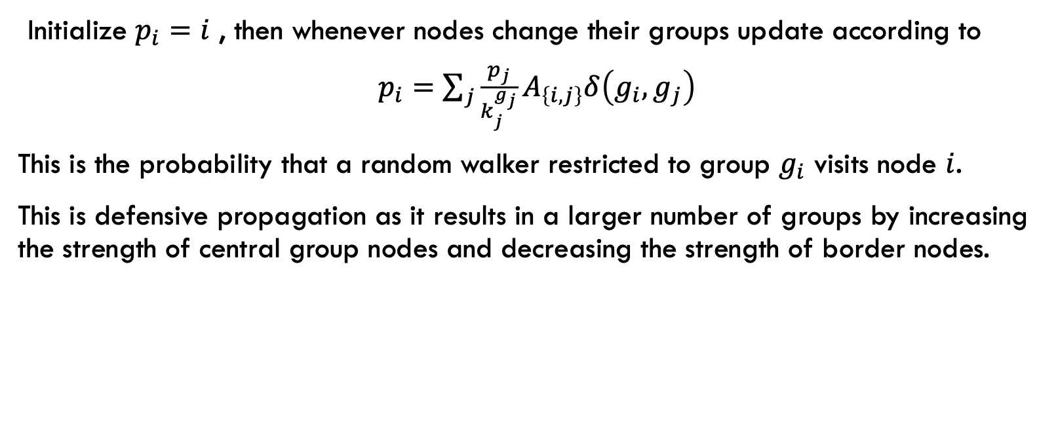
Defensive Propagation
Initialize $p_{i}=i$ , then whenever nodes change their groups update according to
$p_{i}=\sum_{j}{\frac{p_{j}}{k_{j}^{g_{j}}}A_{\left\{i,j\right\}}δ\left(g_{i}, g_{j}\right)}$
This is the probability that a random walker restricted to group $g_{i}$ visits node $i$.
This is defensive propagation as it results in a larger number of groups by increasing the strength of central group nodes and decreasing the strength of border nodes.

Slide 15
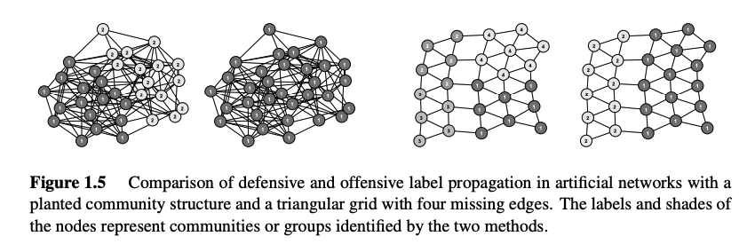
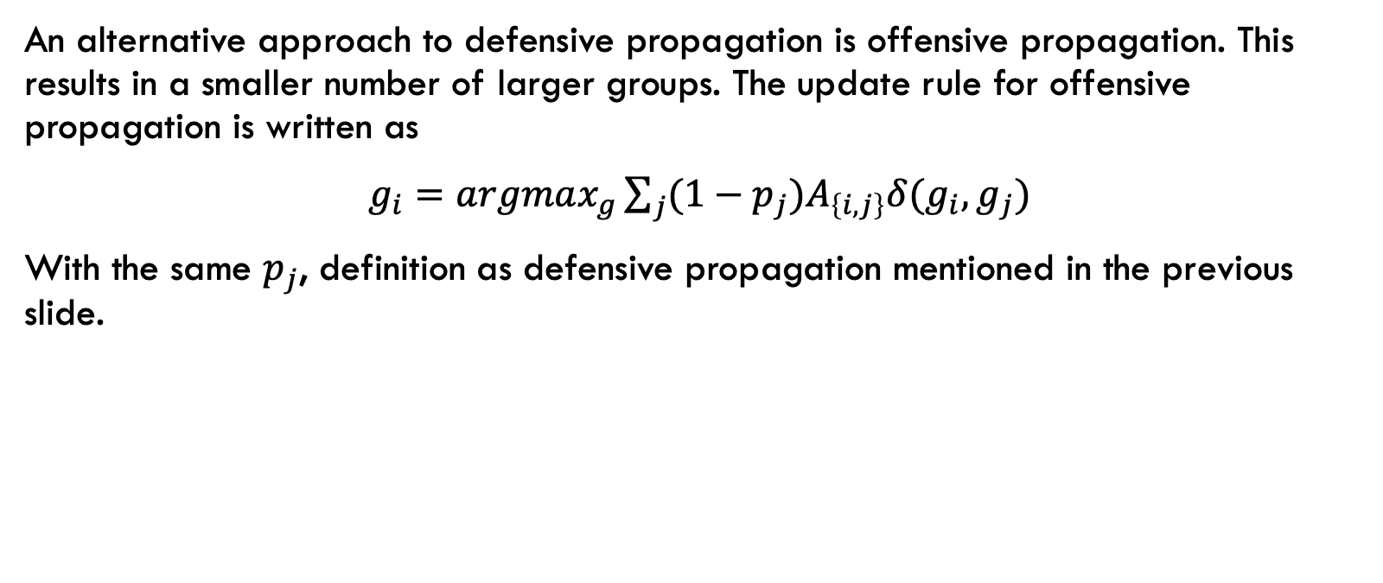
Offensive Propagation
An alternative approach to defensive propagation is offensive propagation. This results in a smaller number of larger groups. The update rule for offensive propagation is written as
$g_{i}=argmax_{g}\sum_{j}{(1−p_{j})A_{\left\{i,j\right\}}δ(g_{i}, g_{j})}$
With the same $p_{j}$, definition as defensive propagation mentioned in the previous slide.

Slide 16
Method Stability and Complexity
Problem: Label propagation is unstable
Solution 1: Semi-Synchronous label propagation.
Color graph: A graph coloring is one such that no two connected nodes share the same color
Then traverse nodes with different color in random order
Update same color nodes synchronously
Convergence can be proven.
Solution 2: Consensus clustering
Apply label propagation method to network multiple times.
Construct a weighted consensus graph where weights represent the number of times two nodes were classified into the same community.
Repeat process on consensus graph.
Repeat entire process until convergence

Slide 17
Overlapping Groups of Nodes
The label propagation method was originally designed to detect non-overlapping communities in networks.

