Slide 1
Label Propagation
Survey By: Lovro Subelj
University of Ljubljana, Faculty of Computer and Information Science, Ljubljana, Slovenia

Slide 2
Label Propagation
Label Propagation methods are community detection algorithms for undirected networks. No clear way to generalize method for directed graphs.
Pros | Cons
Simple: Conceptually and only a few lines of code to implement | Not very robust: We will see how to fix this
Fast: nearly O(m) where m is number of edges | Not very stable or accurate: We will see how to fix this too

Slide 3
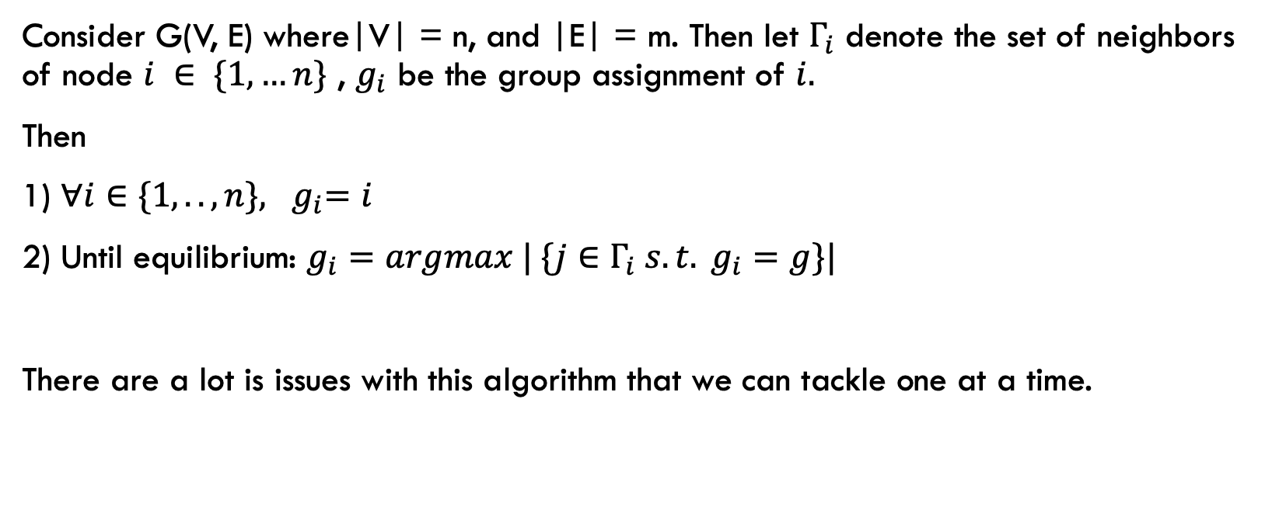
The Framework algorithm
Consider G(V, E) where|V| = n, and |E| = m. Then let $Γ_{i}$ denote the set of neighbors of node $i ∈ \{1, …n\}$ , $g_{i}$ be the group assignment of $i.$
Then
1) ${∀i∈\{1, .. , n\}, g}_{i}=i$
2) Until equilibrium: $g_{i}=argmax | \{j∈Γ_{i} s.t. g_{i}=g\}|$
There are a lot is issues with this algorithm that we can tackle one at a time.

Slide 4
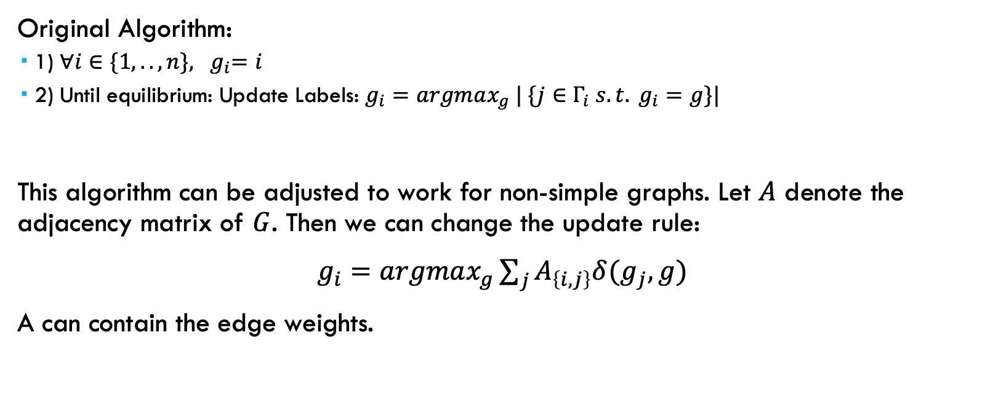
Non-Simple Graphs
Original Algorithm:
1) ${∀i∈\{1, .. , n\}, g}_{i}=i$
2) Until equilibrium: Update Labels: $g_{i}=argmax_{g} | \{j∈Γ_{i} s.t. g_{i}=g\}|$
This algorithm can be adjusted to work for non-simple graphs. Let $A$ denote the adjacency matrix of $G$. Then we can change the update rule:
$g_{i}=argmax_{g}\sum_{j}{A_{\left\{i,j\right\}}δ(g_{j}, g)}$
A can contain the edge weights.

Slide 5
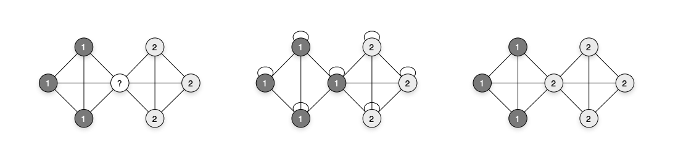
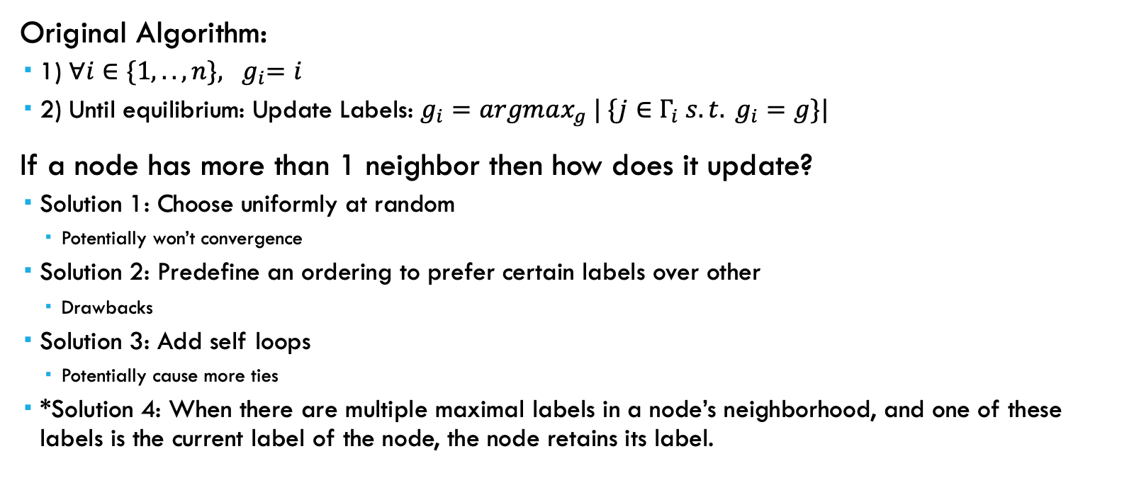
Resolving Ties
Original Algorithm:
1) ${∀i∈\{1, .. , n\}, g}_{i}=i$
2) Until equilibrium: Update Labels: $g_{i}=argmax_{g} | \{j∈Γ_{i} s.t. g_{i}=g\}|$
If a node has more than 1 neighbor then how does it update?
Solution 1: Choose uniformly at random
Potentially won’t convergence
Solution 2: Predefine an ordering to prefer certain labels over other
Drawbacks
Solution 3: Add self loops
Potentially cause more ties
*Solution 4: When there are multiple maximal labels in a node’s neighborhood, and one of these labels is the current label of the node, the node retains its label.

Slide 6
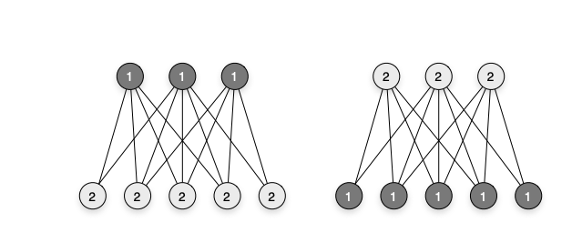
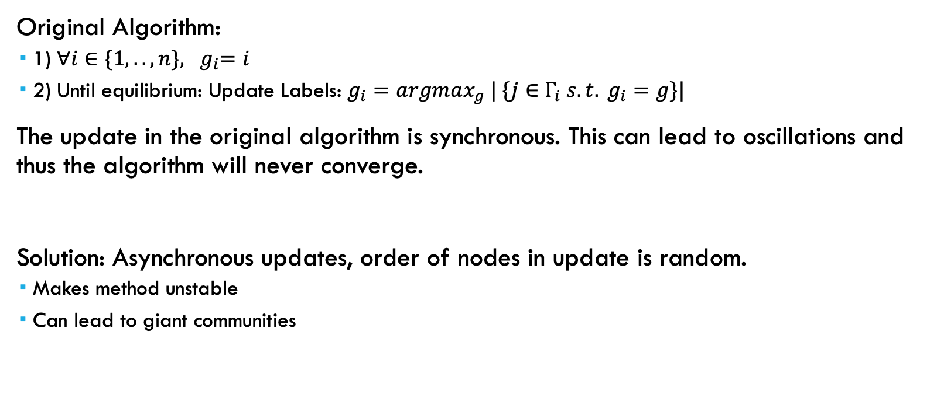
Order of Label Propagation
Original Algorithm:
1) ${∀i∈\{1, .. , n\}, g}_{i}=i$
2) Until equilibrium: Update Labels: $g_{i}=argmax_{g} | \{j∈Γ_{i} s.t. g_{i}=g\}|$
The update in the original algorithm is synchronous. This can lead to oscillations and thus the algorithm will never converge.
Solution: Asynchronous updates, order of nodes in update is random.
Makes method unstable
Can lead to giant communities

Slide 7

Label Equilibrium Criterium
Original Algorithm:
1) ${∀i∈\{1, .. , n\}, g}_{i}=i$
2) Until equilibrium: Update Labels: $g_{i}=argmax_{g} | \{j∈Γ_{i} s.t. g_{i}=g\}|$
In the algorithm above what does equilibrium mean?
We can define equilibrium to be

