Slide 1



OESTERREICH.GV.AT 2030 · DIGITAL ASSISTANTS CHALLENGE
Laufzettel
Nudging and gamification that make public errands fun.
The offices walk. You don’t.
Proactive
Nudging
Gipfelstempel
Concept demo · all people and data are fictional
Notes:
0:00 to 0:08
Errands in Austria are zach, so we put them off. The Laufzettel changes that: a proactive state, plus nudging and gamification that make errands fun. The offices walk. You don’t.

Slide 2




1 Problem
2 Proactive
3 Gipfelstempel
4 Demo
5 Impact
Errands are zach, so we put them off
3 days
6 of 9
1 letter
≈ 45 min
to register after moving in. That is the law.
rows on the Meldezettel the state already knows
in Amtsdeutsch: a parking fine nobody explains
on the way and at the counter, per errand (estimate)
Government today is reactive: it waits for you. And you wait in line.
2
Laufzettel · oesterreich.gv.at 2030
Notes:
0:08 to 0:22
Meet Lena. She moved from Graz to Vienna and has three days to register. The state already knows six of nine rows on her Meldezettel. Still, she types, searches and queues. Then a parking fine in Amtsdeutsch arrives.

Slide 3







1 Problem
2 Proactive
3 Gipfelstempel
4 Demo
5 Impact
From reactive to proactive: the state comes to you
Today: reactive
2030: proactive
You notice the errand
The landlord confirms the move
You search the right form
A notice with the deadline lands on your desk
You type what the state knows
The offices fill 6 of 9 rows, live
You queue at the counter
You answer 2 questions and sign
3
Laufzettel · oesterreich.gv.at 2030
Notes:
0:22 to 0:34
We flip it. Her landlord confirms the move in his app. The state notices and puts a notice with the deadline on her desk. The offices fill six rows themselves. Lena answers two questions and signs.

Slide 4
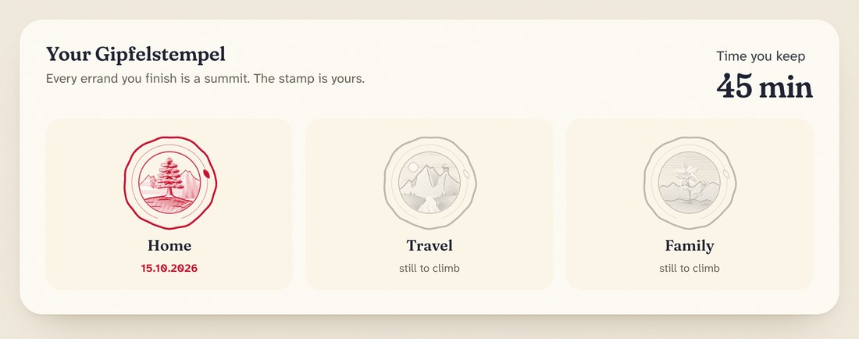

1 Problem
2 Proactive
3 Gipfelstempel
4 Demo
5 Impact
Gipfelstempel: nudging and gamification for errands
Make it visible
The route shows how little is left: 6 rows by the offices, 2 questions, your seal.
Make it fun
Stamps land with a soft thump. Your Gipfelstempel grows ring by ring.
The Gipfelstempel pass on Lena’s desk, after her move
Make it pay off
Voluntary
Private, no ranking
Every errand you finish is a summit. The stamp goes into your pass, with the time you kept.
Only positive
Official errands only
4
Laufzettel · oesterreich.gv.at 2030
Notes:
0:34 to 0:56
Our core idea is the Gipfelstempel: nudging and gamification. Austrians collect summit stamps when they hike. Here, every finished errand is a summit. The route shows how little is left. Stamps land with a thump, her emblem grows. And she keeps the stamp and the time she saved. Voluntary, private, never a ranking.

Slide 5
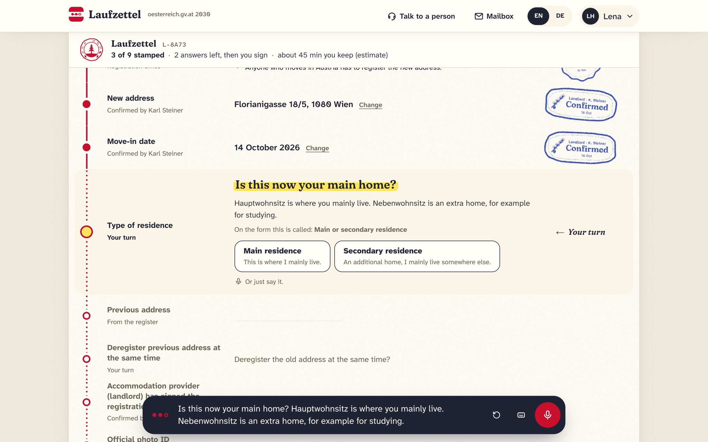



1 Problem
2 Proactive
3 Gipfelstempel
4 Demo
5 Impact
Lena registers her move in two minutes
One official sentence per row
Spoken and captioned. “New address, confirmed by your landlord.”
German words stay German
Meldezettel, Hauptwohnsitz: said like at the counter, even in English.
Say it your way
“I bin grad nach Wien zogn” works. A person is one tap away.
5
Laufzettel · oesterreich.gv.at 2030
Notes:
0:56 to 1:12
This is the slip. Every row gets its stamp, with one official sentence and captions. German terms stay German. Lena answers by tap or by voice, dialect welcome. A person is always one tap away.

Slide 6
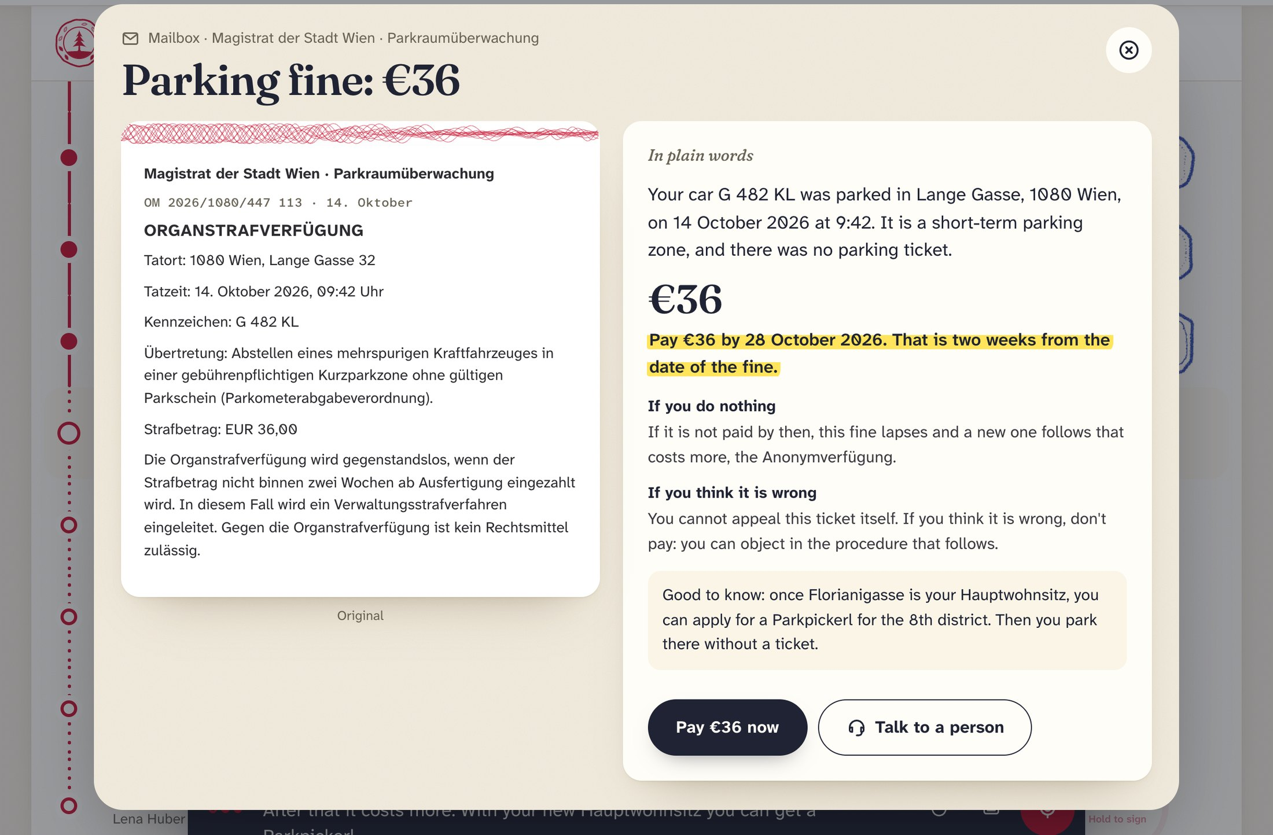

1 Problem
2 Proactive
3 Gipfelstempel
4 Demo
5 Impact
Amtsdeutsch in, plain words out
While she registers
a parking fine arrives in her mailbox: an Organstrafverfügung.
The slip explains it
what happened, €36 by 28 October, what happens if nothing is paid.
And links it to the move
STADT WIEN
PAID
with the new Hauptwohnsitz she can get a Parkpickerl. Proactive.
6
Laufzettel · oesterreich.gv.at 2030
Notes:
1:12 to 1:26
Meanwhile a parking fine arrives. The original sits next to plain words: what happened, 36 euros by the 28th, what happens if she ignores it. And it links to her move: with the new address she can get a Parkpickerl.

Slide 7






1 Problem
2 Proactive
3 Gipfelstempel
4 Demo
5 Impact
Built for the brief, and for the counter
Colloquial and dialect input
For the administration
Amtsdeutsch in plain language
Complete applications from the registers.
Clean cases without a counter visit.
Staff time for the hard cases.
Guided workflow with a prerequisite check
German and English, captions, keyboard, big targets
A person one tap away, with the case attached
33
9/9
2
The AI never submits, signs or pays
Passport, residence, childcare, combined requests
unit tests
AI scenario evals
languages
Cloudflare Workers AI · Durable Objects · ElevenLabs voice
7
Laufzettel · oesterreich.gv.at 2030
Notes:
1:26 to 1:48
One journey covers the brief: colloquial input, plain language, a guided workflow, two languages, accessibility, a person on call, and an AI that never signs or pays. For the administration: complete applications and time for the hard cases. Tested with 33 unit tests and nine of nine AI scenarios.

Slide 8
Die Ämter laufen.
Sie nicht.
LENA HUBER
ERLEDIGT
The offices walk. You don’t.
Make it cool. Make it fun. Earn your Gipfelstempel.
Laufzettel · oesterreich.gv.at 2030
Try it live: [demo link] · [team name]
Notes:
1:48 to 2:00
The offices walk. You don’t. Make it cool, make it fun. Thank you.

