Slide 1

Use of Machine Learning for Commodity Trading
Presented by
Sanjay Varadharajan, 125158058
Guided by
RAJENDIRAN .P
Assistant Professor, School of Computing

Slide 2

Abstract
Commodity trading faces challenges due to vast data complexity, incomplete information, and outdated analytical methods.
Traditional trading systems struggle with real-time data processing, predictive accuracy, and risk management.
This project integrates Big Data Analytics and Machine Learning to enhance decision-making in commodity trading.
ML algorithms analyse historical and real-time data to detect patterns, predict price movements, and optimize strategies.
The system improves market monitoring, trend analysis, and trading efficiency, demonstrating the potential of emerging technologies in trading analytics.

Slide 3
Base paper details
N. -B. -v. Le, Y. -S. Seo and J. -H. Huh, "Artificial Intelligence in Finance: Coffee Commodity Trading Big Data for Informed Decision Making," in IEEE Access, vol. 12, pp. 91780-91792, 2024
Indexed in SCI
Year or Journal base paper publication : <2024 and above>

Slide 4
Literature survey
Predicting Price of Daily Commodities using Machine Learning
Summary: This study conducts an extensive evaluation of machine learning algorithms to predict daily commodity prices. It emphasizes the importance of empirical evidence in selecting appropriate models for data forecasting.
Key Points:
Comprehensive experimental evaluation of state-of-the-art machine learning algorithms.
Focus on daily commodities and their price fluctuations.
Highlights the necessity of empirical evidence in model selection.

Slide 5
Literature survey
2. On Building Real-Time Intelligent Agricultural Commodity Trading Systems
Summary: The paper presents three improved machine learning models based on LSTM, GRU, and SARIMA, and proposes an advanced deep learning LSTM model with time series and other relevant features for real-time agricultural commodity trading.
Key Points:
Development of improved LSTM, GRU, and SARIMA models.
Proposal of an advanced deep learning LSTM model incorporating time series data.
Focus on real-time applications in agricultural commodity trading..

Slide 6
Literature survey
3. Predictability of Commodity Futures Returns with Machine Learning
Summary: This study utilizes prevailing machine learning models to investigate the predictability of futures returns in 22 commodities, considering both commodity-specific and macroeconomic factors.
Key Points:
Application of machine learning models to predict futures returns.
Analysis of 22 different commodities.
Incorporation of commodity-specific and macroeconomic variables.

Slide 7
Literature survey
4. Forecasting Commodity Prices Using Long Short-Term Memory Neural Networks
Summary: This paper applies Long Short-Term Memory (LSTM) neural networks to forecast cotton and oil prices, comparing the performance with traditional ARIMA models and suggesting a forecast averaging method for improved accuracy.
Key Points:
Implementation of LSTM neural networks for price forecasting.
Comparison with traditional ARIMA models.
Proposal of a forecast averaging method to enhance accuracy.

Slide 8
Literature survey
5. Market Making via Reinforcement Learning in China Commodity Market
Summary: This research explores the application of reinforcement learning to market making in the China commodity market, developing an automatic trading system and analysing agent behaviours under different market conditions.
Key Points:
Application of reinforcement learning in market making.
Development of an automatic trading system.
Behavioural analysis of agents in various market scenarios.

Slide 9
Literature survey
6. Combining Deep Learning on Order Books with Reinforcement Learning for Profitable Trading
Summary: This study focuses on forecasting returns across multiple horizons using order flow imbalance, training temporal-difference learning models for various financial instruments, and evaluating their performance through back testing and forward testing.
Key Points:
Forecasting returns using order flow imbalance.
Training of temporal-difference learning models.
Comprehensive performance evaluation through back testing and forward testing.

Slide 10
Existing System
Traditional commodity trading relies on statistical models and rule-based approaches.
Most systems process historical data but struggle with real-time market fluctuations.
Limited automation and reliance on human decision-making slow down trading efficiency.
Lack of integration with AI/ML reduces predictive accuracy and adaptability.
Scalability issues arise due to outdated infrastructure and data processing limitations.

Slide 11
Drawbacks of Existing System
Inability to handle large-scale, high-frequency data efficiently.
Poor predictive capabilities lead to suboptimal trading strategies.
Risk management is reactive rather than proactive, increasing exposure.
Conventional methods fail to capture complex market patterns and anomalies.
High dependency on manual intervention leads to slower decision-making and missed opportunities.
Limited adaptability to sudden market shifts and external economic factors.

Slide 12
Proposed System
ML-based commodity price prediction system using historical and real-time data.
Data sourced from MCX, NSE, Investing.com, and Moneycontrol.
Features include historical prices, technical indicators, and market sentiment.
Use of traditional, existing ML models + Neural networks to predict crude prices
Use of the predictions to suggest profitable trades

Slide 13
Workflow Diagram
Data Collection
Gather historical & real-time data from MCX, NSE, Investing.com, etc.
Preprocessing & Feature Engineering
Extract relevant features: historical prices, technical indicators, sentiment analysis.
Model Training
Try out classic models like Linear Regression, Random Forest, XGBoost etc. Try to optimise, if required use NN
Visualization & Decision Support
Display predictions via a dashboard.
Back testing & Evaluation
Test the model on past data to assess performance.

Slide 14
Modules and Algorithm
Module 1: Data Collection & Preprocessing
Data sources: MCX, NSE, Investing.com, Money control
Feature extraction: historical prices, technical indicators, sentiment analysis
Module 2: Feature and ML model selection
Module 3: Model Training & Evaluation
Back testing and performance assessment
Module 4: Deployment & Dashboard for visualization and decision support

Slide 15
Dataset description & Preprocessing
Crude oil Futures prices from Multi Commodity Exchange, India
Columns : Instrument Type, Date, Segment, Commodity Traded, Contract(Lots), Total Value (Lacs)
Instrument type : FUTCOM : Future contracts of commodities
Date range : 01/01/2009 to 06/03/2025
Segment / Commodity Traded : Energy – Crude Oil
Total value (₹) = Price per contract (₹) x Traded Contracts (measured in lots)
For oil, 1 lot = 100 barrels
∴ per lot price (₹) = ( Total value / Traded Contracts ) * ₹100, 000
∴ per barrel price (₹) = price of 1 lot / 100
Price per barrel is the main variable that is going to be predicted and used for Technical Indicators. Price per barrel was computed for each day in the dataset.
Missing values were removed.

Slide 16
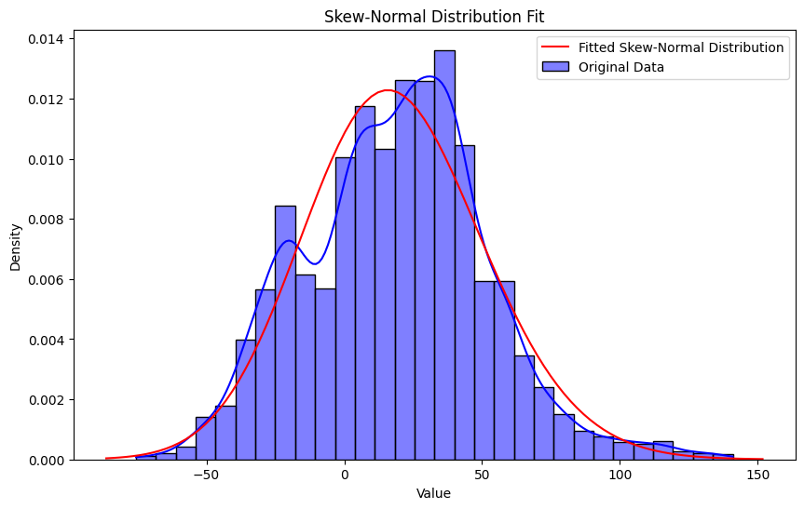
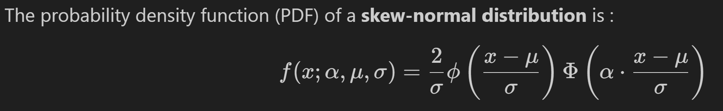
Experiment 1 : Stochastic Indicator
Creation of a stochastic model to using the “reversion to the mean idea” to predict the probability of prices moving up or down
Deviation from all time median is computed for each day and the data is fit in a distribution. Between Normal and Skew Normal, the data fits the best in Skew Normal with a skewness of 0.2221 (+ve skewed) and Kurtosis of 0.2540.
Using the CDF of the function, the probability of increasing and decreasing can be computed using empirical probability for any given value of deviation

Slide 17
Experiment 1 : Results
A rolling back test was carried out to test the results of the model.
A starting threshold was set at 1000 days to ensure enough data for the fit.
From this starting date, based on the probability output found using the distribution of deviation from all previous days, a direction was mapped for each of the days for the crude price
A reasonable forecast horizon of 126 days (6 months considering a 252 trading days year) was set and the prediction was compared to the actual movement of the price per barrel
The above rolling back test yielded a result of ~60% success rate performing slightly better than a coin flip indicating the complex nature of crude prices and the need for a more complex model to capture these relations.

Slide 18
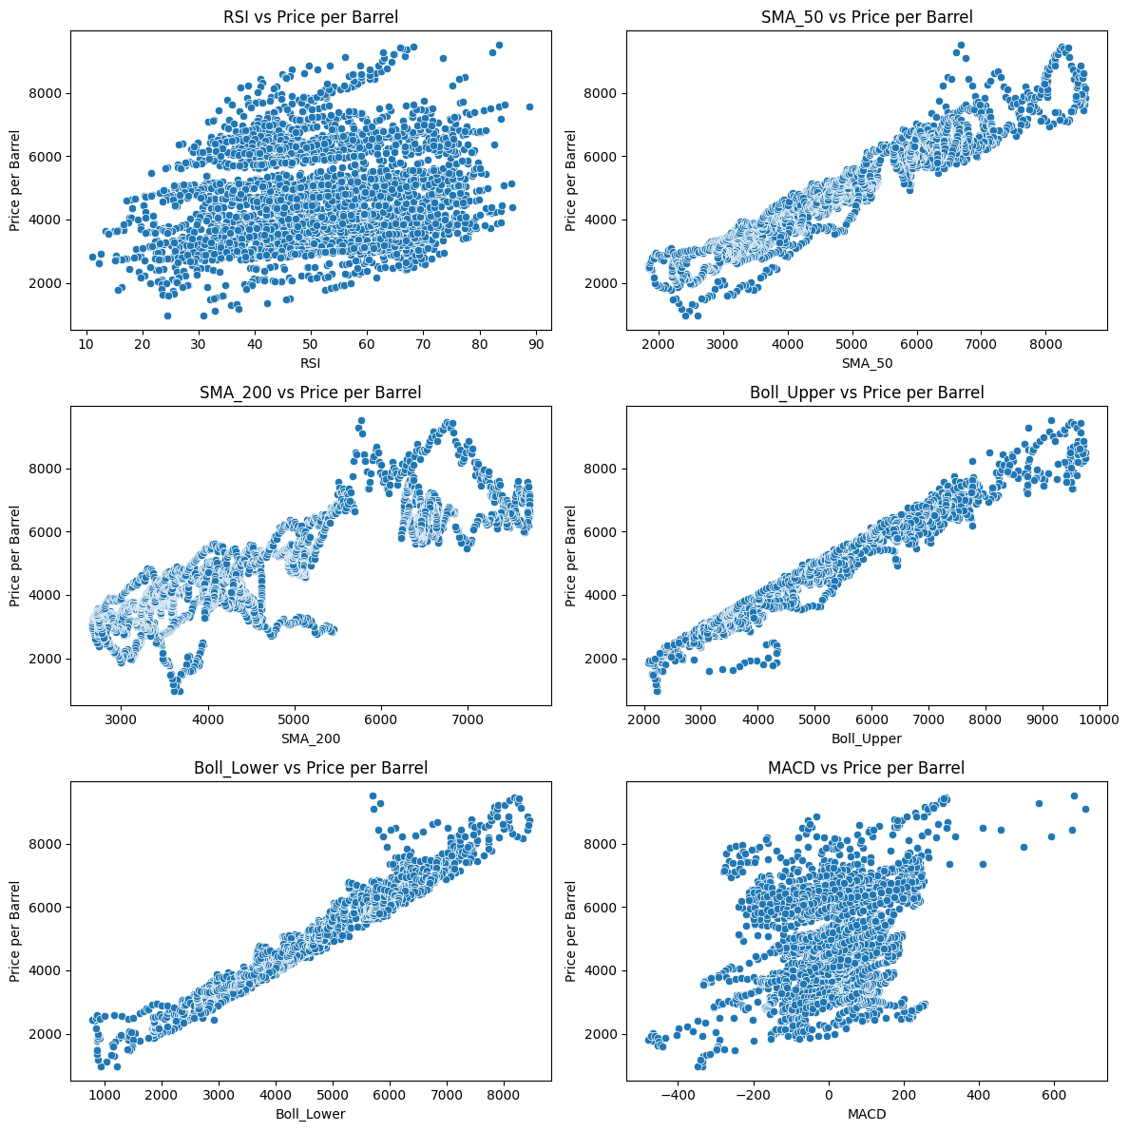
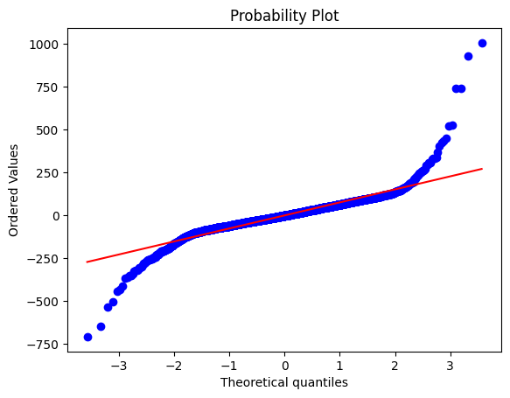
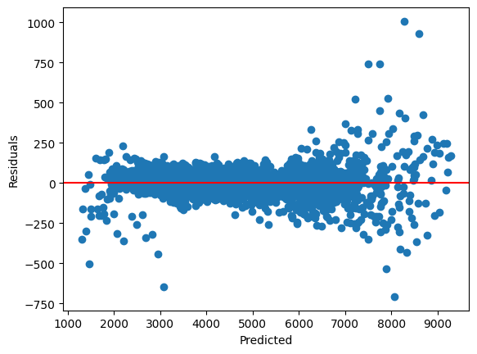
Experiment 2 : Multiple Linear Regression
Technical features RSI, Simple Moving Average : SMA, Bollinger Bands and Moving average convergence divergence : MACD are computed for the data.
Next, the 5 assumptions of Linear regression
are tested to select the features that show lower
Intercorrelation and describe the data well.
Normality and homoskedasticity of the
residuals are verified as well.

Slide 19
Experiment 2 : Result
3 features – MACD, SMA_200 and Rsi were selected as features
The model was fit and it showed an MSE (mean square error) of 258,107 and R2 score of 0.867.
Given that 1 is perfect R2, the model seems to fit surprisingly well.
A time series mean R2 was computed and it performed very poorly with a score of -0.3622, implying that the model was overfitting and could not do any amount of generalisation across time.
The lack of the model’s ability to generalise the time-series data can be attributed to :
Linear regression’s ability to only capture linear relations and its simple nature
The deviation from the 5 assumptions of multiple linear regression.

Slide 20
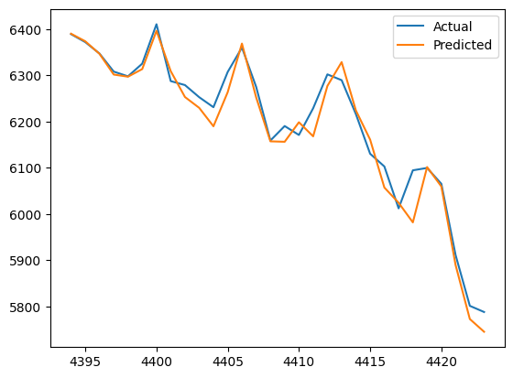
Experiment 3 : XGRandom Boost
Use of ensemble learning can help with complicated relations b/w independent and the dependent variable. It uses decision trees to help predict. As opposed to Ada, grad boost does well with regression.
X gradient boosting is applied to make a series of weak learners and then they’re combined to make prediction.
The n_estimators and learning rate hyper parameters are initially set to 100 and 0.1 respectively
The model is trained and the predictions are evaluated

Slide 21
Experiment 3 : Results
The time-series mean cross validation R2 is 0.76 which is a massive improvement from the time series R2 of linear regression
This can further be improved by tuning the hyperparameters
The n_estimators, max_depth, learning_rate, subsample, colsample_bytree hyperparameters determine the tree’s configuration. These are optimised using Grid search which tries out all the P& C to give the best result.
The grid search resulted in :
MSE: 130057.2961, Optimized XGBoost R2 Score: 0.932, Best Parameters: {'colsample_bytree': 1.0, 'learning_rate': 0.05, 'max_depth': 7, 'n_estimators': 500, 'subsample': 0.8}
Thus, showing great improvement from the previous version

Slide 22
Experiment 4 : Random Forest + Results
The same process of the XGRandomBoost was done for Random Forests too.
The random forest gives a similar result as the XGRandomboost
Best Hyperparameters: {'bootstrap': True, 'max_depth': None, 'min_samples_leaf': 1, 'min_samples_split': 2, 'n_estimators': 500}
Optimized Random Forest MSE: 143547.27
Optimized Random Forest R2 Score: 0.930’

Slide 23
Way Forward
Try fundamental features to see how they are related with the price per barrel
See if data augmentation helps.
Try building NN to see if a less constrained learning helps it learn better.
Choose the final model / combination of models and make a dashboard to help make trades

Slide 24
Team Member Responsibility and Time line
Complete work - Sanjay Varadharajan
Problem Identification : 20.1.25 - 31.1.25
Module 1 – 1.2.25 to 15.2.25
Module 2 – 16.2.25 to 29.2.25
Module 3 – 1.3.25 to 15.3.25
Module 4 – 16.3.25 to 30.3.25

Slide 25
Conclusion and Future work

Slide 26
References
Amin, Md Nur. (2020). Predicting Price of Daily Commodities using Machine Learning. 1-6. 10.1109/3ICT51146.2020.9312012.
J. Zhou, J. Ye, Y. Ouyang, M. Tong, X. Pan and J. Gao, "On Building Real Time Intelligent Agricultural Commodity Trading Models," 2022 IEEE Eighth International Conference on Big Data Computing Service and Applications (BigDataService), Newark, CA, USA, 2022, pp. 89-95, doi: 10.1109/BigDataService55688.2022.00021.
Wang, S., & Zhang, T. (2024). Predictability of commodity futures returns with machine learning models. The Journal of Futures Markets, 44, 302–322. https://doi.org/10.1002/fut.22471
Ly, R., Traore, F., & Dia, K. (2021). Forecasting Commodity Prices Using Long Short-Term Memory Neural Networks. arXiv preprint arXiv:2101.03087.
Jiang, J., Dierckx, T., Xiao, D., & Schoutens, W. (2022). Market Making via Reinforcement Learning in China Commodity Market. arXiv preprint arXiv:2205.08936.
Jaddu, K. S., & Bilokon, P. A. (2023). Combining Deep Learning on Order Books with Reinforcement Learning for Profitable Trading. arXiv preprint arXiv:2311.02088.

