Slide 1


Cryptocurrency trading through Alexa voice assistant and the Starling Bank API
(name is a work in progress…)
Linkedin: https://www.linkedin.com/in/flinn-dolman-277564145/
Linkedin: https://www.linkedin.com/in/vishal-soomaney-vijaykumar-03638710a/

Slide 2
It sounds fancy but what is it???
Our hack provides users with the ability to buy and sell Ethereum based cryptocurrencies by simply speaking to your amazon echo.
Payments to buy the cryptocurrency are made using a clients Starling bank account through the Starling API.

Slide 3

How does it work?
1.) Users install our electron app (via npm or git clone).
2.) Users authenticate their Starling account information and Ethereum information on the app by clicking start server and following any prompts

Slide 4
How does it work (cont.)
3.) Users Also have the option to add contacts to their address book. This Allows them to send ether/money directly to a person via telling the echo their name.
GIF OF ADDRESS BOOK HERE

Slide 5
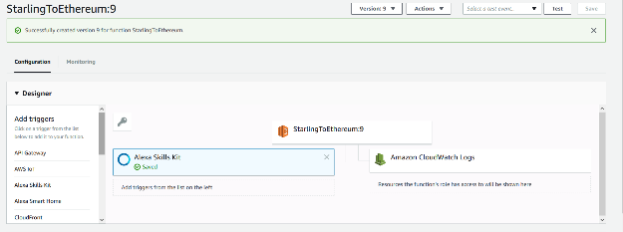
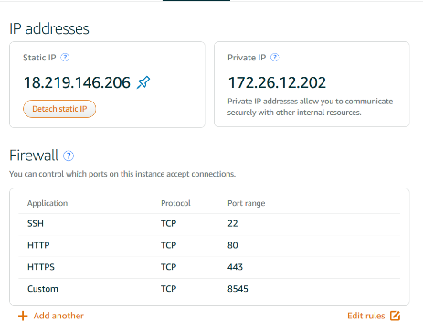
Using AWS throughout
Notes:
Hosting testrpc on lightsail and the Alexa functionality on AWS-Lambda

Slide 6
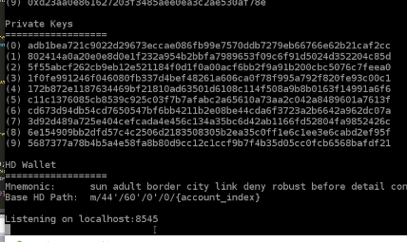
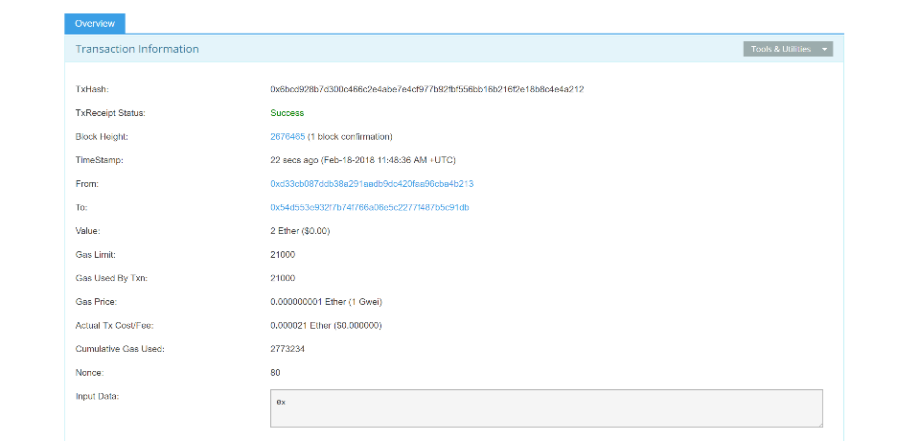

Slide 7
Amazon Echo commands When authenticated on the app you can ask alexa…
‘Alexa, how much ether do I have?’
‘Alexa, Buy £700 worth of Ether .’
‘QUICKLY ALEXA, SELL my ether!!!! (jk HODL…)’
‘Alexa, send the hackcity judges 500 eth…’
And many others…
Notes:
Alexa ask Smart Wallet to Purchase 5 Ethereum
Alexa ask Smart Wallet how much Ethereum I have
So, time to bankrupt ourselves…”Alexa ask Smart Wallet to send 10 billion Ethereum to flinn”

Slide 8
Thank you
Thanks for listening, be sure to check us out on devpost/github for more details.
Devpost: https://devpost.com/software/smart-assistant-controlled-transactions

