Slide 1


Buy and sell cryptocurrencies using a smart speaker and a Starling account
(name is a work in progress…)
Linkedin: https://www.linkedin.com/in/flinn-dolman-277564145/
Linkedin: https://www.linkedin.com/in/vishal-soomaney-vijaykumar-03638710a/

Slide 2
Firstly what is it???
Our hack provides users with the ability to buy and sell Ethereum based cryptocurrencies by simply speaking to your amazon echo.
Payments to buy the cryptocurrency are made using a clients Starling bank account.
Some rando picture here

Slide 3
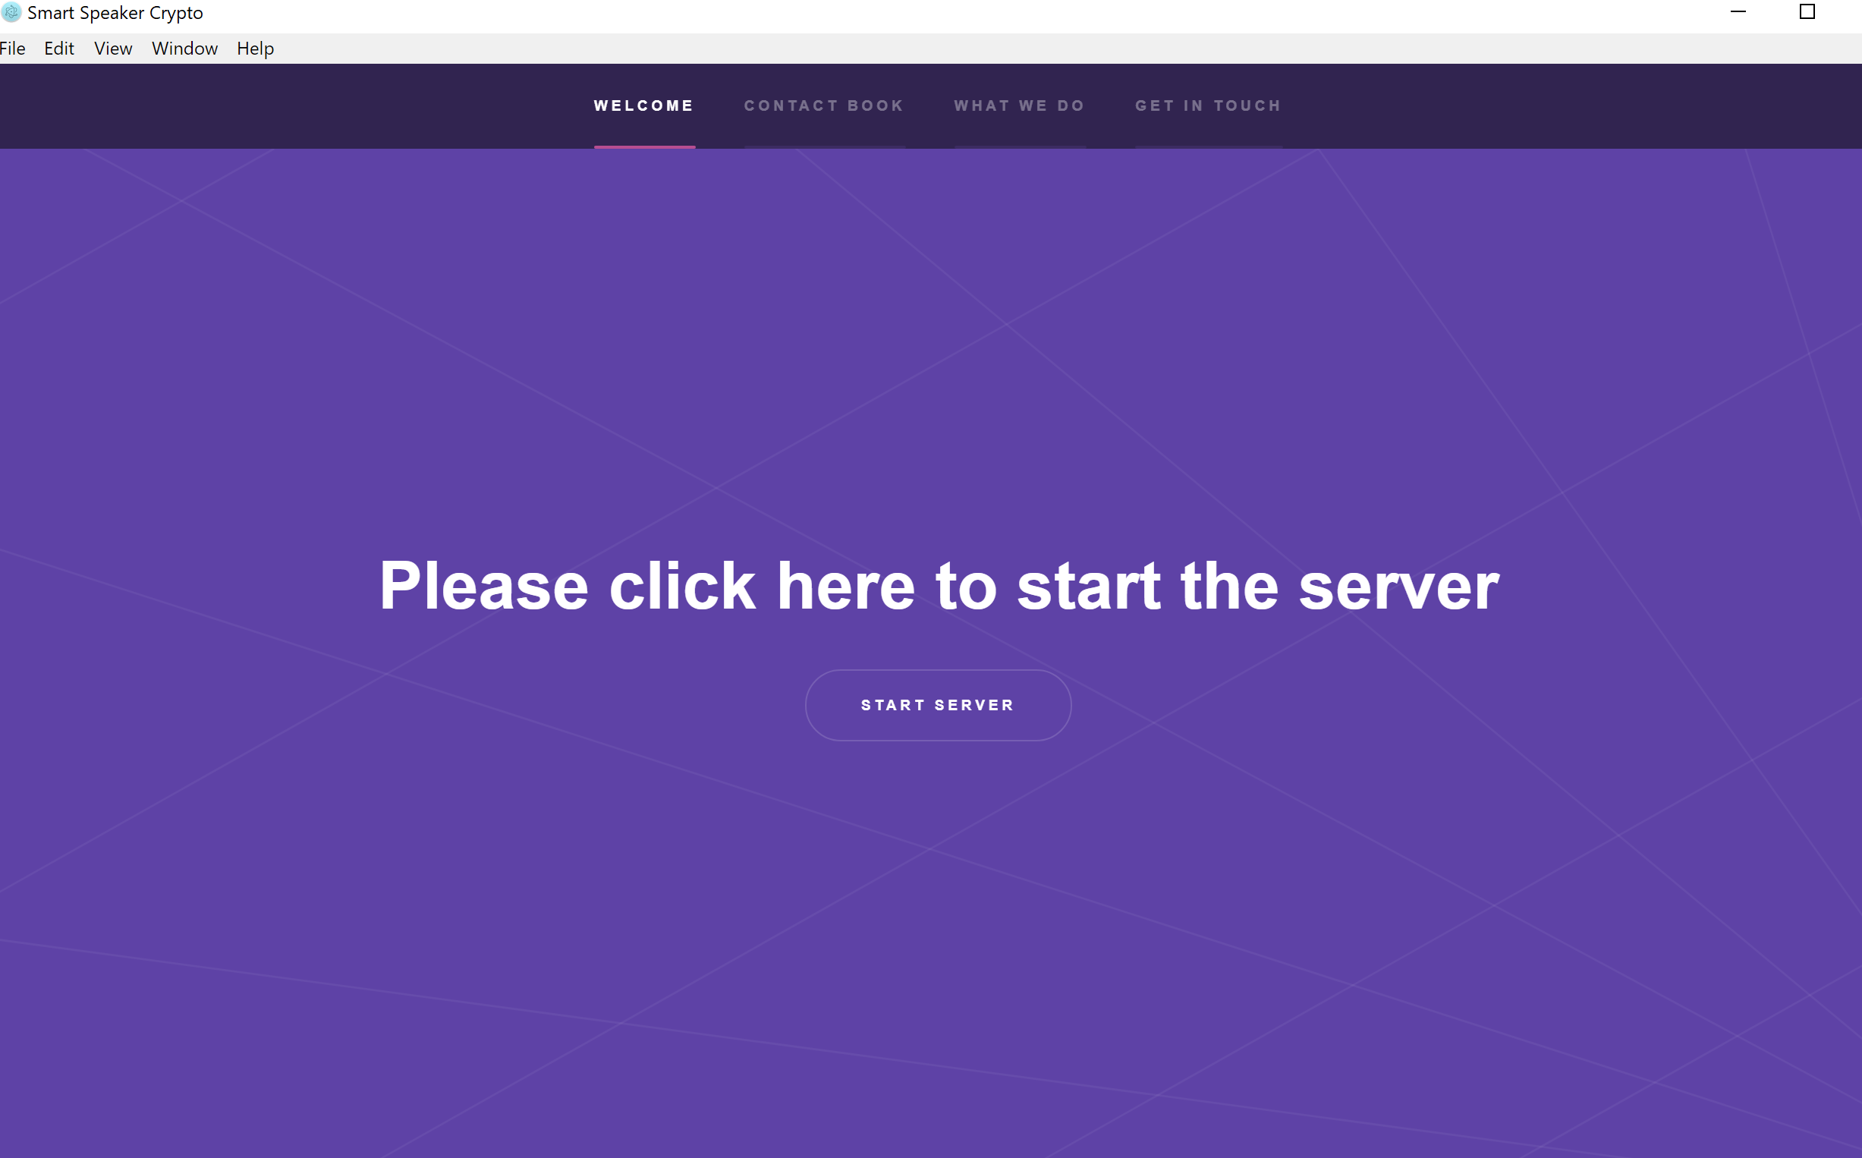
How does it work?
1.) Users install our electron app (via npm or git clone).
2.) Users authenticate their Starling account information and Ethereum information on the app by clicking start server and following any prompts

Slide 4
How does it work (cont.)
3.) Users Also have the option to add contacts to their address book. This Allows them to send ether/money directly to a person via telling the echo their name.
GIF OF ADDRESS BOOK HERE

Slide 5
Amazon Echo commands When authenticated on the app you can ask alexa…
‘Alexa, how much ether do I have?’
‘Alexa, Buy £700 worth of Ether .’
‘QUICKLY ALEXA, SELL my ether!!!! (jk HODL…)’
‘Alexa, send the hackcity judges 500 eth…’
And many others…

Slide 6
Thank you
Thanks for listening, be sure to check us out on devpost/github for more details.
Devpost: https://devpost.com/software/smart-assistant-controlled-transactions

