Slide 1
APEXPLANET | DATA ANALYTICS INTERNSHIP
Sales Performance
Analysis & Statistical
Validation
A data-driven business story using Python, Power BI
and statistical hypothesis testing
Presented by: ANURAG KUMAR RANA
TASK 4 • FINAL PRESENTATION

Slide 2
FROM RAW SALES DATA TO BUSINESS DECISIONS
02
Project overview
PROJECT OBJECTIVE
WORK COMPLETED
Understand sales performance, identify business patterns and validate a category-level finding with statistical evidence.
• Data inspection, quality checks and preparation
• Exploratory data analysis and KPI calculations
• Sales trend and category performance analysis
• Interactive Power BI dashboard development
• Hypothesis testing and business interpretation
Business question: Does average order revenue per customer differ between Electronics and Fashion?
APEXPLANET DATA ANALYTICS INTERNSHIP | TASK 4

Slide 3
UNDERSTANDING THE EVIDENCE
03
Dataset & analytical approach
RECORDS
COLUMNS
UNIQUE ORDERS
CUSTOMERS
1,000
12
992
947
Rows in the dataset
Dataset fields
Distinct Order_ID values
Distinct Customer_ID values
DATE COVERAGE
TOOLS
1 January 2025 – 1 January 2026
Python • Pandas • Matplotlib • Seaborn • Power BI
WORKFLOW
Inspect & clean
Explore & measure
Visualize
Test hypothesis
Recommend
APEXPLANET DATA ANALYTICS INTERNSHIP | TASK 4

Slide 4
A SNAPSHOT OF SALES ACTIVITY
04
Overall business performance
TOTAL REVENUE
UNIQUE ORDERS
AVERAGE ORDER VALUE
₹13.94 Cr
992
₹1.41 L
₹139,399,439.65
Distinct orders
₹140,523.63
QUANTITY SOLD
UNIQUE CUSTOMERS
5,435
947
Total units
Distinct customers
These KPIs summarize revenue, order volume, average order value and customer reach.
APEXPLANET DATA ANALYTICS INTERNSHIP | TASK 4

Slide 5
CATEGORY, PRODUCT AND LOCATION INSIGHTS
05
What the sales data reveals
KEY FINDINGS
• Electronics generated the highest category revenue: about ₹5.08 crore.
• Laptop and Mobile were the leading products by revenue.
• Patna recorded the highest city revenue: about ₹1.93 crore.
• Monthly revenue varied across the observed period.
Note: January 2026 contains data only through 1 January; treat it as partial.
APEXPLANET DATA ANALYTICS INTERNSHIP | TASK 4

Slide 6
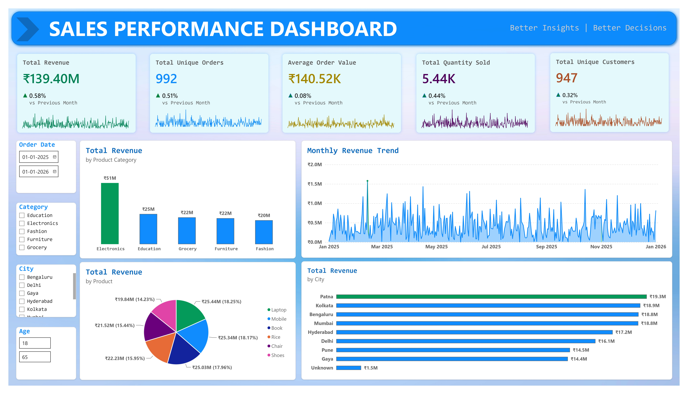
TURNING ANALYSIS INTO AN ACCESSIBLE VIEW
06
Interactive Power BI dashboard
DASHBOARD FEATURES
• KPI cards for key performance measures
• Category and product revenue comparisons
• Monthly revenue trend
• City-level revenue analysis
• Interactive slicers for filtering
APEXPLANET DATA ANALYTICS INTERNSHIP | TASK 4

Slide 7
TESTING THE CATEGORY REVENUE QUESTION
07
Statistical validation
RESEARCH QUESTION
Does average order revenue per customer differ between Electronics and Fashion?
ELECTRONICS-ONLY
FASHION-ONLY
P-VALUE
ALPHA
344 customers
149 customers
0.193027
0.05
Average: ₹143,621.03
Average: ₹129,713.92
Welch's t-test
5% significance
FINAL DECISION: FAIL TO REJECT H₀
The observed average is higher for Electronics, but the difference is not statistically significant at the 5% level.
t = 1.3045 | 95% CI: −₹7,069.57 to ₹34,883.80
Method: Welch's independent-samples t-test on customers exclusive to one category; 7 overlapping customers excluded.
APEXPLANET DATA ANALYTICS INTERNSHIP | TASK 4

Slide 8
FROM FINDINGS TO ACTION
08
Recommendations & conclusion
BUSINESS RECOMMENDATIONS
• Monitor Electronics performance while investigating its customer and product mix.
• Study category preferences and purchasing behaviour across customer segments.
• Use city-level revenue patterns to identify locations for further investigation.
• Monitor monthly trends, accounting for incomplete periods.
• Use statistical evidence alongside business context before making decisions.
CONCLUSION
Data analytics helps turn sales records into business insights.
Statistical testing adds discipline by checking whether observed differences are supported by sufficient evidence.
Thank you
APEXPLANET DATA ANALYTICS INTERNSHIP | TASK 4

